Slide 1
In the name of GOD

Slide 2
POSTPARTUM HEMORRHAGE
Dr. Farahnaz Keshavarzi
Ob. & Gyn. Department
Kermanshah University of Medical Sciences

Slide 3
Obstetric hemorrhage
hemorrhage is the single most important
cause of maternal death worldwide
Obstetric hemorrhage is one of the three leading causes of maternal mortality.

Slide 4
PPH
half of all postpartum deaths in developing countries
14 million women experiencing pregnancy-related hemorrhage each year.
90% of women have no risk factors for PPH.
PPH occurs in 10-15% women giving birth in developing countries.
Severe PPH, can lead to death 2% women.
More than 100,000 maternal deaths per year.

Slide 5
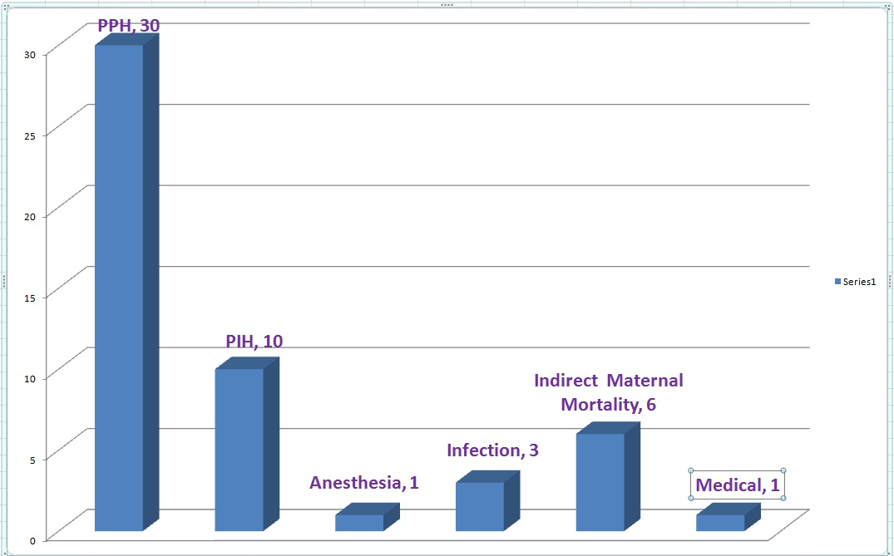
Causes of Maternal Mortality in Kermanshah,1374-1378

Slide 6
علل 50 مورد مرگ مادران بین سالهای 1384-1380

Slide 7
علل 35 مورد مرگ مادران بین سالهای 1389-1385

Slide 8
علل 19 مورد مرگ مادران بین سالهای 1392-1390

Slide 9
مقایسه تعداد موارد مرگ مادران براثر خونریزیهای مامایی از 1392-1374 در استان کرمانشاه

Slide 10
بررسی علل خونریزی مامایی منجر به مرگ بین سالهای 1374-1378

Slide 11
بررسی علل خونریزی مامایی منجر به مرگ بین سالهای 1384-1380

Slide 12
بررسی علل خونریزی مامایی منجر به مرگ بین سالهای 1389-1385

Slide 13
بررسی علل خونریزی مامایی منجر به مرگ بین سالهای 1392-1390

Slide 15
Mechanisms of Normal Homeostasis
near term an incredible amount of blood—at least 600 mL/min—flows through the intervillous space
through the spiral arteries, which average 120 in number.
these vessels have no muscular layer
homeostasis is achieved first by myometrial contraction

Slide 16
Importantly, an intact coagulation system is not necessary for post-partum hemostasis unless there are lacerations in the uterus, birth canal, or perineum.

Slide 17
Third Stage Management:
Active management of the third stage is recommended for all women, regardless of delivery location
use of uterotonic agent (oxytocin,duratocin)
controlled cord traction,
fundal massage immediately after delivery of the placenta (Westhoff. Chochrane Database, 2013).

Slide 18
Etiology of PPH
The "4 T's" as a mnemonic
Tone (abnormalities of uterine contraction)
Tissue (retained products of conception)
Trauma (of the genital tract)
Thrombosis(abnormalities of coagulation)

Slide 19
Predisposing factors & causes of PPH 1
Uterine Atony
Overdistended uterus
Large fetus
Multiple fetuses
Hydramnios
Distention with clots
Anesthesia or analgesia
Halogenated agents
Conduction analgesia with hypotension
Exhausted myometrium
Rapid labor
Prolonged labor
Oxytocin or prostaglandin stimulation
Chorioamnionitis

Slide 20
Predisposing factors & causes of PPH 2
Abnormal Placentation
Placenta previa
Placental abruption
Placenta accreta /increta /percreta
Coagulation Defects

Slide 21
Predisposing factors & causes of PPH 3
Trauma During Labor and Delivery
Episiotomy
Complicated vaginal delivery
Low- or mid forceps delivery
Cesarean delivery
Uterine rupture
Small Maternal Blood Volume
Small women
Pregnancy hypovolemia )Severe preeclampsia Eclampsia (
Other Factors
Obesity
Native American ethnicity
Previous postpartum hemorrhage

Slide 23
Clinical Finding in Obstetric Hemorrhage
Blood Volume Loss | Blood Pressure Systolic | Symptoms & signs | Degree of shock
500 – 1000 10-15% | Normal | Palpitations, Tachycardia, Dizzines | Compensated
1000 – 1500 15 –25 % | Slight fall 80–100 mm Hg | Weakness, Tachycardia, Sweating | Mild
1500 – 2000 25 – 35 % | Moderate fall 70-80 mm HG | Restlessness, Pallor, Oliguria | Moderate
2000 – 3000 35 – 50 % | Marked fall 50-70 mm Hg | Collapse , Air hunger , Anuria | Severe

Slide 25
Blood Loss Estimation
Inaccuracy of Visual Estimation
especially with excessive Bleeding.
underestimated by as much as 50%
post-partum bleeding is frequently steady Instead of sudden massive hemorrhage,.
Thus, monitoring of the uterus immediately postpartum must not be left to an inexperienced person

Slide 26
Methods of Estimation of blood loss
Quantitative: Weighing of blood soaked items [1 gm = 1 ml]
Utilization of collection containers, including calibrated under-buttocks drapes.
Qualitative: Visual estimation of product saturation is another method, but may be more prone to error (Zuckerwise.Obstetrics&Gynecology, 2014).

Slide 27
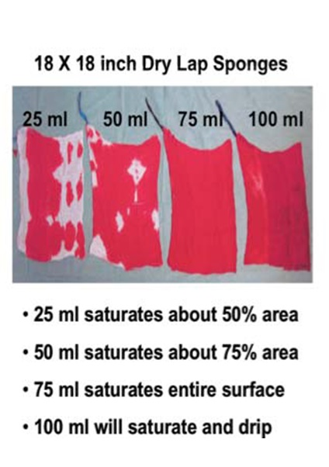

Slide 28
Deaths due to PPH have declined in developed countries
Hospitals have easier access to blood products.
Early identifications and intervention

Slide 29
Prevention OF PPH
During pregnancy, anemia should be treated with iron and folate supplementation
Early detection and rapid management of vaginal bleeding
Preventing prolonged labor and dehydration
Use of forceps and episiotomy in labor should be restricted
The birth of the baby should be slow and
controlled to allow the vaginal and perineal tissue
to stretch without tearing.

Slide 30
Thanks for your Attention

