Slide 1
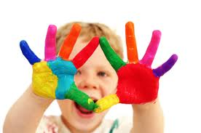
Language & speech disorder and delay

Slide 2
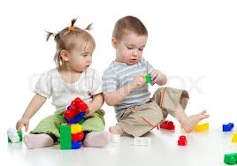
speech and language development is a critical base for learning skills in school-ages.
defect in speech and language skills can also affect children learning in other areas.
If a child of any range of age don’t shows one or more of the milestones that are expected, count as an red flag.

Slide 3
Red flag
EXPRESSIVE and RECEPTIVE LANGUAGE:
The child should be able to clearly communicate his/her ideas, wants and needs. The child should be able to demonstrate an understanding of basic concepts, answer questions, and follow directions.

Slide 4
Red flags
Child is not approximating words or imitating sounds by 18 months of age.
• Child is not combining words at 2 1/2 years of age.
• Child is difficult to understand, cannot express ideas logically or clearly.
• Child cannot maintain a topic, even for a brief period of time.

Slide 5
Red flag
• Child starts talking about something, or sees something, and cannot move on to another topic.
• Child has difficulty answering “what,” “where,” “who,” and “why” questions.
• Child has difficulty talking about events, people, or things that are not in the immediate environment.

Slide 6
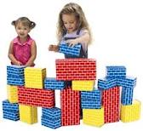
Red flag
• Child uses physical body language, rather than speaking to communicate with peers.
• Child has trouble following directions.
• Child has difficulty completing tasks independently.
• Child has trouble making friends, entering a play circle, or expressing feelings.

