Slide 1
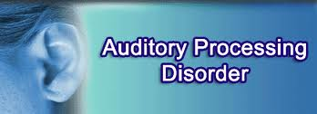

Slide 2
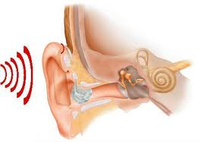
Definition of auditory processing disorder
APD is defect in the neural processing of auditory stimuli that caused by higher level of language, cognitive or other relevant factors.
These persons shows sensory processing defects that are more sensilble in hearing dimensions.
Shows decreased performance in one or more areas as follows:
sound localization
sound lateration
Auditory discrimination
auditory pattern recognition that is the ability to determine the similarities and differences in the voice pattern.

Slide 3
Red flag
problem with understanding conversation subject
inability to organize and express thoughts
problems with answer to open-ended questions
differences in verbal abilities compared with the functional abilities
word finding problems
problem with attention to informations that verbally expressed.

Slide 4
Red flag
problem with remembering information that heared in the form of verbal.
poor auditory skills
poor educationall performance
inappropriate response during conversation
problem with doing complex verbal commands and maintaining their sequence
problem with speech comprehension

Slide 5
Red flag
10 Red Flag Behaviors for auditory processing disorders:
1. Poor listening skills
2. Frequently misunderstands speech
3. Difficulty following oral directions or answering questions
4. Provides inappropriate responses during conversations
5. Tendency to confuse similar sounding words

Slide 6
Red flag
6. Easily distracted by noises and difficulty concentrating when background noise is present
7. Poor academic functioning in the absence of developmental delays
8. History or presence of speech or language delays
9. History of ear infection
10. Generally, “normal” results on regular hearing tests

