Slide 1
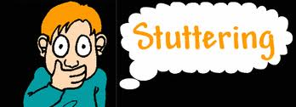

Slide 2
stuttering is problem in the timing and flow of speech.
people with stuttering have problem with speech sounds and words fluently.
nonfluency due to stuttering different from the normal nonfluency during the normal growth of children.
stuttering start in about half of cases are accompanied stress.
in a third of cases, usually stuttering begins suddenly.

Slide 3
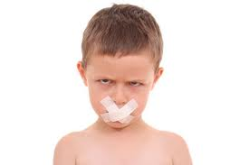
differential diagnosis between speech natural pauses and stuttering is very important
Speech Therapist

Slide 4
Red flag
repeat word in more than one sentence in per 5 sentences
repeat a sound more than three time at a time
Repeat rapid and irregular sound
prolongation a part of words
irregular breathing patterns
abnormal increase in loudness of voice

Slide 5
Red flag
secondary behaviors (blinking fast, unusual head movements, opening mouth inordinately.
avoid speaking situations
trying to communicate always fails.
differences in the intensity of stuttering in different situations
block in more than 10% of the words
using words um ... ah ... singly

Slide 6
Dysfluency (stuttering). Note the child who, compared with others of the same age,
Shows excessive amounts of these behaviors:
repetitions of sounds, words (m-m-m; I-I-I-I-)
prolongations of sounds (mmmmmmmmmmmmmmm)
hesitations or long blocks during speech, usually accompanied by tension or struggle behavior
putting in extra words (um, uh, well)

Slide 7
Shows two or more of these behaviors while speaking:
hand clenching
eye blinking
swaying of body
no eye contact
body tension or struggle
breathing irregularity
tremors
pitch rise
frustration
avoidance of talking

Slide 8
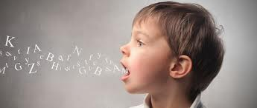
If a child has one or more of the following cases, is at high risk of stuttering:
If family and relatives of child have stutter
over 12 months shows signs of stuttering.
stuttering starts after the age of 3.5 years

Slide 9
با آرزوی آینده ای روشن برای
همه کودکان ایران زمین

