Slide 1
MANAGEMENT postparum hemorrhage
DR maryam zangeneh
Kermanshah University of Medical Sciences
Adopted From Uptodate 2015

Slide 2
Timely, accurate diagnosis is important in order to initiate appropriate interventions (eg, drugs, surgery, referral, consultation) and improve outcome

Slide 3
The management of PPH is multifaceted
obstetricians,
midwives,
nurses,
anesthesiologists,
hematologists/
blood bank personnel,
laboratory medicine,
surgical subspecialists [eg vascular, urology], interventional radiology

Slide 4
Coordination is essential and can be facilitated by protocols

Slide 5
General principles
The rate and volume of bleeding, vital signs, and laboratory results should be closely monitored to assess the best approach to and aggressiveness of intervention.
It is important to not allow the patient to become moribund before initiating life-saving measures.

Slide 6
The obstetrical provider should initiate a sequence of nonoperative and operative interventions for control of
PPH and promptly assess the success or failure of each measure.
The goal is to:
Restore or maintain adequate circulatory volume to prevent hypoperfusion of vital organs
Restore or maintain adequate tissue oxygenation
Reverse or Eliminate or prevent coagulopathy
the obstetric cause of PPH

Slide 7
If an intervention does not succeed, the next treatment in the sequence must be swiftly instituted

Slide 8
Key components of evaluation and treatment
This is an important factor for early recognition of excessive blood loss and timely initiation of life saving interventions
•Collect blood in graduated measurement containers, including drapes with calibrated
pockets

Slide 9
•Use visual aids (eg, posters) that correlate the size and appearance of blood on specific surfaces (eg,
maternity pad, bed sheet, lap sponge) with the volume of blood absorbed by that surface. Regularly
scheduling standardized training in the use of these charts can be helpful for this assessment.
•Measure the total weight of bloody materials and subtract the known weight of the same materials when dry.
The difference in weight between wet and dry in grams approximates the volume of blood in milliliters.

Slide 12
Early, adequate intravenous access
(16 gauge) for massive transfusion.
Frequent assessment of vital signs.
Laboratory evaluation (complete blood count, coagulation studies, potassium and ionized calcium levels).
Blood cross-match or activation of a massive transfusion protocol

Slide 13
Hemoglobin and hematocrit
poor indicators of acute blood loss since they may not decline immediately after an acute bleed.

Slide 14
Class I hemorrhage
blood volume loss of up to 15 percent
The heart rate is minimally elevated or normal,
no change in blood pressure, pulse pressure, or respiratory rate.

Slide 15
Class II hemorrhage
15 to 30 percent blood volume loss
stachycardia = 100 to 120
tachypnea= 20 to 24
decreased pulse pressure
although systolic blood pressure changes minimally if at all.
The skin may be cool and clammy and capillary refill may be delayed.
An increasing maternal heart rate and tachypnea with stable systolic blood pressure should be regarded as evidence of compensated shock and should prompt investigation and institution of a PPH protocol,
even if only light vaginal bleeding is observed

Slide 16
Class III hemorrhage
30 to 40 percent blood volume loss
significant drop in blood pressure and changes in mental status
Any hypotension (systolic blood pressure less than 90 mmHg) or drop in blood
pressure greater than 20 to 30 percent of the measurement
While diminished anxiety or pain may contribute to such a drop, the clinician must assume it is due to hemorrhage until proven otherwise.
Heart rate (120 and thready) and respiratory rate are markedly elevated, while urine output is diminished.
Capillary refill is delayed

Slide 17
Class IV hemorrhage
more than 40 percent blood volume
significant depression in blood pressure and mental status.
(systolic blood pressure less than 90 mmHg).
Pulse pressure is narrowed (25 mmHg),
tachycardia >120
Urine output is minimal or absent.
The skin is cold and pale, and capillary refill is delayed Hypovolemic hemorrhagic shock is treated by aggressive volume resuscitation with packed red blood

Slide 18
Management of postpartum hemorrhage at vaginal delivery

Slide 19
Uterine massage and compression
Fundal massage
Bimanual uterine massage
Massage should be maintained while other interventions are being initiated
and continued until the uterus remains firm and bleeding has abated.

Slide 20
If the fundus is well contracted but bleeding continues unabated, then further massage is not likely to be effective and progression to other methods of hemorrhage control should occur promptly.

Slide 21
Intravenous access
Intravenous access should be provided, preferably with two large bore catheters (at least 16 or 18 gauge, ideally 14 gauge), for administration of fluids and blood
For patients with severe bleeding, central venous access via the subclavian or internal jugular route should be considered early (while the patient is still in compensated shock) as it is often very difficult to gain such access in a shocked and hemodynamically unstable patient.

Slide 22
Oxygenation
Oxygenation is maximized by administering oxygen (10 to 15 liters/minute) by face mask and transfusion to improve oxygen-carrying capacity and delivery.
An anesthesiologist should assess the patient’s airway and breathing, and intubate if indicated.
A high-flow mask with the correct flow rate is important since a low oxygen flow rate
may result in CO2 retention and worsen the situation

Slide 23
Laboratory tests
complete blood count (including platelet count)
coagulation studies (fibrinogen ,PT,PTT)
typed and crossed for multiple units of packed red blood cells.
The coagulation panel should be
repeated every 30 to 60 minutes until PPH is controlled

Slide 24
For every 500 mL of blood loss, hemoglobin levels will fall by about one gram/dL; however, the initial
hemoglobin/hematocrit value does not accurately reflect the amount of blood loss acutely.
Coagulation studies are usually normal in the early stages of hemorrhage, but may be abnormal when comorbidities are present, such as abruptio placentae, liver disease, intrauterine fetal demise, sepsis, or amniotic fluid embolism.
Eventually, significant hemorrhage
without replacement of coagulation factors will result in coagulation abnormalities.
Clot observation test — Prior to the return of the first set of laboratory studies, a red top tube of 5 mL blood can be
observed for

Slide 25
Fibrinogen as a predictor of worsening hemorrhage/coagulopathy
The fibrinogen level at the time of diagnosis of
PPH is predictive of severity and can be used to guide the aggressiveness of management
The normal fibrinogen level in a term pregnancy is 350 to 650 mg/dL, which is nearly double that of nonpregnant adults (200 to 400 mg/dL).
In multiple studies of women with PPH, a low fibrinogen level (less than 200 mg/dL) was predictive of severe PPH.
Fibrinogen falls to critically low levels earlier than other coagulation factors during PPH, thus the fibrinogen level is a more sensitive indicator of ongoing major blood loss than the PT,PTT or platelet count

Slide 26
The most common electrolyte abnormalities
hyperkalemia
low ionized calcium levels

Slide 27
Ionized calcium
Ionized calcium should be measured at baseline and then every 15 minutes during a massive transfusion.
An ionized calcium level <1 mmol/L (normal 1.1 to 1.3 mmol/L) impairs coagulation and places
t he patient at risk of cardiac arrest.
Emergency replacement may be accomplished with 10 percent calcium chloride (1 g/10 mL vial calcium chloride) 1 g/100 mL saline over two to five minutes via a central

Slide 28
Alternatively, 10 percent calcium gluconate (1 g/10 mL) 1 to 2 g over two to three minutes can be given intravenously for every four units of
packed red blood cells (pRBCs) transfused . Hypocalcaemia has a linear, concentration-dependent relationship
more important in predicting hospital mortality than the lowest fibrinogen concentration, the development of acidosis, or the lowest platelet count

Slide 29
Potassium
Hyperkalemia may result from the rapid transfusion of multiple units of pRBCs, especially if they are older units
When urgent reduction of K+ is needed, a 10 percent dextrose water infusion of 500 mL/hour should be given along with intravenous regular insulin (10 units). Repeat bolus doses of regular insulin 10 units may be required.

Slide 30
Uterotonic drugs
Oxytocin 40 units in 1 L of normal saline intravenously at a rate sufficient to control uterine atony or 10 units
intramuscularly (including directly into the myometrium).
While higher doses of oxytocin have been used
intravenously for a short duration to manage atony (eg, up to 80
units in 500 mL over 30 minutes)
rapid infusion of high-dose oxytocin, as may occur in an emergency situation, can cause significant hypotension and cardiovascular collapse.
Therefore, if a high-dose oxytoci n is used, it is advisable to prepare smaller volumes (ie, 15 units in 250 mL) to limit the total dose infused over a short period of time.
this is not advisable since lower doses appear to be just as effective

Slide 31
Carboprost tromethamine (15 methyl-PGF2alpha, Hemabate)
250 mcg intramuscularly every 15 to 90 minutes, as
needed, to a total cumulative dose of 2 mg (eight doses), if no asthma.
About 75 percent of patients respond to a
single dose; move on to a different uterotonic agent if no response after one or two doses.
directly into the myometrium either transabdominally or vaginally.
Prefer 250 mcg in 20mLnormal saline
given via a six-inch spinal needle. Prior to the blind injection of this solution into the myometrium, aspiration should
be performed to prevent intravenous administration

Slide 32
Methylergonovine
0.2 mg intramuscularly or directly into the myometrium (never intravenously), if no hypertension,Raynaud’s phenomenon, or scleroderma.
May repeat at two- to four-hour intervals, as needed.
If there has not been a good response to the first dose, quickly move on to a different uterotonic agent.

Slide 33
Misoprostol (PGE1)
There is no strong evidence that misoprostol is more effective than other uterotonics either for primary therapy of PPH

Slide 34
The optimum dose and route of misoprostol administration are unclear
400 mcg sublingually
Sublingual misoprostol is rapidly absorbed, achieving a peak concentration within 30 minutes.
The peak concentration is higher and sustained longer (about three hours) than with oral administration due to avoidance of first-pass hepatic metabolism; thus, sublingual administration is probably the optimal route of administration for PPH.
>400 mcg increasing potential for hyperthermia
The World Health Organization suggests a single dose of 800 mcg sublingually

Slide 35
Rectal administration takes longer to reach peak concentration compared with oral or sublingual administration (up to an hour versus within 30 minutes), which is disadvantageous in the hemorrhaging patient
The most commonly used rectal doses are 800 and 1000
mcg
Rectally administered misoprostol has a longer
duration of action than oral/sublingual routes (four hours versus two to three hours), which is advantageous in PPH.
Vaginal administration is not recommended because the drug will be washed away by heavy bleeding, thus
impairing absorption.

Slide 36
Unlike methylergonovine and carboprost, misoprostol can be given to women with hypertension or asthma.
Maternal temperature should be monitored closely, as pyrexia 40 degrees Celsius can occur at these doses and should be treated (eg, acetaminophen).

Slide 37
Tranexamic acid
anti-fibrinolytic drug that has been useful for prevention and treatment of bleeding in various clinical settings, but it is not a standard therapy for either prevention or treatment of obstetrical hemorrhage.
Tranexamic acid for prevention of PPH in high risk casas (placenta acreta ,previa , patient who refused blood product) (1 g by intravenous injection

Slide 38
Remove retained products of conception
The uterus should be explored and any retained placental fragments or fetal membranes should be removed manually, if possible, or with ring forceps.
Ultrasound examination can be helpful for
diagnosis of retained tissue and to guide removal.
Curettage with a 16 mm suction catheter or (preferably) a large blunt curette (banjo curette) is performed if manual removal is unsuccessful in controlling hemorrhage.

Slide 39
Uterine tamponade
Uterine tamponade is effective in many patients with atony or lower segment bleeding.
Either a balloon or a pack can be used for tamponade, but a balloon device designed for uterine tamponade is preferable
because it can be placed quickly, allows some assessment of ongoing hemorrhage, and is probably more effective
Regardless of the method employed, hemoglobin, continued blood loss, electrolytes (particularly potassium and
ionized calcium), and urine output should be closely monitored. This is especially important when a gauze pack is used
because a large amount of blood can collect behind the pack and
conceal ongoing blood loss.
If successful, the balloon or pack is removed after 24 hours

Slide 40
Red blood cells, platelets, plasma
Replacement of blood components is more important than crystalloid infusion if massive hemorrhage has occurred or is likely.
Before laboratory studies are available, we suggest transfusing 2 units of pRBCs if hemodynamics do not improve after
the administration of 2 to 3 liters of normal saline, estimated blood loss is under 1500 mLs, and continued bleeding is
likely.
aggressive use of plasma replacement is important to reverse dilutional coagulopathy
The Blood Bank should have compatible blood available for massive transfusion in obstetric emergencies, and eliminate barriers to rapid access of O-negative and O-positive uncrossmatched blood when needed

Slide 41
continue to transfuse RBCs, platelets, cryoprecipitate, and FFP to achieve the following targets
Hemoglobin greater than 7.5 g/dL
Platelet count greater than 50,000/mm3
Fibrinogen greater than 100 mg/dL
PT,PTT less than 1.5 times the control value

Slide 42
Different protocols:
For patients with unstable vital signs,
suspicion of DIC, or blood loss >1500 mLs, transfuse pRBC, FFP, and platelets
in a ratio of 6:4:1 or 4:4:1.
If coagulopathy persists after 8 to 10 units pRBCs and coagulation factor replacement,
recombinant activated factor VIIa is a reasonable option

Slide 43
Blood loss should be estimated every 15 to 30 minutes and laboratory studies drawn every 30 to 60 minutes to guide blood product replacement

Slide 44
In the massively transfused patient, assumptions about possible dilutional effects of RBC
transfusion should be confirmed by measurement of thePT,PTT and platelet count or a viscoelastic test after the administration of every five to seven units of red cells.

Slide 45
Replacement therapy should be based on these parameters rather than on any formula

Slide 46
It is important to stress that critically low fibrinogen levels cannot be returned to normal using only FFP without the use of
cryoprecipitate, and in some cases of established coagulopathy, without fibrinogen concentrate

Slide 47
When bleeding is controlled and the patient is stable, the infusion further blood products is likely to only add risk (eg, fluid overload and transfusion complications) without clear benefit

Slide 48
Recombinant factor VIIa
Recombinant human activated factor VII (rFVIIa) is used for treatment of individuals with bleeding related to hemophilia A and B inhibitors, acquired inhibitors, and congenital factor VII deficiency.
It has also been used successfully off-label for control of bleeding in other situations, such as intractable bleeding associated with
postpartum uterine atony, placenta accreta, or uterine rupture

Slide 49
Although this therapy appears promising for patients with hemorrhage refractory to standard therapy,the drug is very expensive, failed in 50 percent of patients, and may have increased the risk of thrombotic events; thus,
we suggest reserving its use for women with postpartum hemorrhage and coagulopathy
unresponsive to standard therapies.

Slide 50
SECONDARY INTERVENTIONS

Slide 51
After vaginal delivery

Slide 52
Provide adequate anesthesia
Local anesthesia rarely provides sufficient pain relief for thorough examination and
treatment; regional or general anesthesia should be administered

Slide 53
Repair vaginal and cervical lacerations
The entire birth canal from perineum to cervix should be inspected for significant lacerations.
The uterine cavity should be palpated for defects indicating uterine rupture or dehiscence

Slide 54
It is often difficult to begin a suture line at the apex of the laceration because of problems with exposure and visualization.
In such cases, one can begin the suture line at the distal end of the laceration and sew toward the apex, while using the suture to pull the lacerated tissue toward the surgeon.

Slide 55
Alternatively, these patients are good candidates for angiographic embolization, if stable

Slide 56
Two pitfalls to avoid
1-Sutures should not be placed cephalad to the fornix, as this can result in ureteral ligation.
When an extension exists high in the vagina, possibly extending into the cardinal ligament, we perform a laparotomy

Slide 57
Two pitfalls to avoid
2-Vaginal hematomas should not be drained unless expanding. Attempts at operative drainage can result in
significant additional blood loss because it is often difficult to identify and ligate bleeding vessels in a fresh vaginal
sulcus hematoma.
A stable hematoma may be drained later if it becomes infected or pain is not relieved adequately with analgesics.
Continuous expansion of a hematoma leading to hypovolemia may necessitate drainage and packing.
Alternatively, embolization may be the best approach.

Slide 58
Exclude uterine rupture
1- pain and persistent vaginal bleeding despite use of uterotonic agents
2-hemodynamic instability in any postpartum patient, whether she has observed bleedingor not
3-Hematuria may occur if the rupture extendsinto the bladder
4-abdominal distention
5-Palpation of the uterine cavity
6-ultrasound examination may reveal blood in the abdomen and/or a broad ligament hematoma

Slide 59
Arterial embolization
an option if the woman is hemodynamically and hemostatically stable and where
Personnel and facilities are readily available
timing

Slide 60
If the embolization is unsuccessful, uterine artery ligation can be attempted subsequently.
In contrast, embolization after a failed uterine artery ligation is more difficult , although not impossible.
Thus, uterine arterial embolization should be
considered an option even after failed surgical ligation due to incomplete/ineffective occlusion.

Slide 61
INDICATIONS FOR LAPAROTOMY
Laparotomy is indicated for management of uterine atony unresponsive to the conservative interventions
The uterine vessels are ligated and/or uterine compression sutures are placed.
The need for laparotomy is rare, as the combination of balloon tamponade and uterine artery embolization
controls bleeding in virtually all cases

Slide 62
Laparotomy to assess and treat suspected pelvic bleeding is best performed through a vertical midline incision to provide
exposure of both the pelvis and abdomen
Extrauterine bleeding can usually be identified without difficulty if the bleeder is extraperitoneal.
Retroperitoneal bleeding resulting in a retroperitoneal hematoma is more challenging, and identification of an isolated bleeding point is often impossible.

Slide 63
Hysterectomy
In a hemodynamically unstable patient, compression of the uterus and pressure on the posterior pelvic side walls (and also the infrarenal aorta) after opening the abdomen may reduce bleeding while blood products, electrolytes, and volume are being given to stabilize the patient.
These conservative maneuvers should be attempted prior to performing any surgical procedures, such as opening the retroperitoneum, that could increase bleeding and thus lead to maternal mortality.

Slide 64
Even the most simple-appearing hysterectomy in a patient with severe coagulopathy can be very difficult once the retroperitoneum fills with blood and structures that were not bleeding start to bleed

Slide 65
However, it is possible that once the patient is resuscitated and the coagulopathy is reversed, hysterectomy may no longer be
required to control hemorrhage

Slide 66
Hysterectomy is the last resort for treatment of atony, and should not be delayed in women who require prompt control of uterine hemorrhage to prevent death.
In cases of known placenta accreta, planned cesarean hysterectomy is generally the preferred approach.

Slide 67
Management of postpartum hemorrhage at cesarean delivery

Slide 68
Ongoing bleeding may not be recognized when it is :
1-retroperitoneal (including vaginal and vulvar hematomas)
2-hidden under surgical drapes or thick dressing
3-confined to the uterine cavity after closure of the Hysterotomy
Retroperitoneal enlargement or bulging of the broad ligament can be signs of retroperitoneal
hemorrhage; the abdomen should not be closed until the possibility of ongoing retroperitoneal bleeding has been excluded.

Slide 69
Serious hemorrhage from the uterine incision

Slide 70
TEMPORIZING MEASURES
Uterine tourniquet
Balloon tamponade
Clamp across utero-ovarian ligaments
Intraoperative blood salvage
Aortic compression
Interventional radiology

Slide 71
CONSERVATIVE SURGICAL INTERVENTIONS
variety of surgical interventions
clinical judgment
The choice depends on patient-specific factors and surgical expertise.

Slide 72
Local techniques for managing focal bleeding from the placental site
1-figure 8 sutures or other hemostatic sutures directly into the placental bed,
2-use of fibrin glues and patches to cover areas of oozing and promote clotting.
3- excised if they are small and easily accessible, particularly in cases of placenta accreta with persistent bleeding.
4-Application of ferric subsulfate (Monsel's solution) to oozing areas may be helpful and is not harmful

Slide 73
Uterine artery and utero-ovarian artery ligation
Bilateral ligation of the uterine vessels (O’Leary stitch) to control
PPH has become a first-line procedure for controlling uterine bleeding at laparotomy
It is preferable to internal
iliac artery ligation because the uterine arteries are more readily accessible, the procedure is technically easier, and there
is less risk to major adjacent vessels and the ureters

Slide 74
Uterine artery ligation is primarily indicated when bleeding is due to laceration of the uterine or utero-ovarian artery branches, but can also temporarily decrease bleeding from other etiologies by reducing perfusion pressure in the uterine tissue.
Although it will not control bleeding from uterine atony or placenta accreta, it may decrease blood loss while other
interventions are being attempted.

Slide 75
After identification of the ureter, a large curved needle with a #0 polyglycolic acid suture is passed through the lateral aspect of the lower uterine segment as close to the cervix as possible and then back through the broad ligament just lateral to the uterine vessels.
If this does not control bleeding, the vessels of the utero-ovarian arcade are similarly ligated
just distal to the cornua by passing a suture ligature through the myometrium just medial to the vessels, then back through the broad ligament just lateral to the vessels, and then tying to compress the vessels

Slide 76
Bilateral ligation of the arteries and veins
successful % 90
Uterine necrosis and placental insufficiency in a subsequent pregnancy have not been
described as complications

Slide 78
Uterine compression sutures
B-Lynch suture
It should only be used in cases of uterine atony; it will not control hemorrhage from placenta accreta.
It will not prevent postpartum hemorrhage in future pregnancies

Slide 79
A large Mayo needle with #1 or #2 chromic catgut is used to enter and exit the uterine cavity laterally in the lower uterine
Segment.
A large suture is used to prevent breaking and a rapid absorption is important to prevent a herniation of bowel through a suture loop after the uterus has involuted.

Slide 80
The technique has been used alone and in combination with balloon tamponade. This combination has been called the
"uterine sandwich”

Slide 81
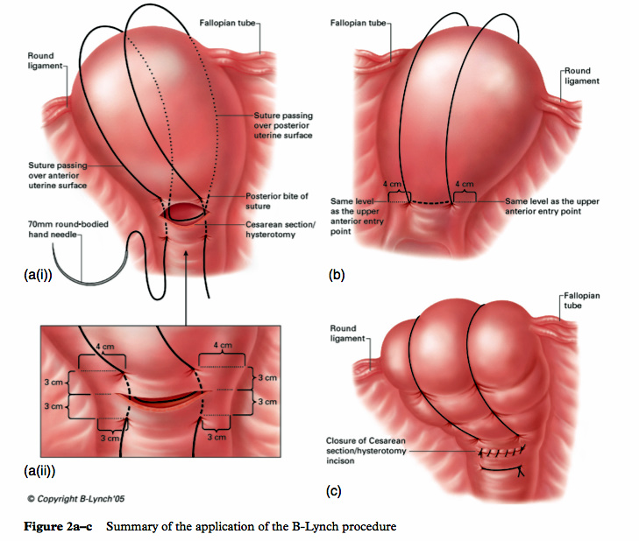
Uterine brace sutures (Lynch)

Slide 82
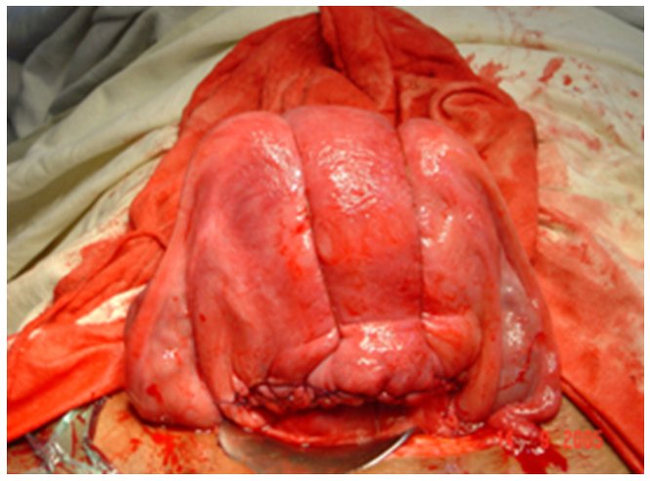

Slide 83
Other compression techniques
Hayman described placement of two to four vertical compression sutures from the anterior to posterior uterine wall
without hysterotomy, thus this is a good choice for surgical treatment of atony after a vaginal delivery
A transverse cervicoisthmic suture can also be placed if needed to control bleeding from the lower uterine segment.

Slide 84
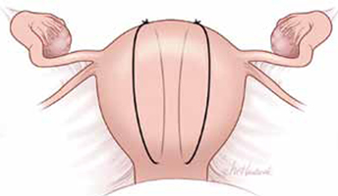
Hayman suture The Hayman suture passes directly from the anterior uterine wall through
the posterior uterine wall. Two to four longitudinal sutures can be placed.
Two longitudinal sutures are pictured in this figure.
A transverse cervicoisthmic suture also can be placed,
if needed, to control bleeding from the lower uterine segmen

Slide 85
Pereira described a technique in which a series of transverse and longitudinal sutures of a delayed absorbable multifilament suture are placed around the uterus via a series of bites into the subserosal myometrium, without entering the uterine cavity
Cho described a technique using multiple squares/rectangles

Slide 86
Pereira sutures
The Pereira sutures combine longitudinal and transverse sutures placed as a series of bites into the submucosal myometrium. The sutures do not enter the uterine cavity. The longitudinal sutures begin and end at the level of the transverse suture closest to the cervix. Avoid damage to blood vessels and the ureters when placing the transverse sutures. Two longitudinal sutures and three transverse sutures are pictured in this figure.

Slide 87
Compression option: Square-suture technique(cho)

Slide 88
Internal iliac artery ligation
Bilateral ligation of the internal iliac arteries (hypogastric arteries) has been used to
control uterine hemorrhage by reducing the pulse pressure of blood flowing to the uterus.
The utility of internal iliac artery ligation may be compromised when there are extensive collateral vessels (such as in placenta percreta).

Slide 89
The technique is challenging
large uterus
transverse lower abdominal incision
ongoing pelvic hemorrhage
or the patient has a high body mass index
Successful and safe bilateral hypogastric ligation becomes even more difficult when attempted by a surgeon who rarely operates deep in the pelvic retroperitoneal space
For these reasons, uterine compression sutures and, less commonly
uterine artery ligation, have largely replaced this procedure as first-line surgical options.

Slide 90
HYSTERECTOMY
Hysterectomy is generally the last resort for treatment of atony, but should not be delayed in
women who require prompt control of uterine hemorrhage to prevent death.
By comparison, in women with placenta
accreta/increta/percreta or uterine rupture, early resort to hysterectomy is one of the best approaches for controlling
hemorrhage.
With improving prenatal diagnosis of placental attachment disorders, hysterectomy can often be anticipated
and discussed with the patient before cesarean delivery.

