Slide 2
راکسیون های دارویی ناشی از شیمی درمانی

Slide 3
Skin toxicity of chemotherapy drugs
Why is it important to know about chemotherapy drugs and the skin?
Each year, 10.9 million people worldwide are diagnosed with cancer and this incidence is rising. This increase reflects the world's growing population and the fact that people are living longer. Chemotherapy is a crucial component to all cancer management and with this rising cancer burden, doctors and patients alike will see an increasing incidence of chemotherapy-related skin toxicity.

Slide 4
What are the skin rashes associated with chemotherapy?
Acral erythema
Alopecia (hair loss)
Photosensitivity (increased sensitivity to sunlight)
Recall reactions
Acneform (pimple-like) eruptions
Skin necrosis
Neutrophilic eccrine hidradenitis
Eccrine squamous metaplasia
Hyperpigmentation
Nail changes
Mucositis
Sclerotic dermal reactions
Vascular injury
Xerosis
Other reactions

Slide 5
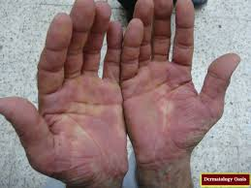
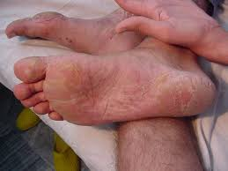
Acral erythema
Acral erythema is also known as palmoplantar erythrodysesthesia or hand-foot syndrome. It manifests as painful erythema (redness of the skin)of the palms and soles,with or without bullae (large blisters). These symptoms can be preceded by dysaesthesia (altered sensation of the skin). The pain from this rash may be so severe that daily activities are limited.

Slide 6
Alopecia
Alopecia (hair loss) is the most common side effect of cancer treatment and often is the most distressing to the patient's self-image. It occurs 7-10 days after treatment and continues to progress over 2-3 months.
There are two main ways chemotherapy drugs cause alopecia:
Anagen effluvium (most common) – refers to toxic effects on rapidly dividing hair cells
Telogen effluvium – refers to increased shedding of normal hair cells
Alopecia is often temporary and resolves after treatment is stopped but some chemotherapy drugs such as busulphan and cyclophosphamide can cause permanent hair loss.
Which drugs are responsible?
Most chemotherapy drugs cause alopecia but the most common culprits are the following:
Taxanes (e.g. paclitaxel and docetaxel)
Anthracyclines (e.g. doxorubicin, idarubicin, epirubicin and mitoxantrone).

Slide 7
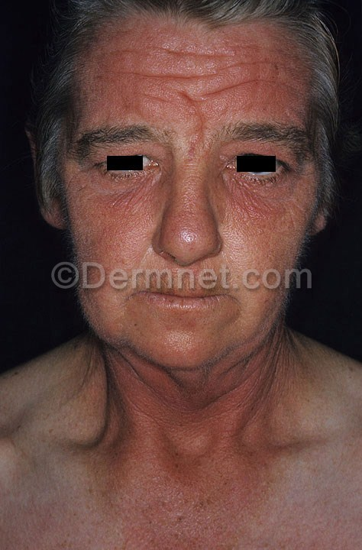
Photosensitivity
Certain chemotherapy drugs result in photosensitivity (increased sensitivity to sunlight) causing sunburn with minimal sun exposure.
Which drugs are responsible?
The chemotherapy drugs which most commonly cause this are:
Methotrexate
Fluorouracil
Dacarbazine.

Slide 8
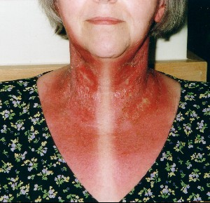
Recall reactions
The term recall reaction refers to erythema (redness of the skin) in areas of previously quiescent sunburn or radiotherapy. The exposure to the sun or radiotherapy may have been weeks to months ago and the skin may have fully recovered until the patient was given chemotherapy.
The actual mechanism is not fully understood but it has been postulated to occur as a result of the recovering keratinocytes (skin cells) being damaged by the chemotherapy drugs, as these cells are the ones which are most rapidly dividing and regenerating.

Slide 9
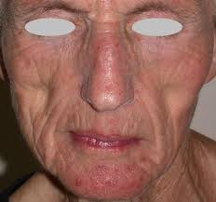
Acneform (pimple-like) eruptions
Also known as folliculitis, an acneform reaction begins as facial erythema followed by papules (small bumps) and pustules (small pockets of pus) over the face and upper trunk. Unlike true acne, the pustules are sterile (they contain no bacteria).
Which drugs are responsible?
Actinomycin D is the most common cause. Other drugs may also cause folliculitis, particularly the epidermal growth factor receptor (EGFR) inhibitors such as gefitinib and cetuximab.

Slide 10
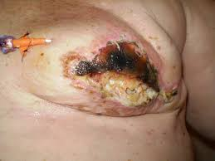
Skin necrosis
Skin necrosis is the term used to describe dead skin cells, which blacken and peel off. Most chemotherapy drugs are toxic when exposed to the skin. Drugs that are meant to be delivered into veins and arteries may leak into the subcutaneous tissue (extravasation).
There are two types of skin necrosis reaction:
Irritants – The chemotherapy agent causes a phlebitis (inflammation of veins) and chemical cellulitis (inflammation of the deeper layers of the skin).
Vesicants or blistering agents – The chemotherapy agent causes severe tissue necrosis (death of cells), resulting in ulcers and eventual scar formation.
Which drugs are responsible?
Most chemotherapy drugs are irritants if they extravasate. Doxorubicin is the most vesicant and can cause necrosis, ulceration and thrombosis (blood clots).

Slide 11
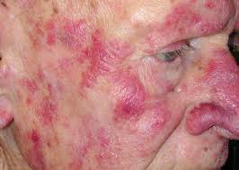
Neutrophilic eccrine hidradenitis
Neutrophilic eccrine hidradenitis is characterised by tender red papules, plaques or nodules on the trunk, face and ears. The diagnosis of this condition relies on skin biopsy and analysing the histological (microscopic) changes. Neutrophils (a type of white cell) are seen surrounding eccrine (sweat) glands. Which drugs are responsible? The most commonly implicated agents are: Cytarabine Bleomycin.

Slide 12
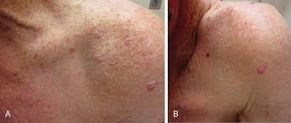
Eccrine squamous metaplasia
Eccrine squamous metaplasia is a rare skin reaction. It is also known as syringometaplasia and affects the upper part of the eccrine sweat duct. It presents as a non-specific red plaques or a papular, crusted eruption.
A distinctive subtype affecting armpits, groin and the sides of the neck has been described.
Which drugs are responsible?
Three large groups of chemotherapy drugs have been known to cause this skin reaction.
Nitrogen mustards e.g. cyclophosphamide, chlorambucil and melphalan
Anthracyclines e.g. doxorubicin, idarubicin and epirubicin. Antimetabolites e.g. azathioprine, methotrexate, fluorouracil and capecitabine

Slide 13
Hyperpigmentation (excess darkening of the skin)
The most unique pattern of hyperpigmentation is the flagellate hyperpigmentation caused by bleomycin. This reaction occurs as dark brown linear streaks about 10cm in length and criss-crossing one another in a pattern resembling a flagella (whip-like structure of certain bacteria that assists them in moving).
Various mechanisms have been reported to explain the cause of this hyperpigmentation. The most well accepted hypothesis is that bleomycin induces pruritus (itching) of the trunk causing the patient to scratch. The action of scratching causes local accumulation of bleomycin into the skin.
What other drugs can cause hyperpigmentation?
Fluorouracil, vinorelbine and daunorubicin can cause hyperpigmentation of the skin, nails and oral mucosa. Although not characteristically flagellate in nature, pigmentation caused by these agents can follow the distribution of veins (called serpentine supravenous hyperpigmentation) or may simply be patchy and macular (flat nonspecific colour change).

Slide 14
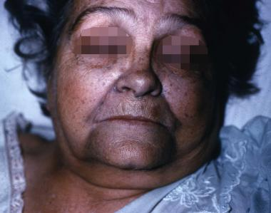
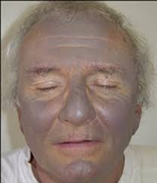
Hyperpigmentation (excess darkening of the skin)

Slide 15
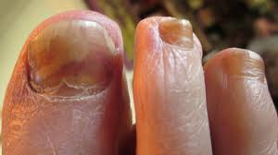
Nail changes
There are several changes that can occur in the nail (nail diseases). This is due to direct toxicity of the chemotherapy drug to the nail plate.
Beau's line – a transverse groove in the nail plate
Onycholysis – separation of the nail plate from the underlying nail bed
Onchomadesis – loss of the entire nail
Nail pain, thickening and/or thinning
Hyper- or hypo-pigmentation – pale or dark streaks in the nail plate
Paronychia
Which drugs are responsible?
Two groups of chemotherapy drugs are particularly prone to cause nail changes:
Taxanes e.g. docetaxel and paclitaxel
Anthracyclines e.g. doxorubicin, idarubicin and epirubicin.
Nail changes may also be seen with hydroxyurea.
Paronychia has also been observed and they occur with an incidence of 10-15% with EGFR therapy and < 1% with capecitabine therapy. Although supportive therapy is the best form of treatment, there has been some success with the use of doxycycline. In its most severe form a pyogenic granuloma can occur.

Slide 16
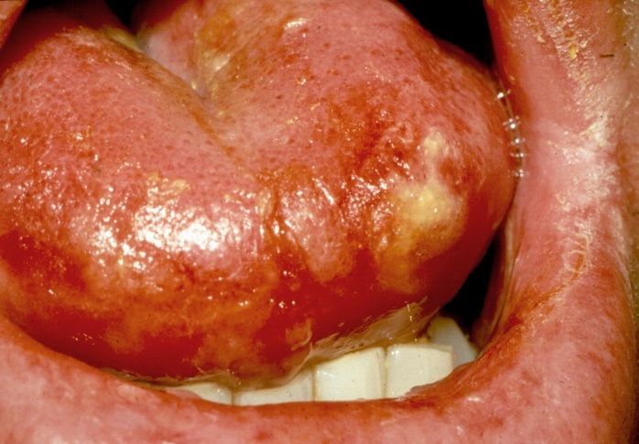
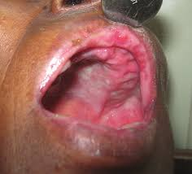
Mucositis
Mucositis refers to inflammation of mucosal surfaces. The lining of the mouth and the gastrointestinal tract are extremely susceptible to being damaged by chemotherapy drugs due to high cell regeneration and growth rate. Up to 80% of chemotherapy patients suffer from this complication.
The symptoms begin with burning and erythema of the mouth followed by erosions and ulcerations that are intensely painful. Although the signs in the mouth are most apparent, any part of the gastrointestinal tract may be involved so patients may also develop diarrhoea.
Which drugs are responsible?
Almost all chemotherapy drugs have a potential to cause mucositis but agents that affect DNA synthesis and are S-phase specific (this is the synthesis phase of the cell cycle) cause the most mucositis.
Examples include:
Methotrexate
Anthracycline drugs
Cyclophosphamide.

Slide 17
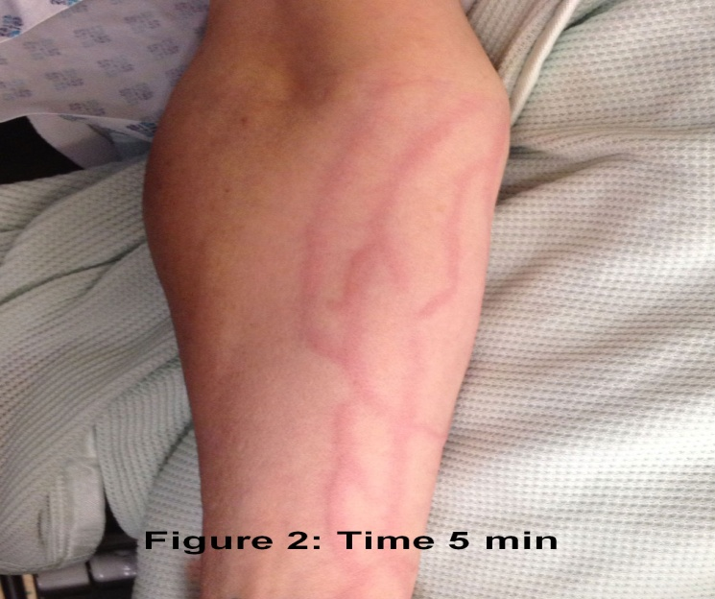
Sclerotic dermal reactions
Scar-like skin reactions that mimic morphoea or systemic sclerosis may accompany the use of bleomycin and docetaxel. In some cases, these reactions have resolved after the drug has been stopped. The exact mechanism is unknown but it is postulated that these drugs increases the activity of fibroblasts in the skin.

Slide 18
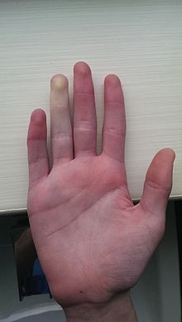
Vascular phenomenon – Raynaud phenomenon and vasculitis
Raynaud phenomenon is an exaggerated response of the blood vessels to cold temperature or emotional stress. The symptoms are that of sharply demarcated color changes of the skin of the digits.
Vasculitis refers to inflammation of the vessel walls and as a result of this inflammation there is compromise to lumen of the vessel causing tissue ischaemia and necrosis.
Vasculitis can present as livedo reticularis, ulceration and thromboembolism (blood clots).
Which drugs are responsible?
Drugs reported to cause Raynaud's phenomenon or vasculitis include:
Bleomycin
Cisplatin
Gemcitabine
Rituximab.

Slide 19
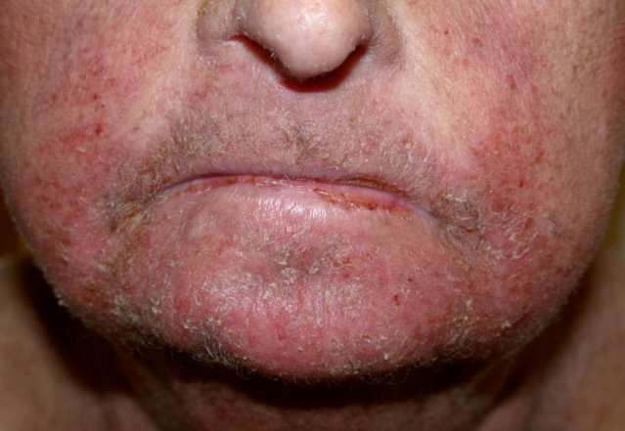
Xerosis
Xerosis (dry skin) is commonly observed in patients receiving epidermal growth factor receptor EGFR) inhibitors. At times, the dry skin can be observed with concomitant greasy scales resembling seborrhoeic dermatitis. It is postulated that the EGFR inhibitors cause growth arrest of the keratinocytes (skin cells) and initiates terminal maturation. Mucosal surfaces of the skin such as the vagina, mouth and eyes may also be affected.

Slide 20
Druge Induce Psoriasis
Lithium
Antimalarials
Inderal
Quinidine
Indomethacin

Slide 21
Druge Induce Acne
Anticonvulsants
Anabolic-Androgen Steroids
Barbiturates
Contraceptives
Corticosteroids
Immunosuppressants
Lithium
Thyroid Medication

