Slide 1


Slide 2
Heart failure
Heidarimoghaddam .MD

Slide 3
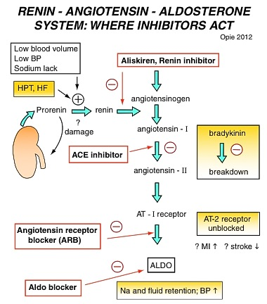

Slide 4
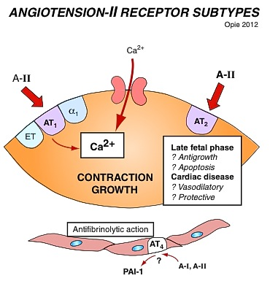

Slide 5
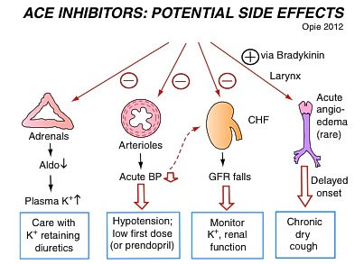

Slide 6
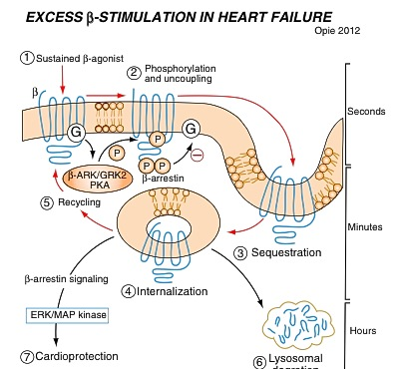

Slide 7
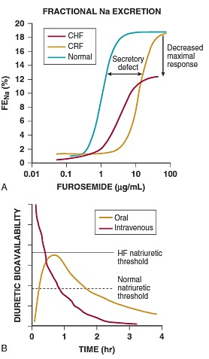
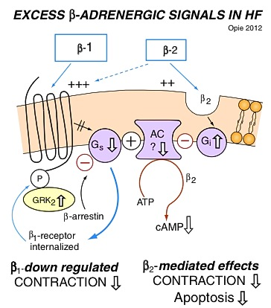

Slide 8
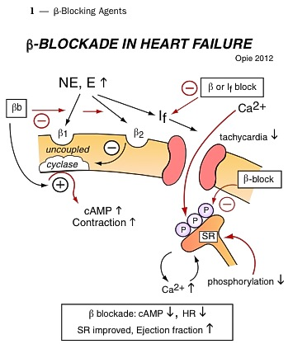

Slide 9
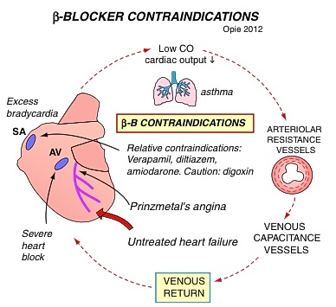

Slide 10
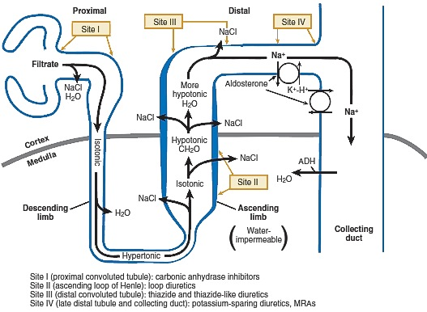

Slide 11
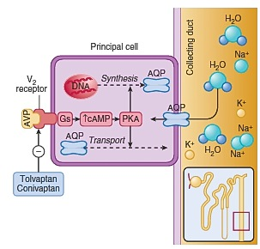

Slide 12
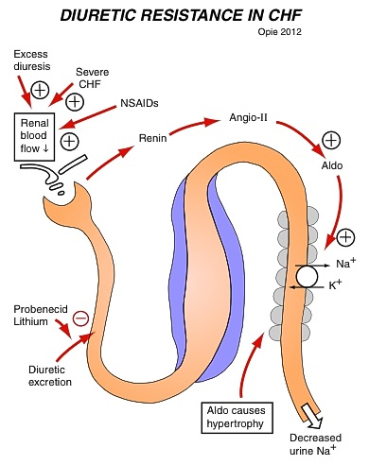

Slide 13
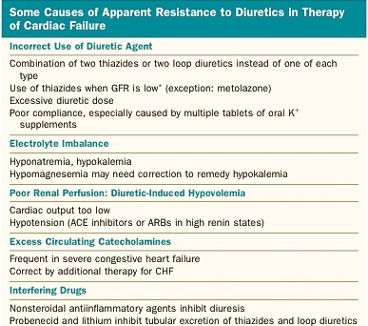

Slide 14
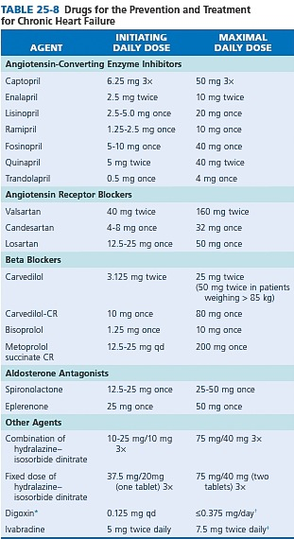

Slide 15
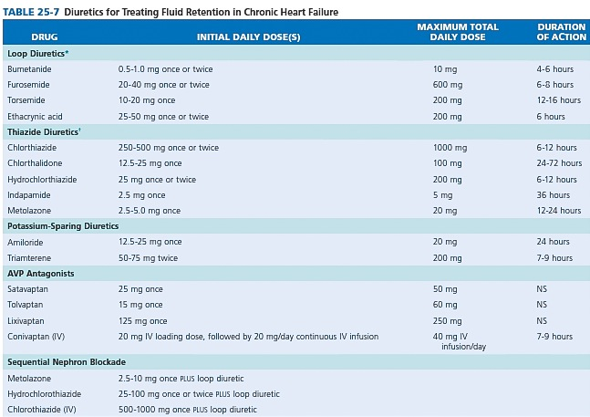

Slide 16
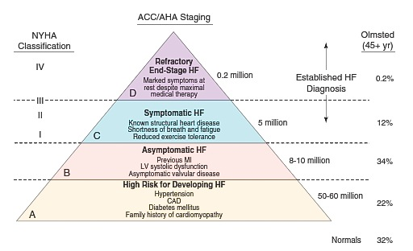

Slide 17
2013 ACCF/AHA Guideline for the Management of Heart Failure
Developed in Collaboration With the American Academy of Family Physicians, American College of Chest Physicians, Heart Rhythm Society, and International Society for Heart and Lung Transplantation
Endorsed by the American Association of Cardiovascular and Pulmonary Rehabilitation
© American College of Cardiology Foundation and American Heart Association, Inc.

Slide 18
Stages, Phenotypes and Treatment of HF

Slide 19
Outline
Initial and Serial Evaluation of the HF Patient
(including HFpEF)
II. Treatment of Stage A thru D Heart Failure
(including HFpEF)
III. The Hospitalized Patient
IV. Surgical/Percutaneous/Transcatheter Interventional Treatments
V. Coordinating Care for Patients With Chronic HF
VI. Quality Metrics/Performance Measures

Slide 20
Initial and Serial Evaluation of the HF Patient
Clinical Evaluation

Slide 21
Definition of Heart Failure
Classification | Ejection Fraction | Description
I. Heart Failure with Reduced Ejection Fraction (HFrEF) | ≤40% | Also referred to as systolic HF. Randomized clinical trials have mainly enrolled patients with HFrEF and it is only in these patients that efficacious therapies have been demonstrated to date.
II. Heart Failure with Preserved Ejection Fraction (HFpEF) | ≥50% | Also referred to as diastolic HF. Several different criteria have been used to further define HFpEF. The diagnosis of HFpEF is challenging because it is largely one of excluding other potential noncardiac causes of symptoms suggestive of HF. To date, efficacious therapies have not been identified.
a. HFpEF, Borderline | 41% to 49% | These patients fall into a borderline or intermediate group. Their characteristics, treatment patterns, and outcomes appear similar to those of patient with HFpEF.
b. HFpEF, Improved | >40% | It has been recognized that a subset of patients with HFpEF previously had HFrEF. These patients with improvement or recovery in EF may be clinically distinct from those with persistently preserved or reduced EF. Further research is needed to better characterize these patients.

Slide 22
Classification of Heart Failure
ACCF/AHA Stages of HF |  | NYHA Functional Classification
A | At high risk for HF but without structural heart disease or symptoms of HF. | None
B | Structural heart disease but without signs or symptoms of HF. | I | No limitation of physical activity. Ordinary physical activity does not cause symptoms of HF.
C | Structural heart disease with prior or current symptoms of HF. | I | No limitation of physical activity. Ordinary physical activity does not cause symptoms of HF.
 |  | II | Slight limitation of physical activity. Comfortable at rest, but ordinary physical activity results in symptoms of HF.
 |  | III | Marked limitation of physical activity. Comfortable at rest, but less than ordinary activity causes symptoms of HF.
 |  | IV | Unable to carry on any physical activity without symptoms of HF, or symptoms of HF at rest.
D | Refractory HF requiring specialized interventions.

Slide 23
Guideline for HF
Initial and Serial Evaluation of the HF Patient

Slide 24
Initial and Serial Evaluation of the HF Patient
History and Physical Examination

Slide 25
History and Physical Examination
I
IIa
IIb
III
A thorough history and physical examination should be
obtained/performed in patients presenting with HF to
identify cardiac and noncardiac disorders or behaviors
that might cause or accelerate the development or
progression of HF.
In patients with idiopathic DCM, a 3-generational family
history should be obtained to aid in establishing the
diagnosis of familial DCM.
Volume status and vital signs should be assessed at
each patient encounter. This includes serial assessment
of weight, as well as estimates of jugular venous
pressure and the presence of peripheral edema or
orthopnea.
I
IIa
IIb
III
I
IIa
IIb
III
B

Slide 26
Initial and Serial Evaluation of the HF Patient
Risk Scoring

Slide 27
Risk Scoring
Validated multivariable risk scores can be useful to estimate subsequent risk of mortality in ambulatory or hospitalized patients with HF.
I
IIa
IIb
III
B

Slide 28
Risk Scores to Predict Outcomes in HF
Risk Score | Reference (from full-text guideline)/Link
Chronic HF
All patients with chronic HF
Seattle Heart Failure Model | (204) / http://SeattleHeartFailureModel.org
Heart Failure Survival Score | (200) / http://handheld.softpedia.com/get/Health/Calculator/HFSS-Calc-37354.shtml
CHARM Risk Score | (207)
CORONA Risk Score | (208)
Specific to chronic HFpEF
I-PRESERVE Score | (202)
Acutely Decompensated HF
ADHERE Classification and Regression Tree (CART) Model | (201)
American Heart Association Get With the Guidelines Score | (206) / http://www.heart.org/HEARTORG/HealthcareProfessional/GetWithTheGuidelinesHFStroke/GetWithTheGuidelinesHeartFailureHomePage/Get-With-The-Guidelines-Heart-Failure-Home- %20Page_UCM_306087_SubHomePage.jsp
EFFECT Risk Score | (203) / http://www.ccort.ca/Research/CHFRiskModel.aspx
ESCAPE Risk Model and Discharge Score | (215)
OPTIMIZE HF Risk-Prediction Nomogram | (216)

Slide 29
Initial and Serial Evaluation of the HF Patient
Diagnostic Tests

Slide 30
Diagnostic Tests
I
IIa
IIb
III
Initial laboratory evaluation of patients presenting with HF should include complete blood count, urinalysis, serum electrolytes (including calcium and magnesium), blood urea nitrogen, serum creatinine, glucose, fasting lipid profile, liver function tests, and thyroid-stimulating hormone.
Serial monitoring, when indicated, should include serum electrolytes and renal function.
I
IIa
IIb
III

Slide 31
Diagnostic Tests (cont.)
I
IIa
IIb
III
A 12-lead ECG should be performed initially on all patients presenting with HF.
Screening for hemochromatosis or HIV is reasonable in selected patients who present with HF.
Diagnostic tests for rheumatologic diseases, amyloidosis, or pheochromocytoma are reasonable in patients presenting with HF in whom there is a clinical suspicion of these diseases.
I
IIa
IIb
III
I
IIa
IIb
III

Slide 32
Initial and Serial Evaluation of the HF Patient
Biomarkers
Ambulatory/Outpatient

Slide 33
Ambulatory/Outpatient
I
IIa
IIb
III
In ambulatory patients with dyspnea, measurement of BNP or N-terminal pro-B-type natriuretic peptide (NT-proBNP) is useful to support clinical decision making regarding the diagnosis of HF, especially in the setting of clinical uncertainty.
Measurement of BNP or NT-proBNP is useful for establishing prognosis or disease severity in chronic HF.
A
I
IIa
IIb
III
A

Slide 34
Ambulatory/Outpatient (cont.)
I
IIa
IIb
III
BNP- or NT-proBNP guided HF therapy can be useful to achieve optimal dosing of GDMT in select clinically euvolemic patients followed in a well-structured HF disease management program.
The usefulness of serial measurement of BNP or NT-proBNP to reduce hospitalization or mortality in patients with HF is not well established.
Measurement of other clinically available tests such as biomarkers of myocardial injury or fibrosis may be considered for additive risk stratification in patients with chronic HF.
B
I
IIa
IIb
III
B
I
IIa
IIb
III
B

Slide 35
Initial and Serial Evaluation of the HF Patient
Biomarkers
Hospitalized/Acute

Slide 36
Hospitalized/Acute
I
IIa
IIb
III
Measurement of BNP or NT-proBNP is useful to support clinical judgment for the diagnosis of acutely decompensated HF, especially in the setting of uncertainty for the diagnosis.
Measurement of BNP or NT-proBNP and/or cardiac troponin is useful for establishing prognosis or disease severity in acutely decompensated HF.
A
I
IIa
IIb
III
A

Slide 37
Hospitalized/Acute (cont.)
I
IIa
IIb
III
The usefulness of BNP- or NT-proBNP guided therapy for acutely decompensated HF is not well-established.
Measurement of other clinically available tests such as biomarkers of myocardial injury or fibrosis may be considered for additive risk stratification in patients with acutely decompensated HF.
I
IIa
IIb
III
A

Slide 38
Recommendations for Biomarkers in HF
Biomarker, Application | Setting | COR | LOE
Natriuretic peptides
Diagnosis or exclusion of HF | Ambulatory, Acute | I | A
Prognosis of HF | Ambulatory, Acute | I | A
Achieve GDMT | Ambulatory | IIa | B
Guidance of acutely decompensated HF therapy | Acute | IIb | C
Biomarkers of myocardial injury
Additive risk stratification | Acute, Ambulatory | I | A
Biomarkers of myocardial fibrosis
Additive risk stratification | Ambulatory | IIb | B
 | Acute | IIb | A

Slide 39
Causes for Elevated Natriuretic Peptide Levels
Cardiac | Noncardiac
Heart failure, including RV syndromes Acute coronary syndrome Heart muscle disease, including LVH Valvular heart disease Pericardial disease Atrial fibrillation Myocarditis Cardiac surgery Cardioversion | Advancing age Anemia Renal failure Pulmonary causes: obstructive sleep apnea, severe pneumonia, pulmonary hypertension Critical illness Bacterial sepsis Severe burns Toxic-metabolic insults, including cancer chemotherapy and envenomation

Slide 40
Initial and Serial Evaluation of the HF Patient
Noninvasive Cardiac Imaging

Slide 41
Noninvasive Cardiac Imaging
I
IIa
IIb
III
Patients with suspected or new-onset HF, or those presenting with acute decompensated HF, should undergo a chest x-ray to assess heart size and pulmonary congestion, and to detect alternative cardiac, pulmonary, and other diseases that may cause or contribute to the patients’ symptoms.
A 2-dimensional echocardiogram with Doppler should be performed during initial evaluation of patients presenting with HF to assess ventricular function, size, wall thickness, wall motion, and valve function.
Repeat measurement of EF and measurement of the severity of structural remodeling are useful to provide information in patients with HF who have had a significant change in clinical status; who have experienced or recovered from a clinical event; or who have received treatment, including GDMT, that might have had a significant effect on cardiac function; or who may be candidates for device therapy.
I
IIa
IIb
III
I
IIa
IIb
III

Slide 42
Noninvasive Cardiac Imaging (cont.)
I
IIa
IIb
III
Noninvasive imaging to detect myocardial ischemia and viability is reasonable in patients presenting with de novo HF who have known CAD and no angina unless the patient is not eligible for revascularization of any kind.
Viability assessment is reasonable in select situations when planning revascularization in HF patients with CAD.
Radionuclide ventriculography or magnetic resonance imaging can be useful to assess LVEF and volume when echocardiography is inadequate.
I
IIa
IIb
III
B
I
IIa
IIb
III

Slide 43
Noninvasive Cardiac Imaging (cont.)
I
IIa
IIb
III
Magnetic resonance imaging is reasonable when assessing myocardial infiltrative processes or scar burden.
Routine repeat measurement of LV function assessment in the absence of clinical status change or treatment interventions should not be performed.
B
I
IIa
IIb
III
B
No Benefit

Slide 44
Recommendations for Noninvasive Imaging
Recommendation | COR | LOE
Patients with suspected, acute, or new-onset HF should undergo a chest x-ray | I | C
A 2-dimensional echocardiogram with Doppler should be performed for initial evaluation of HF | I | C
Repeat measurement of EF is useful in patients with HF who have had a significant change in clinical status or received treatment that might affect cardiac function, or for consideration of device therapy | I | C
Noninvasive imaging to detect myocardial ischemia and viability is reasonable in HF and CAD | IIa | C
Viability assessment is reasonable before revascularization in HF patients with CAD | IIa | B
Radionuclide ventriculography or MRI can be useful to assess LVEF and volume | IIa | C
MRI is reasonable when assessing myocardial infiltration or scar | IIa | B
Routine repeat measurement of LV function assessment should not be performed | III: No Benefit | B

Slide 45
Initial and Serial Evaluation of the HF Patient
Invasive Evaluation

Slide 46
Invasive Evaluation
I
IIa
IIb
III
Invasive hemodynamic monitoring with a pulmonary artery catheter should be performed to guide therapy in patients who have respiratory distress or clinical evidence of impaired perfusion in whom the adequacy or excess of intracardiac filling pressures cannot be determined from clinical assessment.
Invasive hemodynamic monitoring can be useful for carefully selected patients with acute HF who have persistent symptoms despite empiric adjustment of standard therapies and
  a. whose fluid status, perfusion, or systemic or pulmonary vascular resistance is uncertain;
  b. whose systolic pressure remains low, or is associated with symptoms, despite initial therapy;
  c. whose renal function is worsening with therapy;
  d. who require parenteral vasoactive agents; or
  e. who may need consideration for MCS or transplantation.
I
IIa
IIb
III

Slide 47
Invasive Evaluation (cont.)
When ischemia may be contributing to HF, coronary arteriography is reasonable for patients eligible for revascularization.
Endomyocardial biopsy can be useful in patients presenting with HF when a specific diagnosis is suspected that would influence therapy.
I
IIa
IIb
III
I
IIa
IIb
III

Slide 48
Invasive Evaluation (cont.)
I
IIa
IIb
III
Routine use of invasive hemodynamic monitoring is not recommended in normotensive patients with acute decompensated HF and congestion with symptomatic response to diuretics and vasodilators.
Endomyocardial biopsy should not be performed in the routine evaluation of patients with HF.
B
No Benefit
I
IIa
IIb
III
Harm

Slide 49
Recommendations for Invasive Evaluation
Recommendation | COR | LOE
Monitoring with a pulmonary artery catheter should be performed in patients with respiratory distress or impaired systemic perfusion when clinical assessment is inadequate | I | C
Invasive hemodynamic monitoring can be useful for carefully selected patients with acute HF with persistent symptoms and/or when hemodynamics are uncertain | IIa | C
When coronary ischemia may be contributing to HF, coronary arteriography is reasonable | IIa | C
Endomyocardial biopsy can be useful in patients with HF when a specific diagnosis is suspected that would influence therapy | IIa | C
Routine use of invasive hemodynamic monitoring is not recommended in normotensive patients with acute HF | III: No Benefit | B
Endomyocardial biopsy should not be performed in the routine evaluation of HF | III: Harm | C

Slide 50
Guideline for HF
Treatment of Stages A to D

Slide 51
Treatment of Stages A to D
Stage A

Slide 52
Stage A
I
IIa
IIb
III
Hypertension and lipid disorders should be controlled in accordance with contemporary guidelines to lower the risk of HF.
Other conditions that may lead to or contribute to HF, such as obesity, diabetes mellitus, tobacco use, and known cardiotoxic agents, should be controlled or avoided.
A
I
IIa
IIb
III

Slide 53
Treatment of Stages A to D
Stage B

Slide 54
Stage B
I
IIa
IIb
III
In all patients with a recent or remote history of MI or ACS and reduced EF, ACE inhibitors should be used to prevent symptomatic HF and reduce mortality. In patients intolerant of ACE inhibitors, ARBs are appropriate unless contraindicated.
In all patients with a recent or remote history of MI or ACS and reduced EF, evidence-based beta blockers should be used to reduce mortality.
In all patients with a recent or remote history of MI or ACS, statins should be used to prevent symptomatic HF and cardiovascular events.
A
I
IIa
IIb
III
B
I
IIa
IIb
III
A

Slide 55
Stage B (cont.)
I
IIa
IIb
III
In patients with structural cardiac abnormalities, including LV hypertrophy, in the absence of a history of MI or ACS, blood pressure should be controlled in accordance with clinical practice guidelines for hypertension to prevent symptomatic HF.
ACE inhibitors should be used in all patients with a reduced EF to prevent symptomatic HF, even if they do not have a history of MI.
Beta blockers should be used in all patients with a reduced EF to prevent symptomatic HF, even if they do not have a history of MI.
A
I
IIa
IIb
III
A
I
IIa
IIb
III

Slide 56
Stage B (cont.)
I
IIa
IIb
III
To prevent sudden death, placement of an ICD is reasonable in patients with asymptomatic ischemic cardiomyopathy who are at least 40 days post-MI, have an LVEF of 30% or less, are on appropriate medical therapy and have reasonable expectation of survival with a good functional status for more than 1 year.
Nondihydropyridine calcium channel blockers with negative inotropic effects may be harmful in asymptomatic patients with low LVEF and no symptoms of HF after MI.
B
I
IIa
IIb
III
Harm

Slide 57
Recommendations for Treatment of Stage B HF
Recommendations | COR | LOE
In patients with a history of MI and reduced EF, ACE inhibitors or ARBs should be used to prevent HF | I | A
In patients with MI and reduced EF, evidence-based beta blockers should be used to prevent HF | I | B
In patients with MI, statins should be used to prevent HF | I | A
Blood pressure should be controlled to prevent symptomatic HF | I | A
ACE inhibitors should be used in all patients with a reduced EF to prevent HF | I | A
Beta blockers should be used in all patients with a reduced EF to prevent HF | I | C
An ICD is reasonable in patients with asymptomatic ischemic cardiomyopathy who are at least 40 d post-MI, have an LVEF ≤30%, and on GDMT | IIa | B
Nondihydropyridine calcium channel blockers may be harmful in patients with low LVEF | III: Harm | C

Slide 58
Treatment of Stages A to D
Stage C

Slide 59
Treatment of Stages A to D
Nonpharmacological Interventions

Slide 60
Stage C: Nonpharmacological Interventions
I
IIa
IIb
III
Patients with HF should receive specific education to facilitate HF self-care.
Exercise training (or regular physical activity) is recommended as safe and effective for patients with HF who are able to participate to improve functional status.
Sodium restriction is reasonable for patients with symptomatic HF to reduce congestive symptoms.
B
I
IIa
IIb
III
A
I
IIa
IIb
III

Slide 61
Stage C: Nonpharmacological Interventions (cont.)
I
IIa
IIb
III
Continuous positive airway pressure (CPAP) can be beneficial to increase LVEF and improve functional status in patients with HF and sleep apnea.
Cardiac rehabilitation can be useful in clinically stable patients with HF to improve functional capacity, exercise duration, HRQOL, and mortality.
B
I
IIa
IIb
III
B

Slide 62
Treatment of Stages A to D
Pharmacological Treatment for Stage C HFrEF

Slide 63
Pharmacological Treatment for Stage C HFrEF
I
IIa
IIb
III
Measures listed as Class I recommendations for patients in stages A and B are recommended where appropriate for patients in stage C. (Levels of Evidence: A, B, and C as appropriate)
GDMT as depicted in Figure 1 should be the mainstay of pharmacological therapy for HFrEF.
See recommendations for stages A, B, and C LOE for LOE
I
IIa
IIb
III
A
Notes:
380624 slide 37

Slide 64
Pharmacologic Treatment for Stage C HFrEF
Notes:
380624 slide 37

Slide 65
Pharmacological Treatment for
Stage C HFrEF (cont.)
I
IIa
IIb
III
Diuretics are recommended in patients with HFrEF who have evidence of fluid retention, unless contraindicated, to improve symptoms.
ACE inhibitors are recommended in patients with HFrEF and current or prior symptoms, unless contraindicated, to reduce morbidity and mortality.
ARBs are recommended in patients with HFrEF with current or prior symptoms who are ACE inhibitor-intolerant, unless contraindicated, to reduce morbidity and mortality.
I
IIa
IIb
III
A
I
IIa
IIb
III
A

Slide 66
Drugs Commonly Used for HFrEF
(Stage C HF)
Drug | Initial Daily Dose(s) | Maximum Doses(s) | Mean Doses Achieved in Clinical Trials
ACE Inhibitors
Captopril | 6.25 mg 3 times | 50 mg 3 times | 122.7 mg/d (421)
Enalapril | 2.5 mg twice | 10 to 20 mg twice | 16.6 mg/d (412)
Fosinopril | 5 to 10 mg once | 40 mg once | ---------
Lisinopril | 2.5 to 5 mg once | 20 to 40 mg once | 32.5 to 35.0 mg/d (444)
Perindopril | 2 mg once | 8 to 16 mg once | ---------
Quinapril | 5 mg twice | 20 mg twice | ---------
Ramipril | 1.25 to 2.5 mg once | 10 mg once | ---------
Trandolapril | 1 mg once | 4 mg once | ---------
ARBs
Candesartan | 4 to 8 mg once | 32 mg once | 24 mg/d (419)
Losartan | 25 to 50 mg once | 50 to 150 mg once | 129 mg/d (420)
Valsartan | 20 to 40 mg twice | 160 mg twice | 254 mg/d (109)
Aldosterone Antagonists
Spironolactone | 12.5 to 25 mg once | 25 mg once or twice | 26 mg/d (424)
Eplerenone | 25 mg once | 50 mg once | 42.6 mg/d (445)

Slide 67
Drugs Commonly Used for HFrEF (Stage C HF) (cont.)
Drug | Initial Daily Dose(s) | Maximum Doses(s) | Mean Doses Achieved in Clinical Trials
Beta Blockers
Bisoprolol | 1.25 mg once | 10 mg once | 8.6 mg/d (118)
Carvedilol | 3.125 mg twice | 50 mg twice | 37 mg/d (446)
Carvedilol CR | 10 mg once | 80 mg once | ---------
Metoprolol succinate extended release (metoprolol CR/XL) | 12.5 to 25 mg once | 200 mg once | 159 mg/d (447)
Hydralazine & Isosorbide Dinitrate
Fixed dose combination (423) | 37.5 mg hydralazine/ 20 mg isosorbide dinitrate 3 times daily | 75 mg hydralazine/ 40 mg isosorbide dinitrate 3 times daily | ~175 mg hydralazine/90 mg isosorbide dinitrate daily
Hydralazine and isosorbide dinitrate (448) | Hydralazine: 25 to 50 mg, 3 or 4 times daily and isorsorbide dinitrate: 20 to 30 mg 3 or 4 times daily | Hydralazine: 300 mg daily in divided doses and isosorbide dinitrate 120 mg daily in divided doses | ---------

Slide 68
Pharmacological Treatment for
Stage C HFrEF (cont.)
I
IIa
IIb
III
ARBs are reasonable to reduce morbidity and mortality as alternatives to ACE inhibitors as first-line therapy for patients with HFrEF, especially for patients already taking ARBs for other indications, unless contraindicated.
Addition of an ARB may be considered in persistently symptomatic patients with HFrEF who are already being treated with an ACE inhibitor and a beta blocker in whom an aldosterone antagonist is not indicated or tolerated.
A
I
IIa
IIb
III
A

Slide 69
Pharmacological Treatment for
Stage C HFrEF (cont.)
I
IIa
IIb
III
Routine combined use of an ACE inhibitor, ARB, and aldosterone antagonist is potentially harmful for patients with HFrEF.
Use of 1 of the 3 beta blockers proven to reduce mortality (i.e., bisoprolol, carvedilol, and sustained-release metoprolol succinate) is recommended for all patients with current or prior symptoms of HFrEF, unless contraindicated, to reduce morbidity and mortality.
Harm
I
IIa
IIb
III
A

Slide 70
Pharmacological Treatment for
Stage C HFrEF (cont.)
I
IIa
IIb
III
Aldosterone receptor antagonists [or mineralocorticoid receptor antagonists (MRA)] are recommended in patients with NYHA class II-IV and who have LVEF of 35% or less, unless contraindicated, to reduce morbidity and mortality. Patients with NYHA class II should have a history of prior cardiovascular hospitalization or elevated plasma natriuretic peptide levels to be considered for aldosterone receptor antagonists. Creatinine should be 2.5 mg/dL or less in men or 2.0 mg/dL or less in women (or estimated glomerular filtration rate >30 mL/min/1.73m2) and potassium should be less than 5.0 mEq/L. Careful monitoring of potassium, renal function, and diuretic dosing should be performed at initiation and closely followed thereafter to minimize risk of hyperkalemia and renal insufficiency.
A

Slide 71
Pharmacological Treatment for
Stage C HFrEF (cont.)
I
IIa
IIb
III
Aldosterone receptor antagonists are recommended to reduce morbidity and mortality following an acute MI in patients who have LVEF of 40% or less who develop symptoms of HF or who have a history of diabetes mellitus, unless contraindicated.
Inappropriate use of aldosterone receptor antagonists is potentially harmful because of life-threatening hyperkalemia or renal insufficiency when serum creatinine greater than 2.5 mg/dL in men or greater than 2.0 mg/dL in women (or estimated glomerular filtration rate <30 mL/min/1.73m2), and/or potassium above 5.0 mEq/L.
B
I
IIa
IIb
III
B
Harm

Slide 72
Pharmacological Treatment for
Stage C HFrEF (cont.)
I
IIa
IIb
III
The combination of hydralazine and isosorbide dinitrate is recommended to reduce morbidity and mortality for patients self-described as African Americans with NYHA class III–IV HFrEF receiving optimal therapy with ACE inhibitors and beta blockers, unless contraindicated.
A combination of hydralazine and isosorbide dinitrate can be useful to reduce morbidity or mortality in patients with current or prior symptomatic HFrEF who cannot be given an ACE inhibitor or ARB because of drug intolerance, hypotension, or renal insufficiency, unless contraindicated.
A
I
IIa
IIb
III
B

Slide 73
Pharmacological Treatment for
Stage C HFrEF (cont.)
I
IIa
IIb
III
Digoxin can be beneficial in patients with HFrEF, unless contraindicated, to decrease hospitalizations for HF.
Patients with chronic HF with permanent/persistent/ paroxysmal AF and an additional risk factor for cardioembolic stroke (history of hypertension, diabetes mellitus, previous stroke or transient ischemic attack, or ≥75 years of age) should receive chronic anticoagulant therapy (in the absence of contraindications to anticoagulation).
B
I
IIa
IIb
III
A

Slide 74
Pharmacological Treatment for
Stage C HFrEF (cont.)
I
IIa
IIb
III
The selection of an anticoagulant agent (warfarin, dabigatran, apixaban, or rivaroxaban) for permanent/persistent/paroxysmal AF should be individualized on the basis of risk factors, cost, tolerability, patient preference, potential for drug interactions, and other clinical characteristics, including time in the international normalized rate therapeutic ration if the patient has been taking warfarin.
Chronic anticoagulation is reasonable for patients with chronic HF who have permanent/persistent/paroxysmal AF but are without an additional risk factor for cardioembolic stroke (in the absence of contraindications to anticoagulation).
I
IIa
IIb
III
B

Slide 75
Pharmacological Treatment for
Stage C HFrEF (cont.)
I
IIa
IIb
III
Anticoagulation is not recommended in patients with chronic HFrEF without AF, a prior thromboembolic event, or a cardioembolic source.
Statins are not beneficial as adjunctive therapy when prescribed solely for the diagnosis of HF in the absence of other indications for their use.
Omega-3 polyunsaturated fatty acid (PUFA) supplementation is reasonable to use as adjunctive therapy in patients with NYHA class II-IV symptoms and HFrEF or HFpEF, unless contraindicated, to reduce mortality and cardiovascular hospitalizations.
B
No Benefit
I
IIa
IIb
III
A
No Benefit
I
IIa
IIb
III
B

Slide 76
Pharmacological Treatment for
Stage C HFrEF (cont.)
I
IIa
IIb
III
Nutritional supplements as treatment for HF are not recommended in patients with current or prior symptoms of HFrEF.
Hormonal therapies other than to correct deficiencies are not recommended for patients with current or prior symptoms of HFrEF.
Drugs known to adversely affect the clinical status of patients with current or prior symptoms of HFrEF are potentially harmful and should be avoided or withdrawn whenever possible (e.g., most antiarrhythmic drugs, most calcium channel blocking drugs (except amlodipine), NSAIDs, or TZDs).
B
No Benefit
I
IIa
IIb
III
No Benefit
I
IIa
IIb
III
B
Harm

Slide 77
Pharmacological Treatment for
Stage C HFrEF (cont.)
I
IIa
IIb
III
Long-term use of infused positive inotropic drugs is potentially harmful for patients with HFrEF, except as palliation for patients with end-stage disease who cannot be stabilized with standard medical treatment (see recommendations for stage D).
Calcium channel blocking drugs are not recommended as routine treatment for patients with HFrEF.
Harm
I
IIa
IIb
III
A
No Benefit

Slide 78
Pharmacological Treatment for
Stage C HFpEF
I
IIa
IIb
III
Systolic and diastolic blood pressure should be controlled in patients with HFpEF in accordance with published clinical practice guidelines to prevent morbidity.
Diuretics should be used for relief of symptoms due to volume overload in patients with HFpEF.
Coronary revascularization is reasonable in patients with CAD in whom symptoms (angina) or demonstrable myocardial ischemia is judged to be having an adverse effect on symptomatic HFpEF despite GDMT.
B
I
IIa
IIb
III
I
IIa
IIb
III

Slide 79
Pharmacological Treatment for
Stage C HFpEF (cont.)
I
IIa
IIb
III
Management of AF according to published clinical practice guidelines in patients with HFpEF is reasonable to improve symptomatic HF.
The use of beta-blocking agents, ACE inhibitors, and ARBs in patients with hypertension is reasonable to control blood pressure in patients with HFpEF.
I
IIa
IIb
III

Slide 80
Pharmacological Treatment for
Stage C HFpEF (cont.)
I
IIa
IIb
III
The use of ARBs might be considered to decrease hospitalizations for patients with HFpEF.
Routine use of nutritional supplements is not recommended for patients with HFpEF.
B
I
IIa
IIb
III
No Benefit

Slide 81
Pharmacological Therapy for Management of Stage C HFrEF
Recommendations | COR | LOE
Diuretics
Diuretics are recommended in patients with HFrEF with fluid retention | I | C
ACE Inhibitors
ACE inhibitors are recommended for all patients with HFrEF | I | A
ARBs
ARBs are recommended in patients with HFrEF who are ACE inhibitor intolerant | I | A
ARBs are reasonable as alternatives to ACE inhibitor as first line therapy in HFrEF | IIa | A
The addition of an ARB may be considered in persistently symptomatic patients with HFrEF on GDMT | IIb | A
Routine combined use of an ACE inhibitor, ARB, and aldosterone antagonist is potentially harmful | III: Harm | C
Notes:
380624 slide 37

Slide 82
Pharmacological Therapy for Management of Stage C HFrEF (cont.)
Recommendations | COR | LOE
Beta Blockers
Use of 1 of the 3 beta blockers proven to reduce mortality is recommended for all stable patients | I | A
Aldosterone Antagonists
Aldosterone receptor antagonists are recommended in patients with NYHA class II-IV HF who have LVEF ≤35% | I | A
Aldosterone receptor antagonists are recommended in patients following an acute MI who have LVEF ≤40% with symptoms of HF or DM | I | B
Inappropriate use of aldosterone receptor antagonists may be harmful | III: Harm | B
Hydralazine and Isosorbide Dinitrate
The combination of hydralazine and isosorbide dinitrate is recommended for African-Americans, with NYHA class III–IV HFrEF on GDMT | I | A
A combination of hydralazine and isosorbide dinitrate can be useful in patients with HFrEF who cannot be given ACE inhibitors or ARBs | IIa | B
Notes:
380624 slide 37

Slide 83
Pharmacologic Therapy for Management of Stage C HFrEF (cont.)
Recommendations | COR | LOE
Digoxin
Digoxin can be beneficial in patients with HFrEF | IIa | B
Anticoagulation
Patients with chronic HF with permanent/persistent/paroxysmal AF and an additional risk factor for cardioembolic stroke should receive chronic anticoagulant therapy* | I | A
The selection of an anticoagulant agent should be individualized | I | C
Chronic anticoagulation is reasonable for patients with chronic HF who have permanent/persistent/paroxysmal AF but without an additional risk factor for cardioembolic stroke* | IIa | B
Anticoagulation is not recommended in patients with chronic HFrEF without AF, prior thromboembolic event, or a cardioembolic source | III: No Benefit | B
Statins
Statins are not beneficial as adjunctive therapy when prescribed solely for HF | III: No Benefit | A
Omega-3 Fatty Acids
Omega-3 PUFA supplementation is reasonable to use as adjunctive therapy in HFrEF or HFpEF patients | IIa | B
Notes:
380624 slide 37

Slide 84
Pharmacological Therapy for Management of Stage C HFrEF (cont.)
Recommendations | COR | LOE
Other Drugs
Nutritional supplements as treatment for HF are not recommended in HFrEF | III: No Benefit | B
Hormonal therapies other than to replete deficiencies are not recommended in HFrEF | III: No Benefit | C
Drugs known to adversely affect the clinical status of patients with HFrEF are potentially harmful and should be avoided or withdrawn | III: Harm | B
Long-term use of an infusion of a positive inotropic drug is not recommended and may be harmful except as palliation | III: Harm | C
Calcium Channel Blockers
Calcium channel blocking drugs are not recommended as routine in HFrEF | III: No Benefit | A
Notes:
380624 slide 37

Slide 85
Medical Therapy for Stage C HFrEF: Magnitude of Benefit Demonstrated in RCTs
GDMT | RR Reduction in Mortality | NNT for Mortality Reduction (Standardized to 36 mo) | RR Reduction in HF Hospitalizations
ACE inhibitor or ARB | 17% | 26 | 31%
Beta blocker | 34% | 9 | 41%
Aldosterone antagonist | 30% | 6 | 35%
Hydralazine/nitrate | 43% | 7 | 33%

Slide 86
Treatment of Stages A to D
Treatment for Stage C HFpEF

Slide 87
Treatment of HFpEF
Recommendations | COR | LOE
Systolic and diastolic blood pressure should be controlled according to published clinical practice guidelines | I | B
Diuretics should be used for relief of symptoms due to volume overload | I | C
Coronary revascularization for patients with CAD in whom angina or demonstrable myocardial ischemia is present despite GDMT | IIa | C
Management of AF according to published clinical practice guidelines for HFpEF to improve symptomatic HF | IIa | C
Use of beta-blocking agents, ACE inhibitors, and ARBs for hypertension in HFpEF | IIa | C
ARBs might be considered to decrease hospitalizations in HFpEF | IIb | B
Nutritional supplementation is not recommended in HFpEF | III: No Benefit | C

Slide 88
Treatment of Stages A to D
Device Treatment for Stage C HFrEF

Slide 89
Device Therapy for Stage C HFrEF
I
IIa
IIb
III
ICD therapy is recommended for primary prevention of SCD to reduce total mortality in selected patients with nonischemic DCM or ischemic heart disease at least 40 days post-MI with LVEF of 35% or less, and NYHA class II or III symptoms on chronic GDMT, who have reasonable expectation of meaningful survival for more than 1 year.
CRT is indicated for patients who have LVEF of 35% or less, sinus rhythm, left bundle-branch block (LBBB) with a QRS duration of 150 ms or greater, and NYHA class II, III, or ambulatory IV symptoms on GDMT.
A
I
IIa
IIb
III
A
NYHA Class III/IV
I
IIa
IIb
III
B
NYHA Class II

Slide 90
Device Therapy for Stage C HFrEF (cont.)
I
IIa
IIb
III
ICD therapy is recommended for primary prevention of SCD to reduce total mortality in selected patients at least 40 days post-MI with LVEF less than or equal to 30%, and NYHA class I symptoms while receiving GDMT, who have reasonable expectation of meaningful survival for more than 1 year.
CRT can be useful for patients who have LVEF of 35% or less, sinus rhythm, a non-LBBB pattern with a QRS duration of 150 ms or greater, and NYHA class III/ambulatory class IV symptoms on GDMT.
B
I
IIa
IIb
III
A

Slide 91
Device Therapy for Stage C HFrEF (cont.)
I
IIa
IIb
III
CRT can be useful for patients who have LVEF of 35% or less, sinus rhythm, LBBB with a QRS duration of 120 to 149 ms, and NYHA class II, III, or ambulatory IV symptoms on GDMT.
CRT can be useful in patients with AF and LVEF of 35% or less on GDMT if a) the patient requires ventricular pacing or otherwise meets CRT criteria and b) atrioventricular nodal ablation or pharmacological rate control will allow near 100% ventricular pacing with CRT.
B
I
IIa
IIb
III
B

Slide 92
Device Therapy for Stage C HFrEF (cont.)
I
IIa
IIb
III
CRT can be useful for patients on GDMT who have LVEF of 35% or less, and are undergoing placement of a new or replacement device placement with anticipated requirement for significant (>40%) ventricular pacing.
The usefulness of implantation of an ICD is of uncertain benefit to prolong meaningful survival in patients with a high risk of nonsudden death as predicted by frequent hospitalizations, advanced frailty, or comorbidities such as systemic malignancy or severe renal dysfunction.
I
IIa
IIb
III
B

Slide 93
Device Therapy for Stage C HFrEF (cont.)
I
IIa
IIb
III
CRT may be considered for patients who have LVEF of 35% or less , sinus rhythm, a non-LBBB pattern with a QRS duration of 150 ms or greater, and NYHA class II symptoms on GDMT.
CRT may be considered for patients who have LVEF of 30% or less, ischemic etiology of HF, sinus rhythm, LBBB with a QRS duration of 150 ms or greater, and NYHA class I symptoms on GDMT.
B
I
IIa
IIb
III

Slide 94
Device Therapy for Stage C HFrEF (cont.)
I
IIa
IIb
III
CRT is not recommended for patients with NYHA class I or II symptoms and non-LBBB pattern with a QRS duration of less than 150 ms.
CRT is not indicated for patients whose comorbidities and/or frailty limit survival with good functional capacity to less than 1 year.
B
No Benefit
I
IIa
IIb
III
No Benefit

Slide 95
Indications for CRT Therapy
Notes:
380624 slide 37

Slide 96
Device Therapy for Stage C HFrEF (cont.)
Recommendations | COR | LOE
ICD therapy is recommended for primary prevention of SCD in selected patients with HFrEF at least 40 days post-MI with LVEF ≤35%, and NYHA class II or III symptoms on chronic GDMT, who are expected to live ≥1 year* | I | A
CRT is indicated for patients who have LVEF ≤35%, sinus rhythm, LBBB with a QRS ≥150 ms | I | A (NYHA class III/IV)
 |  | B (NYHA class II)
ICD therapy is recommended for primary prevention of SCD in selected patients with HFrEF at least 40 days post-MI with LVEF ≤30%, and NYHA class I symptoms while receiving GDMT, who are expected to live ≥1 year* | I | B
CRT can be useful for patients who have LVEF ≤35%, sinus rhythm, a non-LBBB pattern with a QRS ≥150 ms, and NYHA class III/ambulatory class IV symptoms on GDMT. | IIa | A
CRT can be useful for patients who have LVEF ≤35%, sinus rhythm, LBBB with a QRS 120 to 149 ms, and NYHA class II, III or ambulatory IV symptoms on GDMT | IIa | B
CRT can be useful in patients with AF and LVEF ≤35% on GDMT if a) the patient requires ventricular pacing or otherwise meets CRT criteria and b) AV nodal ablation or rate control allows near 100% ventricular pacing with CRT | IIa | B
Notes:
380624 slide 37

Slide 97
Device Therapy for Stage C HFrEF (cont.)
Recommendations | COR | LOE
CRT can be useful for patients on GDMT who have LVEF ≤35%, and are undergoing new or replacement device with anticipated (>40%) ventricular pacing | IIa | C
An ICD is of uncertain benefit to prolong meaningful survival in patients with high risk of nonsudden death such as frequent hospitalizations, frailty, or severe comorbidities* | IIb | B
CRT may be considered for patients who have LVEF ≤35%, sinus rhythm, a non-LBBB pattern with QRS 120 to 149 ms, and NYHA class III/ambulatory class IV on GDMT | IIb | B
CRT may be considered for patients who have LVEF ≤35%, sinus rhythm, a non-LBBB pattern with a QRS ≥150 ms, and NYHA class II symptoms on GDMT | IIb | B
CRT may be considered for patients who have LVEF ≤30%, ischemic etiology of HF, sinus rhythm, LBBB with a QRS ≥150 ms, and NYHA class I symptoms on GDMT | IIb | C
CRT is not recommended for patients with NYHA class I or II symptoms and non-LBBB pattern with QRS <150 ms | III: No Benefit | B
CRT is not indicated for patients whose comorbidities and/or frailty limit survival to <1 year | III: No Benefit | C
Notes:
380624 slide 37

Slide 98
Treatment of Stages A to D
Stage D

Slide 99
Clinical Events and Findings Useful for Identifying Patients With Advanced HF
Repeated (≥2) hospitalizations or ED visits for HF in the past year
Progressive deterioration in renal function (e.g., rise in BUN and creatinine)
Weight loss without other cause (e.g., cardiac cachexia)
Intolerance to ACE inhibitors due to hypotension and/or worsening renal function
Intolerance to beta blockers due to worsening HF or hypotension
Frequent systolic blood pressure <90 mm Hg
Persistent dyspnea with dressing or bathing requiring rest
Inability to walk 1 block on the level ground due to dyspnea or fatigue
Recent need to escalate diuretics to maintain volume status, often reaching daily furosemide equivalent dose >160 mg/d and/or use of supplemental metolazone therapy
Progressive decline in serum sodium, usually to <133 mEq/L
Frequent ICD shocks
Adapted from Russell et al. Congest Heart Fail. 2008;14:316-21.

Slide 100
Treatment of Stages A to D
Water Restriction

Slide 101
Water Restriction
Fluid restriction (1.5 to 2 L/d) is reasonable in stage D, especially in patients with hyponatremia, to reduce congestive symptoms.
I
IIa
IIb
III

Slide 102
Treatment of Stages A to D
Inotropic Support

Slide 103
Inotropic Support
I
IIa
IIb
III
Until definitive therapy (e.g., coronary revascularization, MCS, heart transplantation) or resolution of the acute precipitating problem, patients with cardiogenic shock should receive temporary intravenous inotropic support to maintain systemic perfusion and preserve end-organ performance.
Continuous intravenous inotropic support is reasonable as “bridge therapy” in patients with stage D refractory to GDMT and device therapy who are eligible for and awaiting MCS or cardiac transplantation.
I
IIa
IIb
III
B

Slide 104
Inotropic Support (cont.)
I
IIa
IIb
III
Short-term, continuous intravenous inotropic support may be reasonable in those hospitalized patients presenting with documented severe systolic dysfunction who present with low blood pressure and significantly depressed cardiac output to maintain systemic perfusion and preserve end-organ performance.
Long-term, continuous intravenous inotropic support may be considered as palliative therapy for symptom control in select patients with stage D despite optimal GDMT and device therapy who are not eligible for either MCS or cardiac transplantation.
B
I
IIa
IIb
III
B

Slide 105
Inotropic Support (cont.)
I
IIa
IIb
III
Long-term use of either continuous or intermittent, intravenous parenteral positive inotropic agents, in the absence of specific indications or for reasons other than palliative care, is potentially harmful in the patient with HF.
Use of parenteral inotropic agents in hospitalized patients without documented severe systolic dysfunction, low blood pressure, or impaired perfusion, and evidence of significantly depressed cardiac output, with or without congestion, is potentially harmful.
B
Harm
I
IIa
IIb
III
B
Harm

Slide 106
Treatment of Stages A to D
Mechanical Circulatory Support

Slide 107
Mechanical Circulatory Support
I
IIa
IIb
III
MCS use is beneficial in carefully selected* patients with stage D HFrEF in whom definitive management (e.g., cardiac transplantation) or cardiac recovery is anticipated or planned.
Nondurable MCS, including the use of percutaneous and extracorporeal ventricular assist devices (VADs), is reasonable as a “bridge to recovery” or a “bridge to decision” for carefully selected* patients with HFrEF with acute, profound hemodynamic compromise.
Durable MCS is reasonable to prolong survival for carefully selected* patients with stage D HFrEF.
B
I
IIa
IIb
III
B
I
IIa
IIb
III
B

Slide 108
Treatment of Stages A to D
Cardiac Transplantation

Slide 109
Cardiac Transplantation
I
IIa
IIb
III
Evaluation for cardiac transplantation is indicated for carefully selected patients with stage D HF despite GDMT, device, and surgical management.

Slide 110
Guideline for HF
The Hospitalized Patient

Slide 111
The Hospitalized Patient
Precipitating Causes of Decompensated HF

Slide 112
Precipitating Causes of Decompensated HF
I
IIa
IIb
III
ACS precipitating acute HF decompensation should be promptly identified by ECG and serum biomarkers including cardiac troponin testing, and treated optimally as appropriate to the overall condition and prognosis of the patient.
Common precipitating factors for acute HF should be considered during initial evaluation, as recognition of these conditions is critical to guide appropriate therapy.
I
IIa
IIb
III

Slide 113
The Hospitalized Patient
Maintenance of GDMT During Hospitalization

Slide 114
Maintenance of GDMT During Hospitalization
I
IIa
IIb
III
In patients with HFrEF experiencing a symptomatic exacerbation of HF requiring hospitalization during chronic maintenance treatment with GDMT, it is recommended that GDMT be continued in the absence of hemodynamic instability or contraindications.
Initiation of beta-blocker therapy is recommended after optimization of volume status and successful discontinuation of intravenous diuretics, vasodilators, and inotropic agents. Beta-blocker therapy should be initiated at a low dose and only in stable patients. Caution should be used when initiating beta blockers in patients who have required inotropes during their hospital course.
B
I
IIa
IIb
III
B

Slide 115
The Hospitalized Patient
Diuretics in Hospitalized Patients

Slide 116
Diuretics in Hospitalized Patients
I
IIa
IIb
III
Patients with HF admitted with evidence of significant fluid overload should be promptly treated with intravenous loop diuretics to reduce morbidity.
If patients are already receiving loop diuretic therapy, the initial intravenous dose should equal or exceed their chronic oral daily dose and should be given as either intermittent boluses or continuous infusion. Urine output and signs and symptoms of congestion should be serially assessed, and the diuretic dose should be adjusted accordingly to relieve symptoms, reduce volume excess, and avoid hypotension.
B
I
IIa
IIb
III
B

Slide 117
Diuretics in Hospitalized Patients (cont.)
I
IIa
IIb
III
The effect of HF treatment should be monitored with careful measurement of fluid intake and output, vital signs, body weight that is determined at the same time each day, and clinical signs and symptoms of systemic perfusion and congestion. Daily serum electrolytes, urea nitrogen, and creatinine concentrations should be measured during the use of intravenous diuretics or active titration of HF medications.
When diuresis is inadequate to relieve symptoms, it is reasonable to intensify the diuretic regimen using either:
  higher doses of intravenous loop diuretics.
  addition of a second (e.g., thiazide) diuretic.
I
IIa
IIb
III
B

Slide 118
Diuretics in Hospitalized Patients (cont.)
Low-dose dopamine infusion may be considered in addition to loop diuretic therapy to improve diuresis and better preserve renal function and renal blood flow.
I
IIa
IIb
III
B

Slide 119
The Hospitalized Patient
Renal Replacement Therapy

Slide 120
Renal Replacement Therapy
I
IIa
IIb
III
Ultrafiltration may be considered for patients with obvious volume overload to alleviate congestive symptoms and fluid weight.
Ultrafiltration may be considered for patients with refractory congestion not responding to medical therapy.
B
I
IIa
IIb
III

Slide 121
The Hospitalized Patient
Parenteral Therapy in Hospitalized HF

Slide 122
Parenteral Therapy in Hospitalized HF
I
IIa
IIb
III
If symptomatic hypotension is absent, intravenous nitroglycerin, nitroprusside or nesiritide may be considered an adjuvant to diuretic therapy for relief of dyspnea in patients admitted with acutely decompensated HF.
B

Slide 123
The Hospitalized Patient
Venous Thromboembolism Prophylaxis in Hospitalized Patients

Slide 124
Venous Thromboembolism Prophylaxis in Hospitalized Patients
I
IIa
IIb
III
A patient admitted to the hospital with decompensated HF should be treated for venous thromboembolism prophylaxis with an anticoagulant medication if the risk:benefit ratio is favorable.
B

Slide 125
The Hospitalized Patient
Arginine Vasopressin Antagonists

Slide 126
Arginine Vasopressin Antagonists
I
IIa
IIb
III
In patients hospitalized with volume overload, including HF, who have persistent severe hyponatremia and are at risk for or having active cognitive symptoms despite water restriction and maximization of GDMT, vasopressin antagonists may be considered in the short term to improve serum sodium concentration in hypervolemic, hyponatremic states with either a V2 receptor selective or a nonselective vasopressin antagonist.
B

Slide 127
Arginine Vasopressin Antagonists
Risk of liver injury has been described in those with pre-existing liver disease when exposed to AVP antagonists
http://www.fda.gov/Safety/MedWatch/SafetyInformation/SafetyAlertsforHumanMedicalProducts/ucm336669.htm - accessed 06/04/13

Slide 128
The Hospitalized Patient
Inpatient and Transitions of Care

Slide 129
Inpatient and Transitions of Care
I
IIa
IIb
III
The use of performance improvement systems and/or evidence-based systems of care is recommended in the hospital and early postdischarge outpatient setting to identify appropriate HF patients for GDMT, provide clinicians with useful reminders to advance GDMT, and to assess the clinical response.
B

Slide 130
Inpatient and Transitions of Care
Throughout the hospitalization as appropriate, before hospital discharge, at the first postdischarge visit, and in subsequent follow-up visits, the following should be addressed:
  a. initiation of GDMT if not previously established and not contraindicated;
  b. precipitant causes of HF, barriers to optimal care transitions, and limitations in postdischarge support;
  c. assessment of volume status and supine/upright hypotension with adjustment of HF therapy, as appropriate;
  d. titration and optimization of chronic oral HF therapy;
  e. assessment of renal function and electrolytes, where appropriate;
  f. assessment and management of comorbid conditions;
  g. reinforcement of HF education, self-care, emergency plans, and need for adherence; and
  h. consideration for palliative care or hospice care in selected patients.
I
IIa
IIb
III
B

Slide 131
Inpatient and Transitions of Care
I
IIa
IIb
III
Multidisciplinary HF disease-management programs are recommended for patients at high risk for hospital readmission, to facilitate the implementation of GDMT, to address different barriers to behavioral change, and to reduce the risk of subsequent rehospitalization for HF.
Scheduling an early follow-up visit (within 7 to 14 days) and early telephone follow-up (within 3 days) of hospital discharge is reasonable.
Use of clinical risk prediction tools and/or biomarkers to identify patients at higher risk for postdischarge clinical events is reasonable.
B
I
IIa
IIb
III
B
I
IIa
IIb
III
B

Slide 132
Therapies in the Hospitalized HF Patient
Recommendation | COR | LOE
HF patients hospitalized with fluid overload should be treated with intravenous diuretics | I | B
HF patients receiving loop diuretic therapy, should receive an initial parenteral dose greater than or equal to their chronic oral daily dose, then should be serially adjusted | I | B
HFrEF patients requiring HF hospitalization on GDMT should continue GDMT unless hemodynamic instability or contraindications | I | B
Initiation of beta-blocker therapy at a low dose is recommended after optimization of volume status and discontinuation of intravenous agents | I | B
Thrombosis/thromboembolism prophylaxis is recommended for patients hospitalized with HF | I | B
Serum electrolytes, urea nitrogen, and creatinine should be measured during the titration of HF medications, including diuretics | I | C

Slide 133
Therapies in the Hospitalized HF Patient (cont.)
Recommendation | COR | LOE
When diuresis is inadequate, it is reasonable to a) Give higher doses of intravenous loop diuretics; or b) add a second diuretic (e.g., thiazide) | IIa | B
 |  | B
Low-dose dopamine infusion may be considered with loop diuretics to improve diuresis | IIb | B
Ultrafiltration may be considered for patients with obvious volume overload | IIb | B
Ultrafiltration may be considered for patients with refractory congestion | IIb | C
Intravenous nitroglycerin, nitroprusside or nesiritide may be considered an adjuvant to diuretic therapy for stable patients with HF | IIb | B
In patients hospitalized with volume overload and severe hyponatremia, vasopressin antagonists may be considered | IIb | B

Slide 134
Hospital Discharge
Recommendation or Indication | COR | LOE
Performance improvement systems in the hospital and early postdischarge outpatient setting to identify HF for GDMT | I | B
Before hospital discharge, at the first postdischarge visit, and in subsequent follow-up visits, the following should be addressed: a) initiation of GDMT if not done or contraindicated; b) causes of HF, barriers to care, and limitations in support; c) assessment of volume status and blood pressure with adjustment of HF therapy; d) optimization of chronic oral HF therapy; e) renal function and electrolytes; f) management of comorbid conditions; g) HF education, self-care, emergency plans, and adherence; and h) palliative or hospice care. | I | B
Multidisciplinary HF disease-management programs for patients at high risk for hospital readmission are recommended | I | B
A follow-up visit within 7 to 14 days and/or a telephone follow-up within 3 days of hospital discharge is reasonable | IIa | B
Use of clinical risk-prediction tools and/or biomarkers to identify higher-risk patients is reasonable | IIa | B

Slide 135
Guideline for HF
Surgical/Percutaneous/ Transcatheter Interventional Treatments of HF

Slide 136
Surgical/Percutaneous/Transcatheter Interventional Treatment of HF
I
IIa
IIb
III
Coronary artery revascularization via CABG or percutaneous intervention is indicated for patients (HFpEF and HFrEF) on GDMT with angina and suitable coronary anatomy, especially for a left main stenosis (>50%) or left main equivalent disease.
CABG to improve survival is reasonable in patients with mild to moderate LV systolic dysfunction (EF 35% to 50%) and significant (≥70% diameter stenosis) multivessel CAD or proximal LAD coronary artery stenosis when viable myocardium is present in the region of intended revascularization.
I
IIa
IIb
III
B

Slide 137
Surgical/Percutaneous/Transcatheter Interventional Treatment of HF (cont.)
I
IIa
IIb
III
CABG or medical therapy is reasonable to improve morbidity and cardiovascular mortality for patients with severe LV dysfunction (EF <35%), HF, and significant CAD.
Surgical aortic valve replacement is reasonable for patients with critical aortic stenosis and a predicted surgical mortality of no greater than 10%.
Transcatheter aortic valve replacement after careful candidate consideration is reasonable for patients with critical aortic stenosis who are deemed inoperable.
B
I
IIa
IIb
III
B
I
IIa
IIb
III
B

Slide 138
Surgical/Percutaneous/Transcatheter Interventional Treatment of HF (cont.)
I
IIa
IIb
III
CABG may be considered with the intent of improving survival in patients with ischemic heart disease with severe LV systolic dysfunction (EF <35%), and operable coronary anatomy whether or not viable myocardium is present.
Transcatheter mitral valve repair or mitral valve surgery for functional mitral insufficiency is of uncertain benefit and should only be considered after careful candidate selection and with a background of GDMT.
Surgical reverse remodeling or LV aneurysmectomy may be considered in carefully selected patients with HFrEF for specific indications including intractable HF and ventricular arrhythmias.
B
I
IIa
IIb
III
B
I
IIa
IIb
III
B

Slide 139
Surgical/Percutaneous/Transcatheter Interventional Treatment of HF
Recommendation | COR | LOE
CABG or percutaneous intervention is indicated for HF patients on GDMT with angina and suitable coronary anatomy especially, significant left main stenosis or left main equivalent disease | I | C
CABG to improve survival is reasonable in patients with mild to moderate LV systolic dysfunction and significant multivessel CAD or proximal LAD stenosis when viable myocardium is present | IIa | B
CABG or medical therapy is reasonable to improve morbidity and mortality for patients with severe LV dysfunction (EF <35%), HF and significant CAD | IIa | B
Surgical aortic valve replacement is reasonable for patients with critical aortic stenosis and a predicted surgical mortality of no greater than 10% | IIa | B
Transcatheter aortic valve replacement is reasonable for patients with critical aortic stenosis who are deemed inoperable | IIa | B
CABG may be considered in patients with ischemic heart disease, severe LV systolic dysfunction and suitable coronary anatomy whether or not viable myocardium is present | IIb | B
Transcatheter mitral valve repair or mitral valve surgery for functional mitral insufficiency is of uncertain benefit | IIb | B
Surgical reverse remodeling or LV aneurysmectomy may be considered in HFrEF for specific indications including intractable HF and ventricular arrhythmias | IIb | B

Slide 140
Guideline for HF
Coordinating Care for Patients With Chronic HF

Slide 141
Coordinating Care for Patients With Chronic HF
I
IIa
IIb
III
Effective systems of care coordination with special attention to care transitions should be deployed for every patient with chronic HF that facilitate and ensure effective care that is designed to achieve GDMT and prevent hospitalization.
Every patient with HF should have a clear, detailed and evidence-based plan of care that ensures the achievement of GDMT goals, effective management of comorbid conditions, timely follow-up with the healthcare team, appropriate dietary and physical activities, and compliance with Secondary Prevention Guidelines for cardiovascular disease. This plan of care should be updated regularly and made readily available to all members of each patient’s healthcare team.
Palliative and supportive care is effective for patients with symptomatic advanced HF to improve quality of life.
B
I
IIa
IIb
III
I
IIa
IIb
III
B

Slide 142
Guideline for HF
Quality Metrics/Performance Measures

Slide 143
Quality Metrics/Performance Measures
I
IIa
IIb
III
Performance measures based on professionally developed clinical practice guidelines should be used with the goal of improving quality of care for HF.
Participation in quality improvement programs and patient registries based on nationally endorsed, clinical practice guideline-based quality and performance measures may be beneficial in improving quality of HF care.
B
I
IIa
IIb
III
B

Slide 144
ACCF/AHA/AMA-PCPI 2011 HF Performance Measurement Set
Measure | Description* | Care Setting | Level of Measurement
1. LVEF assessment | Percentage of patients aged ≥18 y with a diagnosis of HF for whom the quantitative or qualitative results of a recent or prior (any time in the past) LVEF assessment is documented within a 12 mo period | Outpatient | Individual practitioner
2. LVEF assessment | Percentage of patients aged ≥18 y with a principal discharge diagnosis of HF with documentation in the hospital record of the results of an LVEF assessment that was performed either before arrival or during hospitalization, OR documentation in the hospital record that LVEF assessment is planned for after discharge | Inpatient | Individual practitioner Facility
3. Symptom and activity assessment | Percentage of patient visits for those patients aged ≥18 y with a diagnosis of HF with quantitative results of an evaluation of both current level of activity and clinical symptoms documented | Outpatient | Individual practitioner
*Please refer to the complete measures for comprehensive information, including measure exception.
Adapted from Bonow et al. J Am Coll Cardiol. 2012;59:1812-32.

Slide 145
ACCF/AHA/AMA-PCPI 2011 HF Performance Measurement Set (cont.)
Measure | Description* | Care Setting | Level of Measurement
4. Symptom management† | Percentage of patient visits for those patients aged ≥18 y with a diagnosis of HF and with quantitative results of an evaluation of both level of activity AND clinical symptoms documented in which patient symptoms have improved or remained consistent with treatment goals since last assessment OR patient symptoms have demonstrated clinically important deterioration since last assessment with a documented plan of care | Outpatient | Individual practitioner
5. Patient self-care education†‡ | Percentage of patients aged ≥18 y with a diagnosis of HF who were provided with self-care education on ≥3 elements of education during ≥1 visits within a 12 mo period | Outpatient | Individual practitioner
6. Beta-blocker therapy for LVSD (outpatient and inpatient setting) | Percentage of patients aged ≥18 y with a diagnosis of HF with a current or prior LVEF <40% who were prescribed beta-blocker therapy with bisoprolol, carvedilol, or sustained release metoprolol succinate either within a 12 mo period when seen in the outpatient setting or at hospital discharge | Inpatient and Outpatient | Individual practitioner Facility
*Please refer to the complete measures for comprehensive information, including measure exception.
†Test measure designated for use in internal quality improvement programs only. These measures are not appropriate for any other purpose, e.g., pay for performance, physician ranking or public reporting programs.
‡New measure.
Adapted from Bonow et al. J Am Coll Cardiol. 2012;59:1812-32.

Slide 146
ACCF/AHA/AMA-PCPI 2011 HF Performance Measurement Set (cont.)
Measure | Description* | Care Setting | Level of Measurement
7. ACE Inhibitor or ARB Therapy for LVSD (outpatient and inpatient setting) | Percentage of patients aged ≥18 y with a diagnosis of HF with a current or prior LVEF <40% who were prescribed ACE inhibitor or ARB therapy either within a 12 mo period when seen in the outpatient setting or at hospital discharge | Inpatient and Outpatient | Individual practitioner Facility
8. Counseling regarding ICD implantation for patients with LVSD on combination medical therapy†‡ | Percentage of patients aged ≥18 y with a diagnosis of HF with current LVEF ≤35% despite ACE inhibitor/ARB and beta-blocker therapy for at least 3 mo who were counseled regarding ICD implantation as a treatment option for the prophylaxis of sudden death | Outpatient | Individual practitioner
9. Post-discharge appointment for heart failure patients | Percentage of patients, regardless of age, discharged from an inpatient facility to ambulatory care or home health care with a principal discharge diagnosis of HF for whom a follow-up appointment was scheduled and documented including location, date and time for a follow-up office visit, or home health visit (as specified) | Inpatient | Facility
*Please refer to the complete measures for comprehensive information, including measure exception.
†Test measure designated for use in internal quality improvement programs only. These measures are not appropriate for any other purpose, e.g., pay for performance, physician ranking or public reporting programs.
‡New measure.
Adapted from Bonow et al. J Am Coll Cardiol. 2012;59:1812-32.

Slide 147
Conclusions
Evidence-based guideline directed diagnosis, evaluation and therapy should be the mainstay for all patients with HF.
Effective implementation of guideline-directed best quality care reduces mortality, improves QOL and preserves health care resources.
Ongoing research is needed to answer the remaining questions including: prevention, nonpharmacological therapy of HF including dietary adjustments, treatment of HFpEF, management of hospitalized HF, effective reduction in HF readmissions, more precise use of device-based therapy, smaller MCS platforms and cell-based regenerative therapy.

