Slide 1
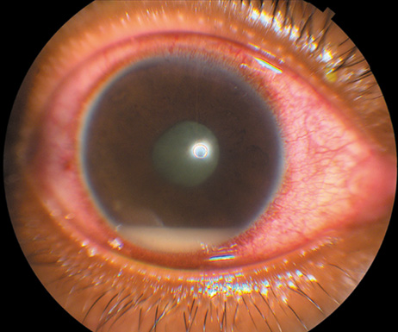
POST-CATARACT SURGERY ENDOPHTHALMITIS: AN UPDATE
F.Fazel MD

Slide 2
Postoperative inflammation after uneventful cataract surgery is
Endophthalmitis
until proven otherwise and should be treated accordingly with ophthalmologists erring on the side of over management rather than under management.

Slide 3
Questions arising endophthalmitis
What are the risk factors today?
What are the most suitable antibiotics to treat endophthalmitis?
What is the best way to administer them?
Do we have to get vitreous and aqueous humour samples?
Do corticosteroids have any place in the treatment of endophthalmitis?
When perform Vitrectomy
How to prevent it?

Slide 4
Risk factors
incision in clear cornea
A non-watertight incision
vitreous prolapse and vitreous loss
increased duration of surgery
intraocular lenses made in silicone
Immunosuppression and diabetes
The conjunctival flora is the main source of infection, followed by the eyelids and the lacrymal saca. Chronic Blepharitis , Lacrimal drainage abnormalities Prosthesis in fellow eye
Active infection elsewhere

Slide 6
Signs and Symptoms
The key symptoms are pain and decreased visual acuity.
patients may be asymptomatic
The key signs are hypopion and tyndall in the aqueous humour.
Less reliable signs are redness and edema of the eyelids, conjunctival injection and corneal infiltrates.

Slide 7
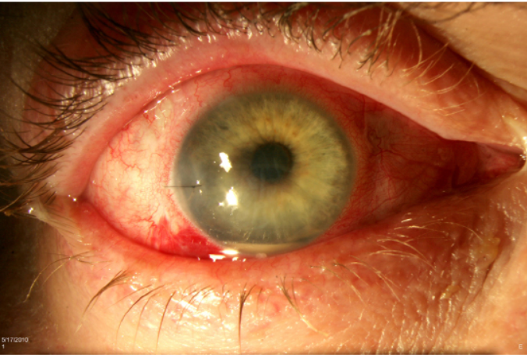
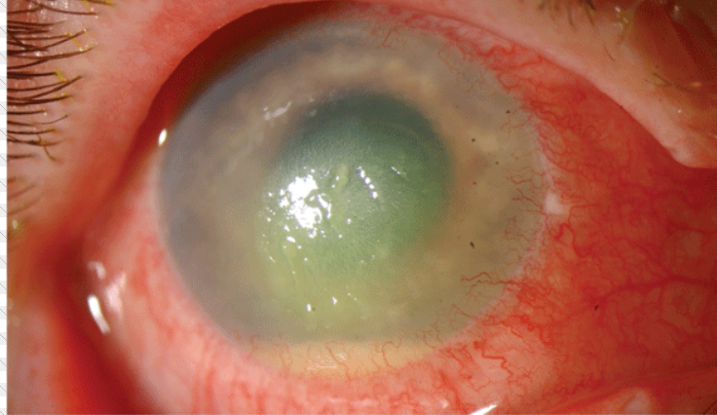
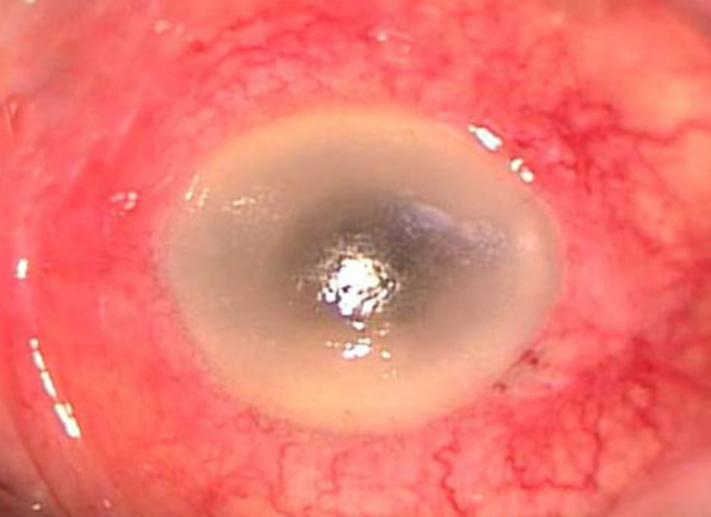
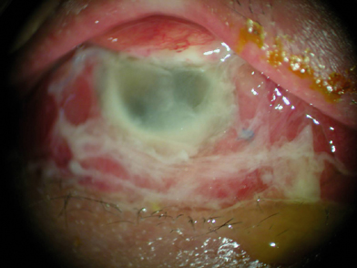

Slide 8
Management
EVS based

Slide 9
FIRST PRIORITY: MICROBIOLOGIC DIAGNOSIS
As soon as the diagnosis of endophthalmitis is suspected, the first maneuver to be done is to obtain a vitreous sample in order to find the causal microorganism. A sample of aqueous humour may be useful also.
staphylococcus epidermidis is the most common followed by streptococcus species and staphylococcus aureus
However, the causal germs are changing. In the recent study, MRSA were found in 18% of the cases, among which 2/3 ended up with a final visual acuity of hand motions or less.

Slide 10
Vitreous Sampling
Needle sampling
Cutter Sampling

Slide 11
SECOND PRIORITY: INTRA-VITREAL ANTIBIOTICS
In order to cover as well as possible all the germs that can be responsible for the endophthalmitis,two combinations of two antibiotics are to be recommended.
vancomycin 1 mg + ceftazidine 2.25 mg(may precipitate and become less biodisponible)
vancomycin 1 mg + amikacin 0.4 mg(may cause macular infarction)

Slide 13
Drug precipitate
Macular infarction

Slide 14
SYSTEMIC ANTIBIOTICS?
There was no difference in final visual acuity or media clarity with or without the use of systemic Antibiotics in EVS study.
So far, there has been no definitive study to prove that the endophthalmitis patient is better managed with than without systemic antibiotic therapy.
Best choice today would be a quinolone with good bioavailability,a long half-life, and a good penetration in the vitreous cavity
Experts in the field recommend the use of a third-generation quinolone such as moxifloxacine and gatifloxacine.

Slide 15
IMMEDIATE VITRECTOMY OR NOT?
In the EVS study, there was no difference in visual outcome whether or not an immediate vitrectomy was performed if the initial visual acuity was hand motions or better.
We may recommend immediate vitrectomy when the initial visual acuity is reduced to light perception only, and delayed vitrectomy if there is no clinical improvement 48 hours after intravitreal antibiotic injection
Once the infection is well controlled, a functional vitrectomy may also be necessary in order to improve the final visual acuity, should thevitreous remains opaque.

Slide 16
Pars plana vitrectomy

Slide 17
EVS Results:
a. No difference in final VA or media clarity whether or not systemic antibiotics were employed.
b. No difference in outcomes between immediate 3 port PPV vs. tap/biopsy for patients with hand motion or better vision.
c. For patients with initial visual acuity of LP only, much better visual results occurred in the immediate 3 port PPV group (versus tap/biopsy group)

Slide 18
CORTICOSTEROIDS: YES OR NO?
The rationale for the use of corticosteroids is that the ocular inflammation that occurs during endophthalmitis may become the main cause of irreversible complications.
Corticotherapy may probably be started as soon as 48 hours after the beginning of the antibiotherapy,if a fungal infection is not suspected.
Dexamethasone may be injected in the vitreous cavity. The recommended dose is 400 μg
Most often corticoids drops and sub-conjunctival injections are used, but their action is mainly directed toward the anterior segment.

Slide 19
PROPHYLAXIS
PRE-OPERATIVE EXAMINATION(detect and treat pre-operatively the patients at risk)
ASEPSIS(the single most important step is to decontaminate the operative field: lids, ocular surface and conjunctival cul-de-sacs with 10% aqueous polyvidone iodine before surgery.
ANTIBIOPROPHYLAXIS(. The only indication for systemic pre-operative antibiotherapy is severe atopia. In this situation,staphylococcus aureus may colonize the lid margins,

Slide 20
ANTIBIOPROPHYLAXIS
The only indication for systemic pre-operative antibiotherapy is severe atopia. In this situation,staphylococcus aureus may colonize the lid margins
In spite of the positive results of several studies,antibiotics should not be used in the irrigation fluid during phakoemulsification
antibioprophylaxis, mainly with fluoroquinolones,is commonly used before cataract surgery,without any definite proof of efficacy
A single prospective randomized study dealing with 16000 cases of phacoemulsificationhas shown that cefuroxime(1mg in 0.1 ml), a third-generation cephalosporin,given intra-camerally at the completion of surgery would decrease five-fold the risk of post-operative endophthalmitis

Slide 21
CHRONIC ENDOPHTHALMITIS
Typically appears several weeks to several months after surgery.
It can mimic a chronic uveitis, and the beginning is insidious.
A pathognomonic sign is the development of white plaques on the posterior capsule and the intraocular implant.
This kind of infection is usually corticoid-respondent and may become corticoid-corticoid-dependent.
The most common causal germs are Staphylococcus epidermidis, propionibacterium acnes, and some corynebacteria
May be triggered by YAG posterior capsulotomy.

Slide 22
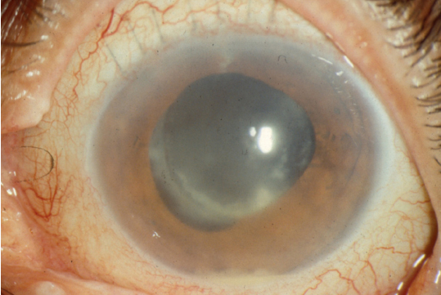
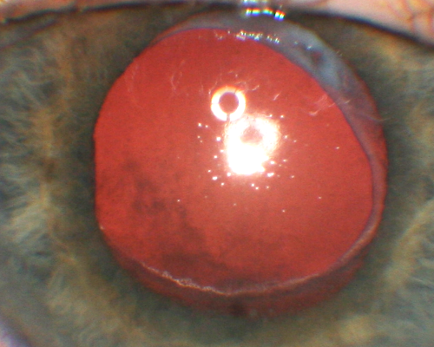

Slide 23
Complete and Early Vitrectomy for Endophthalmitis (CEVE) Ferenc Kuhn
Clinical signs of the disease are sufficient to recognize the condition as endophthalmitis and initiate treatment
If the attending ophthalmologist does not have the expertise or equipment and thus cannot offer the optimal treatment option, the patient should immediately be referred to a specialist who is able and willing to perform the most promising therapy.
It is unacceptable to simply inject intravitreal antibiotics and then claim that everything that possibly could have been done has been done to save your eye, but unfortunately the disease has proven to be too tough to conquer.
The cell wall of the organism may be toxic, and the bacterium may secrete endo- and exotoxins as well as harmful enzymes. This volatile mixture is rather heavy and tends to “sink” toward the deepest point of the vitreous cavity–the macula.

Slide 24
Macular hypopyon.

Slide 25
Macular hypopyon.

Slide 26
Complete and Early Vitrectomy for Endophthalmitis

Slide 27
Complete and Early Vitrectomy for Endophthalmitis (CEVE)
The authors strongly believe that the primary line of treatment for the vast majority of eyes with endophthalmitis should be vitrectomy, i.e., purely medical treatment is the exception, not the rule.
Statistically significantly better anatomical and functional results are achieved with “complete and early vitrectomy”than in either management arm in the

Slide 28
Advantage Of Early Vitrectomy
Increases retinal oxygenization
Provides a large specimen for diagnostic evaluation
Allows definite treatment at a time when the organism (and its virulence) is still unknown
Dramatically reduces the inflammatory debris load in the vitreous cavity, thereby lessening its harmful effect on the retina and other intraocular tissues
Reduces the incidence and severity of macular complications
Allows direct inspection of the retina by removing the nontransparent medium, Increases the access to the retina of intravitreally administered pharmacological agents
Reduces the duration of the disease, thus accelerating visual rehabilitation

Slide 29
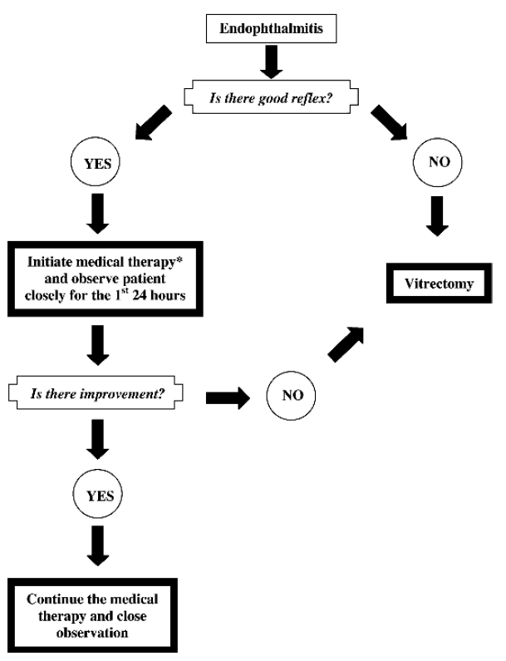

Slide 30
