Slide 1
Posterior segment complications of strabismus surgery;
Dr.J.Omidian
Kermanshah university of medical science

Slide 2
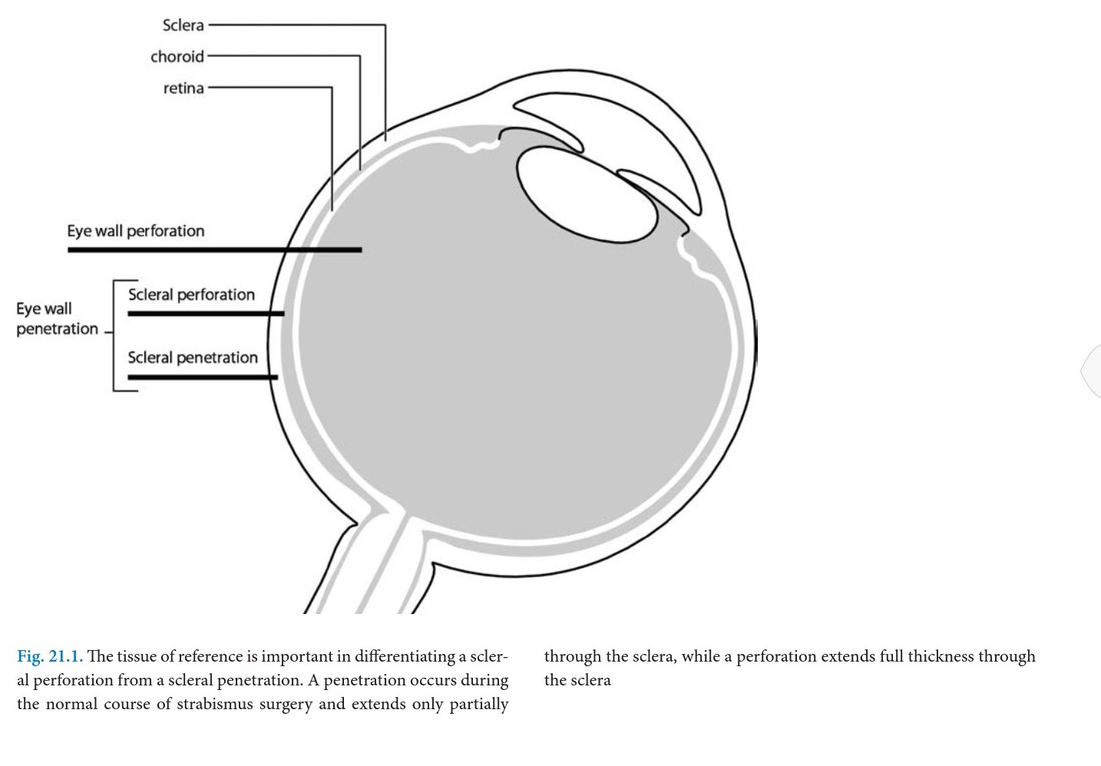

Slide 3
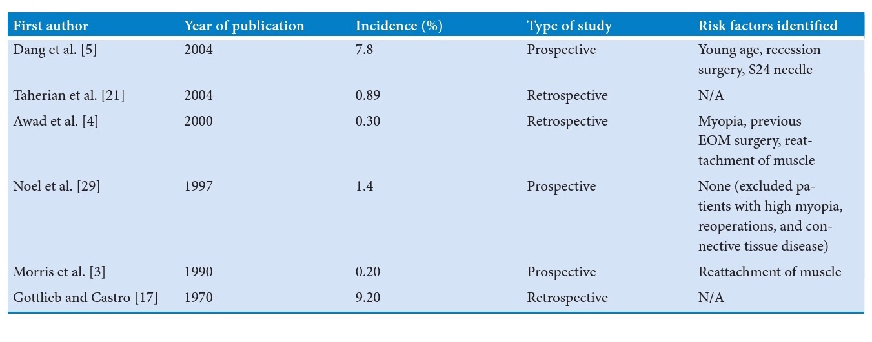

Slide 4
Muscle reattachment ; 87%
Muscle disinsertion ; 3.3%
Muscle dissection ; 1%
Traction sutur ; 1%

Slide 5
Risk factors;
Axial myopia
History of scleritis
History of ocular surgery

Slide 6
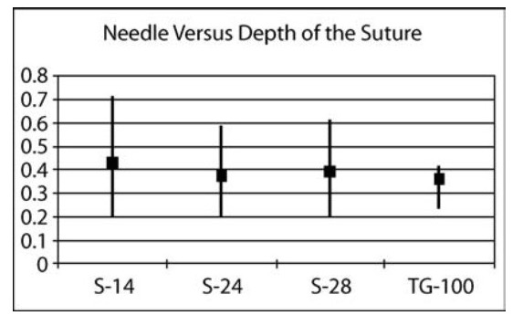

Slide 7
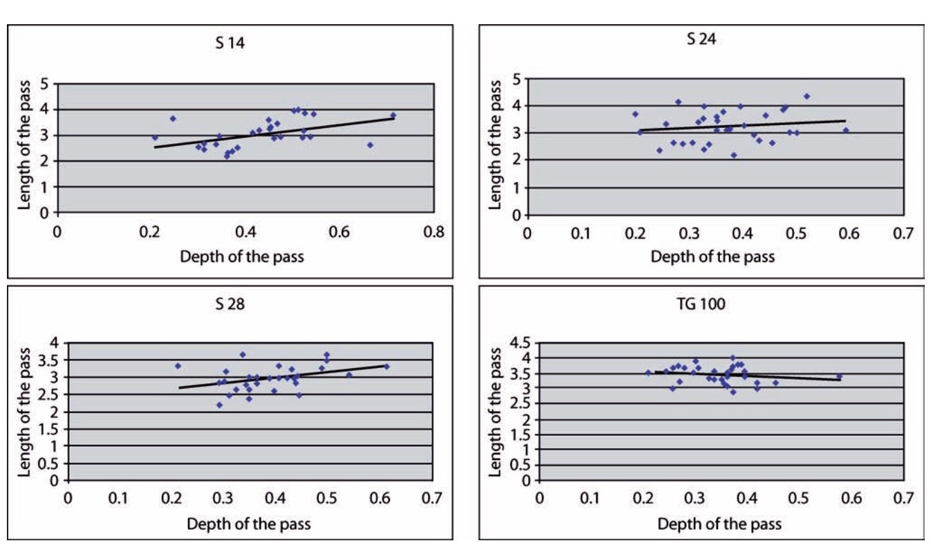

Slide 8
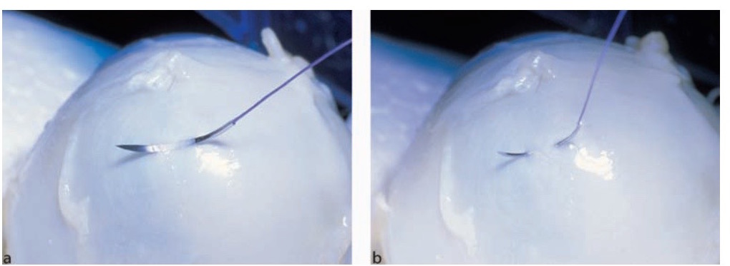

Slide 9
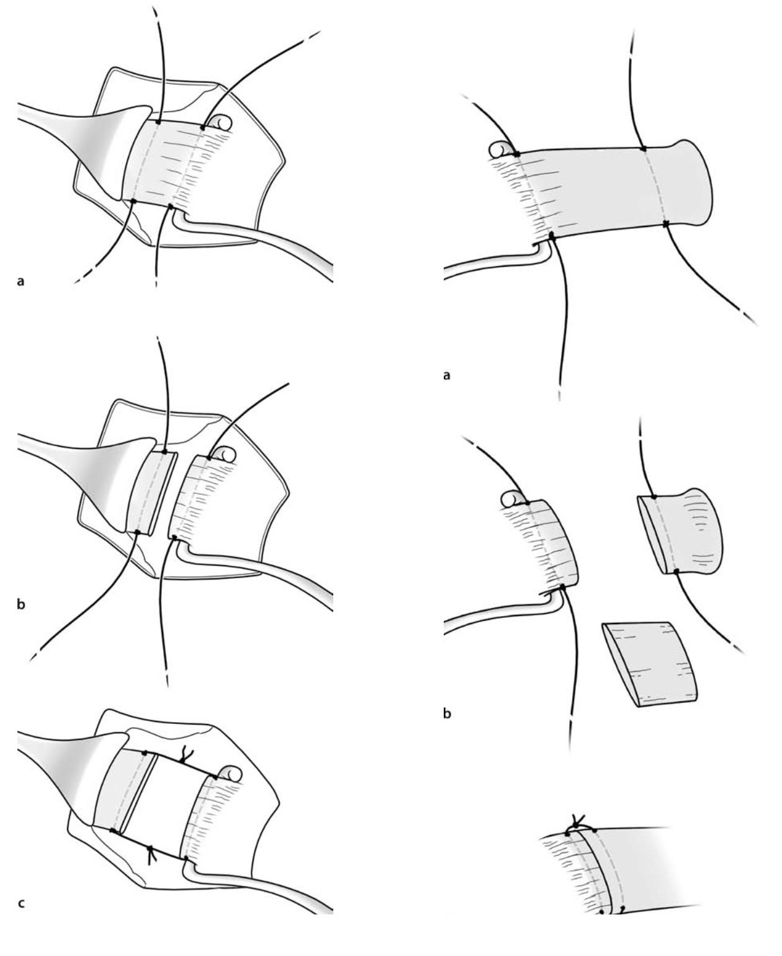

Slide 10
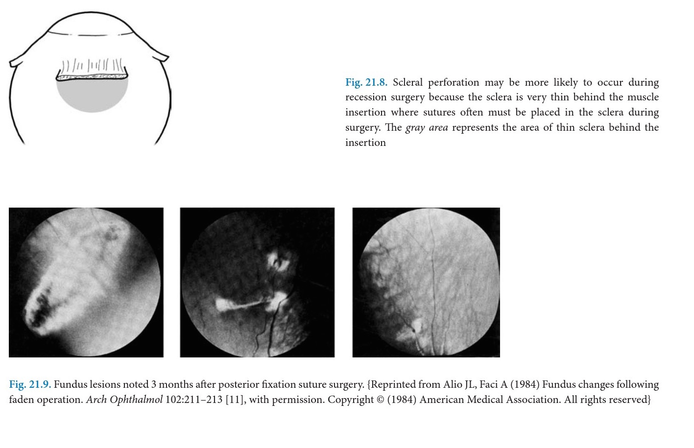

Slide 11
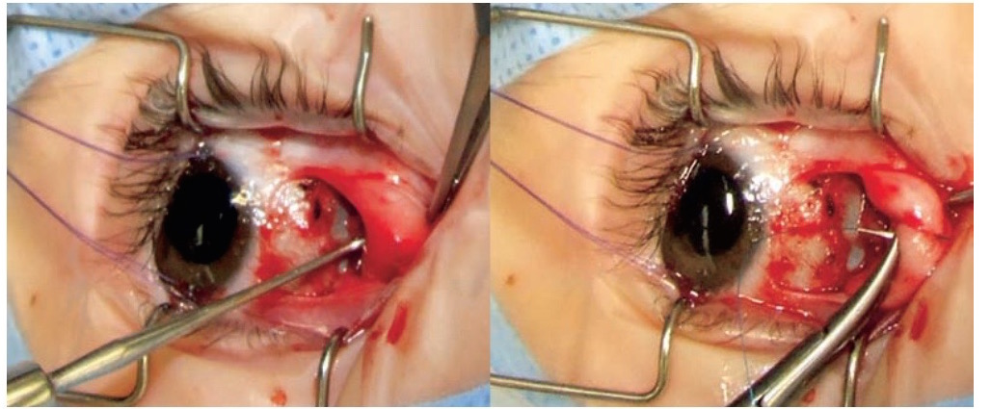

Slide 12
Clinical evidence of perforation;
Surgen feeling
Recognition of uveal and vitrous on the tip needle
Small dark red blood
Retinal hemorrhage
Retinal break

Slide 13
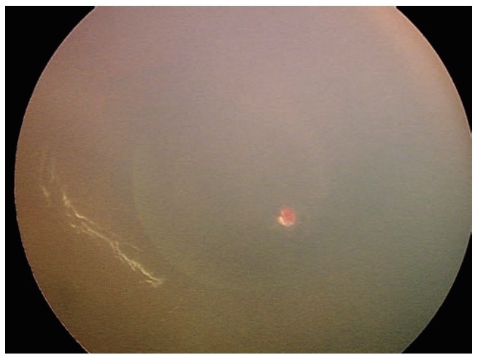

Slide 14
Treatment;
Withdraw the needle and sutur and reposition it
Apply antibiotic drop and/or 5% povodine-iodine
subconjunctival antibiotic
Intravenous or oral antibiotic
Close F/U

Slide 15
Large retinal break or small retinal break with subretinal fluid or high risk patient;
Laser retinopexy in two rows surround the berak

Slide 16
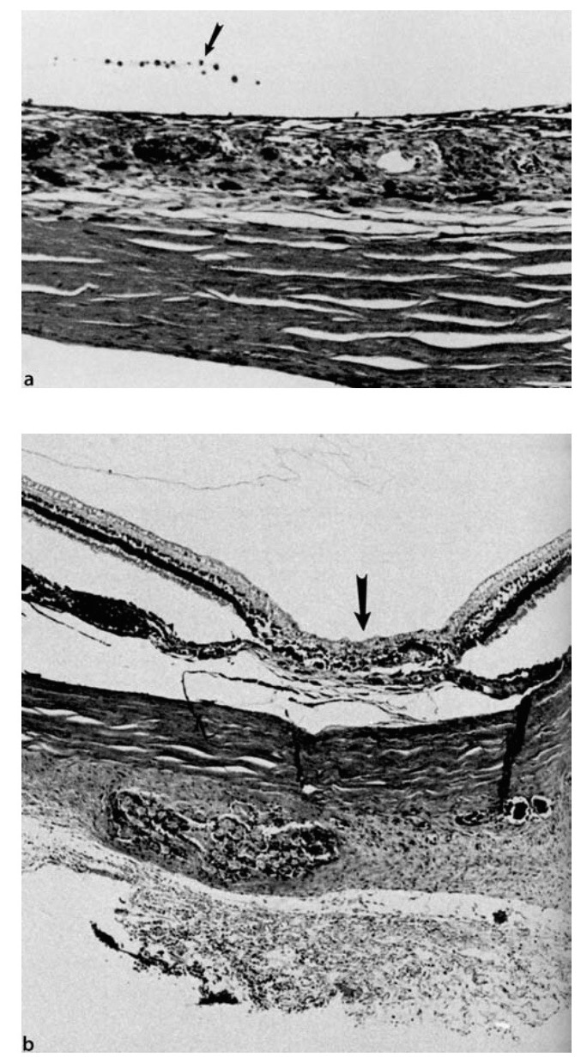

Slide 17
Post operative endophthalmitis
Source:
Normal Bacterial flora
Contaminated surgical material
Transient endogenous bacteremia

Slide 18
Estimated incidence ;
1 in 350000 in 1962
1 in 18500 in 1992

Slide 19
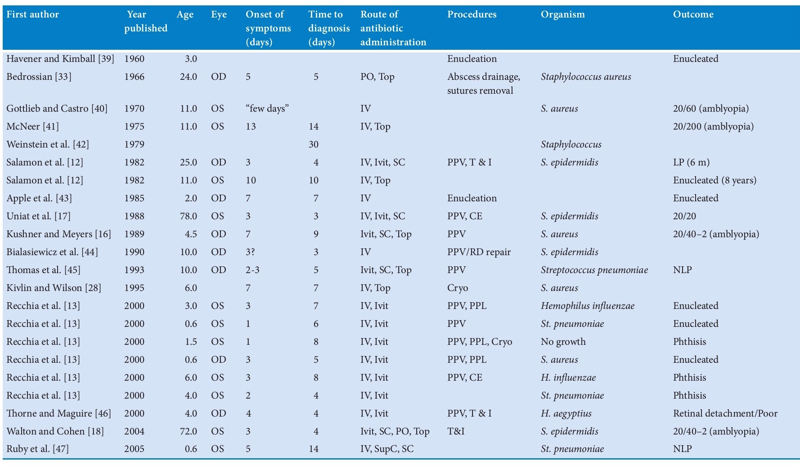

Slide 20
Treatment guidelines of E.VS;
If vision is LP: vitrectomy and intravitreal antibiotic with systemic fourth generation of Fluoroquinolons

Slide 21
Preventations;
Awareness of minor preoperative
use of topical antibiotic infection
Awareness of signs and symptoms of endophthalmus

Slide 22
Thank you.

