Slide 1
Branch retinal artery occlusion (brao )
Dr. Ramezani
Assistant Professor of Ophthalmology
Kermanshah University of Medical Science

Slide 2
Epidemiology
BRAO is a rare event , even less common than CRAO overall.
The exception to this comparative incidence is with young patients, in whom BRAO is the more common type of retinal artery obstruction.
Overall, men are more affected than women by a 2 : 1 ratio.
In the subset of young patients (less than 50 years of old) men and women affected equally.
The mean age of affected patients is 60 years, with a range from the second decade of life to the tenth.
.

Slide 3
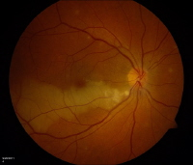
Epidemiology
The right eye (60%) is affected more commonly than the left (40%) , which probably reflects the greater possibility of cardiac or aortic emboli traveling to the right carotid artery.
BRAO strikes the temporal retinal circulation far more frequently than the nasal, consistent with the greater blood flow to the macular retina.

Slide 4
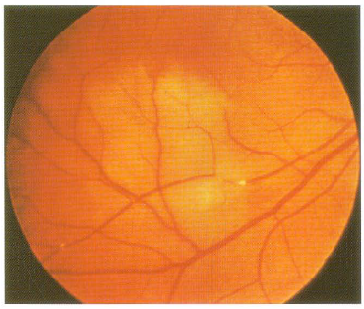
pathogenesis
Over two-thirds of BRAOs are secondary to emboli to the retinal circulation.
Three main types of retinal emboli have been identified :
Cholesterol (Hollenhorst plaque)
Platelet-fibrin
Calcific
Cholesterol emboli typically emanate from atheromatous plaques of the ipsilateral carotid artery system.

Slide 5
Cholesterol emboli

Slide 6
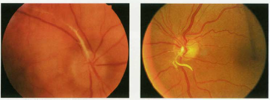
Platelet-fibrin emboli
Platelet-fibrin emboli are long, smooth, white-colored, intra-arterial plugs that may be mobile or break up over time.

Slide 7
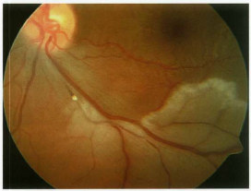
Calcific emoli
Calcific emoli are solid, white, non refractile plugs associated with calcification of heart valves or the aorta.
Calcific embolous in a patient with calcific cardiac valve

Slide 8
Ocular manifestations
Aprupt, painless loss of vision in the visual field is the typical history of presentation.
Amaurosis fugax occurs in about one fourth of patients prior to frank obstraction,
Acutely, examination reveals intact central acuity in about 50% of patients. A RAPD is common, the presense of which is determined by the extent of retinal involvement.

Slide 9
Ocular manifestations
Retinal whitening that corresponds to the areas of ischemia is the most notable finding.
Retinal emboli are seen in over two-thirds of BRAOs.
Flame hemorrhages at the margins of retinal ischemia are not uncommon.

Slide 10
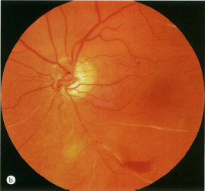
Ocular manifestations
In the chronic phase, when the retinal whitening has diminished, a loss of NFL in the affected area may be apparent.
In most instances, the affected retina appears normal.
At the site of obstruction, localized sheathing of the arteriol is common.
Arteriolar collaterals on the optic disc or at the site of obstruction may develop.

Slide 11
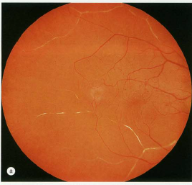
Susac’ s syndrome
Susac's syndrome is a rare disease that is characterised by the clinical triad of encephalopathy, recurrent and bilateral BRAO, and sensorineural hearing loss.
It was first described as a distinctive syndrome by Susac in 1979. There have been 304 reported individual patients with Susac's syndrome.
.
Etiopathogenesis is not clear, although it is now thought that it is an immune-mediated endotheliopathy that affects the microvasculature of the brain, retina, and inner ear

Slide 12
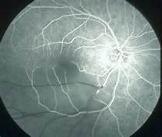
Diagnosis and ancillary testing
Ancillary testing is not usually ecessary to make.
FA reveals an abrupt diminution in dye at the site of the obstruction and distally. filling in the adjacent retinal veins is slow to absent, and late staining or even leakage from the embolus site may occur.

Slide 13
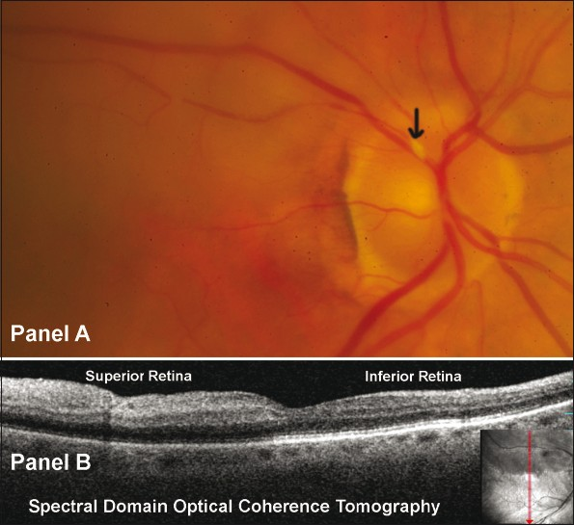
Optical coherence tomography
OCT initially reveals thickening of the inner retina in the territory of the obstructed artery. Over time, the corresponding inner retina will be severely thinned.

Slide 14
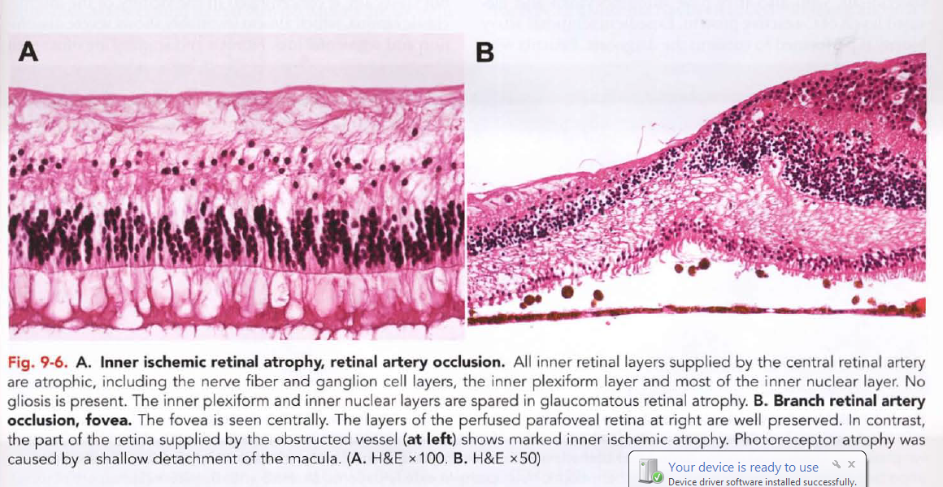
pathology
Early, coagulative necrosis of the inner layers of the neural retina, which are supplied by the retinal arterioles, is manifested by edema of the neuronal cells during the first few hours after arterial occlusion and becomes maximal within 24 hours.
The intracellular swelling accounts for the gray, retinal opacity seen clinically.

Slide 15
Systemic associations
Systemic evaluation of patients who have BRAO discloses evidence of an embolic source from the carotid arteries or the heart in many cases.
BRAO associated with temporal arteritis is exceedingly uncommon. It is not usually necessary to obtain an ESR unless other evidence of temporal arteritis exists.

Slide 16
treatment
Because the visual prognosis is much better for BRAO than for CRAO, invasive therapeutic maneuvers of dubious utility are not typically performed, unless significant foveal involvement is seen.
Rarely, ocular massage or paracentesis will successfully dislodge an embolus.

Slide 17
treatment
Laser treatment has been employed to disrupt emboli, in some cases with improvement in the vision.
In all cases, the risks of TYE must be weighed against the possibility of severe and permanent loss of vision secondary to retinal artery occlusions.
Vojnosanit Pregl. 2014 Nov;71(11):1072-7.
Transluminal Nd:YAG laser embolysis--a reasonable method to reperfuse occluded branch retinal arteries.
Stanca HT, Petrović Z, Munteanu M

Slide 19
treatment
Hyperbaric oxygen therapy may improve the visual loss associated with BRAO.
Case Rep Ophthalmol Med. 2015;2015:640247. doi: 10.1155/2015/640247. Epub 2015 Feb 5.
Hyperbaric oxygen therapy in branch retinal artery occlusion in a 15-year-old boy with methylenetetrahydrofolate reductase mutation.
Celebi AR¹, Kadayifcilar S², Eldem B²
Undersea Hyperb Med. 2008 Sep-Oct;35(5):333-87.
Hyperbaric oxygen therapy and the eye.
Butler FK Jr¹, Hagan C, Murphy-Lavoie H.
Undersea Hyperb Med. 2010 May-Jun;37(3):167-72.
Hyperbaric oxygen treatment of retinal artery occlusion.
Weiss JN¹.

Slide 20
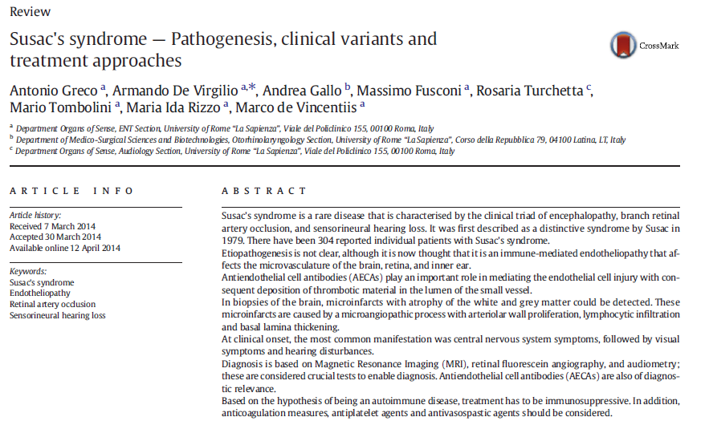
Treatment
In rare patients who has BRAO accompanied by a systemic clotting disorder, systemic anticoagulation may prevent further event.

Slide 21
Course and outcome
Most patients remain with a fixed visual field defect but intavt central acuity.
About 80% of eyes recover to 20/40 or better central acuity.
Retinal neovascularization has been reported but is distinctly uncommon.
Iris neovascularization does not occur.

