Slide 1
54 year old woman with type 2 DM
VA: OS: 5/10
How do you proceed with this case in your current practice?

Slide 2
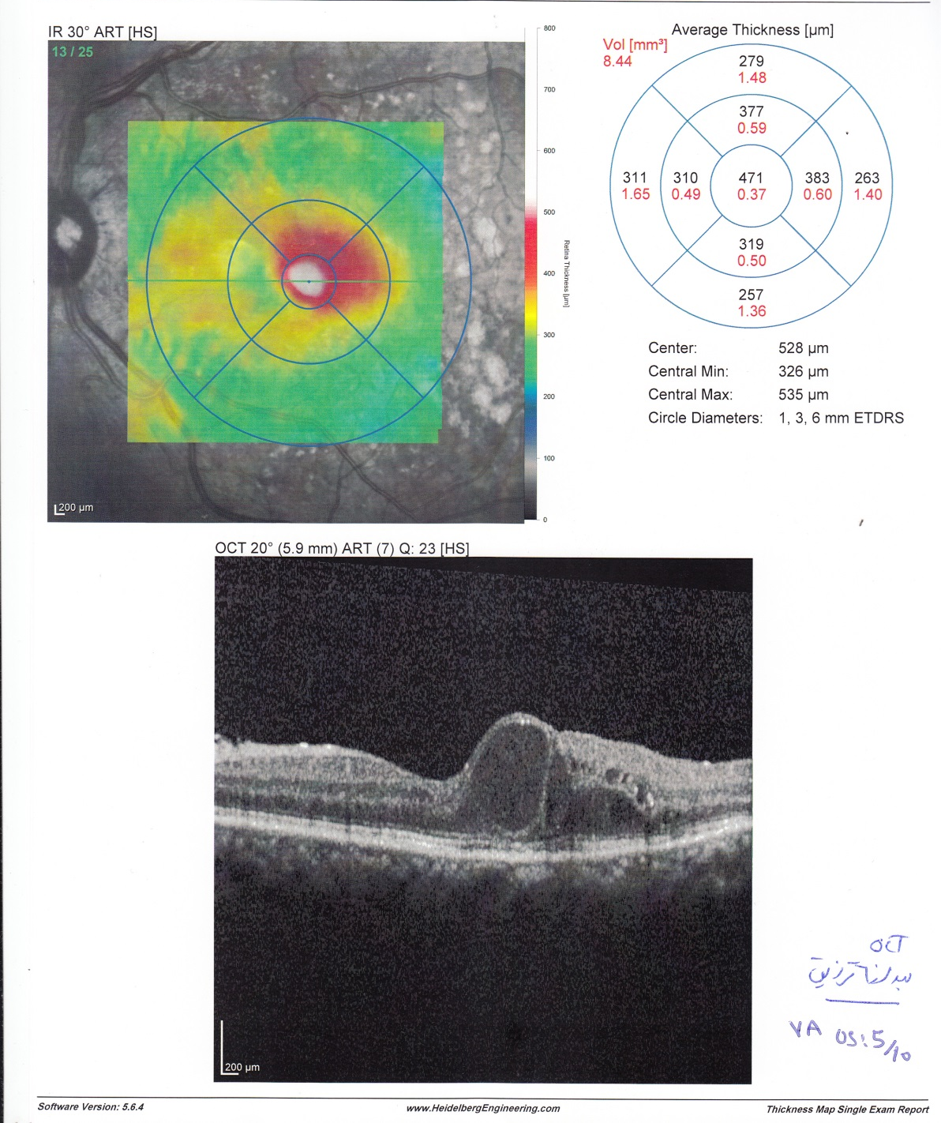

Slide 3
after 6 intravitreal injection (IVB × 3 IVB + IVTA × 3)

Slide 4
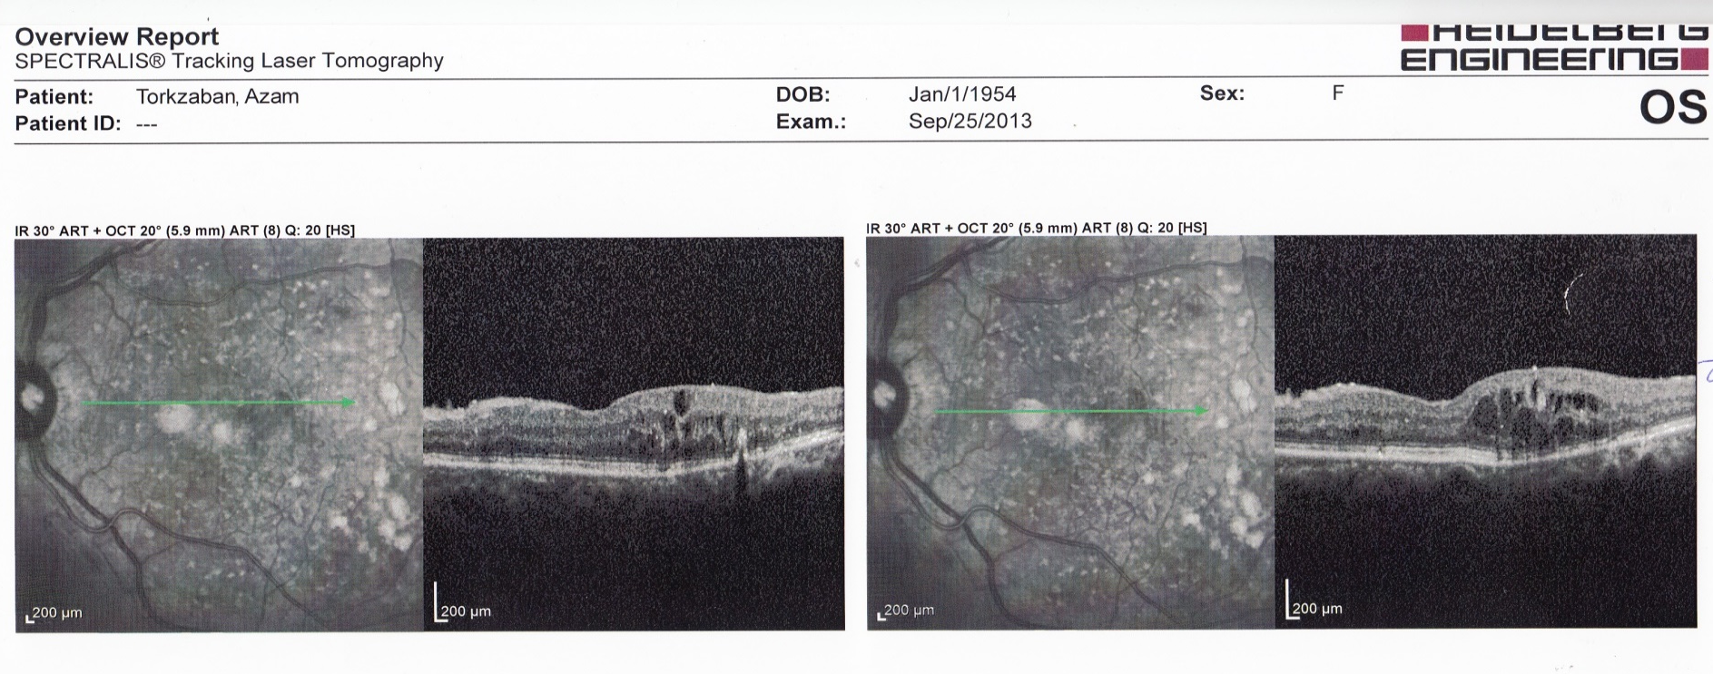

Slide 5
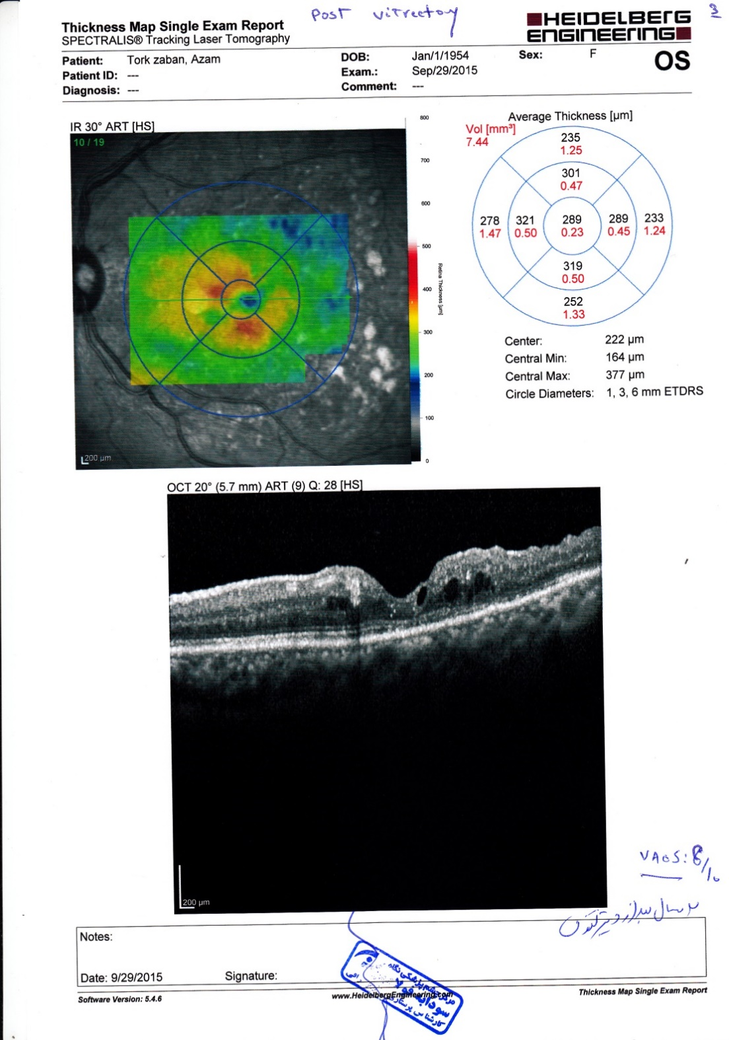
23 months after Vitrectomy

Slide 6
