Slide 1


The Usage of common CT and MRI Contrast Agents
Dr. Shamim Jafari

Slide 2
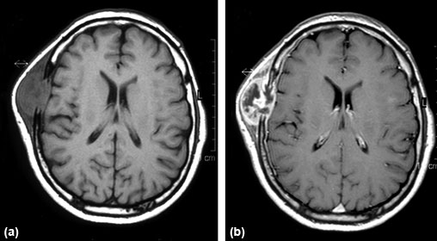
Introduction
Contrast agents are indispensable in the practice of radiology. Significant improvements in their composition during the past few decades have made them safer. Nonetheless, risks associated with contrast agents have not been eliminated, and adverse reactions of varying degree continue to occur. Consequently, it is imperative for anybody administering contrast agents to be intimately familiar with the characteristics, indications, and potential side effects of these agents.

Slide 3
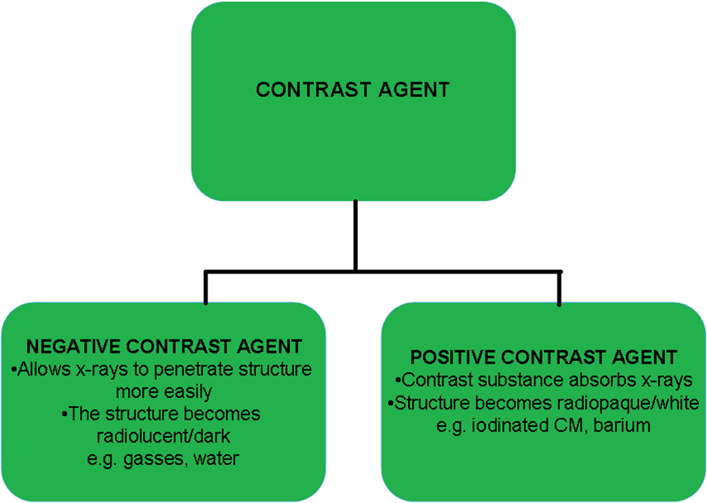
Contrast Agents Types

Slide 4
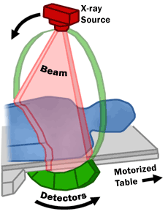
Computed Tomography (CT)
It differs from conventional radiography in that a more sensitive x-ray detection system is used, the images consist of sections (slices) through the body, and the data are manipulated by a computer. The x-ray tube and detectors rotate around the patient

Slide 5
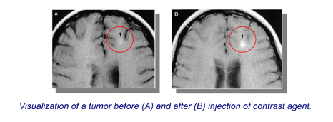
Contrast Agents
Radiographic contrast agents are used to visualize structures or disease processes that would otherwise be invisible or difficult to see.

Slide 6
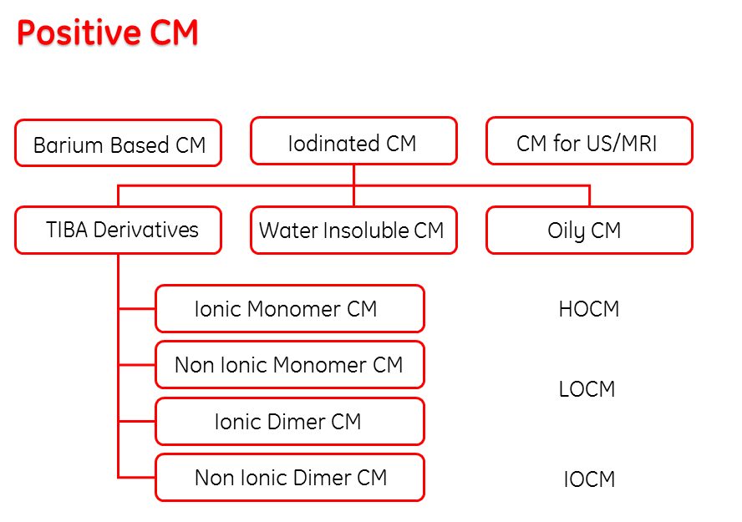

Slide 7
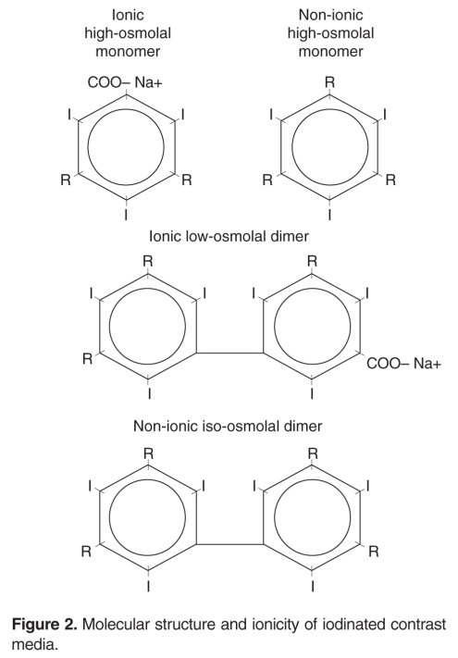
Iodine Based Contrast Agents
All these contrast agents are based on a benzene ring to which three iodine atoms are attached. A monomer contains one tri-iodinated benzene ring and a dimer contains two tri-iodinated benzene rings.
They can also can be divided into ionic and non-ionic. Ionic contrast agents are water soluble because they dissociate into negative and positive ions. Non ionic compounds are rendered water soluble by their polar OH groups.

Slide 8
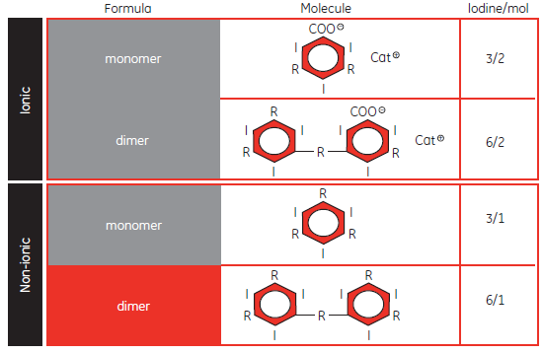

Slide 9
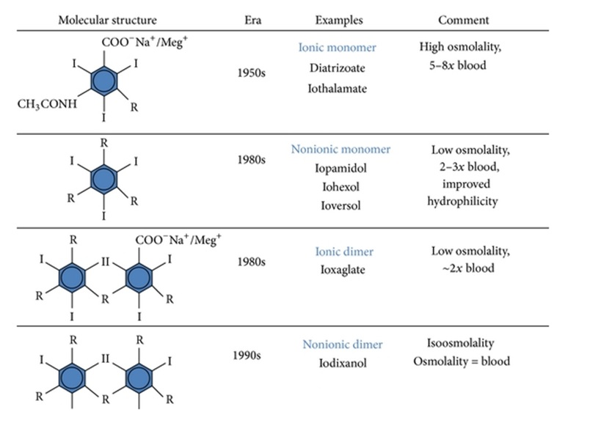

Slide 10
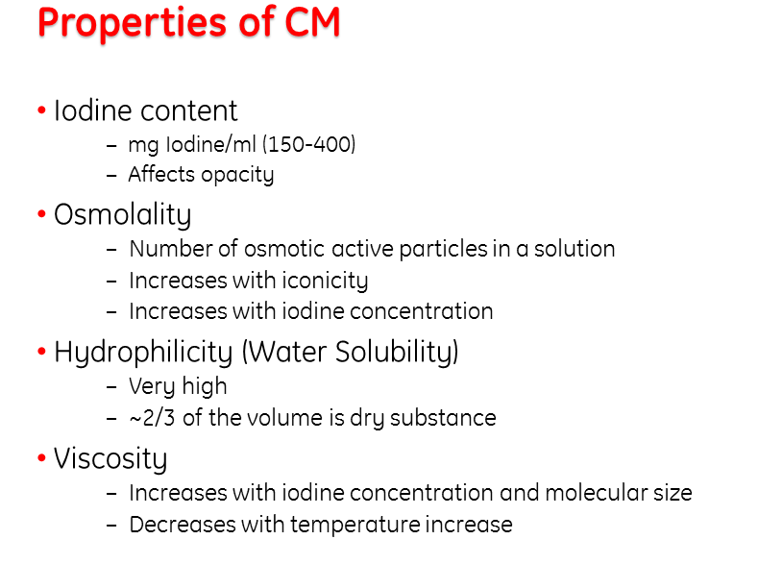

Slide 11
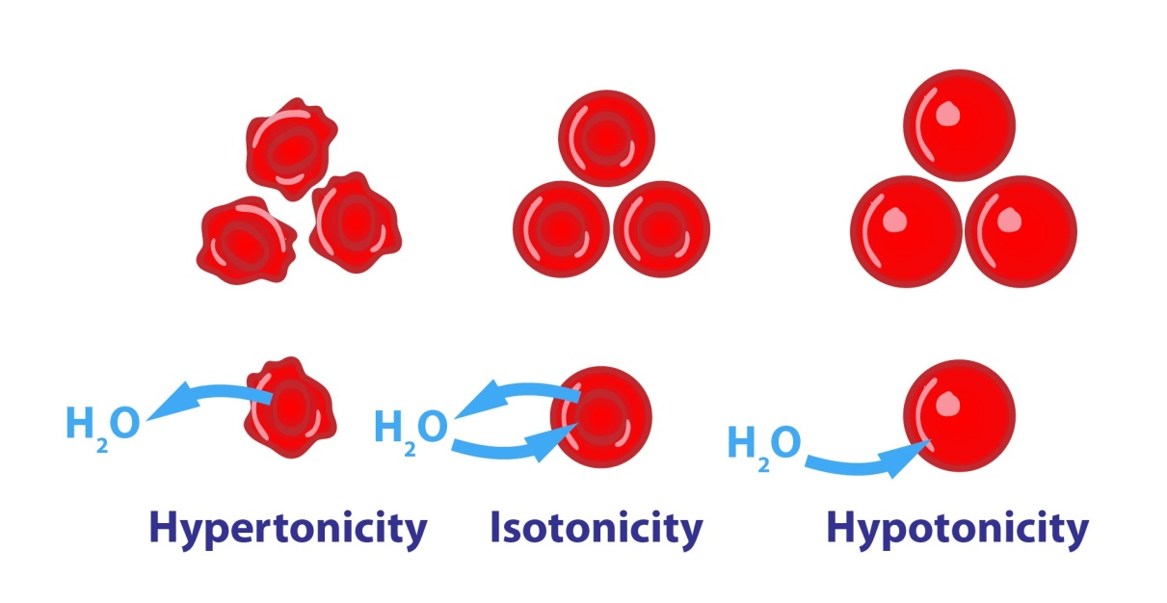
Osmolality
If the ECF becomes too hypotonic, water would fill surrounding cells, increasing their volume and potentially lysing them. If the ECF becomes too hypertonic, it would lead to shrinkage of the cells.
The osmolality of contrast agents affects the incidence of side effects, particularly above 800 mosm/kg.

Slide 13
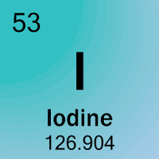
Iodine Content
Indication of the osmolality of an agent is given by the contrast agent ratio, which is derived by dividing the number of iodine atoms in solution by the number of particles in solution:
The higher osmolality agents have more particles per iodine atom and therefore have lower ratios.
Higher iodine concentration means that particular contrast agent is more radio-opaque and results in better opacification, and fewer particles of contrast medium mean lower osmotic effects.

Slide 15
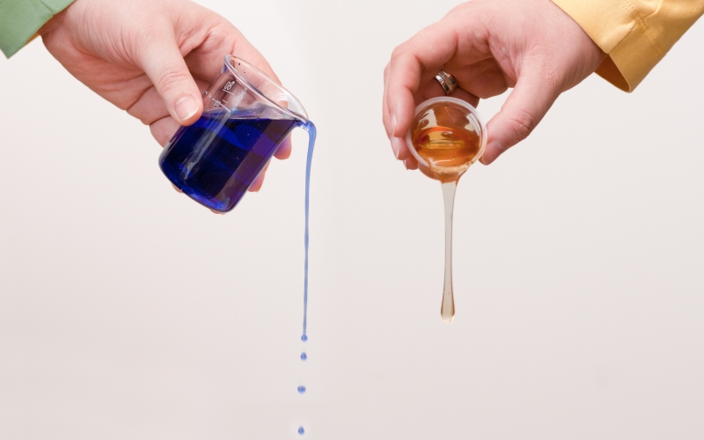
Viscosity
Viscosity of a contrast agent is a function of solution concentration, molecular shape, and weak interactions among the contrast agents and water molecules.
The move from ionic to non-ionic agents actually increased viscosity while decreasing osmolality and toxicity. The new dimers continue this trend.

Slide 17
Side effects
Adverse effects are uncommon ranging from 5% to 12% of intravascular injections with ionic agents to 1% to 3% with nonionic lower osmolality agents.
Evidences suggests that a true allergic reaction mediated by IgE is a likely precipitating event. Triggering of mast cells to release histamine is related to severe reactions.
Patients with a history of allergy, asthma, or previous contrast reaction are clearly at higher risk.
Cardiovascular effects are more common and more severe in patients with cardiac disease.

Slide 18
Mild side effects
Nausea, vomiting
Altered taste
Sweats
Cough
Itching
Rashes & hives
Nasal stuffiness
Headache Flushing
Swelling of eyes & face
Dizziness
Abdominal pain
Chills
Anxiety
Shaking

Slide 19
Moderate side effects
Tachycardia, bradycardia
Hypotension
Bronchospasm, wheezing
Hypertension
Dyspnea
Laryngeal edema
Pulmonary edema

Slide 20
Severe side effects
Laryngeal edema
Shock
Convulsions
Cardiopulmonary arrest
Arrhythmias

Slide 21
Delayed adverse events
Delayed allergic like and non allergic like adverse events are most commonly cutaneous and may develop from 30 to 60 minutes to up to one week following contrast material exposure, with the majority occurring between three hours and two days.
Delayed cutaneous reactions commonly manifest as urticaria, persistent rash, exanthema and angioedema and is usually associated with pruritus.
Delayed non cutaneous reactions include nausea, vomiting, fever, drowsiness, and headache.

Slide 22
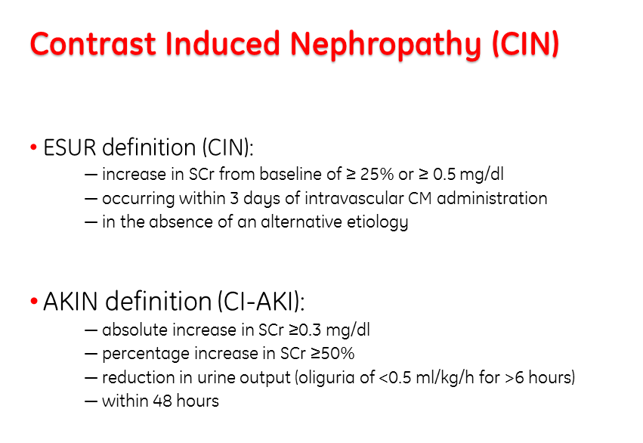

Slide 23
CIN Patophysiology
Hypoxia in the renal outer medulla due to perturbations in renal microcirculation and occlusion of small vessels;
Cytotoxic damage to the tubules directly or via the generation of oxygen free radicals, especially since the concentration of the agent within the tubule is markedly increased; and
Transient tubule obstruction with precipitated contrast material.

Slide 24
High Osmolar Contrast Media (HOCM)
They are the oldest agents. They are relatively inexpensive, but their utility is limited. They are monomers that ionize in solution (ionic monomers).
Osmolality ranges between 1500 – 2000 mOsm/kg
Diatrizoate
Meglumine
Lothalamate
Loxithalamate

Slide 25
Low Osmolar Contrast Media (LOCM)
They are non ionic monomers that dissolve in water but do not dissociate that result in fewer particles in solution.
Osmolality ranges between 500 – 900 mOsm/kg
Iohexol | Omnipaque | GE Healthcare
Iopamidol | Scanlux
Iopromide | Ultravist | Bayer
Iomeprol | Iomeron

Slide 26
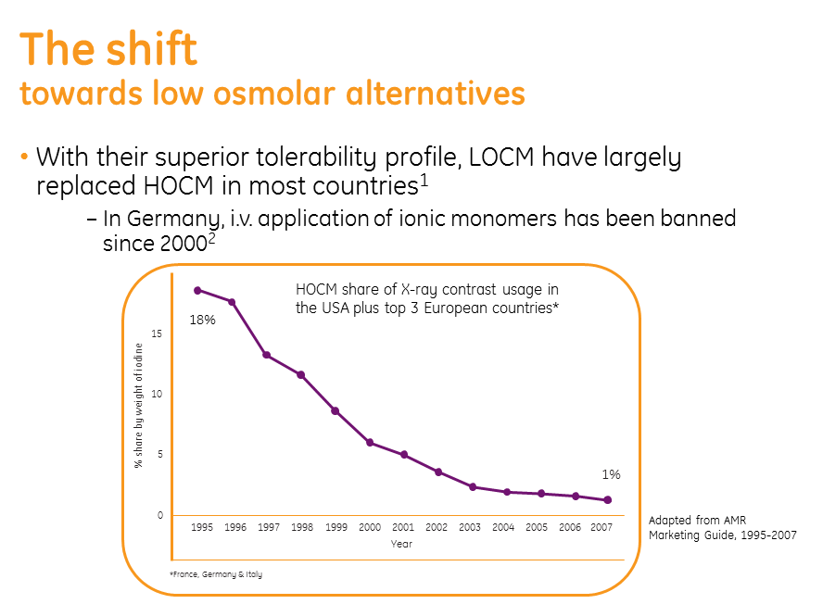

Slide 27
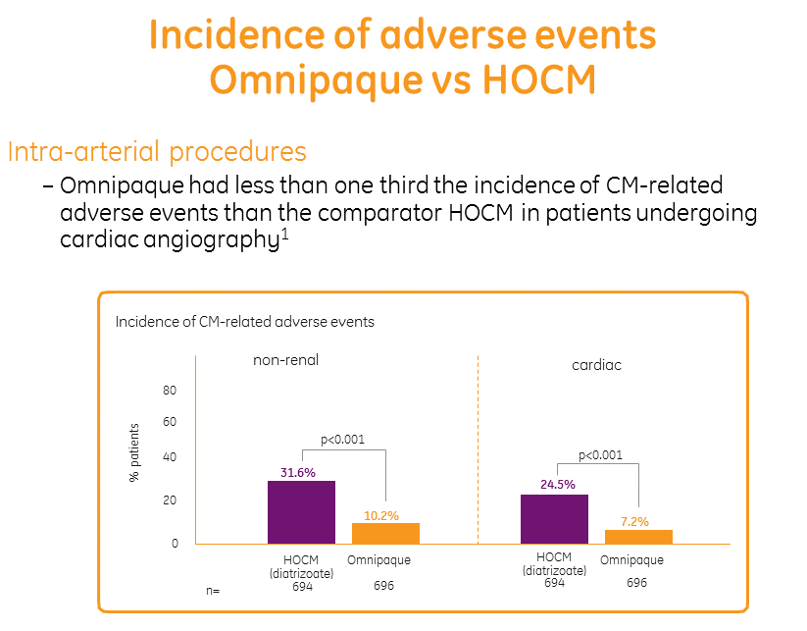

Slide 28
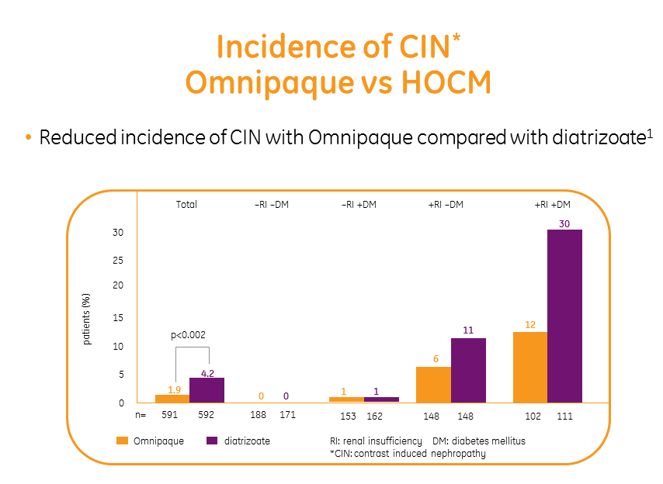

Slide 29
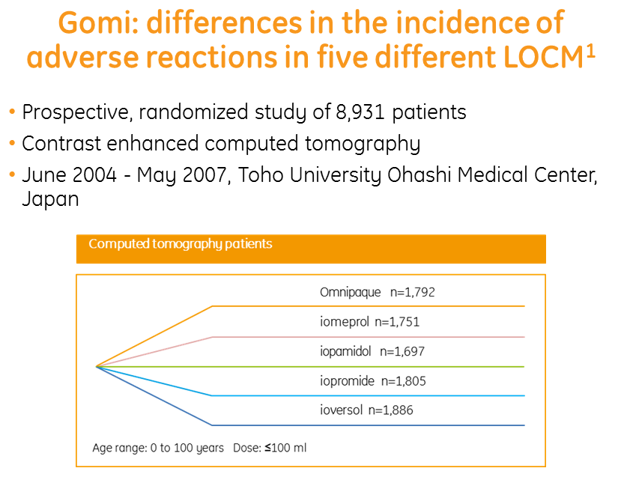

Slide 30
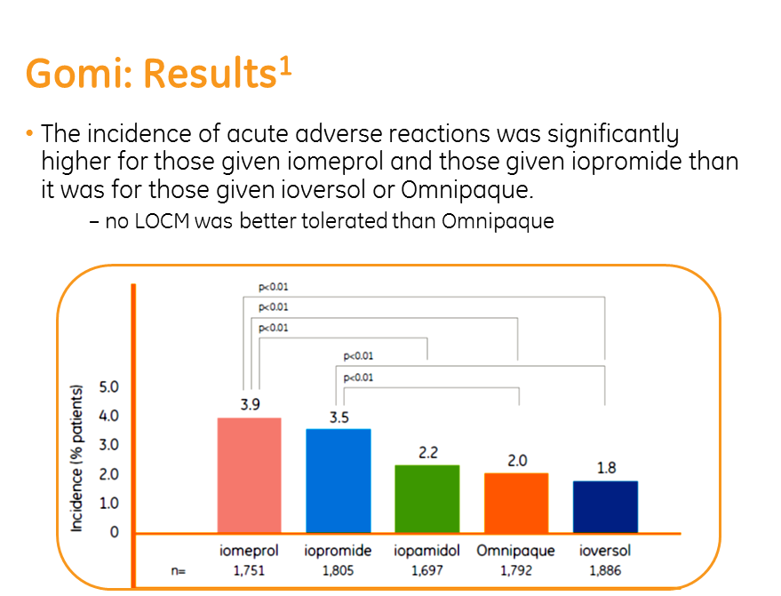

Slide 31
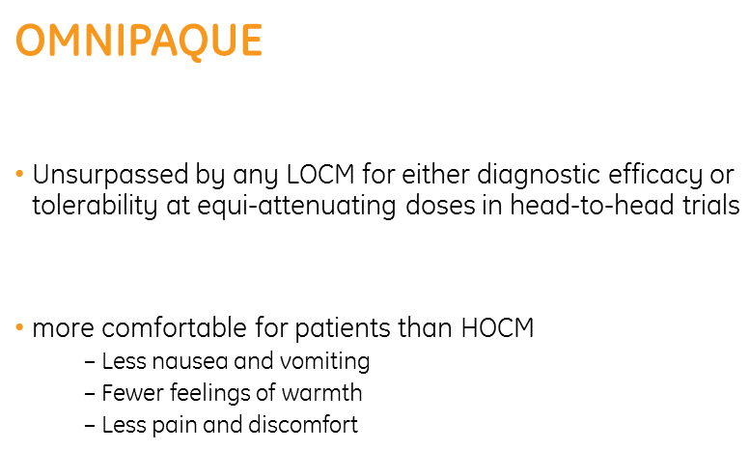

Slide 32
Iso Osmolar Contrast Media (IOCM)
The most recent class of agents is non ionic dimers that consist of a molecule with two benzene rings that does not dissociate in water.
Osmolality is almost the osmolality of blood. (300 mOsm/kg)
Iodixanol Visipaque GE Healthcare

Slide 33
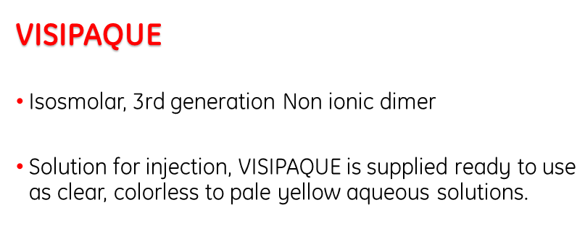

Slide 34
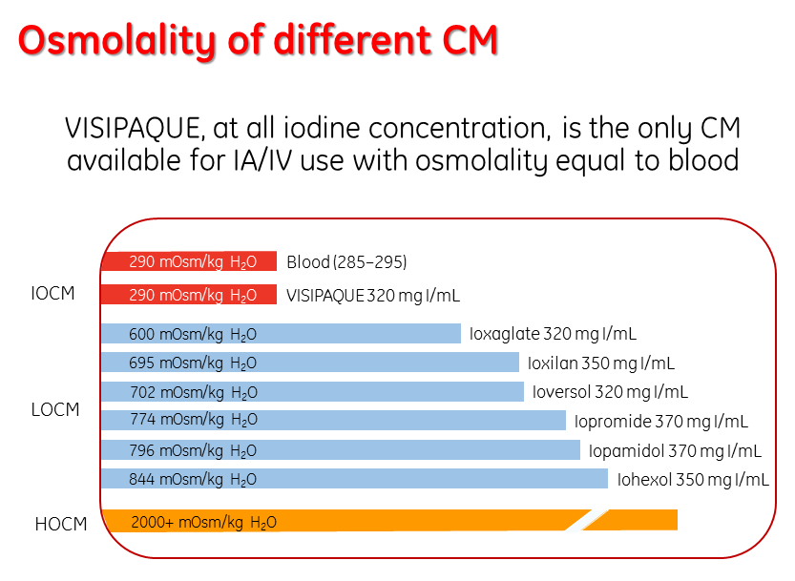

Slide 35
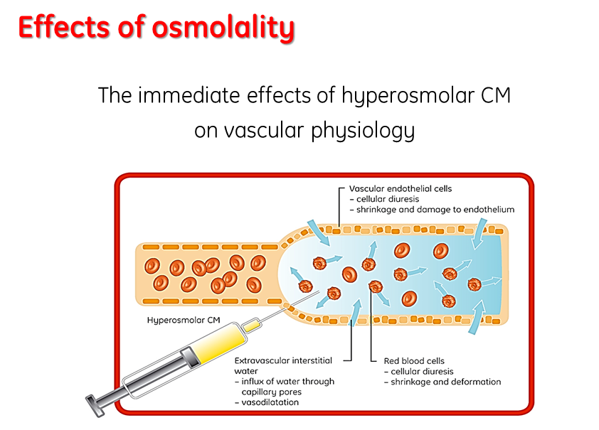

Slide 36
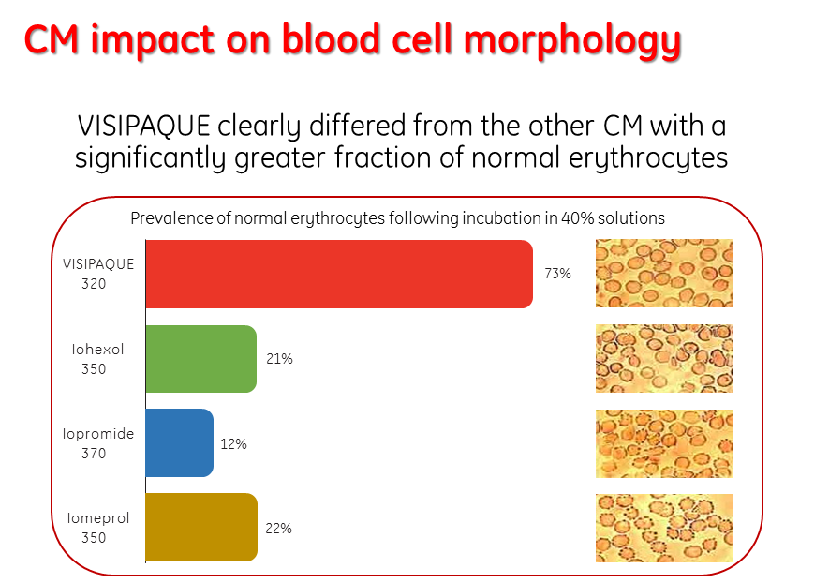

Slide 37
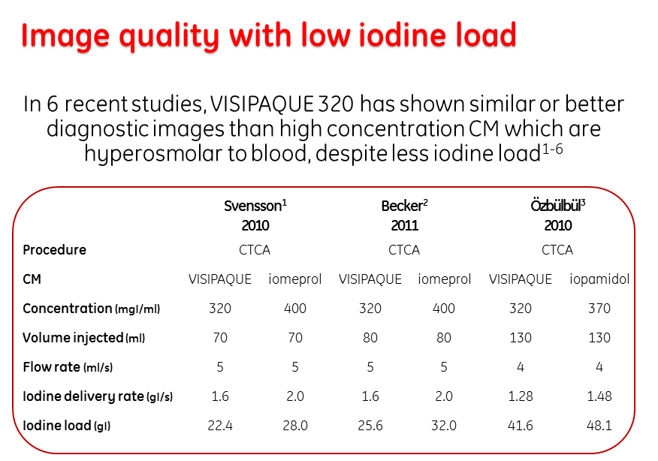

Slide 38
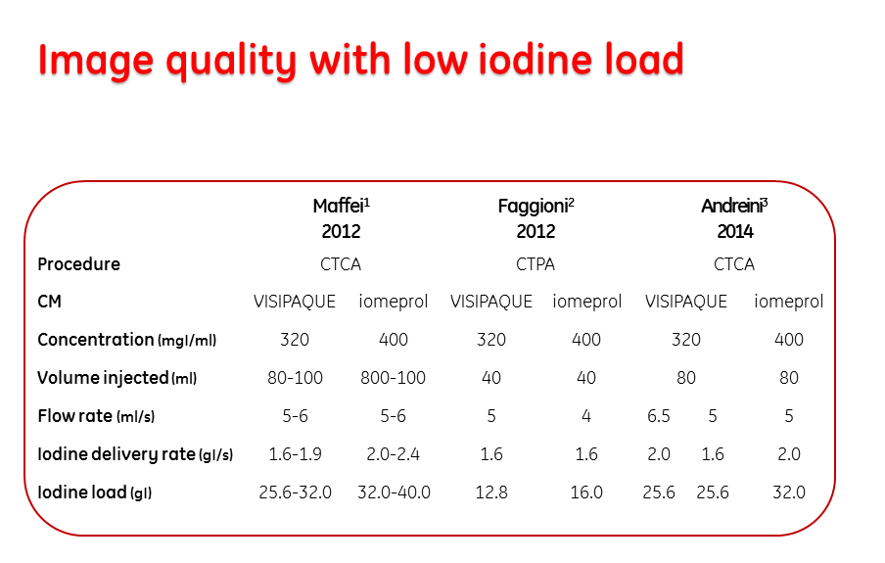

Slide 39
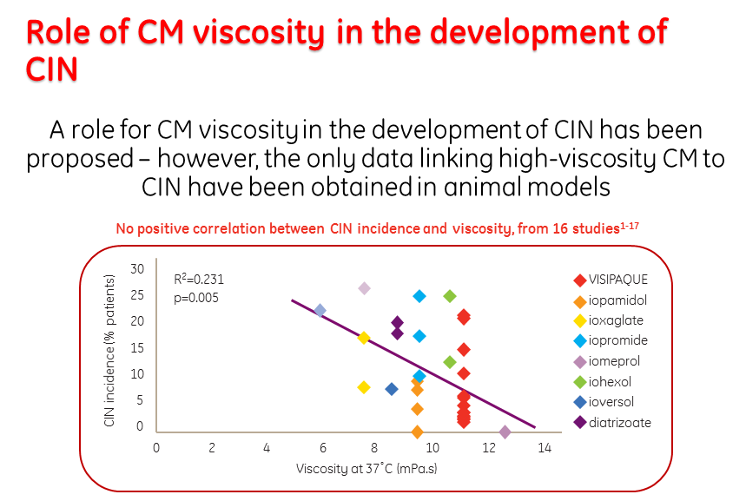

Slide 40
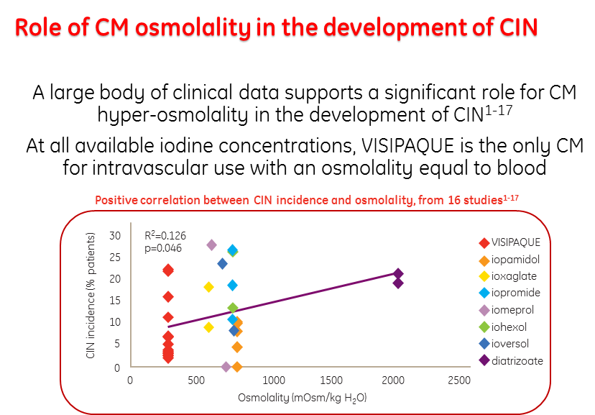

Slide 41
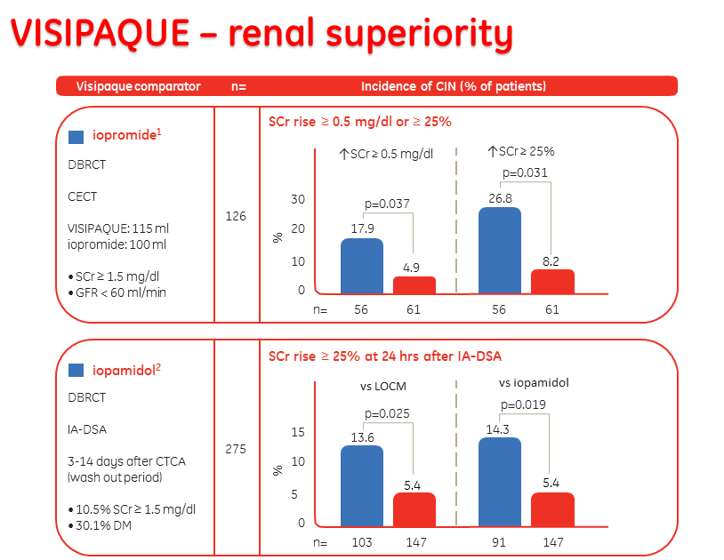

Slide 42
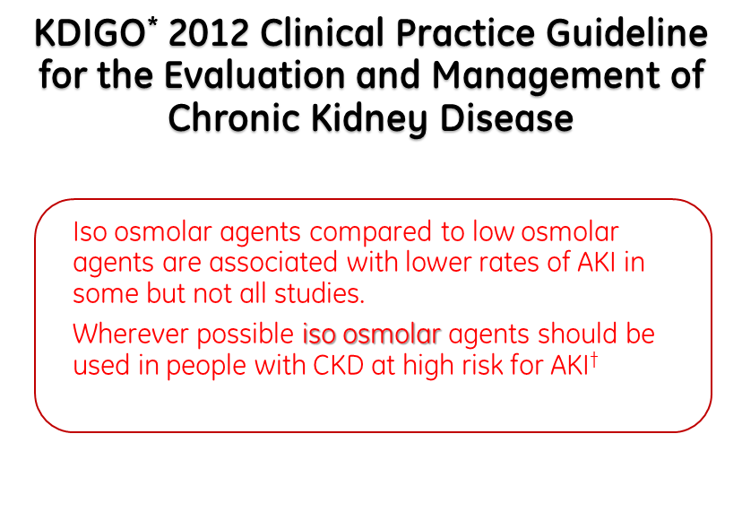

Slide 43
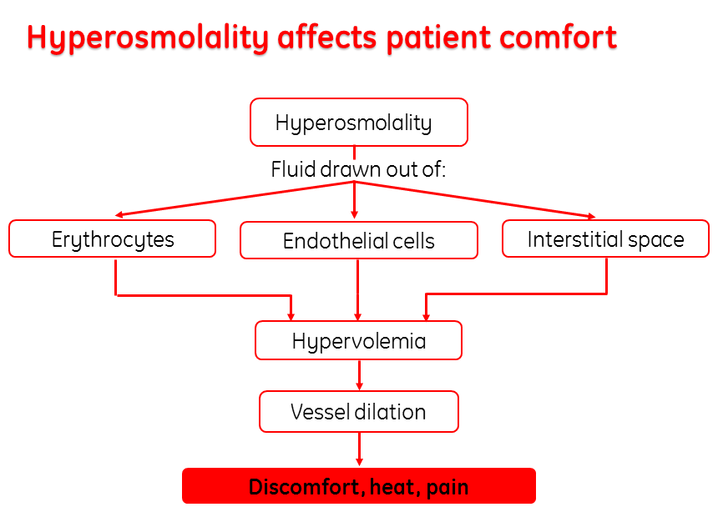

Slide 44
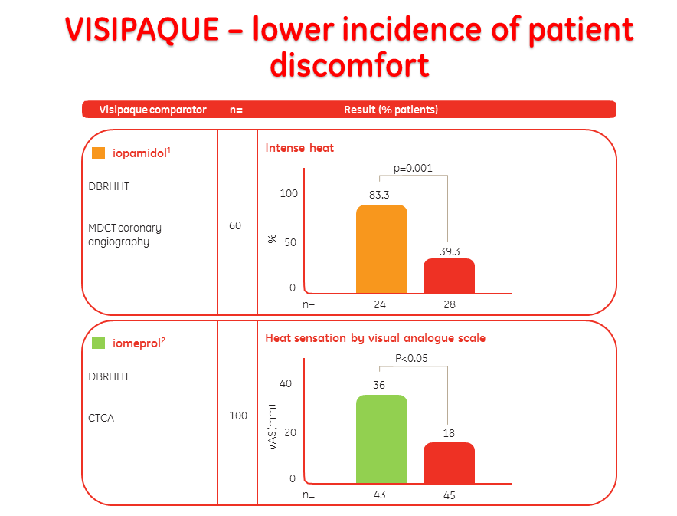

Slide 45
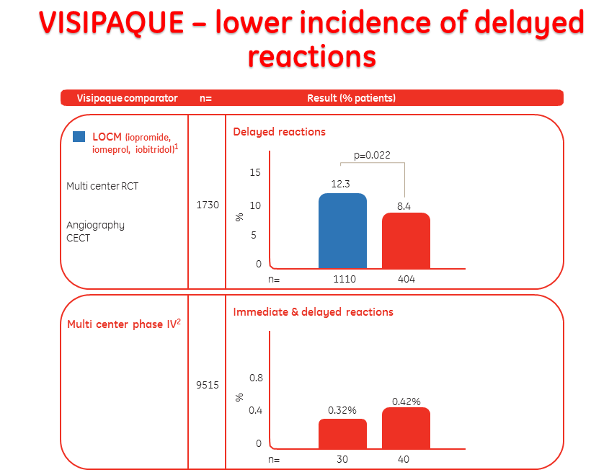

Slide 46
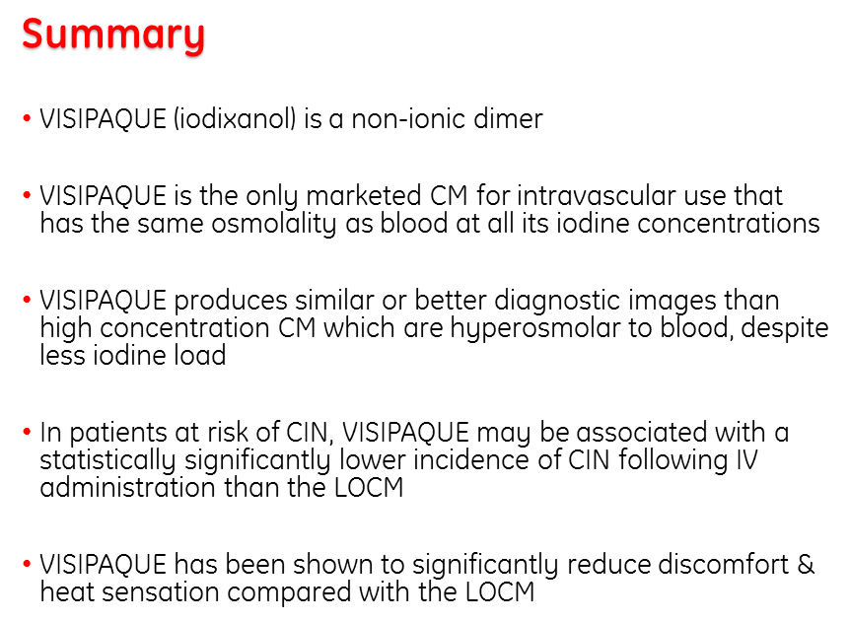

Slide 47
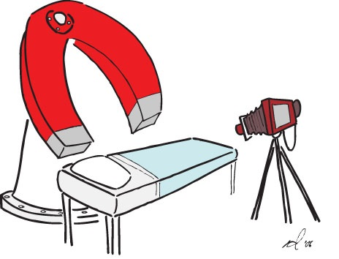
MR contrast agents
Magnetic resonance (MR) imaging contrast agents contain metal ions, which affect the MR signal properties of the surrounding tissues. They are used to enhance contrast, to characterize lesions and to evaluate perfusion and flow-related abnormalities. They can also provide functional and morphological information.

Slide 48
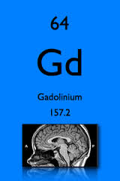
Gadolinium Based Contrast Agents (GBCA)
Gadolinium is a heavy metal, which in its free form is very toxic. Thus, gadolinium ion is bound to a ligand in a chelate to minimize its toxicity.
The ligands are either linear or cyclic, and may be ionic, which have a charge in solution, or non-ionic. Their osmolality varies between 600 and 2,000 mosmol/kg.
Unlike iodine based contrast agents, high osmolality gadolinium based agents do not cause more acute non renal adverse reactions and discomfort than low osmolality agents.

Slide 49
Available GBCA
Gadodiamide | Omniscan | Linear Non ionic | GE Healthcare | Vial 15ml 0.5mmol/ml
Gadobutrol | Gadovist | Cyclic Non ionic | Bayer Schering | Prefilled syringe 15ml 1mmol/ml
Gadopentetate | Magnevist | Linear Ionic | Bayer Schering | Vial 15ml 0.5mmol/ml
Gadoterate | Dotarem | Cyclic Ionic | Guerbet | Vial 15ml 0.5mmol/ml

Slide 50
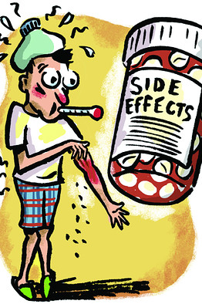
Adverse Reactions to GBCA
Gadolinium chelates are extremely well tolerated by the vast majority of patients in whom they are injected. Acute adverse reactions are encountered with a lower frequency than is observed after administration of iodinated contrast media.
GBC agents are generally well tolerated; adverse reactions occur in approximately 0.07% to 2.4% of cases. Minor reactions include coldness, warmth, or pain at the injection site, nausea, vomiting, headache, paresthesia, dizziness, itching, Rash, hives & urticaria.
Severe life-threatening reactions occur in about 0.001% to 0.01%.

Slide 51
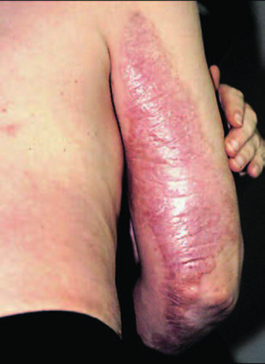
Nephrogenic Systemic Fibrosis (NSF)
Nephrogenic systemic fibrosis (NSF) is a fibrosing disease, primarily involving the skin and subcutaneous tissues but also known to involve other organs, such as the lungs, esophagus, heart, and skeletal muscles.
Initial symptoms typically include skin thickening and/or pruritis. Symptoms and signs may develop and progress rapidly, with some affected patients developing contractures and joint immobility. In some patients, the disease may be fatal.

Slide 52
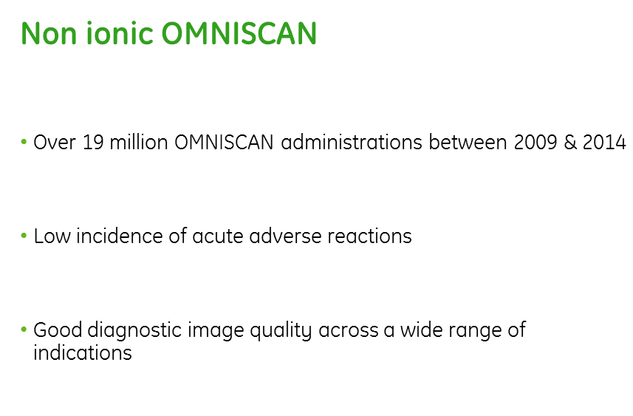

Slide 53
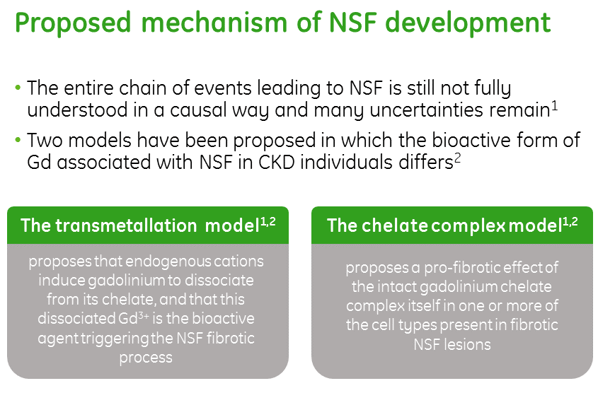

Slide 54
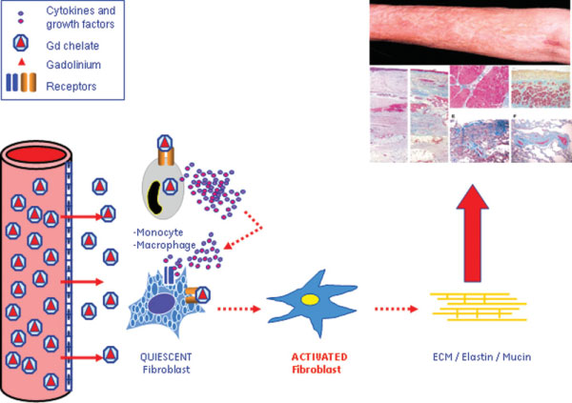
The Chelate-Complex Model

Slide 55
Other Signiﬁcant Factors In the Development of NSF
High-dose GBCA is associated with NSF.
Inﬂammatory burden is associated with NSF.
NSF skin induration, thickening, and tightening is colocalized to peripheral edematous regions.
Gd is usually, but not always, found in NSF patient biopsies.
Some countries have a relatively high incidence of NSF, while others using the same agent at standard doses have few reported cases.
Stability constants are more similar when the constant reﬂects a more physiological pH.

Slide 56
Evidence In Favor of Chelate-Complex Theory
Protracted retention of GBCA in renal insufﬁciency provides the conditions for enhanced exposure of tissues to GBCA.
High levels of GBCA in blood and extravascular tissue could trigger inﬂammatory and ﬁbrotic responses in susceptible patients.
GBCA interacting with cells may be internalized via receptor-driven phagocytosis in macrophages and receptor-mediated endocytosis in ﬁbroblastic cells.
The highly acidic environment inside lysosomes could provide the conditions for accumulation of GBCA and the resulting Gd in NSF patient tissue

Slide 57
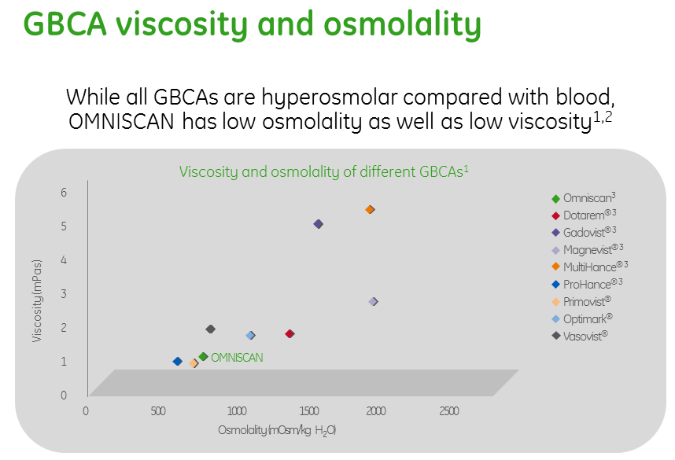

Slide 58
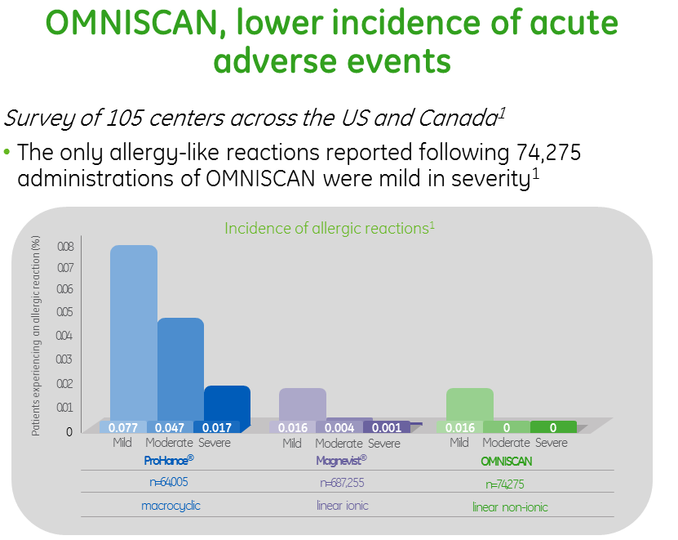

Slide 59
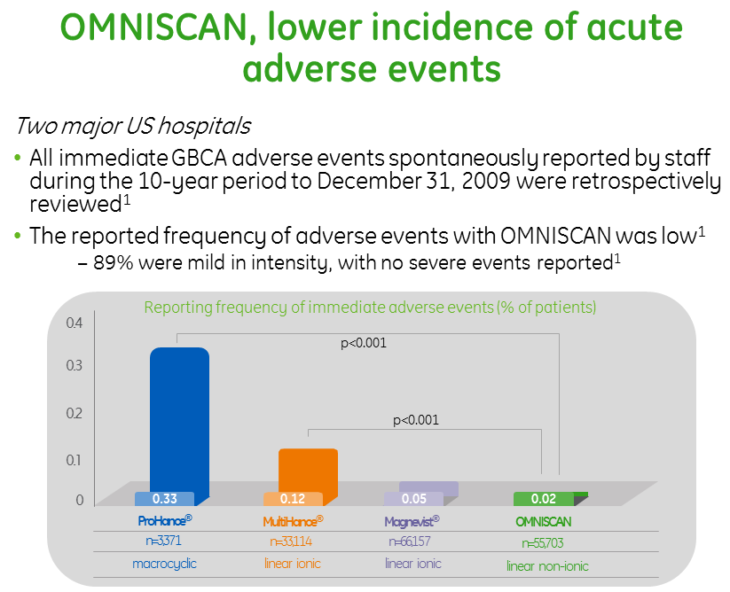

Slide 60
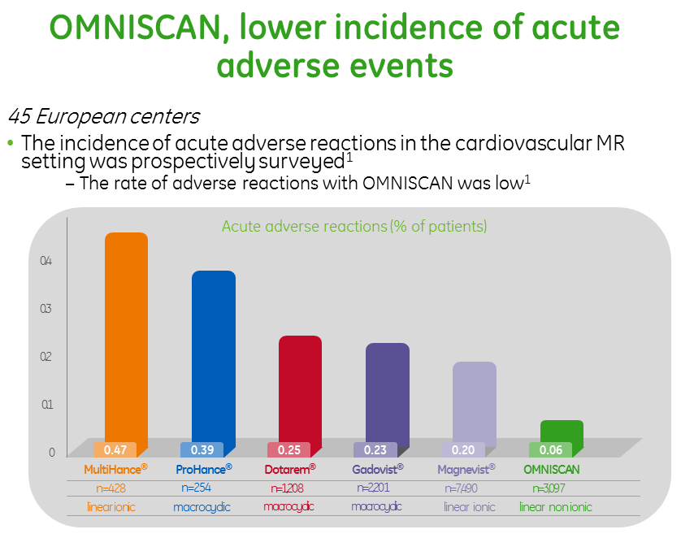

Slide 61
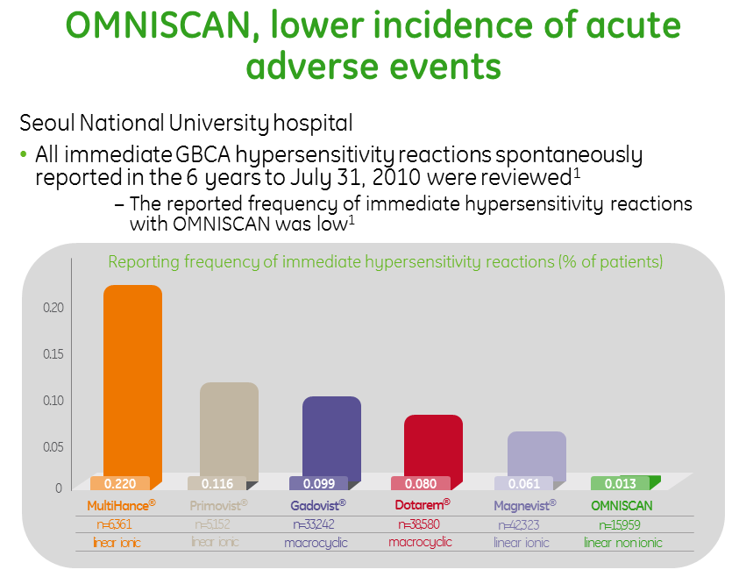

Slide 62
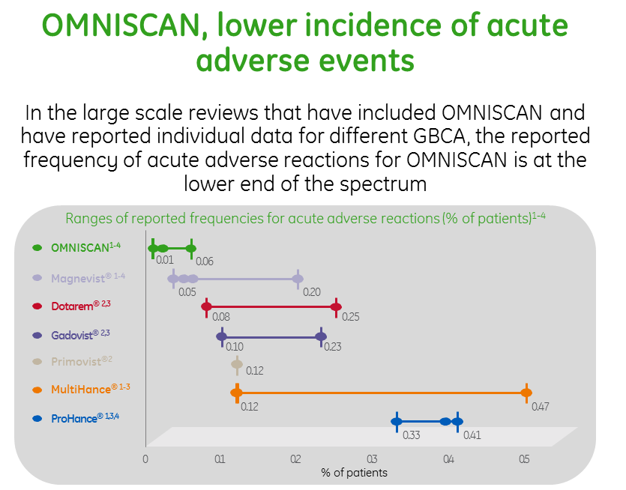

Slide 63
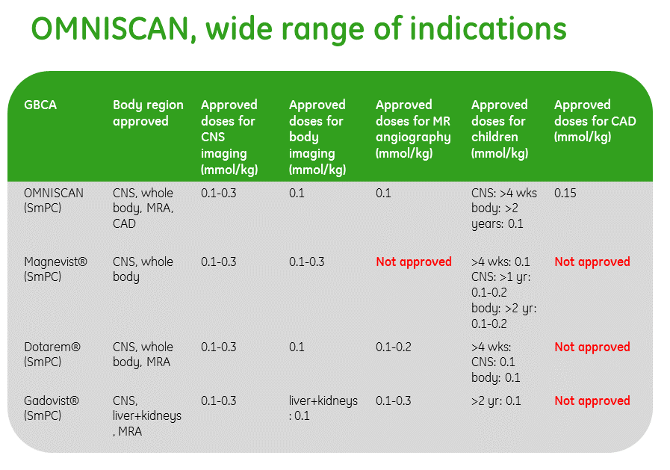

Slide 64

Dr. Shamim Jafari
Thanks For Your Attention

