Slide 1
Peripheral Sympathetic Blocks
Mehul P. Sekhadia, MD
DO b Antoun Nader, MD
b Honorio T. Benzon, MD

Slide 2
Dr Shetabi
Anesthesiologist
KUMS

Slide 3
Jonnesco ) 1920 ( cervicothoracic block followed by
Lawen for the differential diagnosis of abdominal pain.
Kappis used sympathetic blocks for the treatment of severe pain in visceral pain syndromes, including the blockade of the stellate ganglion.
Brunn and Mandl) 1924 (lumbar sympathetic blocks
They became popular )1950s( for the management of causalgia and reflex sympathetic dystrophies.

Slide 4
Sympathetic blocks can be used for:
Diagnostic :to determine if the pain is sympathetically mediated or not.
Prognostic:to determine if neurolysis or surgical sympathectomy could be beneficial
therapeutic purposes:(usually in a series with local anesthetics) are done to treat conditions such as:
complex regional pain syndromes (CRPSs)
phantom limb pain
post herpetic neuralgia
ischemic and cancer pain.
The role of therapeutic blocks are best utilized as part of a comprehensive functional restoration program

Slide 5
ANATOMY
STELLATE GANGLION BLOCK
INDICATIONS
Peripheral Sympathetic Blocks
TECHNIQUES
LUMBAR SYMPATHETIC BLOCKS
MONITORING
COMPLICATIONS:
blockade and neurolysis:
Stellate ganglion
Lumbar sympathetic

Slide 6
STELLATE GANGLION BLOCK
superior(c1-c4)
ANATOMY : middle(c5-c6)
The cervical sympathetic trunk contains three interconnected ganglia: inferior(stellate)
c7-c8-t1
STELLATE GANGLION cervicothoracic )80% of people( the lowest cervical ganglion .
is fused with the first thoracic ganglion
first thoracic ganglion )not connected(
The stellate ganglion is oval shaped and measures 2.5 cm long, 1 cm wide, and 0.5 cm thick

Slide 7
The cervical ganglia receive preganglionic fibers from:
the lateral gray column of the spinal cord cervical ganglia
the anterolateral horn of the spinal cord myelinated preganglionic
cell axons cervical ganglia

Slide 8
head and neck
T1-T5(mainly the upper three(
ascending in the sympathetic trunk to synapse in the cervical ganglia
preganglionic fibers supplying
upper limb
upper thoracic segment probably )T2–T6( ascend via the sympathetic trunk to synapse in the cervicothoracic ganglion
where postganglionic fibers pass to the brachial plexus

Slide 9
The white ramus(contains most of the preganglionic fibers) superior cervical ganglion postganglionic branches head and neck supply :
vasoconstrictor and sudomotor nerves to the face and neck,
secretory fibers to the salivary glands,
dilator pupillae, and
nonstriated muscle in the eyelid and orbitalis.
Blockade of white ramus leads to :(Horner’s syndrome)
ptosis
miosis
enophthalmos
loss of sweating of the face and neck

Slide 10
the cervical sympathetic chain may be in direct communication with several spaces including :
the space in front of the scalenus anterior muscle,
the brachial plexus,
spinal nerve roots,
the prevertebral portion of the vertebral artery
These communications may explain some of the side effects of stellate ganglion block.

Slide 11
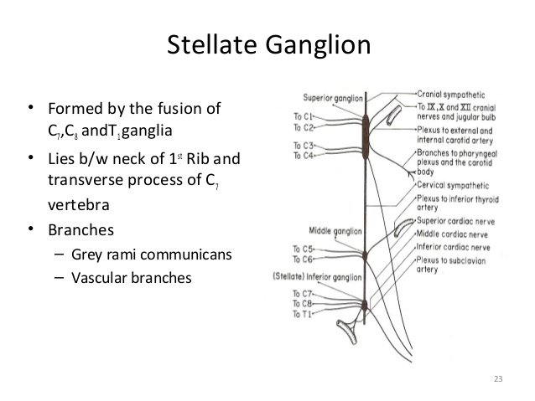

Slide 12
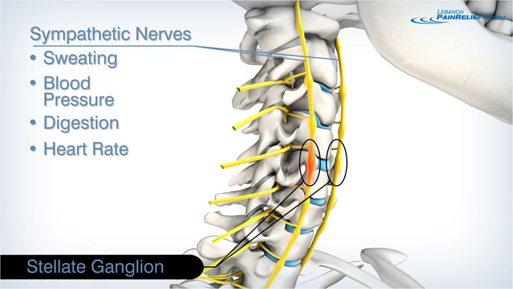

Slide 13
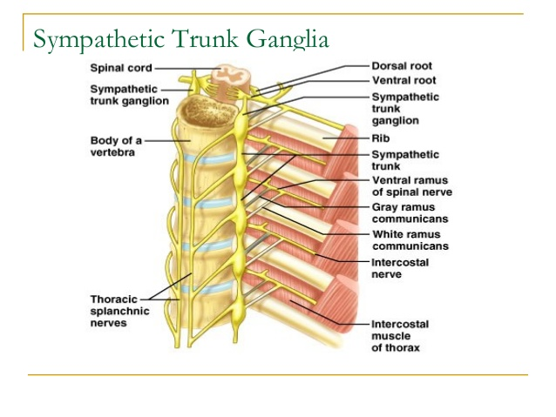

Slide 14
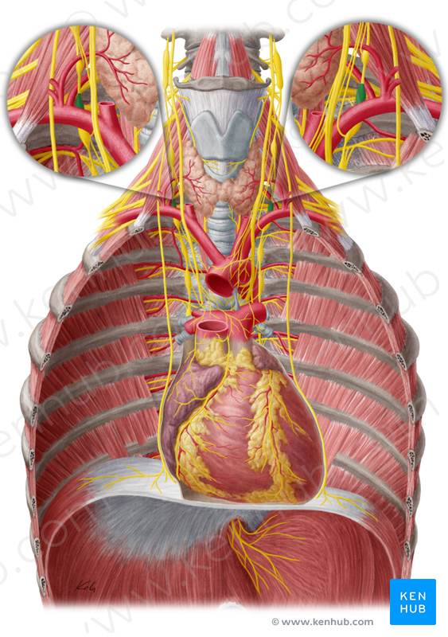
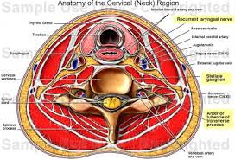

Slide 15
subclavian artery vertebral artery passes anterior to the ganglion at C7 enters the vertebral foramen, posterior to the anterior tubercle of C6 in 90% of cases
In the other 10% of cases, the artery may enter at C5 or higher
This may account for variable blockade and failed neurolysis in the presence of successful blockade.

Slide 16
STELLATE GANGLION BLOCK :
INDICATIONS

Slide 18
STELLATE GANGLION BLOCK : TECHNIQUES
Surface Landmark (Non–Image Guided) Technique :
Fluoroscopic Technique:
Ultrasound Approach:
CT guidance:

Slide 19
Surface Landmark (Non–Image Guided) Technique:
The blind technique relies on the use of landmarks (anatomy)
monitoring₊ IV access ₊ supine position with the neck slightly extended
The cricoid cartilage is palpated to find the C6 level and, more specifically, the transverse process (Chassaignac’s tubercle at C6 ).
In most individuals, the tubercle is located approximately 3 cm cephalad to the sternoclavicular joint at the medial border of the sternocleidomastoid muscle.

Slide 20
Between the SCM muscle and the trachea The carotid is retracted slightly laterally local anesthetic placement of needle (Quincke or pencil-point) perpendicularly in an anterior to posterior fashion until the needle contacts bone and then withdrawn 2 mm negative aspiration
0.5 to 1 ml of local anesthetic is injected slowly while the patient is awake and responsive to detect aberrant spread of the local anesthetic to surrounding structures.If negative 5 to 8 ml of 0.25% bupivacaine is injected incrementally with frequent aspiration the patient is monitored for a minimum of 30 min to assess response to the blockade

Slide 21
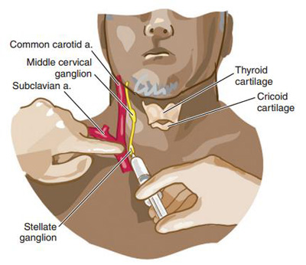

Slide 22
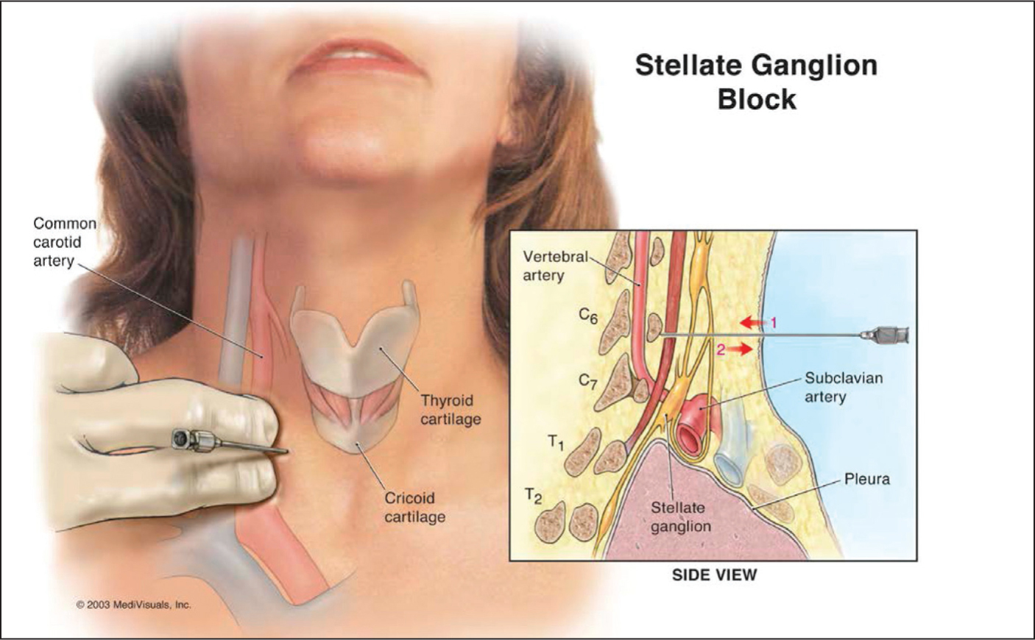

Slide 23
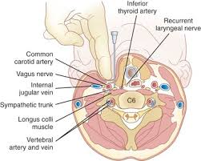

Slide 24
STELLATE GANGLION BLOCK :
Fluoroscopic Technique

Slide 25
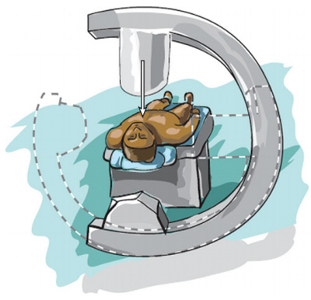
STELLATE GANGLION BLOCK
در تکنیک فلوروسکوپی بیمار به پشت دراز می‌کشد و دستگاه C-arm ناحیه مهره‌های ششم و هفتم گردنی را از نماهای قدامی- خلفی و جانبی نمایش می‌دهد

Slide 26
STELLATE GANGLION BLOCK (Fluoroscopic Technique) . advantages:
Eliminates pushing away vasculature and pressing on the potentially painful Chaissagnac’s tubercle
Minimizes the chance of intravascular injection
Minimizes esophageal perforation
Minimizes the chance of recurrent laryngeal nerve paralysis
Reduces the volume of local anesthetic
Easy to teach trainees

Slide 27
STELLATE GANGLION BLOCK Ultrasound Approach:
Ultrasound allows direct visualization of :
the thyroid gland
vertebral artery
Esophagus
pleura
nerve roots,
longus colli muscle, and
direct visualization of local anesthetic spread

Slide 28
Ultrasound Approach (A linear-array, 3- to 12-MHz frequency probe )
Anterior Approach(supine position) probe is placed transversely at the level of C6, just lateral to the trachea.
(Fluoroscopy may be utilized initially to identify the C6 level)
Posterior Approach (prone position)
normally utilized when there is a failure of achieving sympathetic blockade of the upper extremity or when the block is done as a precursor to percutaneous or surgical sympathectomy.
(usually fluoroscopy to obtain AP images of the T2 and T3 vertebrae)
but CT can be utilized).
The C-arm is then rotated obliquely until the transverse process is just over the vertebral body followed by cephalocaudal rotation until the first rib is squared off.
The target is then the midpoint of the T2 and/or the T3 vertebra

Slide 29
Appropriate sympathetic blockade was monitored and achieved based on:
presence of Horner’s syndrome
increased extremity temperature
without recurrent laryngeal nerve blockade

Slide 30
LUMBAR SYMPATHETIC BLOCKS: ANATOMY
The lumbar sympathetic chain :
consists of four to five paired ganglia ( lie along the anterolateral surface of the lumbar vertebral bodies )
contains pre- and post-ganglionic fibers pelvis and lower extremities
sympathetic ganglia were most frequently located at the inferior third of the L2 vertebra, L2–L3 disc space, and at the superior third of the L3 vertebra.

Slide 31
LUMBAR SYMPATHETIC BLOCKS
the best site for placement of the tip of the needle is the anterolateral surface of :
the lower third of L2 body or
at the upper third of the L3 body.

Slide 32
LUMBAR SYMPATHETIC BLOCKS: INDICATIONS
Any pain syndrome that includes a sympathetically mediated or atypical pattern maybe considered for diagnostic sympathetic block.

Slide 34
LUMBAR SYMPATHETIC BLOCKS: TECHNIQUES
Blind
Fluoroscopic Approach Paradiscal *
Transdiscal

Slide 35
LUMBAR SYMPATHETIC BLOCKS: TECHNIQUES
Sympathetic block was first done blindly by starting :
5 to 8 cm lateral to the spinous processes of L2–L4 transverse process walking anteriorly off of the vertebral body.
it is rarely used since image guidance allows for better placement and hopefully fewer complications.

Slide 36
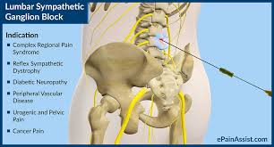

Slide 37
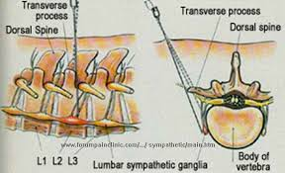

Slide 38
LUMBAR SYMPATHETIC BLOCKS Fluoroscopic Approach : (Paradiscal)
The paradiscal approach is probably the most common technique utilized
The patient is positioned prone.
The fluoroscope to identify the L2, L3, and L4 levels.
The target is :
Anterosuperior portion of L3 or
Anteroinferior portion of L2 .

Slide 40
LUMBAR SYMPATHETIC BLOCKS: TECHNIQUES
Fluoroscopic Approach (TRANSDISCAL )
The benefits of this technique include:
decreased incidence of genitofemoral neuritis,
decreased incidence of injuring lumbar arteries,
closer proximity to the ganglia,
decreased scarring of the paravertebral muscles ( repeated neurolysis),
.

Slide 41
NEUROLYSIS
Percutaneous neurolysis has been performed successfully for both the stellate ganglion and the lumbar sympathetics.
The two options for neurolysis are :
radiofrequency (RF) (pulsed and thermal) allow for more controlled lesions
chemical (phenol and alcohol) allow for larger lesions (are dependent on the volume of agent injected)
Both techniques have been utilized when :
the effect of local anesthetic is confirmed but relief is unsustained.

Slide 42
CHEMICAL NEUROLYSIS :
At the stellate or lumbar levels,
2 to 3 ml of phenol (3%–6%) or alcohol (50%–100%) is injected to minimize spread to adjacent structures.
Phenol is usually the agent of choice because of a decrease in incidence of neuritis post procedure.
The usual concentration of phenol is 6%,

Slide 43
Neurolysis at the stellate level (for upper extremity problems ):
anterior approach at C6 or C7,
posterior approach at T2 or T3
A test dose of local anesthetic should be injected prior to a chemical neurolysis to ensure a negative motor and sensory block prior to the injection of the neurolytic agent.
For larger lesions at this level, multiple needles should be placed with the same amount of volume injected at each needle and appropriate contrast studies prior to injection of the neurolytic agent.

Slide 44
Neurolysis at the lumbar level:
multiple needles (Most authors advocate )
one needle up to 15 ml of agent is injected
(with the same efficacy and safety profile as smaller volumes through multiple needles)

Slide 45
RADIOFREQUENCY LESIONING
Radiofrequency lesioning is a more controlled method of neurolysis as the only areas lesioned are at the tip of the needle.
Options include a:
nondestructive pulsed lesion or
destructive thermal lesion(more conventional)
The RF needle can be electrically stimulated prior to lesioning, this helps to avoid lesioning of unwanted surrounding structures such as the recurrent laryngeal nerve or genitofemoral nerve.

Slide 46
RF lesion of the stellate ganglion.(with fluoroscopic guidance )
Anterior approach at C6 or C7
Posterior approach at T2 and/or T3

Slide 47
RADIOFREQUENCY LESIONING At the lumbar level
the needles can be placed at the :
inferior third of L2,
superior or middle third of L3, or
middle third of L4.
Multiple needles should be placed to obtain the best neurolysis.

Slide 48
COMPLICATIONS
Stellate ganglion blockade and neurolysis:
Bleeding/hematoma
Pneumothorax, hemothorax
Vertebral artery injury or
inadvertent injection into neuraxis
Esophageal trauma
Tracheal trauma
Phrenic nerve injury
Brachial plexus injury
Recurrent laryngeal nerve injury
Neuritis—any nerve or plexus listed above
Post sympathectomy syndrome

Slide 49
COMPLICATIONS Lumbar sympathetic blockade and neurolysis:
Bleeding
Infection
Intra vascular injection
Intra lymphatic injection
Subarachnoid injection
Discitis (transdiscal approach)
Back pain
Spinal nerve injury
Genitofemoral nerve injury (L4 and L5 levels and too posterior and lateral placement)
Lumbar plexus injury
Neuritis
Horner’s syndrome and brachial paresis

Slide 50
MONITORING ADEQUACY OF SYMPATHETIC BLOCKADE
Successful stellate ganglion block denervates the upper cervical segments Horner’s syndrome includes :
ptosis, miosis, and anhidrosis.
Other signs include unilateral nasal stuffiness (Guttman’s sign) and warmth of the face.
The presence of Horner’s syndrome signifies cephalic sympathetic blockade and does not imply sympathetic denervation of the arm.

Slide 51
If stellate ganglion block is used to treat the shoulder or upper limb, additional signs are needed to determine sympathetic blockade in the area.
Complete block is reliably detected when:
a test of adrenergic fiber activity is combined with
(thermography, plethysmography, laser Doppler flowmetry)
a test of sympathetic cholinergic (sudomotor) fiber activity:
(sweat test, sympathogalvanic response).

Slide 52
Increase in skin temperature is the most commonly used clinical sign of sympathetic blockade. (*different increases in skin temp)
greater increases are noted in patients with lower preblock temperatures
the ipsilateral temperature increase should exceed that of the contralateral side to indicate successful sympathetic blockade(Hogan et al)

Slide 53
Patients whose baseline skin temperatures are low because of vasoconstriction (those with late-stage CRPS) will have large increases after complete sympathetic blockade.
A patient who has vasodilatation of the involved extremity (a person with early-stage CRPS), cannot be expected to have a large temperature increase

Slide 54
successful sympathetic block increase in the skin blood flow determined by :
Laser Doppler flowmetry( a 50% or greater signify successful )
Plethysmographic(such as venousocclusion ple) significant increase in the pulse wave marked increase of the upward slope
volume plethysmography

Slide 55
Abolition of sweating and of the sympathogalvanic response (SGR) are among the standard tests of complete sympathetic blockade.
sweat tests:
starch iodine test(older test) is messy and cumbersome
the cobalt blue and the ninhydrin sweat tests(newer test) are easier to perform.
(Unfortunately, the cobalt blue and ninhydrin sweat tests are not available commercially)

Slide 56
sympathetic block
Partial sympathetic block reduces the SGR
complete sympathetic block abolishes the SGR.
The two sweat tests are more reliable than the SGR in predicting complete sympathetic blockade.
Since these tests are rarely used clinically:
temperature increases to 35° or 36° C can be considered as signifying complete sympathetic blockade.

Slide 57
Relief of pain :
complete pain relief:
does not imply complete sympathetic blockade (patients with chronic pain may exhibit complete pain relief after partial sympathetic blockade.)
Partial pain relief:
signifies one of two things:
the patient’s pain may be due to causes other than sympathetic-mediated pain (e.g., combined somatic sensory- and sympathetic-mediated pain or combined sympathetic-mediated and central pain)
or the sympathetic blockade may be partial.

Slide 58
KEY POINTS
The stellate ganglion is located just anterior or lateral to the longus colli muscle between the base of the seventh cervical transverse process and the neck of the first rib.
The appearance of Horner’s syndrome does not signify sympathetic blockade of the upper extremity.
The evidence for the efficacy of stellate ganglion blocks is based mostly on case reports.
The risks of potential complications with stellate ganglion blocks are rare, but real, and may be decreased by the use of image guidance.
Lumbar sympathetic blocks are best performed at the inferior third of L2, L2–L3 intervertebral disc level, or superior third of L3.
There is evidence that lumbar sympathetic blocks are efficacious for decreasing allodynia to brush and temporal summation to pinprick in complex regional pain syndromes in the pediatric patient.
Neurolysis of the sympathetic ganglia can be performed with chemical or RF ablation. Proper needle placement, sensory, and motor testing should be done before RF procedures.
Abolition of sweating and SGR are the standard tests of complete sympathetic blockade.

