Slide 2
Spinal Cord Stimulation
دکتر مهرداد نوروزی
دانشیار بیهوشی و فلوشیپ درد دانشگاه علوم پزشکی کرمان

Slide 3
Spinal cord stimulation (SCS) describes the use of pulsed electrical energy near the spinal cord to control pain.
This technique was first applied in the intrathecal space and finally in the epidural space as described by Shealy in 1967.
Sometimes called dorsal column stimulation.

Slide 4
MECHANISM OF ACTION
Neurostimulation began shortly after Melzack and Wall proposed the gate control theory in 1965.
This theory proposed that nonpainful stimulation of large myelinated Ab fibers could impede painful stimuli carried by C-fibers and lightly myelinated Ad fibers.
As an application of the gate control theory, Shealy implanted the first spinal cord stimulator device for the treatment of chronic pain.

Slide 5
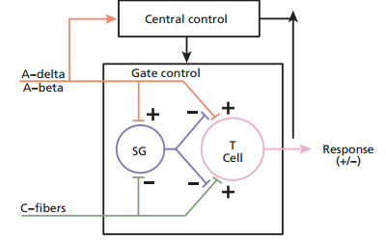

Slide 6
Recent research has given us insight into effects occurring at the local and supraspinal levels, and through dorsal horn interneuron and neurochemical mechanisms.
Specifically, there is some evidence for increased levels of gamma-aminobutyric acid (GABA) and serotonin, and perhaps suppression of levels of some excitatory amino acids including glutamate and aspartate.
In the case of ischemic pain, analgesia seems to be obtained through restoration of a favorable oxygen supply and demand balance—perhaps through a favorable alteration of sympathetic tone.

Slide 7
TECHNICAL CONSIDERATIONS
SCS is a technically challenging interventional/surgical pain medicine technique.
It involves the placement of an electrode array (leads) in the epidural space, a trial period, anchoring the lead(s),
positioning and implantation of the pulse generator , and the tunneling and connection of the wires.

Slide 8
A spinal cord stimulator system is made up of three parts:
(1) electrodes or leads .
(2) IPGs or the battery.
(3) the charging and programming systems.

Slide 9
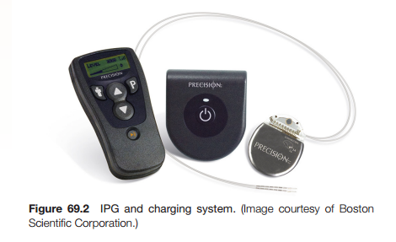

Slide 10
Electrodes are of two types: percutaneous versus paddle.
The paddle leads are flat and wide with insulation on one side and electrical pads on the other.
This has the advantage of directing the current in one direction. Paddle leads must be placed via laminotomy or laminectomy.
Percutaneous leads are cylindrical catheters placed via a needle. Contacts are cylindrical and generate a less eficient electric field circumferentially around the catheter.

Slide 11
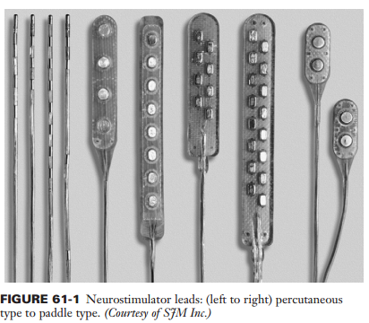

Slide 12
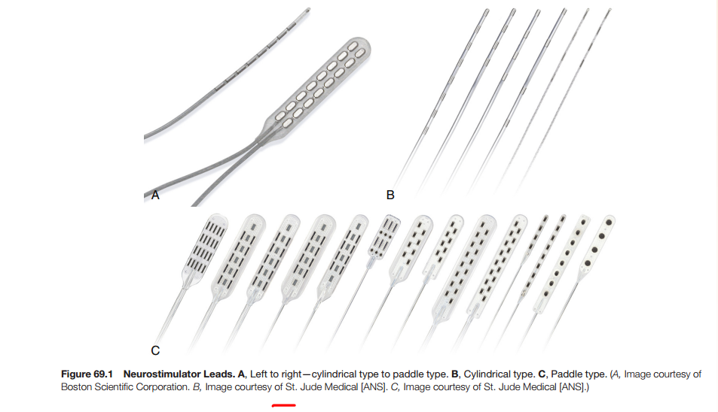

Slide 13
Electrodes are connected to an implanted pulse generator (IPG) .

Slide 14
All three manufacturers offer rechargeable IPG systems with two significant advantages over the previous IPG devices:
the patient may use higher voltage settings without worry of prompt battery depletion, allowing more flexibility in programming, and
the promise of a much longer interval until replacement is required, perhaps 10 years or more.
The unit is recharged via an external recharger every
7 to 14 days as needed.

Slide 15
The IPG is generally implanted in the flank, occasionally in the posterior superior gluteal area or rarely the lower abdominal area or pectoral region.
It should be in a location the patient can access with the dominant hand for adjustment of the settings with the patient-held remote control unit.
If the patient’s pain pattern requires the use of many anode or cathode settings with high power requirements during the trial, consider a rechargeable, higher-capacity unit.

Slide 16
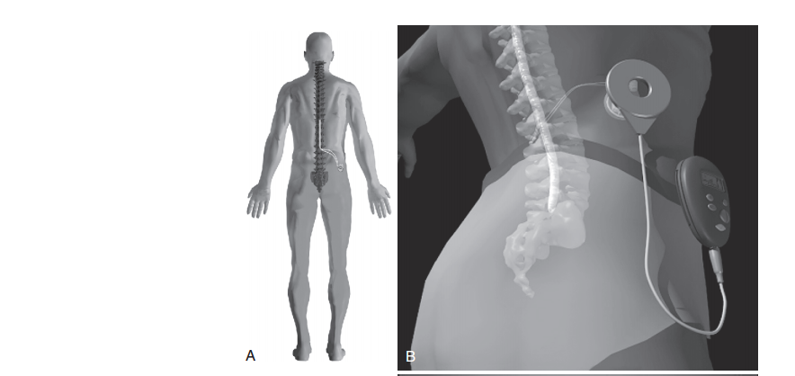

Slide 17
Under fluoroscopy and sterile conditions, a lead is introduced into the epidural space with a standard epidural needle or curved epidural needle.
To facilitate threading of the lead cephalad in the dorsal midline region, it is imperative to have the needle at a shallow angle (often less than 45 degrees). It is essential to avoid perpendicular or near perpendicular needle placement into the epidural space (unless using a curved needle) because of the consequent 75- to 90-degree bend then required to introduce the stimulator lead.
The lead is directed under fluoroscopic imaging into the posterior or dorsal paramedian epidural space up to the desired anatomic location— generally the low thoracic cord region (commonly T8 to T10) to obtain paresthetic coverage of the lower extremities or the midcervical level to obtain coverage of the upper extremities (i.e., the lead is moved cephalad and caudad in the epidural space until the pattern of resulting electrical stimulation overlies the painful region;

Slide 18
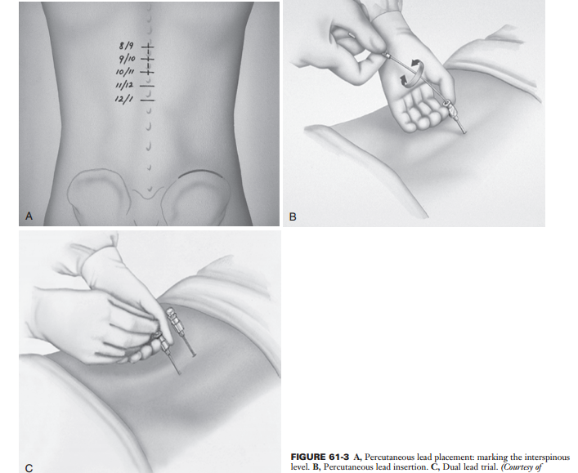

Slide 19
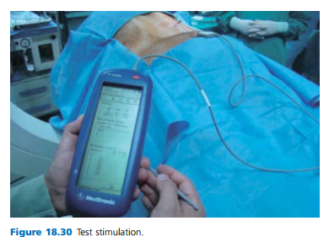

Slide 20
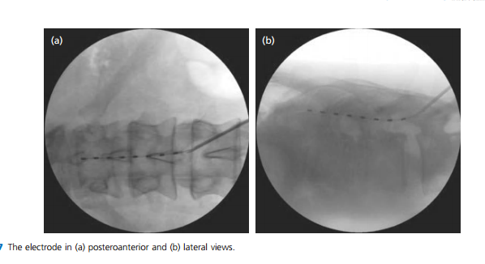

Slide 21
Typically, good stimulation can be achieved using the following upper cervical placements for specific nerve involvement:
C1–C3, facial pain; C2–C3, upper neck; C4–C5, radial nerve; just below C5, median nerve; C6–C7, ulnar nerve.
A percutaneous lead with a broad area of coverage can provide good stimulation for these areas with four- or eight-contact electrodes.
When pain is bilateral, the lead can be placed at the midline, or two separate electrode arrays (placed bilaterally on the spinal cord) can be used.
The point entry for lower extremity pain is the L1–T12 level.

Slide 22
In the case of leg pain, the usual electrode position is TH10–12 .
In thoracic pain (such as postherpetic neuralgia), the electrode position depends on the level of the pathology,
in brachial pain, final electrode position is at level C3–C6.

Slide 23
Technique(s) The intervention takes place under strictly sterile conditions and antibiotic prophylaxis, eg, 1,000 mg of a cephalosporin intravenously. The patient is placed in a prone position on an operating table suitable for X - ray screening. The T8 – T9 vertebral level is identified by means of a C - arm.
A Tuohy needle is inserted under X - ray guidance to find the epidural space, and a four - contact or eight - contact electrode array is placed with its cephalad tip at the T2 – T3 level left of midline. Subsequently, test stimulations are performed; the test stimulations should overlap the areas that are painful during angina attacks. The electrode is normally located in the T1 – T4 area.

Slide 24
A careful trial period of 5 to 7 days is advocated to decrease the risk of a failed implant.
Patients are encouraged to pursue normal activities with the exception of aggressive bending or twisting to prevent lead migration.

Slide 25
When the patient returns for implant, a new lead is placed in the location of the trial lead and connected to an implanted IPG.
Alternatively, trial leads can also be implanted with tunneled extensions exiting the skin such that, during permanent implantation, only the extensions are discarded and the original trial leads can be used to connect to the generator.

Slide 26
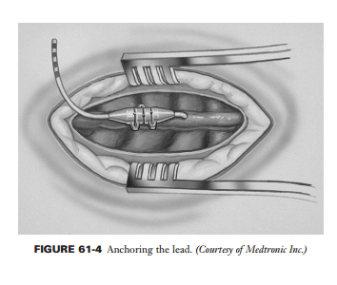

Slide 27
This method has the advantage of retaining the same lead position in a successful trial .
In both cases, perioperative antibiotic use is controversial but common.

Slide 28
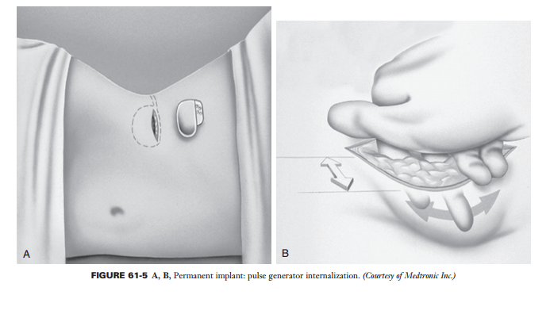

Slide 29
Most consider 50% or more pain relief to be indicative of a successful trial .
Although the ultimate decision also should include other factors such as activity level and medication intake.

Slide 30
OUTCOMES The most common use for SCS in the United States is failed back surgery syndrome (FBSS), whereas in Europe, peripheral ischemia is the predominant indication.
There have been prospective randomized controlled trials (RCTs) examining SCS therapy in FBSS, CRPS, angina, and peripheral vascular disease (PVD) meeting Class II evidence requirements.

Slide 31
PATIENT SELECTION
Appropriate patients : 1-neuropathic pain syndromes
2- the patient has failed conservative therapy
3- significant psychological issues have been ruled out, and 4- a trial has demonstrated pain relief.
Pure neuropathic pain syndromes are relatively less common than the mixed nociceptive/neuropathic disorders including failed back surgery syndrome (FBSS).
In addition, many patients with chronic pain will have some depressive symptomatology, and psychological screening can be extremely helpful to avoid implanting patients with major
psychological disorders.

Slide 32
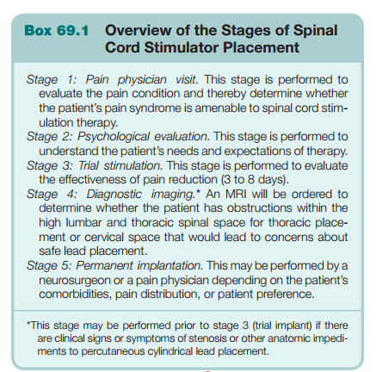

Slide 33
IMAGING
(MRI) or (CT) to determine patency and sufficiency of the high lumbar and low to mid thoracic epidural space should be used to evaluate patients progressing forward to the implantation phase of the thoracic SCS.
Ruling out moderate to severe stenosis increases the safety of the procedure. This evaluation may also guide the pain physician’s decision to refer the patient to a surgeon for implantation—for instance, if a surgical decompression is needed prior to implantation of the lead system.
Cases of mild (nonoperative) spinal stenosis at the target levels could lead the physician to choose a smaller cylindrical lead rather than the paddle-type leads.

Slide 34
Indications • Radicular neuropathic pain. • Failed back surgery syndrome.
• Ischemic pain due to peripheral vascular disease. • Complex regional pain syndromes type I, type II. • Phantom pain. • Postherpetic neuralgia. • Deafferentation pain. • Angina pectoris. • Multiple sclerosis. Contraindications • Systemic or local infection. • Coagulopathy. • Anomalies of spinal canal. • Spina bifida. • Drug dependence, with behavioral abnormalities. • Psychopathologies.

Slide 35
COMPLICATIONS
Overall complication rates from spinal cord stimulation range from 28% to 42%. In a recent systemic review, the most common complication was found to be lead migration or breakage, which occurred in 22% of implanted .

Slide 36
Complications Early complications: • Bleeding. Bleeding at the surgery site. Bleeding at the subcutaneous tunnel. Epidural hematoma. • Nerve injury, spinal cord injury. • Inadvertent dural puncture, postdural puncture headache. • Early infection: infection at the epidural space, epidural abscess, meningitis, discitis. • Edema and seroma formation at the generator site. Late complications: • Epidural fibrosis. • Spinal stenosis due to the narrowing of the spinal canal. • Infection at the generator pocket or around the leads at the paraspinous region. • Skin necrosis around the generator or leads.

Slide 37
PROGRAMMING
There are four basic parameters in neurostimulation, which may be adjusted to create stimulation paresthesias in the painful areas thereby mitigating the patient’s pain .
They are amplitude, pulse width, rate, and electrode selection.

Slide 38
Amplitude is the intensity or strength of each
pulse and can be controlled by voltage (V) or current.

Slide 39
Pulse width is the duration of a pulse measured in microseconds (msec).
It is usually set between 100 and 400 msec. Similar to increasing the amplitude, a larger pulse width delivers more energy per pulse and typically broader coverage.

Slide 40
Rate is measured in hertz (Hz) or cycles per second, between 20 and 120 Hz.
At lower rates, the patient may feel myoclonic vibrations, whereas at higher frequencies, the feeling is more of a buzzing sensation.
Very high frequencies (500 Hz) are suggested to increase blood flow and decrease vascular resistance.

Slide 41
Most patients’ stimulators are programmed with electrode selection changes until the patient obtains anatomic coverage,
then the pulse width and rate are adjusted for maximal comfort.
The patient is left with full control to (1) turn the stimulator on and off, (2) choose between numerous programs in the device (which have different effects), and (3) adjust the intensity of stimulation up and down for comfort.

Slide 42
The lowest acceptable settings on all parameters are generally used to conserve battery life.
Other programming modes that save battery life include a cycling mode during which the stimulator cycles full on/off at patientdetermined intervals (minutes, seconds, or hours).
The patients’ programming may change over time and reprogramming needs are common.
Many busy pain practices designate a stimulator nurse to handle patient reprogramming needs

Slide 43
COST EFFECTIVENESS
Kumar prospectively followed 104 patients with FBSS. Of the 104 patients, 60 were implanted with an SCS using a standard selection criterion.
Both groups were monitored over a period of 5 years.
The stimulation group’s annual cost was $29,000 versus $38,000 in the control group.
The authors found 15% of subjects returned to work in the stimulation group versus 0% in the control group.
The higher costs in the nonstimulator group were in the categories of medications, emergency center visits, radiographs, and ongoing physician visits.

Slide 44
PERIPHERAL, CORTICAL, AND DEEP BRAIN STIMULATION
Neurostimulation can successfully be used at other locations in the peripheral and central nervous systems to provide analgesia .
Motor cortex and deep brain stimulation are techniques that have been explored to treat highly refractory neuropathic pain syndromes including central pain, deafferentation syndromes, trigeminal neuralgia, and others . Deep brain stimulation has become a widely used technique for movement disorders, and much less so for painful indications.

Slide 45
Peripheral Nerve Stimulation

Slide 46
Recent technical advances have led to growth in PNS for a wide variety of chronic pain disorders such as, limb mononeuropathies, complex regional pain syndrome, cranial neuralgias, headache disorders .
This will focus on PNS for neuropathic pain in the limbs through stimulation of large peripheral nerves.

Slide 47
HISTORY AND PATHOPHYSIOLOGY Wall and Sweet used percutaneous stimulation to treat chronic neuropathic pain in subjects and correlated these findings to the gate theory of pain.
Theories include direct effects on peripheral pain fibers, selective release of pain-modulating neurotransmitters, and changes in cerebral flow in pain centers.

Slide 48
TECHNICAL CONSIDERATIONS
A key factor that has likely caused resurgence in interest among pain physicians in PNS is the increase in using ultrasound (US) as an image-guidance technique for procedures .
Recent anatomic feasibility studies suggested one could place conventional spinal cord stimulator electrodes very near target nerves with US in both the upper and lower extremities without significant risk of mechanical neural injury.

Slide 49
The key nerves of interest are usually superficial enough to be seen well under US.
For implantation cases, the lead can be anchored to the superficial muscle fascia.
The nerve will normally translate within the neurovascular compartment as much as several millimeters. This means that a normal nerve may move up to several millimeters between the muscle and surrounding fascia with flexion, extension, and rotation of the extremity.
Thus, redundancy of the number of lead contacts in the vicinity of the desired fascicle is important.
Consider placement of more than one percutaneous electrode .

Slide 50
ANATOMY
RADIAL NERVE
The radial nerve is very close to the lateral surface of the humerus, at a point 10 to 14 cm proximal to the lateral epicondyle. Ultrasound scanning usually begins at the elbow and, with the probe in a transverse orientation to the arm, continues proximally until the desired approach is identified .
The needle can be advanced from posterolateral to anteromedial to lie between nerve and humerus.
Early problems with lead migration were most prominently noted in the case series with radial nerve placements. Subsequent radial nerve placements have utilized more than one electrode, and a 4-week period of soft arm immobilization to allow the electrode(s) to better fibrose into place.

Slide 51
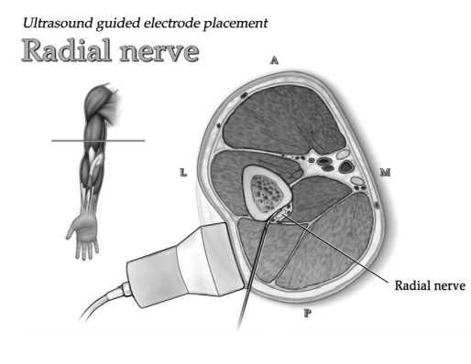

Slide 52
KEY POINTS Peripheral nerve stimulation systems can be trialed prior to permanent implantation with an ultrasoundguided placement.
The long-term safety of permanent implants of percutaneous electrodes is not yet known with certainty. When programming the peripheral nerve stimulator system, the lowest frequencies, durations, and amplitudes of stimulation are likely to be safer.
A thorough knowledge of cross-sectional anatomy is desirable to avoid injury to surrounding structures.
Adaptation of percutaneous spinal cord stimulation electrodes to PNS is undesirable as a long-term strategy, and necessitates the development of novel technologies.

Slide 53
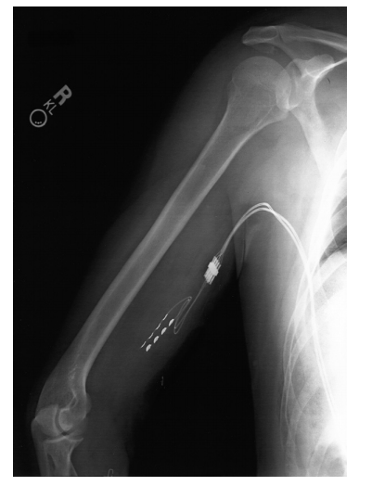

Slide 54
Combined Spinal Cord Stimulation and Peripheral Nerve Stimulation for Brachial Plexopathy

Slide 55
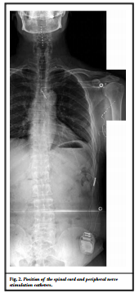

Slide 56
Recently, combined SCS and PNS have been tried for various conditions, such as post herniorrhaphy pain and failed back surgery syndrome, because of their different mechanisms of action.

Slide 57
Magnetic resonance imaging safety recommendations vary between the models. Certain systems allow for MRI of the brain to be performed, and only one system allows for MRI of the body to be performed, both under strict labeling conditions. Before an MRI is performed, it is imperative to ascertain that the system is intact, without any lead breaks or low impedances, as these can result in heating of the spinal cord stimulation (SCS) and injury to the patient.
Monopolar electrocautery is generally not recommended for patients with SCS; however, in some circumstances, it is used when deemed required by the surgeon. When cautery is necessary, bipolar electrocautery is recommended. Modern electrocautery units are to be used with caution as there remains a risk of thermal injury to the tissue in contact with the SCS. As with MRI, electrocautery usage in patients with SCS systems with suspected breaks or abnormal impedances is unsafe and may cause injury to the patient

Slide 58
Mode of anesthesia for delivery included 4 neuraxial anesthetics, with 3 successfully obtaining an adequate level of anesthesia for delivery.
Four general anesthetics were administered for cesarean delivery, one of which included a failed attempt at neuraxial anesthesia.

Slide 59
It has become apparent that about 17%–20% of the patients have a negative trial result and do not proceed to IPG implantation, even when the test electrode has the optimal position and the paraesthesia coverage of the painful region is complete.
Moreover, SCS effects diminish over time after IPG implantation in some patients.
The extent of decrease of SCS effect over time is reported variously in the literature. Some studies state that the effect has decreased 25%–50% after 2 years, but others only see a slight loss of efficacy over time.

Slide 60
Although in the 1970s about 40% of the patients
achieved pain relief of more than 50%, this percentage in recent studies is more than 70%.
Proper patient selection and meticulous preoperative diagnostics, including psychological assessment, are crucial for the success of the method.

Slide 61
Position-adaptive SCS The intensity of the SCS-induced paresthesia is dependent on body position. Under equal technical settings of the stimulator, the paresthesia is perceived more intensely in the supine position than in an upright position.
Therefore, up to now, patients had to correct changes in stimulation intensity (ie, while standing up) by means of a handheld programming device.
This position dependency of the stimulation is not caused by a dislocation of the electrode. In fact, it is based on the variable thickness of the cerebrospinal fluid layer around the spinal cord.

Slide 62
The success rate in patients who received their SCS
system within the first 2 years of their pain syndrome
was 85%, whereas the success rate was 9% in patients
with a more than 15-year history of chronic pain.

Slide 63
Peripheral nerve field stimulation (PNFS) is a different method.
Here the electrode is placed subcutaneously, with no direct relation to a particular peripheral nerve.
One of the first applications of this method was occipital nerve stimulation (ONS) for chronic migraine or chronic cluster headache.

Slide 64
Current evidence is insufficient to establish the role of
SCS in treating refractory cancer-related pain.

