Slide 2
Provocation Diskography
دکتر مهرداد نوروزی
دانشیار بیهوشی و فلوشیپ درد دانشگاه علوم پزشکی کرمان

Slide 3
The diagnostic procedure often referred to as diskography in actuality consists of two separate and distinct components.
The first part, diskography (i.e., a picture of the intervertebral disk), involves the injection of contrast medium into the nucleus pulposus of the intervertebral disk to study its internal morphology.
This is a static test in which contrast is injected and radiographic images, fluoroscopic and computed tomography (CT), are obtained and evaluated.
The second dynamic element of the procedure, the disk stimulation aspect, distention of the nucleus pulposus by the pressure produced by the injectate to determine whether a specific disk is involved in generating the patient's pain symptoms.

Slide 4
Axial pain of the low back or neck is often confused with radiculopathy or radicular pain.
By definition, radiculopathy is a neurologic condition in which a conduction block of the motor or sensory axons is noted during physical examination.
Radicular pain refers to pain originating from spinal nerves or their roots and is described as electrical, shooting, lancinating, and “band-like,” with distal, rather than proximal, extremity pain.
In contrast, mechanical low back, or cervical, pain (i.e., referred somatic pain) is described as deep, dull, achy, and diffuse and is usually hard to localize.
Lumbar radicular pain is associated with a herniated intervertebral disk about 98% of the time.

Slide 5
It has been well documented that the three structures involved in the majority of chronic low back pain are the sacroiliac joint, the zygapophysial (facet) joints, and the intervertebral disk .
All are accompanied by deep, dull, achy low back pain often referred to the hips or buttocks, and physical examination is usually unable to differentiate between the three.
Diskogenic pain is known to be highly correlated with internal disk disruption involving extension of radial anular fissures into the outer third of the anulus fibrosus.

Slide 6
Internal disk disruption the most common cause of
chronic low back pain that can be objectively
demonstrated, and provocation diskography is the
only means of making the diagnosis.

Slide 7
Anatomy of the Intervertebral Disk
The lumbar intervertebral disk consists of three components:
the outer anulus fibrosus,
the inner nucleus pulposus,
two cartilaginous vertebral end plates .

Slide 8
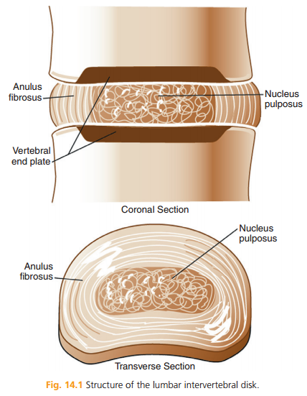

Slide 9
The nucleus pulposus of the lumbar intervertebral disk is a viscous structure.
Chemically, it is composed of 70% to 90% water, depending on age, along with proteoglycans, collagen, elastic fibers, and noncollagenous proteins.
Being a viscous semifluid, the nucleus pulposus is freely deformable and noncompressible.

Slide 10
The lumbar anulus fibrosus is composed of collagen fibers arranged in concentric rings of 10 to 20 lamellae (i.e., sheets), which results in an exceedingly strong ligamentous structure.
Within each lamella the collagen fibers are parallel to each other, at approximately 65 degrees from the vertical, and extend between adjacent vertebral bodies.
Neighboring lamellae alternate in the obliquity of the fibers between right and left.

Slide 11
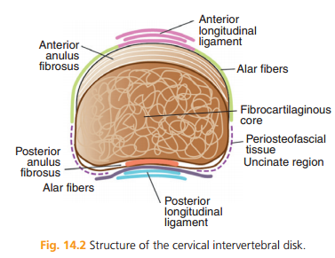

Slide 12
The blood supply to the intervertebral disk is limited to small branches of the metaphyseal arteries, which penetrate only into the outer aspect of the anulus, and the capillary plexuses beneath the vertebral end plates.
Diffusion of nutrients through the vertebral end plates and anulus fibrosus allows only a low level of metabolic activity.

Slide 13
It is now known that the outer third of the anulus fibrosus is not only innervated but contains a wide variety of simple and complex neural structures derived from branches of the sinuvertebral nerves, gray rami communicantes, and lumbar ventral rami.
Physiologic changes are known to occur in a painful intervertebral disk, including nerve ingrowth into the usually aneural inner anulus, and an increase in nerve growth factor has been demonstrated in painful versus asymptomatic intervertebral disks.

Slide 14
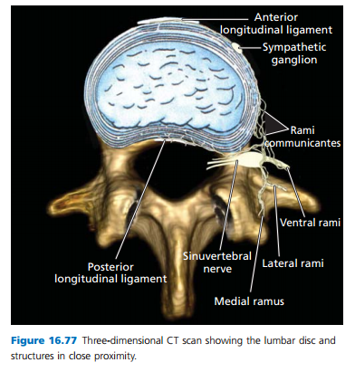

Slide 15
Several possible physiologic mechanisms for the production of pain in the intervertebral disk have been postulated.
Although mechanical stress across the anulus has been proposed, an inflammatory mechanism appears likely.
The nucleus of the intervertebral disk is known to have a low pH and contains a multitude of inflammatory enzymes.
These chemicals, when released secondary to injury or disk degradation, are thought to sensitize neural structures within and in close proximity to the disk.

Slide 16
Despite this major advance in the ability to visualize anatomy and tissue characteristics, MRI was still found to be less sensitive than diskography in detecting tears and fissures.
Although gadolinium enhancement may be of assistance.
Even though these new imaging technologies (i.e., CT and MRI) have helped, they do not tell us whether the pathoanatomy is symptomatic.

Slide 17
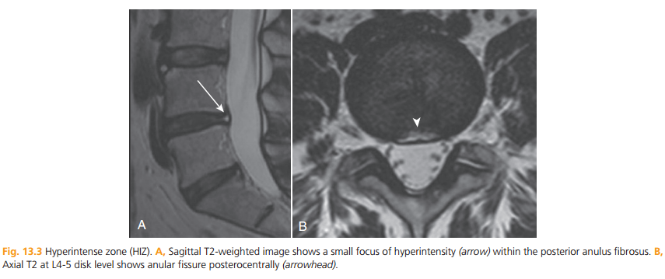

Slide 18
Diskography has become the “gold standard” for the
diagnosis of diskogenic pain.

Slide 19
Patient Selection Indications With the advent of CT and MRI, diskography is no longer indicated for diagnosis of radicular pain, sciatica, and elucidation of the external disk morphology.
MRI and CT imaging will rule out the so-called red flag conditions of tumor, infection, and fracture, but cannot diagnose the cause of low back pain in the majority of patients.

Slide 20
Diskography is indicated to diagnose somatic, chronic low back pain with or without referral.
In that for the majority of patients the natural history of low back pain evidences improvement and resolution within 3 months, diskography before this time period should be rarely considered .

Slide 21
Contraindications
Absolute: (1) the patient being unable to consent to the procedure; (2) inability to assess the patient's response to the procedure, sedation , significant analgesic use, or psychiatric overlay; (3) significant localized or systemic infection; and (4) pregnancy.
Relative (1) anticoagulant therapy or bleeding diathesis; (2) allergy to radiographic contrast, local anesthetic, or antibiotic; and (3) anatomic derangements that would compromise the safe and successful conduct of the procedure.

Slide 22
The Technique of Diskography
Preprocedure and Periprocedure Considerations
A medical history and physical examination
(NPO)
Any allergies to non-ionic water-soluble contrast media
Analgesic medications should not be administered routinely before or during diskography.
Prophylactic antibiotic (cefazolin, 1 g)

Slide 23
At the least, the most likely level and the two adjoining levels should be included.
Rarely is it necessary to inject more than four segments. When simulating the disks, the patient is blinded regarding the onset and level being stimulated.

Slide 24
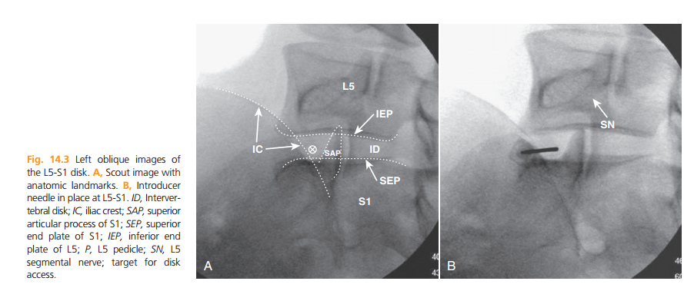
Lumbar Diskography Technique

Slide 25
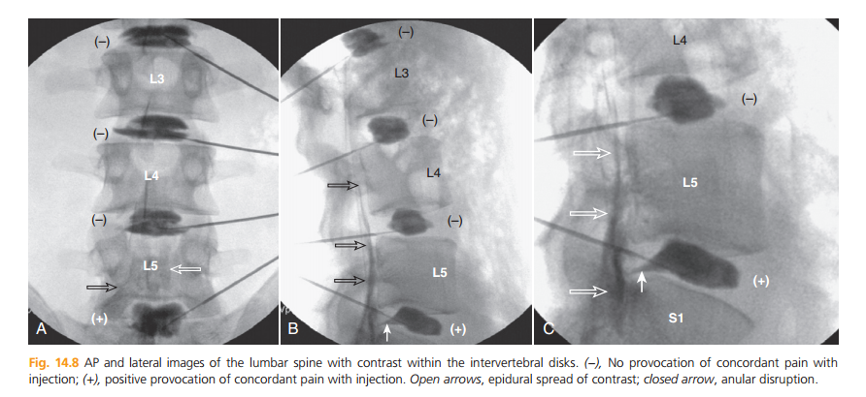

Slide 26
Interpretation of Disk Stimulation and Imaging Studies
The pain response must therefore be classified with respect to its location. In most cases, one of three descriptions can be used to characterize the discomfort provoked:
(1) “no pain,” (2) “nonconcordant” (i.e., dissimilar) pain or pressure, or (3) “concordant” with the patient's familiar pain.

Slide 27
Severe intensity (>6on a 10-point visual analog)
Provocation diskography cannot be considered valid if all disks stimulated are shown to be concordantly painful.
Valid diskography cannot be performed by stimulation of a single level.
If all levels are found to be positive to stimulation, the study is described as “indeterminate.”

Slide 28
Evaluation by axial CT imaging is integral to the diagnostic diskography study.
Axial images validate the procedure in that contrast is seen to fill the nucleus and reveals anular fissures.

Slide 29
Because anular tears radiating into the outer third of the disk have been shown to be the primary indicator of diskogenic pain,a grading scale of anular disruption has been developed and modified.
The Modified Dallas Diskogram Scale is widely used in reporting findings on the axial post-diskogram CT scan images, and it describes five grades of anular fissures .

Slide 30
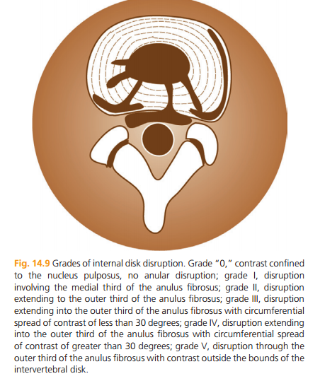

Slide 31
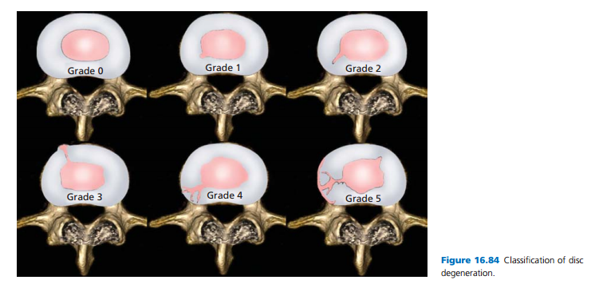

Slide 32
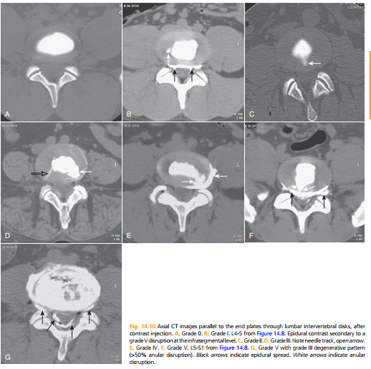

Slide 33
Once the procedure has been completed and all images examined, a diagnosis of diskogenic pain may be made if the following requirements are met:
(1) stimulation of the disk in question produces concordant pain;
(2) the concordant pain is greater than 6 on a visual analog or equivalent scale;
(3) the pain is produced at less than 50 psi above opening pressure when a manometer is used
(4) a negative control disk produces no pain when stimulated.

Slide 34
THANKS FOR YOUR ATTENTION
THE END

Slide 35
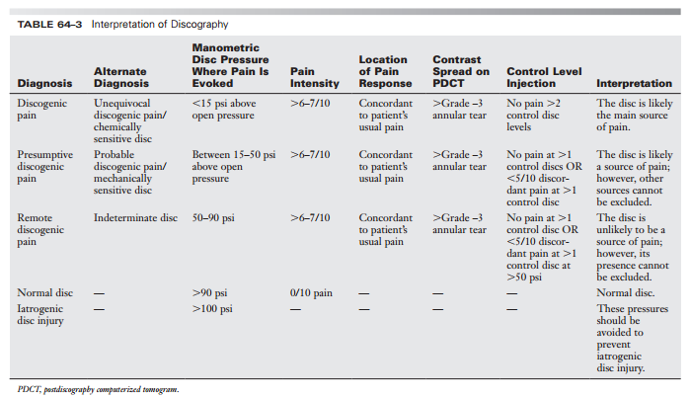

Slide 36
Patient selection
chronic low back pain, with or without pseudo-radicular referral, which lasts for longer than 3 months and which does not react to medication,TENS and other conservative measures, and for which minimal invasive treatments of the facet joints and the sacroiliac joints do not prove to be effective or are not sufficiently effective.
Only advisable as a preparation for a possible interventional treatment aimed at reducing discogenic pain.
An X-ray and an MRI of the lumbar spinal column must be performed not earlier than 6 months prior to the procedure.

Slide 37
Discus stimulation
After verification of the correct needle position, the stylet is removed from the needle and the needle is connected to a contrast agent delivery system which can measure the intradiscal pressure (manometry).
The rate of infusion of the contrast agent should not exceed 0.05 mL/s.
If a higher flow is used, false positive discographies can occur because of the resultant pressure peaks due to vertebral end-plate compression and distention of the adjacent facet joint.

Slide 38
Discus stimulation
The following parameters must be carefully monitored
during the injection of the contrast solution:
The opening pressure (OP), the pressure at which contrast is first visible in the discus; the provocation pressure,the pressure greater than the opening pressure at which complaints of pain arise; and the peak pressure or the final pressure at the end of the procedure.
Ideally, pressure, volume, and provocation details are recorded at 0.5 mL increments.

Slide 39
Discus stimulation
The procedure, per level, is continued until the following events:
• Concordant pain is reproduced at a level of 7 or greater (on a 0 to 10 numeric rating scale; NRS),and subsequent injected volume confirms the response.
• The volume infused reaches the 3.0 mL. (Up to 4 mL may be injected into a very degenerated discus when pressures remain less than 15 psi.).
• The pressure rises to 50 psi above opening pressure in discs with a Grade 3 annular tear.
• If contrast leaks through the outer annulus or through the endplates, one may not be able to pressurize the disc to a pressure sufficient to test the disc sensitivity. In these cases, the rapid manual injection may be acceptable, but must be noted and a negative response is a more defendable response.

Slide 40
Assessment criteria
The guidelines of the IASP (International Association for the Study of Pain), as well as those of the ISIS (International Spine Intervention Society), state that two levels must always be tested as controls when performing provocative discography (except if the target disc is that of L5-S1).
A disc is only considered to be provocative (positive) if concordant pain can be induced at the target level, and if the control levels were negative for provocation of pain.

Slide 41
Assessment criteria
Discs with a pain threshold of 0 psi—these discs are described as chemically sensitive discs and discs with a pain threshold of 1 psi or higher—these discs are considered to be pressure sensitive.
Pain thresholds ≤ 50 psi above the opening pressure correlated with a 100% chance of a false positive discography, whereas pain thresholds between 25 and 50 psi above the opening pressure still lead to 50% false positive results.This chance of a false positive discus decreases to 14% in a pain-sensitive disc at 15 psi above opening pressure.
The true pressure sensitive discus probably has a pain threshold of 1–9 psi above opening pressure, or is considered a chemically sensitive discus (0 psi).

Slide 43
The IASP and ISIS guidelines
Absolute discogenic pain:
• Stimulation of target discus reproduces concordant pain.
• The intensity of this pain has a Numeric Rating Scale (NRS) score of at least 7 on an 11-point scale.
• The pain is reproduced by a pressure of less than 15 psi above the opening pressure.
• Stimulation of the two adjacent discs is not painful.

Slide 44
The IASP and ISIS guidelines
Highly probable discogenic pain:
• Stimulation of target discus reproduces concordant pain.
• The intensity of this pain has a NRS score of at least 7 on an 11-point scale.
• The pain is reproduced by a pressure of less than 15 psi above the opening pressure.
• Stimulation of one of the adjacent discs is not painful.

Slide 45
The IASP and ISIS guidelines
Discogenic pain:
• Stimulation of target discus reproduces concordant pain.
• The intensity of this pain has a NRS score of at least 7 on an 11-point numerical scale.
• The pain is reproduced by a pressure of less than 50 psi above the opening pressure.
• Stimulation of the two adjacent discs is not painful.

Slide 46
The IASP and ISIS guidelines
Possible discogenic pain:
• Stimulation of target discus reproduces concordant pain.
• The intensity of this pain has a NRS score of at least 7 on an 11-point numerical scale.
• The pain is reproduced by a pressure of less than 50 psi above the opening pressure.
• Stimulation of one of the adjacent discs is not painful, and stimulation of another discus is painful at a pressure greater than 50 psi above the opening pressure, and the pain is discordant.

