Slide 2
Truncal Blocks
دکتر مهرداد نوروزی
دانشیار بیهوشی و فلوشیپ درد دانشگاه علوم پزشکی کرمان

Slide 3
PARAVERTEBRAL BLOCK

Slide 4
ANATOMY
The paravertebral (PV) space is a wedge-shaped area adjacent to the vertebral column
That contains the sympathetic chain, the dorsal and ventral (intercostal) roots of the spinal nerve fatty tissue and intercostal vessels.
The base of the wedge is formed by the vertebral body and the intervertebral disc where there is communication with the epidural space via the intervertebral foramen.

Slide 5
The posterior border of the PV space is the superior
costotransverse ligament which extends laterally to
become continuous with the aponeurosis of the internal
intercostal muscle.

Slide 6
Anterior and lateral to the PV space is the parietal pleura.
Within the paravertebral space, the spinal nerves themselves do not have a fascial sheath and are easily susceptible to local anesthetic blockade.
There is however the endothoracic fascia, which is the deep investing fascia of the thoracic cavity, within the PV space that can affect the spread of injected solutions.

Slide 7
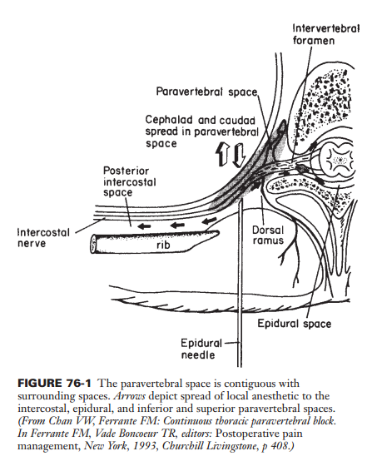

Slide 8
Epidural analgesia when compared to paravertebral blocks for patients undergoing thoracotomy, demonstrated :
No difference in opioid consumption or pain scores.
with fewer side effects including pulmonary complications, hypotension, urinary retention, and nausea and vomiting.

Slide 9
TECHNIQUES Conventional Technique: a loss-of-resistance approach to reach the PV space.
A small-gauge Tuohy needle is inserted 2.5 cm lateral to the superior edge of the spinous process perpendicular to all planes and advanced until contact is made with the transverse process (TP).
The needle is then withdrawn to the skin, redirected caudad or cephalad by 15 degrees and advanced deep to the superior costotransverse ligament at which point loss of resistance is achieved. To avoid pleural puncture, the needle is advanced 1 cm .

Slide 10
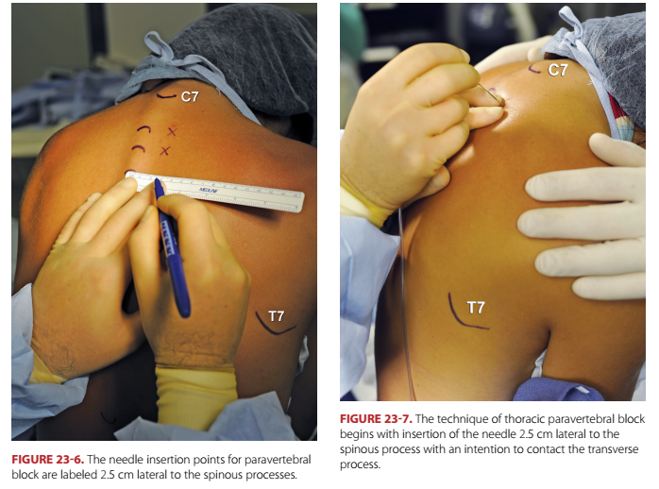

Slide 11
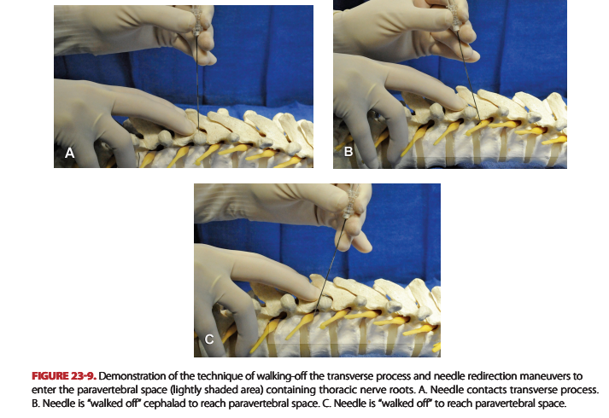

Slide 12
Ultrasound Guidance Technique:
The first approach utilizes US primarily to identify the TP. Once the TP is contacted under US guidance, the conventional loss-of-resistance technique is utilized.
To visualize the TP, the A linear US probe is placed in a longitudinal parasagittal plane 2.5 cm from the midline. Generally, a 5- to 10-degree tilt laterally is needed to best visualize the TP, which appears as concave hyperechoic structure.
This is commonly referred to as a “thumbprint sign.” The parietal pleura can be visualized approximately 1 cm deep to the TP on either side as a sharp hyperechoic line .

Slide 13
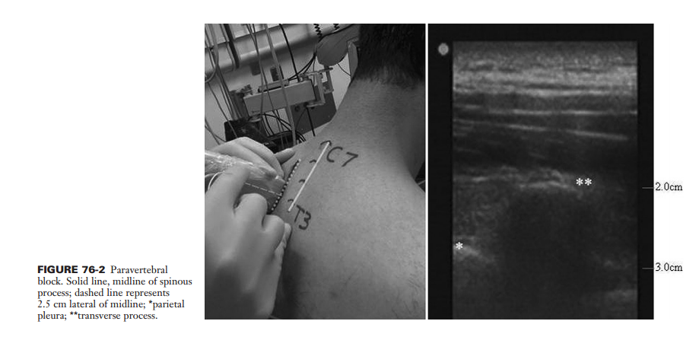

Slide 14
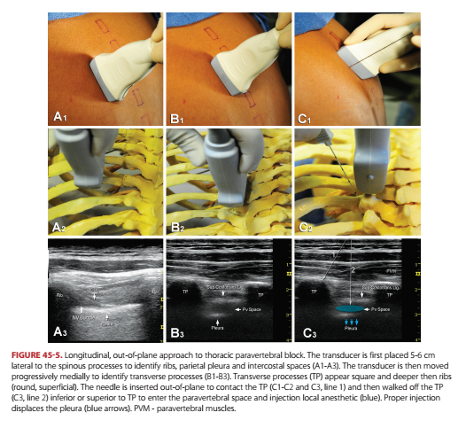

Slide 15
Initial contact with the TP should be made with a 22-gauge finder needle that can serve to infiltrate local anesthetic.
Using an out-of-plane needle approach and similar to the conventional technique, the TP process is contacted and then redirected caudad 1 cm (and no more than 1.5 cm) past the TP.
Loss of resistance to saline is confirmed and local anesthetic injection is performed by an assistant with intermittent aspiration while maintaining US visualization.
It is important to note that loss of resistance can be very subtle and does not invariably occur.

Slide 16
If a Tuohy needle was used, a catheter may be placed while maintaining lateral or cephalad needle tip orientation.
One should expect slight resistance while passing the catheter. If no resistance is encountered, it is possible that the needle tip is in the intrapleural space.
The second approach is a slight variation of the first and utilizes an in-plane or out-of-plane approach to the PV space.
The probe is in the identical longitudinal parasagittal plane as described above and the PV space is approached directly without first contacting the TP process.
Again, a “pop” may be felt when the posterior costotransverse ligament is traversed with corresponding loss of resistance.

Slide 17
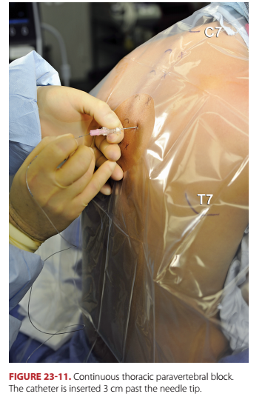

Slide 18
DOSING A single injection of 15 ml can be expected to provide analgesia over 3 to 4.6 dermatomes in the thoracic region.
Spread is initially at the level of injection and along the intercostal nerve, and progresses in the PV “gutter” to cover one dermatome above and two dermatomes below.

Slide 19
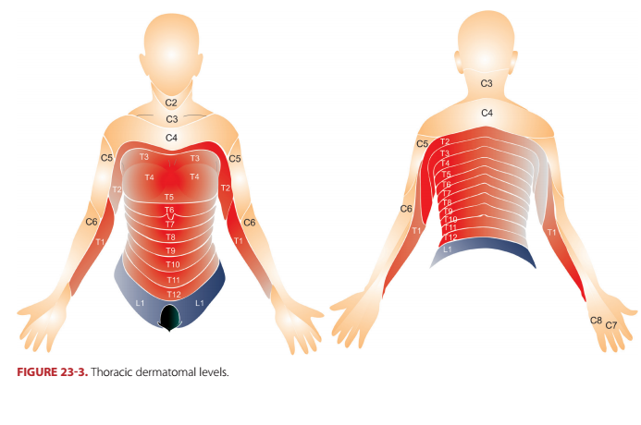

Slide 20
COMPLICATIONS
Pneumothorax is estimated to occur in up to 0.5% of patients, yet most are not clinically significant and can be managed conservatively.
Life-threatening complications from PV blocks have occurred as a result of bolus dosing. A bolus dose can accidentally be injected into the intrathecal or epidural space, or into a blood vessel.

Slide 21
INTERCOSTAL NERVE BLOCK
In patients with spinal anomalies, trauma, or previous
spine surgery that have altered epidural or paravertebral
anatomy, intercostal blocks can be used to provide chest
wall analgesia.

Slide 22
ANATOMY
As nerves leave the PV space, they enter the intercostal space and lie between the innermost intercostal muscle and the pleura.
Lateral to the paravertebral muscles, the prominent angles of the ribs are palpable as the primary landmark for intercostal nerve block.
At the angle of the rib, the nerve lies between the innermost intercostal muscle and the inner intercostal muscle.
Intercostal nerves T4–T11 supply the thoracoabdominal wall from the nipple line to below the umbilicus.
The T12 nerve is actually a subcostal nerve that contributes branches to the iliohypogastric and ilioinguinal nerves.

Slide 23
TECHNIQUE
The ideal patient position is prone, with a pillow under the abdomen and both upper extremities hanging over the sides of the table, which maximizes retraction of the scapulae away from the upper ribs.
The lateral decubitus position is also quite satisfactory for unilateral blockade after rib fractures and for chest tube placement.

Slide 24
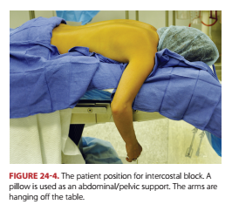

Slide 25
Classic techniques have described locating the angle of the rib (approximately 8 cm lateral to the midline) and using a 22-gauge, short- bevel needle to walk off 3 mm deep to the lower costal margin.
More recently, US-guided approaches have been proposed.
US imaging is used to identify the space between the internal and innermost intercostal muscles 8 cm lateral to the spinous process, and D5W or saline can be injected to confirm needle tip position and anterior pleural displacement

Slide 27
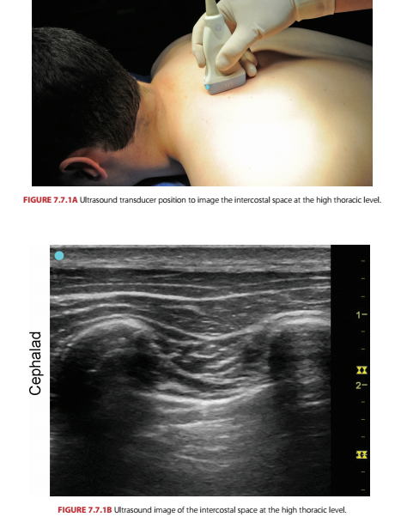

Slide 28
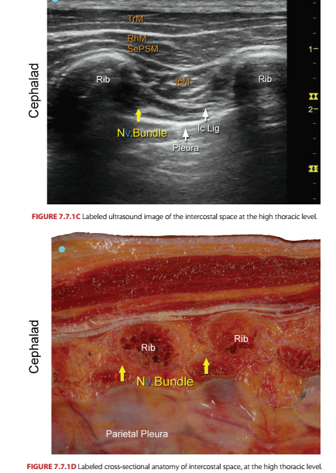

Slide 29
DOSING AND COMPLICATIONS
A single-shot intercostal block can be expected to provide analgesia for only 6 to 8 hours.
Local anesthesia toxicity as a result of bolus dosing may occur due to rapid uptake from the well vascularized intercostal space.
Also, pneumothorax and liver subcapsular hematoma formation are potential complications.
US guidance may aid in maintaining better needle tip control and minimizing the occurrence of these complications.

Slide 30
SUPRASCAPULAR NERVE BLOCK
Suprascapular nerve block (SSNB) is indicated for relief of
acute and chronic pain in the shoulder, which may be
due to bursitis, capsular tear, periarthritis, or arthritis.

Slide 31
In a prospective, randomized, blind study, when SSNB was compared with interscalene nerve block for shoulder arthroscopy, it was found to be an appropriate alternative.
SSNB was used as a method of preemptive analgesia in patients who had various arthroscopic surgeries, and provided significant benefits days 1 to 3 after surgery.

Slide 32
ANATOMY The suprascapular nerve originates from the superior trunk of the brachial plexus (C4–C6).
The nerve traverses the suprascapular notch and descends deep to the supraspinatus and the infraspinatus muscles, supplying the two muscles and about 70% of the shoulder joint.
Sensory innervation includes the posterior and posterosuperior regions of the shoulder joint and capsule, and the acromioclavicular joint.

Slide 33
TECHNIQUE
The patient is positioned sitting, preferably with the arms folded across the abdomen. A line is drawn along the spine of the scapula from the tip of the acromion to the scapular border. The midpoint of this line is noted, and a vertical line, parallel to the vertebral spine, is drawn through it.
The angle of the upper outer quadrant is bisected with a line; the site of insertion of the needle is 2.5 cm from the apex of the angle. A 3-inch (7.5 cm), 22-gauge needle is inserted perpendicular to the skin in all planes .
After contacting bone (i.e., the area surrounding the suprascapular notch) at approximately 5 to 6.5 cm, the needle is slightly withdrawn and redirected as needed until it slides into the notch. Up to 10 ml of local anesthetic is injected. Weakness of external shoulder rotation also confirms successful block.
Pneumothorax may occur in less than 1% of cases.

Slide 34
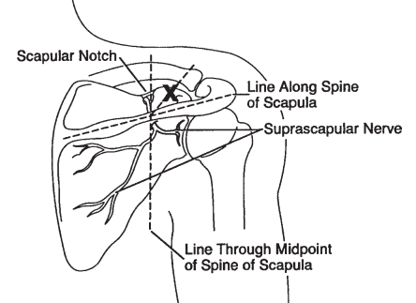

Slide 35
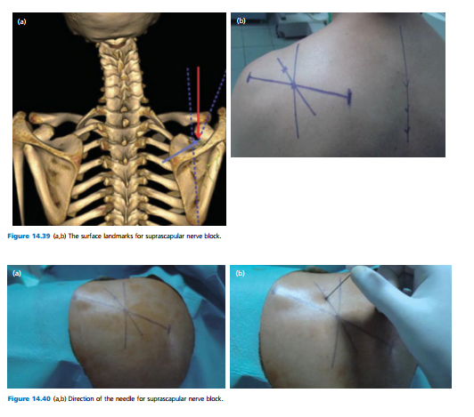

Slide 36
ULTRASOUND GUIDANCE
The patient is positioned sitting. A high-frequency US probe is placed over the scapular spine in transverse orientation, and the suprascapular fossa with the supraspinatus muscle above it are scanned.
Slight lateral movement will bring into view the suprascapular notch. The SSN is visualized as a hyperechoic structure beneath the transverse scapular ligament, in the suprascapular notch .

Slide 37
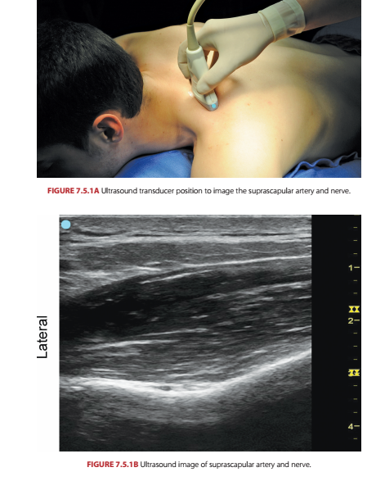

Slide 38
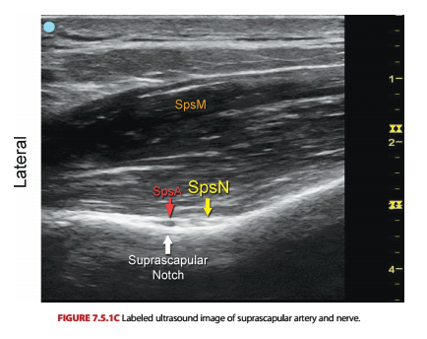

Slide 39
ILIOINGUINAL AND ILIOHYPOGASTRIC NERVE BLOCKS
Ilioinguinal and iliohypogastric nerve blocks may be used in the diagnosis and treatment of chronic inguinal pain after lower abdominal surgery or hernia repair.
They may be combined with genitofemoral nerve block.
Iliohypogastric and ilioinguinal nerve blocks are also important components of regional anesthesia of the inguinal region, typically performed for inguinal herniorrhaphy.
Bilateral ilioinguinal nerve block with 0.5% bupivacaine decreased analgesic requirements and pain scores for 24 hr after cesarean section performed under general anesthesia.

Slide 40
ANATOMY
The iliohypogastric (T12–L1) and ilioinguinal (L1) nerves emerge from the lateral border of the psoas major muscle, travel around the abdominal wall, and penetrate the transverse abdominal and the internal oblique muscles to innervate the hypogastric and inguinal areas.

Slide 41
The use of US-guided serial ilioinguinal nerve blocks has been recently reported for the treatment of chronic inguinal neuralgia in adolescents.
Ultrasound Guidance: The patient is positioned supine, and a high-frequency US probe is placed superior and medial to the ASIS, on an imaginary line uniting the ASIS and the umbilicus.
The nerves are usually visualized between the internal oblique and transversus muscles. An in-plane technique provides optimal access to the ilioinguinal and iliohypogastric nerves; hydrodissection may be useful to better delineate the narrow fascial plane.

Slide 42
TECHNIQUE Ultrasound Guidance:
The three muscle layers, the external oblique, internal oblique, and transversus abdominis, and needle insertion plane, between the internal oblique and transversus abdominis muscles, can be easily vizualized when the probe is placed above the ASIS.
An inplane or out-of-plane technique can be used. Hydrodissection of the plane may facilitate accurate placement of the needle.
Fifteen to 20 ml of local anesthetic are typically used on each side.

Slide 43
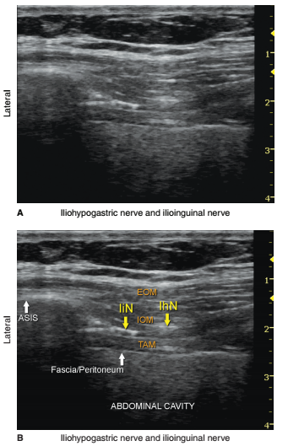

Slide 44
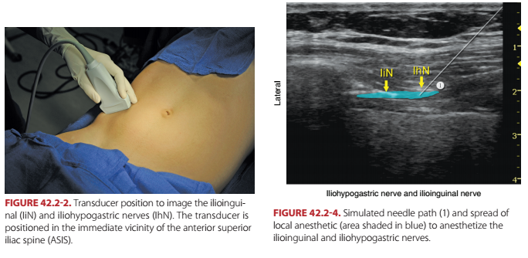

Slide 45
TRANSVERSUS ABDOMINIS PLANE BLOCK
ANATOMY

Slide 46
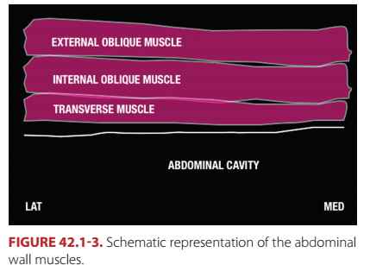

Slide 47
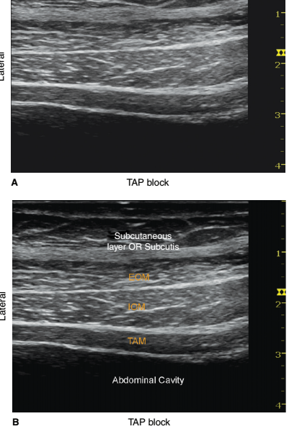

Slide 48
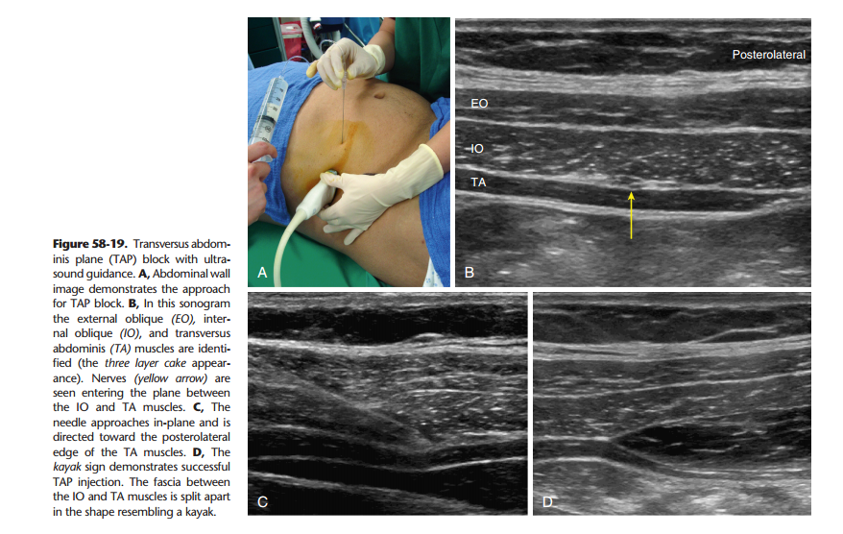

Slide 49
Ultrasound-guided TAP blocks have been used to provide postoperative analgesia for lower abdominal surgeries, including inguinal hernia repair, cesarean section and retropubic prostatectomy.
A subcostal approach has been described for laparoscopic cholecystectomy.
The TAP block is devoid of any hemodynamic effects, and provides no visceral analgesia.

Slide 51
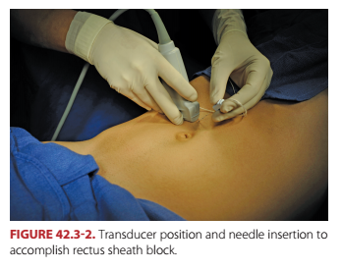

Slide 52
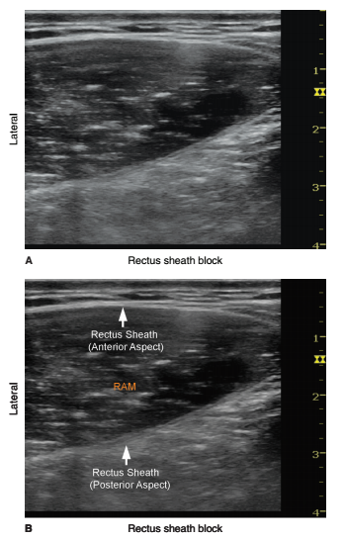

Slide 53
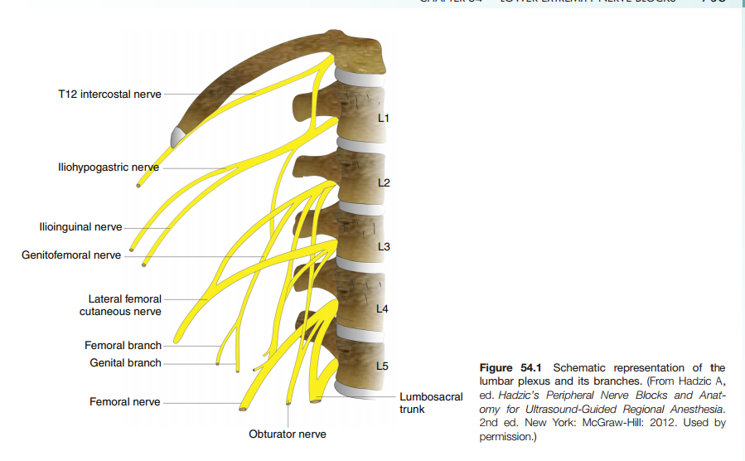

Slide 54
