Slide 1
VMT in AMD

Slide 2
Weber-Krause et al.: Incomplete PVD in eyes with AMD is significantly higher than eyes without AMD.
Weber-Krause et al. Ophthalmologe. 1996;93:660—5

Slide 3
The Body Of Evidence:
In nAMD compared to dry AMD or no disease:
VMA/ VMT ↑↑
PVD $↓↓$
??? nAMD ↔ VMA:
It is plausible that nAMD, through local inflammatory changes, may strengthen the adhesion between the posterior vitreous face and ILM, thereby increasing rates of VMA.
Marmor M. Retina. Mosby, Phildelphia; 2001. ed 3.

Slide 4
Biological Principles
VMT → anterior--posterior or tangential forces on the retina → alterations in retinal structure or function →
FTMH,
VMT syndrome,
diabetic macular edema, and
nAMD, …
When complete PVD:
release of the traction
increased oxygenation or
altered molecular diffusion.

Slide 5
Newton`s 3rd law
VMT applies a traction on the retina
The equal opposite force pulls apart retina
TRD, cyst, schisis

Slide 6
Starling`s law of hydrostatic pressure
Retina being pulled apart
Decreased the intrestitial pressure
Fluid efflux from the vessels leadind to edema: VMT, nAMD

Slide 7
Does the VMT activates the AMD directly?
The distortion of normal anatomy → ↓nutrient supply to the retinal tissues → reparative mechanisms → potentiates the disease activity.
VMT → disruption of choroidal blood supply to the macula → hypoxia → ↑VEGF.
Reese et al. Am J Ophthalmol. 1967; 64(Suppl):544—9
VMT → RPE structural distortion → ↑RPE VEGFs levels.
Seko et al. IOVS.1999;40:3287—91
VMT→ low grade reinal inflammation
Krebs et al. Am J Ophthalmol. 2007;144:741--6

Slide 8
VITREOUS OXYGENATION AND VEGF EXPRESSION
retinal oxygenation is at least partly influenced by the vitreous,
Following lensectomy and vitrectomy in cat eyes:
↓↓ AC pO2 ( esp. in RVO ) → ↑ NVI,
Stefansson et al. Retina. 1982;2:159--66
the vitreous gel consumes a small amount of oxygen, and hence removal of the vitreous →↑vitreous cavity oxygenation.109
Shui et al. Arch Ophthalmol. 2009;127:475--82

Slide 9
PVD ( e.g. pharmacologic vitreolysis)/ vitrectomy→↑oxygen and other molecules (e.g. growth factors/ pro-inflammatory cytokines) diffusion,
ocriplasmin → vitreolysis → PVD →↑oxygen diffusion → ↑vitreous oxygenation.
Quiram et al. Retina. 2007;27:1090—6
following vitrectomy:
little chemical change, because aqueous humour (≈ 100% water) ≈ vitreous itself ( ≈ 99% water )
But substantial reduction in viscosity (centipoise (cP)), 1.00 cP vs. 300 to 2000 cP.
Stokes-Einstein equation: ↓viscosity following vitrectomy (and PVD) →↑molecular diffusion.

Slide 10
Vitrectomy in diabetic eyes→↑NVI
↑ oxygen diffusion from the AC into the vitreous cavity +
↑growth factors diffuse from the retina and vitreous cavity into the AC,
VEGFs are large molecules, with VEGF-A165, as the most abundant and biologically active isoform in humans, weighing 46 kDa
In incomplete PVD, growth factors are less able to diffuse away from the retina into the vitreous cavity → VEGF ↑ at the retina→↑inflammation/neovascularization:
VMA →↑ AMD activity → nAMD.

Slide 11
ALTERED INTRAVITREAL DRUG PHARMACOKINETICS
following vitrectomy or PVD:
↓ drug loculation in the mid-vitreous →↑ anti-VEGF drug delivery to the macula immediately following injection,
↑vitreous diffusion coefficients →↑anti-VEGF - VEGF binding likelihood, but
↑drug diffusion →↑ drug clearance →↓ drug duration of action

Slide 12
Potential Therapies : VITRECTOMY
The bod of evidence shows that
In nAMD + VMT: vitrectomy ( pharmacologic vitreolysis ?? ) →↑improves the functional and anatomical outcome
PVD is protective against the development of both dry and wet forms of the disease.
it is not appropriate to recommend vitrectomy for all cases of nAMD; but those with VMT + nAMD may benefit from vitrectomy.

Slide 13
Molecules Diffusion

Slide 14
law of hydrostatic pressure.117 This fluid build-up
leads to the macular edema commonly seen in VMT.
Given that nAMD, like VMT, is characterized by fluid
accumulation and retinal thickening, it seems
reasonable to assume that, in cases with coexisting
VMT, the two may both contribute to the observed
retinal edema and structural change.
What is less clear is whether the VMTactually

Slide 15
In the PrONTO and the HARBOR Study: no resolution of retinal exudates after 24 months: 5.4 % and 7% respectively!!! Why?
genetic backgrounds,
lifestyle factors,
Tachyphylaxis,
VMA and VMT

Slide 16
Efficacy of vitrectomy and inner limiting membrane peeling in age-related macular degeneration resistant to anti-vascular endothelial growth factor therapy, with vitreomacular traction or epiretinal membrane Shuhei Kimura et al. Graefes Arch Clin Exp Ophthalmol DOI 10.1007/s00417-016-3314-1
We identified patients with VMT or ERMs who had been resistant to anti-VEGF therapy, which we defined as showing no response after at least three anti-VEGF injections.
SD-OCT. VMT was diagnosed by SD-OCTwhen a steeply sloping inner macular surface or a sharp angulation and localized deformation of the retinal profile at the junction with the hyaloid membrane was detected

Slide 17
Preoperative intravitreal injections of anti-VEGF reagents were
given monthly or pro re nata when exudative and/or hemorrhagic
changes such as the accumulation of subretinal fluid and
recurrence of retinal hemorrhage occurred.

Slide 18
Postoperative intravitreal
injections of anti-VEGF reagents were administered bimonthly,
trimonthly, pro re nata, or on a treat-and-extend basis,
depending on the severity of the exudative changes seen after
surgery. We used either 0.5 mg ranibizumab (Lucentis;
Genentech, Inc., South San Francisco, CA, USA) or 0.5 mg
aflibercept (Eylea; Bayer, Basel, Switzerland).

Slide 19
Surgical techniques
All patients underwent 25-gauge transconjunctival, sutureless,
micro-incision vitrectomy using the Constellation
Vision System (Alcon Laboratories, Inc., Fort Worth, TX,
USA). Surgeries were performed by three different surgeons
(F.S., Y.M., S. K.). AfterVMT release or ERMremoval, ILMs
were peeled in all cases. The ILM was stained with 0.25 mg/
mL Coomassie Brilliant Blue G250 (Sigma-Aldrich, St.
Louis, MO, USA).

Slide 20
VMT in DM

Slide 21
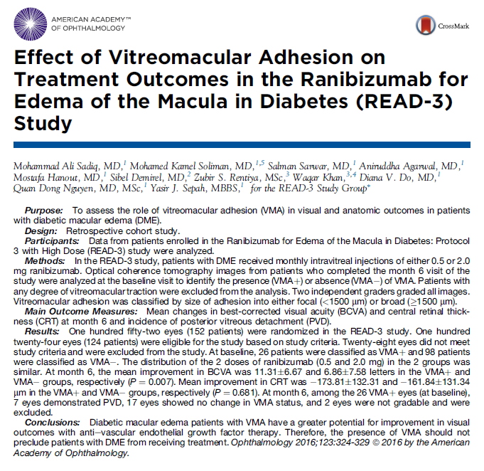

Slide 22
Method:
for DME, monthly intravitreal injections of either 0.5 or 2.0 mg ranibizumab,
any degree of VMT were excluded
In patients who completed the month 6 visit, the baseline OCT images were analyzed for the presence and size of VMA.

Slide 23
Results: 124 patients were included,
At baseline, 26 patients: VMA+ and
98 patients: VMA-
At month 6:
Mean improvement in BCVA: 11 and 6 letters in the VMA + and VMA - groups, respectively (P = 0.007).
Mean improvement in CRT was 173 and 161 µ in the VMA + and VMA - groups, respectively (P = 0.681).

Slide 24
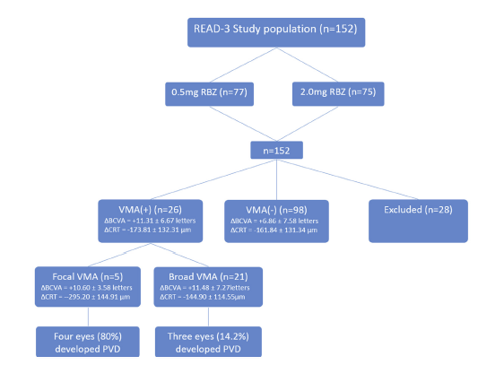

Slide 25
READ- 3: focal vs. broad VMA
Mean change in BCVA: 10.6 ± 3.58 and 11.48 ± 7.27 letters in eyes with focal and broad VMA, respectively (P = 0.80).
Mean change in CRT: 295.20 ± 144.91 and 144.90 ± 114.55 µ in eyes with focal and broad VMA, respectively (P = 0.02).

Slide 26
Mean change in BCVA:
10 and 11 letters in eyes with focal and broad VMA, respectively (P = 0.80).
Mean change in CRT:
295 and 144 µ in eyes with focal and broad VMA, respectively (P = 0.02).

Slide 27
focal VMA is more likely to demonstrate PVD during the disease course and so would show better outcomes than broad VMA.
broad VMA may require a longer time for the vitreous separation.

Slide 28
the subset of patients with PVD (n = 7) by month 6 demonstrated a higher gain in BCVA (14 letters) and may be responsible for the overall better performance of the VMA + group compared with the VMA - group.
In addition, these eyes had a greater reduction in CRT compared with the 17 eyes in which PVD did not develop (245 vs. 164 µ).
occurrence of PVD may be beneficial in the natural history of DME.

Slide 29
Diabetic macular edema with VMA shows a greater potential for visual improvement with anti – VEGF.
Terao et al. J Ophthalmol 2014;58:139–45.
Therefore, the presence of VMA alone, in the absence of retinal traction, may not adversely affect the treatment outcomes and should not be precluded from receiving treatment.

Slide 30
PVD increases the chance of DME resolution
Hikichi et al.: spontaneous resolution of DME was seen in 55% of eyes in which PVD developed compared with only 25% in those in which it did not.
Ophthalmology 1997;104:473–8.
Nasrallah et al.: there is a statistically significant elationship between PVD and lack of DME.
Ophthalmology, vol.95, no. 10, pp. 1335–1339, 1988.

Slide 31
What Mechanisms?
improved transvitreal oxygenation.
Stefansson E. Ocular oxygenation and the treatment of diabetic retinopathy. Surv Ophthalmol 2006;51:364–80.
Removing the nearby growth factor reservoir: increased concentration of growth factor in the premacular hyaloid secondary to increased enzyme-mediated collagen cross-linking in the vitreous. Detachment of the posterior hyaloid in these eyes may remove this reservoir of growth factor from the vicinity of the retina and therefore may lead to improved outcomes of vitrectomy/ PVD.
Stolba U, Binder S, Gruber D, et al. Vitrectomy for persistent diffuse diabetic macular edema. Am J Ophthalmol 2005;140: 295–301.

Slide 32
mean age in the VMA + group << VMA - group;
Bressler et al. previously reported that in patients with DME, a younger age at time of treatment may result in favorable visual outcomes.

Slide 33
PVD may be related to a number of factors in the natural course of the disease apart from the mechanical or pharmacologic actions of the drug

Slide 34
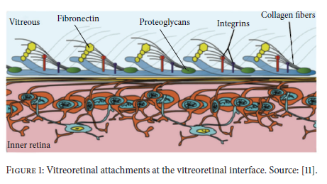
the posterior vitreous is attached to the ILM by collagen along with laminin, fibronectin, and chondroitin.
Barak et al. Journal of Ophthalmology,2012, Article ID 876472.

Slide 35
complete PVD in NPDR >> PDR,
Muqit et al.: SS OCT shows VMT and VMA in PDR, confirming a higher incidence of complete PVD in patients with NPDR versus PDR,
BJO, vol. 98, no. 7, 994–997, 2014.

Slide 36
Gandorfer et al.: in diffuse DME: prominent premacular cortical vitreous covering the ILM + fibroblasts + astrocytes embedded in vitreous collagen in single or multilayers
AJO, vol. 139, no. 4, pp. 638–652, 2005.

Slide 37
vitrectomy for diabetic retinopathy:
↑↑ NVI Rice et al. Am J Ophthalmol. 1983;95:1—11
↓↓ Retinal neovascularization,
Blankenship et al., Ophthalmology.1985;92:503—6
↓↓DME,
Laidlaw. Eye (Lond). 2008;22:1337—41

Slide 38
VMT in AMD

Slide 39
Frequent development of CNV at the sites of VMT
VMT by stretching of retinal cells may trigger release of VEGF.
VMT contributes to VEGF release either directly or indirectly via contributing to retinal hypoxia.
Stefansson E. Physiology of vitreous surgery. Graefes Arch Clin Exp Ophthalmol. 2009;247(2):147-163.

Slide 40
flattening of the PED following vitrectomy suggests that vertical traction on the RPE cells may be implicated in the pathogenic pathway of AMD.
Gross-Jendroska et al. Aust NZ J Ophthalmol. 1998;26(4):311-317.

Slide 41
In wet neovascular AMD with concomitant VMA, At 12 months’ follow-up, microplasmin did not show significant clinical difference versus sham in reducing the frequency of anti-VEGF injections and improving visual acuity or average macular thickness.
Novack et al. Ophthalmology. 2015;122(4):796-802.

Slide 42
VMT in RVO

Slide 43
complete PVD is protective in
ischemic CRVO by ↓ the likelihood of NVD/ NVE,
non-ischemic CRVO by↓ ME. central retinal
Hikichi et al., Retina. 1995;15:29—33
Similar results have been reported with BRVO.
Takahashi et al. Ophthalmic Surg Lasers. 1997;28:294--9

Slide 44
During vitrectomyInduction of PVD and complete removal of PVC has been associated with improved visual acuity and reduced retinal thickness in patients with RVO
Uemura et al. Ophthalmic Surg Lasers Imaging. 2009;40(1):6-12.

Slide 45
In ME due to CRVO treated with intravitreal tPA demonstrated PVD in 76% eyes:
↑↑BCVA correlated with PVD induction,
↓↓macular thickness
suggesting the useful role of vitreolytic agents in RVO
Murakami et al. Retina. 2007;27(8):1031-1037.
Surgical vitrectomy can reduce the macular edema associated with RVO.
Kumagai et al. Retina. 2007;27:49--54

Slide 46
VMT And
Pigment Epithelial Detachment

Slide 47
Rarely PED could be associated with VMT.
Georgalas et al., Int Ophthalmol. 2009;29(5):431-3.
Foveomacular retinoschisis
Duker et al. Ophthalmology 2013;120:2611–2619.

Slide 48
symptomatic dynamic vmt induced by near-vision,
Griffin et al., RETINAL CASES & BRIEF REPORTS 0:1–3, 2015

Slide 49
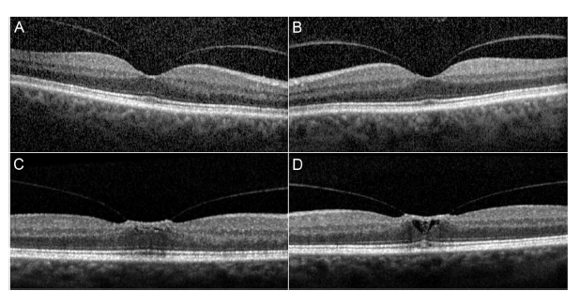
VMA
63 y-o m, complaining of metamorphopsia,after 15 minutes of near working, relieved after 15- 30 relaxation. dynamic VMT after approximately 15 minutes of induced nearvision with formation of cystic spaces in the left eye.

