Slide 1
بسم الله الرحمن الرحیم

Slide 2
Endogenous endophthalmitis
Pejvak Azadi, MD.
Fellowship Of Vitreoretinal Surgeries.
Assistant Professor Of Ophthalmology
Kermanshah University Of Medical Sciences

Slide 3
Introduction

Slide 4
Endophthalmitis: Intraocular infection affecting the inner coats of the eye associated with significant , progressive vitreous inflammation:
exogenous: externai route of entry: trauma, surgery, or infected cornea
Endogenous (EE), ( approximately 2– 8 % of all cases): hematogenous spread of microorganisms from distant foci

Slide 5
Endogenous endophthalmitis is often a diagnostic challenge, manifesting at any age, associating with a number of underlying predisposing factors,
Rare, so no literature guidelines for optimal management.
The first published case: 1856

Slide 6
Causative organisms
2% and 8% of all cases are bacterial
developed countries:
gram-positive organisms ( Streptococci and Staphylococci) dominate the infection,
Asian studies:
gram-negative organisms are more common

Slide 7
Many Underlying Predisposing Factors!!!

Slide 8
recent hospitalization,
diabetes mellitus, (most cases of klebsiella)
urinary tract infection,
immunosuppression (esp. malignancy, neutropenia , HIV),
intravenous drug abuse ( IVDA ),
indwelling catheters,
Liver abscesses: esp. gram-negative rods: Klebsiella pneumonia.
…

Slide 9
Infective endocarditis esp. in the western world
transient bacteremia, e.g. routine colonoscopy,
mold infections are more likely associated with:
Chemotherapy,
organ transplantation especially cardiac and liver transplants,
immunosuppressive therapy for hematopoietic stem cell transplantation (HSCT) or for any hematological malignancy
Pulmonary aspergillus
…

Slide 10
But!!!
Even in immunocompetent patients without underlying predisposing conditions,
may be the first manifestation of an underlying occult systemic infection, with still negative cultures.

Slide 11
In neonates!!!
Bacteremia ( OR= 21.11):
Streptococci species, especially S. agalactiae,
gram-negative rods: Klebsiella or
Pseudomonas
Candidemia ( OR= 2.36),
retinopathy of prematurity( OR= 2.05)
LBW,

Slide 12
Pathophysiology
postoperative endophthalmitis: the organism toxins makes tissue damage.
endogenous endophthalmitis:
In fungemia/ bacteremia: a septic embolus enters the posterior segment vasculature, crosses the blood ocular barrier, …
The right eye is more commonly involved probably due to the more direct route through the right carotid artery.
Direct spread in CNS infection via the optic nerve.

Slide 14
Clinical features

Slide 15
↓ vision, pain, photophobia and floaters
Eyelid edema, conjunctival injection, Anterior chamber inflammation with hypopyon,
iris nodules, and pupillary distortion secondary to synechiae formation
The anterior chamber involvement is more common in bacterial cases
Bilateral involvement: possible like TB

Slide 16
Strongly suggestive
Not specific but could be present

Slide 17
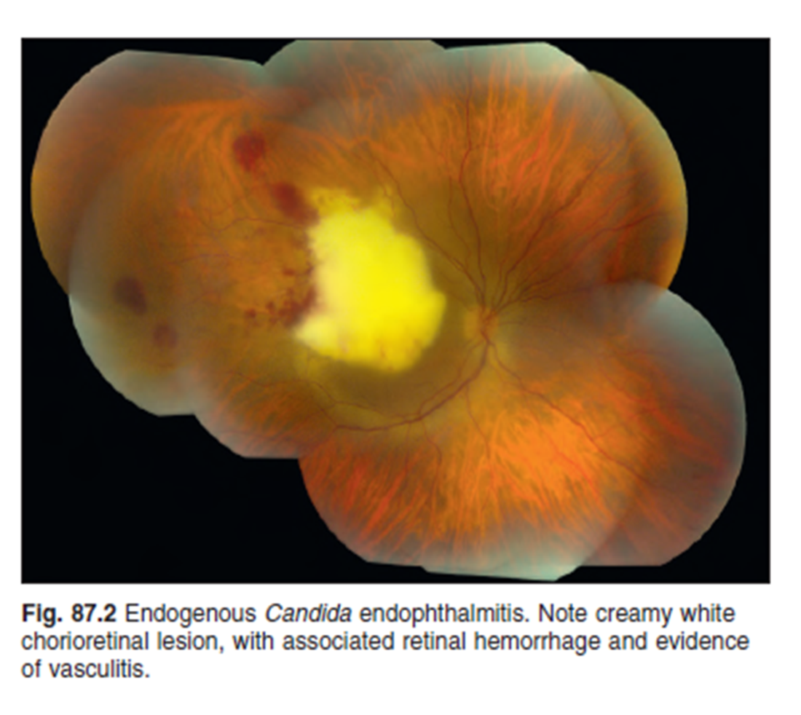
Significant vitritis, the hallmark
Candida: vitritis or fluffy white retinal lesions extending into the vitreous
In candidemia: significant time delay between seeding and development of visible
retinal lesions; therefore,
patients may have a
normal retinal exam initially

Slide 18
Aspergillus: focal or diffuse yellow/ white lesions,
bacterial EE: sub-retinal and choroidal abscess
Methicillin-resistant Staphylococcus aureus (MRSA) associated endophthalmitis: high rates of retinal detachment esp. with > 2 weeks diagnostic delay
flame-shaped hemorrhages , Roth spots and cotton wool spots

Slide 19
Visual acuity + dilated funduscopy = outcome measures during follow up.
A relative afferent pupillary defect (RAPD): guides the vitrectomy necessity.

Slide 20
Diagnosis

Slide 21
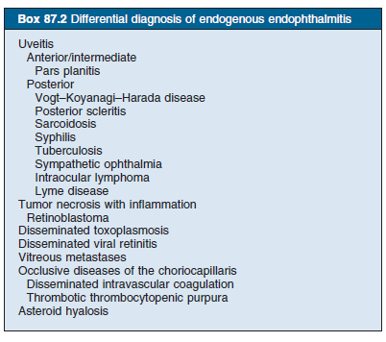

Slide 22
A High Index Of Suspicion:
Systemic risk factors and/or presence of characteristic ocular findings
Multiple visits
EE is generally not among the major concerns in patient s with life-threatening invasive fungal diseases or sepsis
the diagnosis of EE may be delayed with other morbidities being managed acutely.

Slide 23
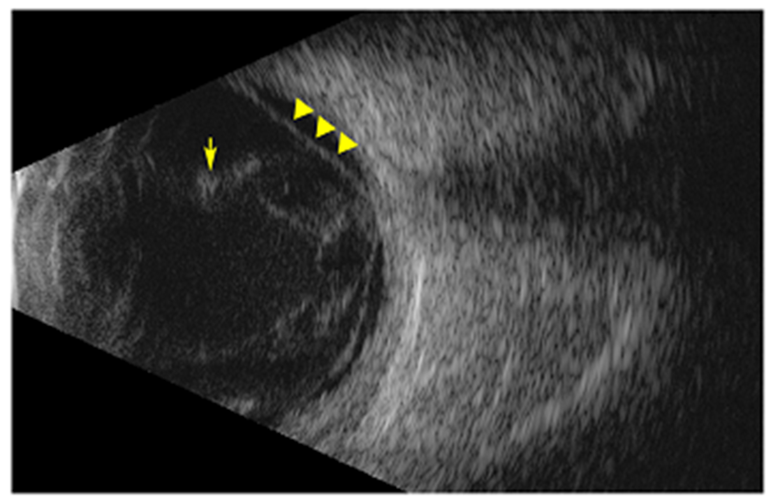
Imaging
B-scan:
Vitritis,
Choroidal abcesses: dome-shaped lesions arising from the choroid
Complications of EE: retinal detachment
OCT
localizing the pathology within the retina or subretina,
elevation of RPE, intra-retinal lesions with or without extrusion into the vitreous, choroidal thickening, and posterior vitreous cells

Slide 24
To confirm a specific etiology: vitreous sample culture/ smear through aspiration or diagnostic vitrectomy
Diagnostic vitrectomy:
Clinical judgment.
The early or localized infection is located near the retinal surface , so the needle biopsy culture could be negative.
culture diagnostic value (92 %) >> vitreous aspirate (44 %)
So if negative vitreous biopsy culture + clinical suspicion then diagnostic vitrectomy.

Slide 25
real-time polymerase chain reaction (RT-PCR) of aqueous and vitreous samples
Excellent sensitivity and specificity for fungi ( better than culture)
rapid diagnosis (within 90 min),
no fear of contamination
But no ability to determine the antibiotic susceptibility

Slide 26
Systemic evaluation
Blood culture x 3 consecutive days
culture other possible nidus e.g. urine cultures,
Confirmatory identification of extra ocular sources: 21– 100 % of cases,

Slide 27
Treatment

Slide 29
Bacterial EE:
Systemic antibiotic after blood culturing
Local therapy
ASAP: within 24 h, then favorable outcome;
as soon as infectious endophthalmitis is suspected then vitreous cultures through needle aspiration/ vitrectomy
If unknown etiology then first empirical intravitreal antibiotics, covering both G + and G -:
G+: vancomycin 1 mg / 0.1 ml but…
G - : ceftazidime 2.25 mg/0.1 ml or amikacin 0.4 mg/ 0.1 ml
Fluoroquinolo esp. 4th. Generation: both G + and G – but recent resistance is growing.

Slide 30
pregnant and breastfeeding women:
Penicillins , cephalosporins, and erythromycin: good safety profiles
Fluoroquinolones:
abnormalities of developing cartilage just in animal studies so,
use fluoroquinolones only when there is no other safer alternatives

Slide 31
Candida endogenous endophthalmitis
severe vitritis:
1. vitrectomy with IOL removal,
2. + intravitreal amphotericin or voriconazole
Intravitreal amphotericin B (AMB): 5 to 10 mcg in 0.1 ml sterile water or dextrose.
If persistent intraocular infection then could be repeated after ≥ 48 h or more.
3. + Systemic AMB:
dose limiting nephrotoxicity, hypotension, arrhythmias, and infusion -related fever and chills (“shake and bake”)
At least 6 weeks

Slide 32
When Vitrectomy?
Commonly used:
severe and sight-threatening fungal/ bacterial EE or
irresponsive to systemic/ local therapy within 24– 48 h of presentation or worsening e.g. RAPD
Klebsiella : esp. with AC inflammation.
if not tolerating, then repeating intravitreal injections,
the earlier surgery →↑final vision + ↓ complications, e.g. RD, evisceration, enucleation,

Slide 33
Role of corticosteroids
Inflammation combats invading organisms, but may ends up with damaging retinal structures
Still contraversial:
Some reports of better visual outcomes with additional intraocular steroids
Some trials of intravitreal dexamethasone did not report any safety risks
Shuwan lee: no significant vision increments
Shah: significant reduction of obtaining a three-line improvement in visual outcomes, therefore:
judicious use of steroids is recommended

Slide 34
Prognosis

Slide 35
generally no favorable prognosis and complete vision loss, esp. in delayed diagnosis/ treatment.
The high risk of RD following vitreous aspirate,
Early diagnosis and treatment of bacterial EE(e.g. vitrectomy in 2 weeks):
Vision ≥ CF in 64 % of patients

Slide 36
Poor Prognostic factors:
Delayed Dx/ Tx
More organism virulance:
Bacterial EE: more requiring enucleation/ evisceration.
Aspergillus and other molds ˃˃ yeasts,
MRSA endophthalmitis: significant mortality
Connell et al. :all the patients needing enucleation were infected by Klebsiella
worse initial visual acuity,
centrally located lesions,
Hypopyon: the main prognostic factor in Klebsiella EE ,
rapid onset of ocular symptoms,
unilateral involvement,
panophthalmitis

Slide 37
Thanks for your attention….

Slide 39
Voriconazole :
excellent intravitreal concentration after oral or intravenous administration
Intravitreal: 100– 200 mcg/ 0.1 ml sterile water with final This dose vitreal concentration of about 25– 50 mcg/ml.
With fungal infections resistant to fluconazole and amphotericin B then voriconazole which shows 100 % activity against Aspergillus, Paecilomyces, and Fusarium.
the Infe ctious Disease Society of America (IDSA) guidelines for Candida endophthalmitis:
Fluconazole 400–800 mg daily or,
amphotericin B + flucytosine

Slide 41
The IDSA guidelines for the Aspergillus endophthalmitis:
IV amphotericin B + intravitreal amphotericin B + vitrectomy for sight-threatening cases.
The alternate therapy: systemic or intravitreal voriconazole

