Slide 1
IN THE NAME OF GOD

Slide 2
Suprachoroidal hemorrhage and pars plana vitrectomy
Leila Rezaei ,vitreoretinal surgeon
Assistant professor of Kermanshah university of medical science

Slide 3
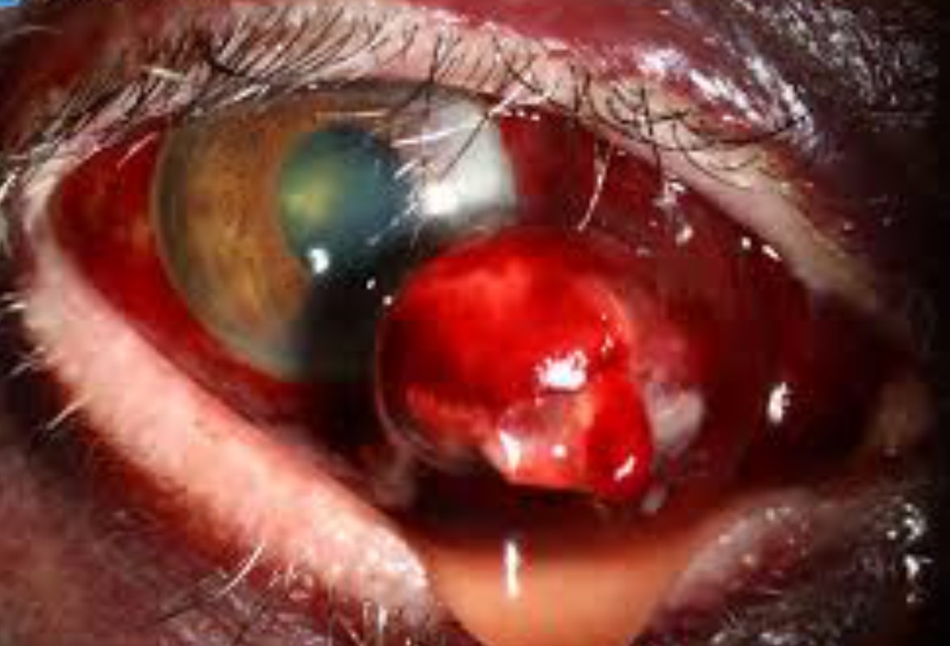
SCH is an uncommon but serious complication of PPV ,with a guarded visual prognosis.
Incidence: 0.17 to 1.03%
1.Advancing age
2.Male
3.RRD
4.Dropped lens fragment
5.Antiplatelet or anticoagulant drugs
6.Increasing quadrants of RRD.
7. Scleral explant or buckling at the time of PPV

Slide 4
Incidence and factors associated with complications of sutured and sutureless cataract surgery following PPV at a tertiary referral centre in Turkey.( Br J Ophthalmol. 2015)
8.Longer duration of PPV surgery
9.Longer interval from PPV to silicone oil extraction
10.Prior 20-gauge PPV,
11. 20-gauge PPV with scleral buckling surgery
12.Aphakia or psudophakia
***Sutureless phacoemulsification in vitrectomised eyes was not associated with a higher incidence of SCH.

Slide 5
Suprachoroidal hemorrhage during PPV. (Curr Opin Ophthalmol. 2014)
12.High myopia
13.Cryotherapy
14.External drainage of SRF
15.Intraoperative HTN
16.Bucking during general anesthesia.
17.Chronic kidney disease.

Slide 6
Warfarin in vitreoretinal surgery: a case controlled series.
2% of patients receiving PPV were on warfarin.
INR ranged between 0.9 and 4.6 (median 2.3).
There was no increase in complications compared with controls.
Patients with RRD are more likely to have VH at presentation if they are on warfarin.

Slide 7
Hemorrhagic risk of vitreoretinal surgery in patients maintained on novel oral anticoagulant therapy. Retina. 2016 Feb;
Rivaroxaban, apixaban, dabigatran, and prasugrel.
No eyes suffered perioperative RH,SCH, or SRH.
11.1% experienced postoperative VH: 5.5% required repeat PPV
5.5% cleared spontaneously.
Although there is a relative risk to such surgery in patients who are taking novel oral anticoagulants.
Patients may safely undergo vitreoretinal surgery while maintaining therapy with this novel drugs.

Slide 8
Delayed SCH after Pars Plana Vitrectomy: Five-Year Results of a Retrospective Multicenter Cohort Study. Am J Ophthalmol. 2015 Dec
DSCH occurs in 0.8% of vitrectomised eyes.
The main risk factors :
1.Postoperative emesis
2.Intraoperative extensive photocoagulation.

Slide 9
Massive SCH during PPV associated with Valsalva maneuver. Am J Ophthalmol. 2015 Sep
After air-fluid exchange but before sclerotomy closure.
Scleral plugs were immediately placed, and sclerotomy closed.
Valsalva maneuver during PPV may result in MSCH with disastrous visual consequences.
Precautionary measures to prevent coughing or "bucking" on endotracheal tube during general anesthesia, or coughing during local anesthesia, may prevent this potentially devastating complication

Slide 10
SCH during pars plana vitrectomy in traumatized eyes. Retina. 2009
SCH during time of producing PVD under ocular hypotony.
SCH developed under ocular hypotony during fluid-gas exchange.
SCH when the depression of the area of pars plana occurred.
Ocular trauma is one of the vital risk factors for the development of intraoperative SCH during PPV.
It is important to control of intraocular inflammation preoperatively.

Slide 11
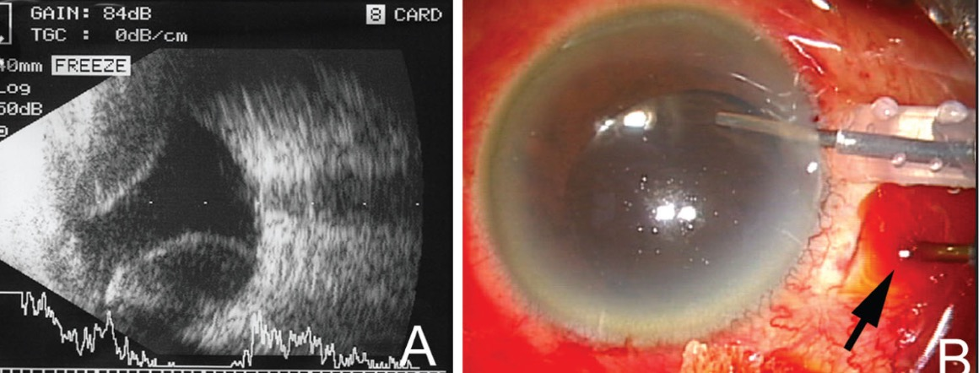
SCH as a complication of vitrectomy. Ophthalmic Surg Lasers. 2014
4.Near the end of vitrectomy
5. In the first postoperative day.
Postoperative SCH has a better than operative type.
Perfluorophenanthrene as an operative and postoperative tamponade :
1- keeping the retina attached
2-preventing pooling of blood under macula.
All patients had vision more than 20/400 after 24 months.

Slide 12
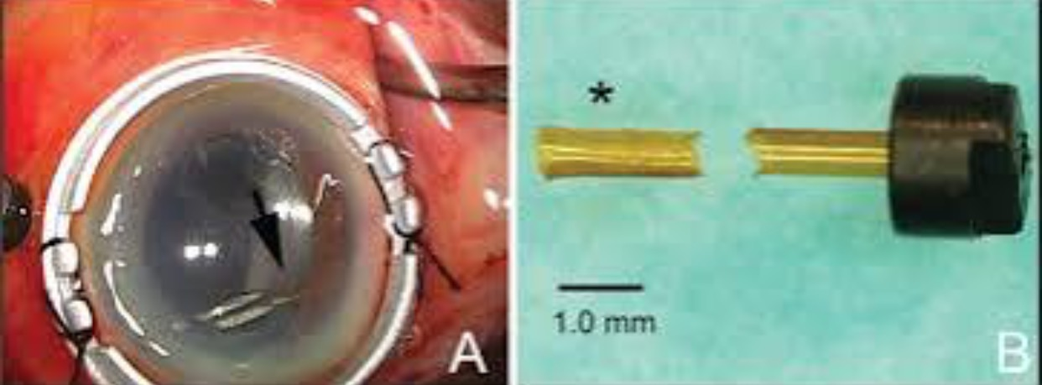
SCH caused by breakage of a 25-gauge cannula. Ophthalmic Surg Lasers Imaging. 2014
6. During removal of cannula
At end of surgery, half of its tip was noted to be missing.
Second surgery: drainage of SCH and removal of tip of 25-gauge cannula stuck inside sclerotomy.
The retained cannula tip acted as a channel allowing vitreous fluid into suprachoroidal space, resulting in SCH and hypotony.

Slide 13
Secondary surgical management of SCH during PPV.
7. bullose RD ,during the substitution of PFCL with silicone oil is very rare.
No initial sclerotomy.
After 3 weeks : PPV and sclerotomy .
Massive epiretinal proliferation with funnel RD was solved and internal tamponade with silicone oil . Postoperative VA was 2/60 on third postoperative day.
Although SCH is one of most devastating complications of intraocular surgery, it might have relatively good prognosis with proper intraoperative and postoperative management.

Slide 14
SCH during silicone oil removal . Ophthalmic Surg Lasers. 2012.
8.Four months after vitrectomy, the silicone oil was removed using AC maintainer and a self-sealing clear corneal incision.
SCH remained to be limited and did not show progression.

Slide 15
Recurrent bleeding after PDT in polypoidal choroidal vasculopathy. Am J Ophthalmol.2014
2 weeks after PDT: extensive SRH.
3 months after PDT, SRH was almost absorbed.
He received a second session of PDT .
2 weeks thereafter: MSCH with further vision loss.
1 month after the second PDT, although the patient underwent PPV, visual acuity was NLP .

Slide 16
Management:

Slide 17
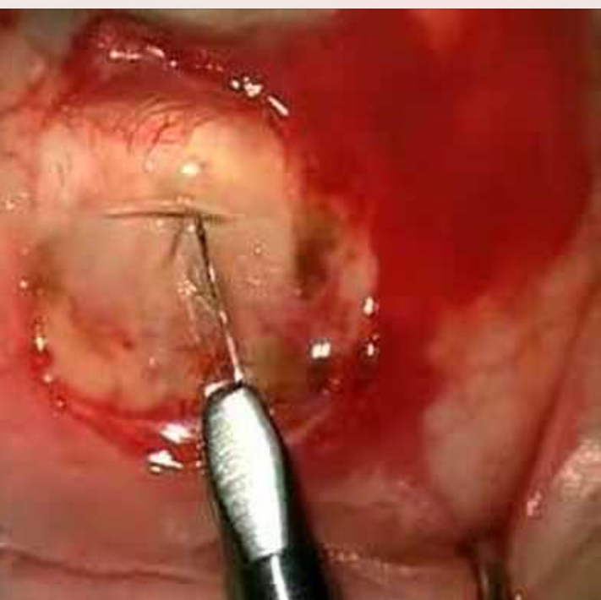
Direct digital pressure
Anterior vitrectomy with scissors and cellulose sponge
Rapid wound closure with 8-0 nylon sutures.
Posterior sclerotomy:( between 8 and 12 days later??)
ACM at limbus for inducing pressure for drainage
Exposure of the sclera
Posterior sclerotomies (5-8 mm posterior to limbus and extending 3-5 mm)
Facilitation of drainage with cotton and iris spatula
The exact site of the sclerotomies corresponding to thicker SCH location
Sclerotomy site sutured using vicryl 6.0
Additional procedures :PPV,removal of silicone oil ,AGV, reinsertion of AGV tube to AC.

Slide 18
A high index of suspicion in cases where risk factors for expulsive SCH exist. Prolapsed intraocular contents should be reposited as quickly; if this is not possible; eye can be softened by performing posterior sclerotomies.
The role of sclerotomies at time of is controversial:
The blood clots rapidly .
Tamponading effect be unsettled due to
ooze through sclerotomies .

Slide 19
Timing of drainage procedures in postoperative SCH depend on
1.Presence of RD,
2.Central retinal apposition (“kissing choroidals”)
3. Vitreous incarceration into wound
4.VH
5. Increased IOP
6.Retained lens material
7.Intractable eye pain.

Slide 20
PPV
Liquefaction of blood in the suprachoroidal space can be seen echographically , occurs between 7 and 14 days( ideal time for intervention)
When vitreoretinal surgery is planned, drainage of haemorrhage through sclerotomies before PPV are made to avoid iatrogenic damage to anterior retina, unless drainage can be accomplished through standard ports for PPV.

Slide 21
Infusion cannula placement in limbus.
Vitrectomy probe placement in similar limbal incision.
Vitreous removal from AC and limited vitrectomy of VH.
Taking care to avoid anteriorly displaced retina and choroid.
Then standard PPV port at pars plana IT.
Continuing infusion into AC to replace volume drained
Once drainage from this site was completed, two other ports . When the media became clear, PFCL for further drainage of blood
Photocoagulation around the retinal tear,PFCL removal,Air-fluid exchange .
Silicone oil injection for prolonged internal tamponade.

Slide 22
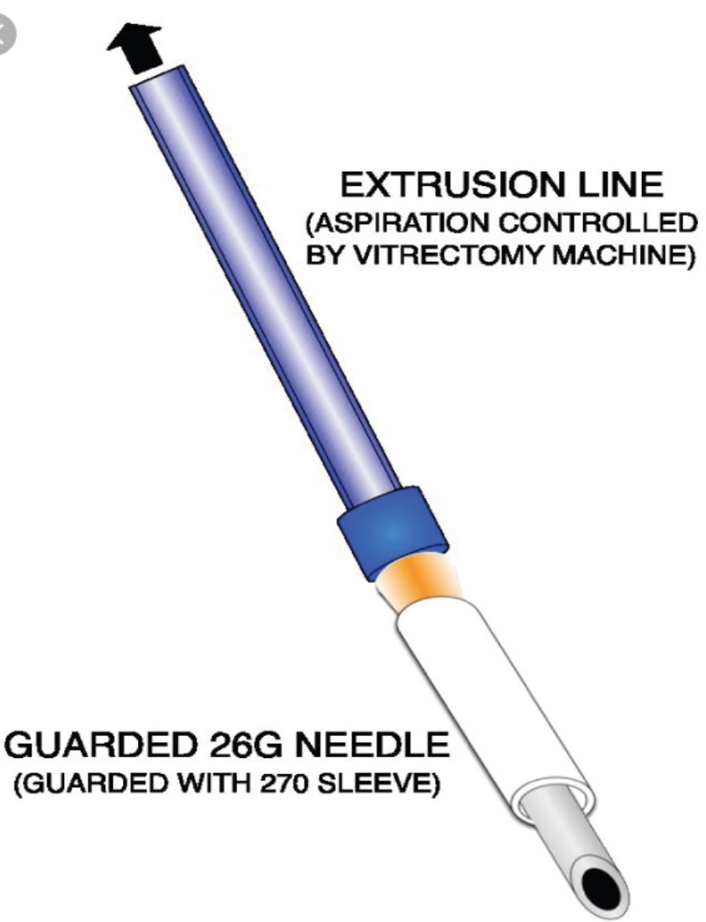
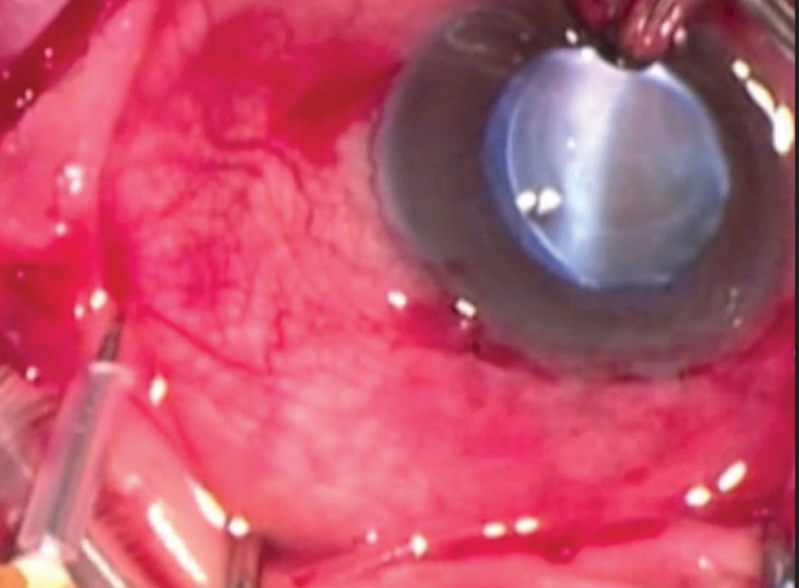
3.Active aspiration of SCH using a guarded needle. Ophthalmic Surg Lasers Imaging Retina. 2014
A guarded 26-needle is used to drain SCH .
Active extrusion used to drain suprachoroidal blood.
successful in draining SCH without complications.
In all cases, vitreous cavity could be restored,
Allowing subsequent PPV.
Optimizes control of SCH drainage
Easy transition to secondary vitrectomy after drainage.

Slide 24
4.Heavy silicone oil and supine position in the management of massive suprachoroidal hemorrhage.Retin Cases Brief Rep. 2012
Massive SCH after a PPV
PPV and Heavy silicone oil endotamponade with supine position can represent a good surgical option in such a dramatic case as a SCH.

Slide 25
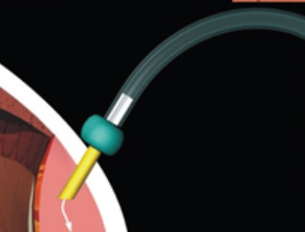
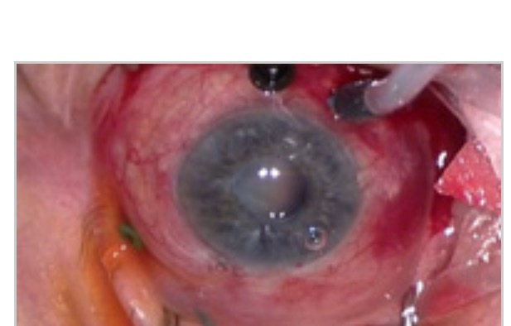
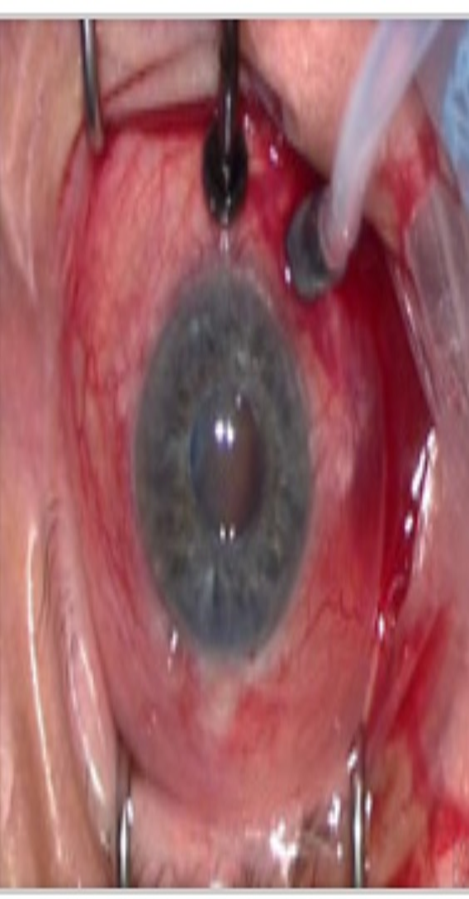
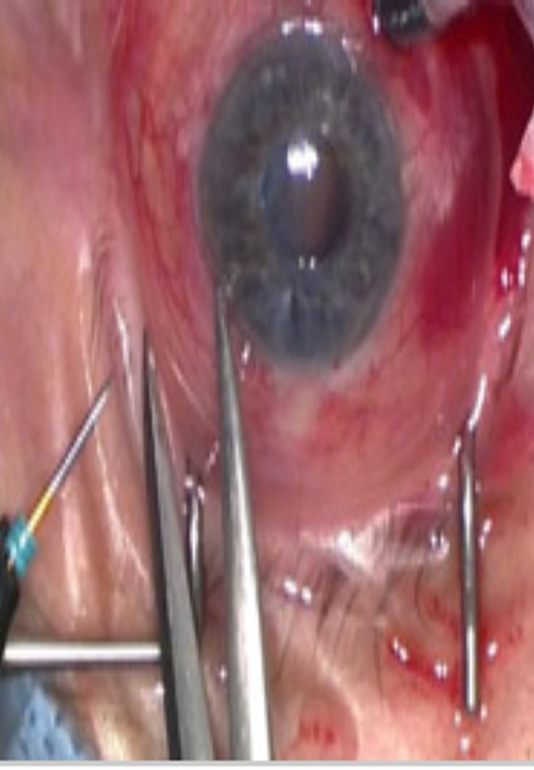
5.Transconjunctival drainage of serous and hemorrhagic choroidal detachment.Retina. 2014
A 25-gauge trocar/cannula system into scs 7.0 mm limbus.
After drainage, cannulas removed with no sutures.

Slide 26
PPV was performed only in eyes with concomitant pathology.
Drainage of SCH resulted in resolution of detachments by 1m postoperatively.
Resolution was achieved by 1 w postdrainage.
The VA improved in all eyes with no complications .
Feasible and simple with minimal scleral and conjunctival damage. PPV may not be necessary when draining choroidal detachments in this manner.

Slide 27
Prognosis:
In vitrectomized eye might be localized, not severe and ended up good without surgical intervention.( Med Hypotheses. 2015)
In general,prognosis of MSCH remains guarded and the visual outcome poor. However, secondary surgical treatment with combined radial sclerotomies and vitrectomy should be considered .(Eur J Ophthalmol. 2014)
In eyes with SCH during PPV ,final visual and anatomic outcomes compromised by persistent RD, secondary glaucoma, and ocular hypotony.
In most cases, intraoperative drainage of SCH is not associated with a better outcome. The prognosis is more favorable if SCH is localized and does not extend in to posterior pole.

