Slide 1
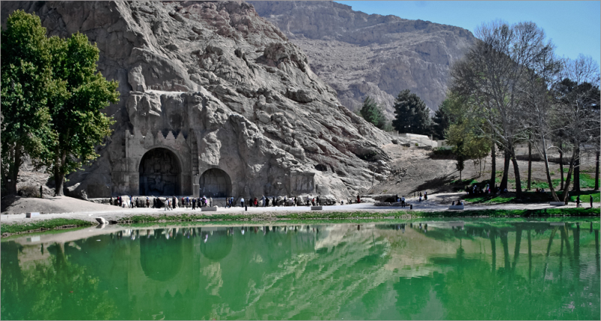
BRANCH RETINAL VEIN OCCLUSION
BRVO

Slide 2
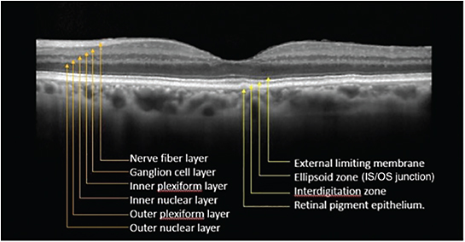

Slide 3
Present by Sattar Heidari MD
General ophthalmologist

Slide 4
Branch Retinal Vein Occlusion
BRVO

Slide 5
INTRODUCTION
RVO is an important cause vision loss among older patient.

Slide 6
Risk factors for the development of BRVO
history of systemic arterial hypertension
cardiovascular disease
increased body mass index at 20 years of age
history of glaucoma

Slide 7
Symptoms
Most patients present complaining of a sudden onset of painless loss of vision.

Slide 8
Clinical Findings
Most occlusions occur in the superotemporal quadrant since most arteriovenous crossings occur in this location.

Slide 9
During the acute phase, intraretinal hemorrhages (usually flame shaped), retinal edema, and cotton-wool spots are seen in the distribution of a retinal vessel.

Slide 10
Normal Retina

Slide 11
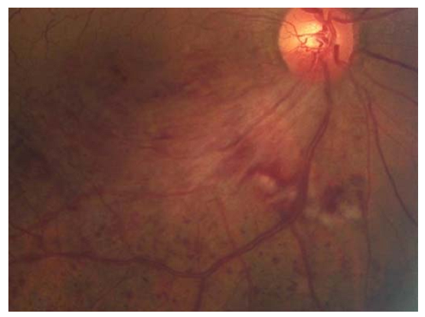

Slide 12
Paraclinic
1- FAG
2- OCT

Slide 13
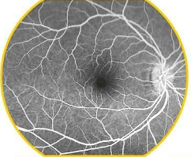
NormalRetina FAG

Slide 14
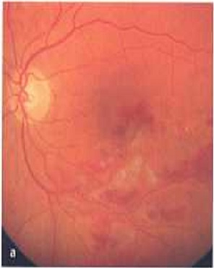
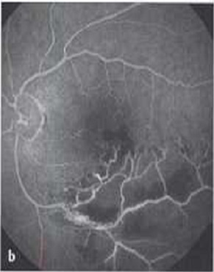
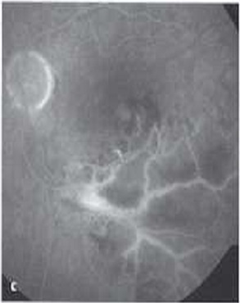

Slide 15
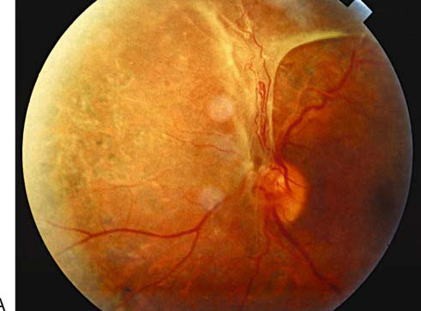
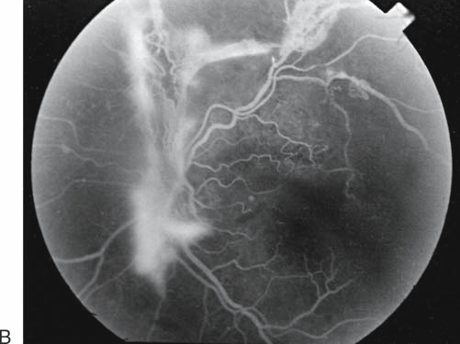

Slide 16
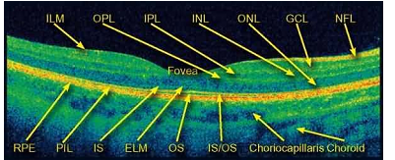

Slide 18
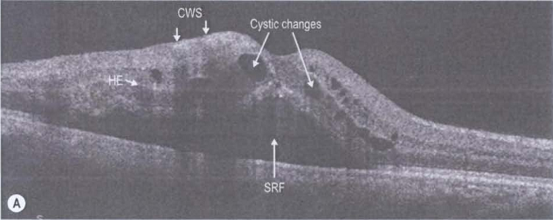

Slide 20
TREATMENT
SYSTEMIC WORK UP
cardiovascular consult

Slide 21
TREATMENT
macular edema
retinal neovascularization
anterior segment neovascularization.

Slide 22
Macular edema
Intravitreal Corticosteroid
intravitrealAnti VEGF
Laser Therapy

Slide 23
4-mginjection triamcinolone. Eyes receiving either dose of corticosteroid were more likely to develop a cataract or experience elevated lOP .

Slide 26
Ozurdex
A dexamethasone (0.7 mg) intravitreal implant was approved in 2009 by the US Food and Drug Administration for the treatment of macular edema in BRVO

Slide 27
VEGF
intravitreal levels of the vascular endothelial derivedgrowth factor protein are significantly increased after BRVOand it is currently thought that ischemia-induced upregulation of VEGF causes a loosening of tight junctions which in return results in vascular leakage and edema.

Slide 28
Angiogenesis
vascular permeability
lymphangiogenesis

Slide 29
Macular edema
anti-vascular endothelial growth factor (VEGF)

Slide 30
Ranibizumab (Lucentis)
Bevacizumab (Avastin)
Aflibercept

Slide 31
Avastin is classified as a "monoclonal antibody" and "anti-angiogenesis" drug.

Slide 32
What Avastin is used for:
Treatment of metastatic colon or rectal cancer, used as part of a combination chemotherapy regimen.
Treatment for non-squamous, non-small cell lung cancer.
Treatment of metastatic breast cancer used as part of a combination chemotherapy regimen.
Treatment of glioblastoma (GBM).
Treatment of metastatic renal cell carcinoma.

Slide 33
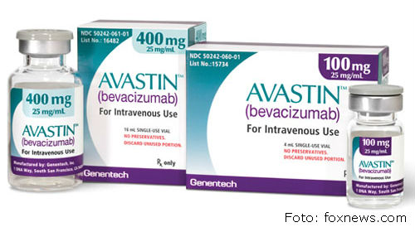

Slide 34
Dosage
0.5mg or 1.25mg

Slide 35
Site injection
3.5 - 4mm from the limbus in inferotemporal

Slide 36
amount introduced into the eye in treatment is very small and has no real systemic effects.

Slide 37
Locally in the eye it can cause infection
bleeding
inflammation
elevation of the internal pressure of the eye
cataract formation acceleration

Slide 38
Aflibercept is a vascular endothelial growth factor (VEGF) inhibitor recently approved by the U.S. Food and Drug Administration for the treatment of diabetic macular edema.

Slide 39
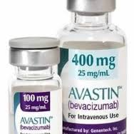

Slide 40
LASER
Neovascularization
Macular edema

Slide 41
Neovascularization of the iris
Scatter laser photocoagulation in the distribution of the occluded vein .

Slide 42
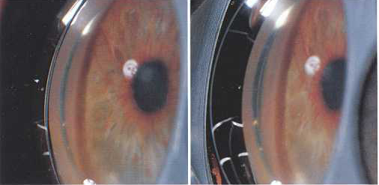

Slide 44
Panretinal photocoagulation
to the area of retinal capillary nonperfusion was effective in causing regression of the new vessels.

Slide 46
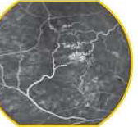

Slide 47
eyes with BRVO in which the foveal vasculature was intact but macular edema had reduced vision to a visual acuity in the 20/40-20/200 range.(5/10 - 1/10)

Slide 48
least 3 months to permit the maximum spontaneous. resolution of the edema and intraretinal blood.

Slide 49
Areas of capillary leakage as identified by recent fluorescein angiography are treated with a light grid pattern using 100- and 200-qm spots. Leaking microvascular abnormalities may be treated directly.

Slide 50
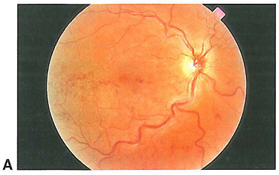
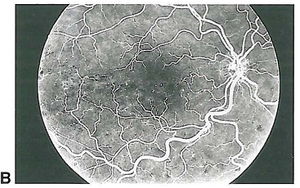
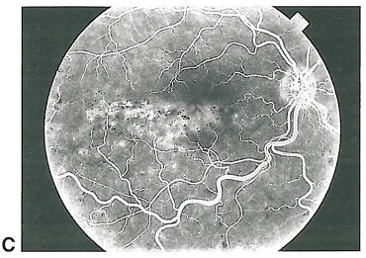
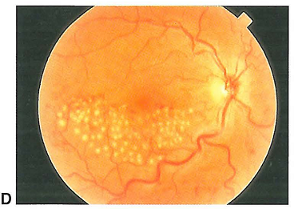

Slide 52
PARS PLANA VITRECTOMY
Vitrectomy may be indicated for eyes that develop nonresorbing vitreous hemorrhage or retinal detachment.

Slide 53
THANKS YOU

