Slide 1
ROLE OF VITRECTOMY IN UVEITIS
M M PARVARESH MD
RASOUL AKRAM HOSPITAL
IUMs
Apil 2016 kermanshah

Slide 2
VITRECTOMY IN UVEITIS
Pars plana vitrectomy has evolved over the past 40 years since it was first introduced by Machemer.
Recent advances include sutureless 23 ,25 and 27 gauge technology , wide angle viewing systems and improved machine fluidics improved safety.

Slide 3
VITRECTOMY IN UVEITIS
1- Dignostic vitrectomy
2-Vitrectomy for repair of structural complications of uveitis
3-Therapeutic vitrectomy
4-prophylactic vitrectomy

Slide 4
DIAGNOSTIC VITRECTOMY
Diagnostic vitreoretinal surgery should be considered when other noninvasive methods of diagnosis have failed to establish a pathoetiologic diagnosis especially when the biopsy results have the potential to significantly alter the management of uveitis.

Slide 5
DIAGNOSTIC VITRECTOMY
Diagnostic vitrectomy
Indications
Chronic uveitis of unknown etiology
Clinical presentation insufficient to make diagnosis
Atypical presentation
Systemic workup inconclusive
Inadequate response to conventional therapy
Suspected intraocular malignancy
Suspected intraocular infection

Slide 6
Vitrectomy for repair of structural complications of uveitis
Pars plana vitrectomy is generally accepted as safe for the repair of structural complications of uveitis

Slide 7
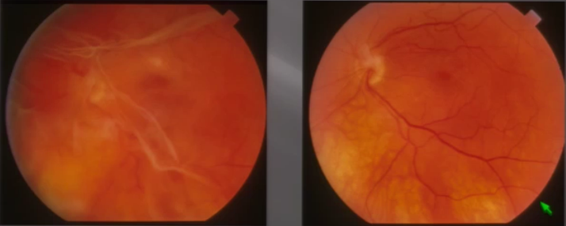
Vitrectomy for repair of structural complications of uveitis
Vitreous opacifications and debris
Retained lens material and lens induced
Vitreous debris due to toxoplasmosis before and after PPV

Slide 8
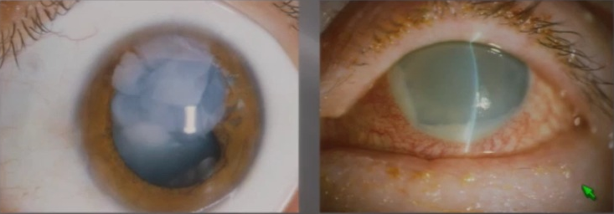
Vitrectomy for repair of structural complications of uveitis
Vitreous opacifications , debris and hemorrhage
Retained lens material and lens induced uveitis
Epiretinal membranes and CME
Tractional and RRD
Hypotony and cyclitic membranes
Uveitic glaucoma and posterior tube placemen

Slide 9
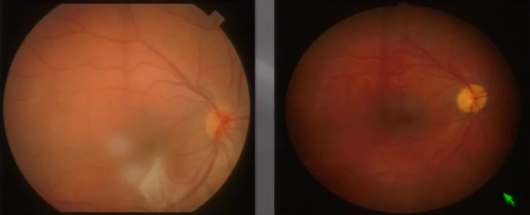
Vitrectomy for repair of structural complications of uveitis
Vitreous opacifications , debris and hemorrhage
Retained lens material and lens induced uveitis
Epiretinal membranes and CME
Tractional and RRD
Hypotony and cyclitic membranes
Uveitic glaucoma and

Slide 10
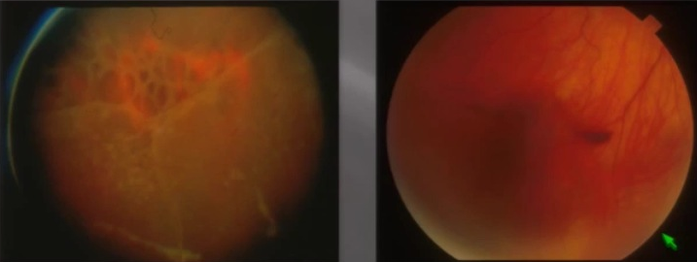
Vitrectomy for repair of structural complications of uveitis
Vitreous opacifications , debris and hemorrhage
Retained lens material and lens induced uveitis
Epiretinal membranes and CME
Tractional and RRD
RD following ARN before and after PPV

Slide 11
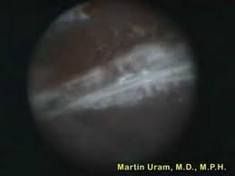
Vitrectomy for repair of structural complications of uveitis
Vitreous opacifications , debris and hemorrhage
Retained lens material and lens induced uveitis
Epiretinal membranes and CME
Tractional and RRD
Hypotony and cyclitic membranes
Uveitic glaucoma and

Slide 12
Vitrectomy for repair of structural complications of uveitis
Vitreous opacifications , debris and hemorrhage
Retained lens material and lens induced uveitis
Epiretinal membranes and CME
Tractional and RRD
Hypotony and cyclitic membranes
Uveitic glaucoma and posterior tube placement

Slide 13
Vitrectomy for repair of structural complications of uveitis
Perioperative Management
For non-emergent procedures, it is certainly advisable to adequately suppress inflammatory activity utilizing topical regional and systemic steroids with or without systemic steroid-sparing IMT as necessary for a minimum of 3 months prior to surgery, particularly if cataract and intraocular lens (IOL) implantation is contemplated.

Slide 14
Vitrectomy for repair of structural complications of uveitis
Perioperative Management
In endophthalmitis, lens-induced uveitis and vitreous surgery designed to control medically unresponsive uveitis, PPV must be performed while the eye is still inflamed.
Surgery in the presence of active intraocular inflammation carries a much higher potential for surgical complications.

Slide 15
Therapeutic vitrectomy
Inflammatory Control
Pars plana vitrectomy has a definitive role in the management of acute post cataract surgery endophthalmitis as defined by the (EVS) guidelines and for endophalmitis following glaucoma filtering surgery and in patients with post-traumatic endophthalmitis.

Slide 16
Therapeutic vitrectomy
Inflammatory Control
PPV is the preferred modality in cases of phacogenic uveitis, which occurs when lens material is retained in the eye following cataract surgery or ocular trauma or in the setting of phacolytic glaucoma.

Slide 17
Vitrectomy for the control of uveitis activity
The therapeutic role of PPV in the management of noninfectious intermediate, posterior or panuveitis is less well-defined.

Slide 18
Vitrectomy for the control of uveitis activity
Scott and colleagues reported a statistically significant decrease in the recurrence rate of intermediate, posterior and panuveitis.
Trittibach and associates reported a statistically significant reduction in the percentage of eyes with uveitis relapses in pediatric patients with chronic uveitis following PPV.
Scott RA, Haynes RJ, Orr GM, et al. Vitreous surgery in the management of chronic endogenous posterior uveitis. Eye (Lond). 2003;17:221-7.
Trittibach P, Koerner F, Sarra GM, et al. Vitrectomy for juvenile uveitis: prognostic factors for the long-term functional outcome.Eye (Lond). 2006;20:184-90.

Slide 19
Vitrectomy for the control of uveitis activity
Becker and Davis – 1981-2005
Literature review of PPV in 1575 uveitis patients and 1792 eyes from 44 articles
Showed improved vision in 68%, reduced systemic medications in 57% and CME reduced from 36% to 18%
Becker M, Davis J. Vitrectomy in the treatment of uveitis. Am JOphthalmol. 2005;140:1096-105.

Slide 20
Vitrectomy for the control of uveitis activity
Becker and Davis – 1981-2005
PPV recommended in 41 of 44 papers (93%)
Complications included RD (4%), cataract (6%) and vitreous hemorrhage (1%)
Based on the evidence in the literature , PPV is possibly relevant to the outcomes of improving vision and reducing inflammation and CME
Randomized and controlled trials are needed for PPV as an adjunct to the medical treatment of uveitis
Becker M, Davis J. Vitrectomy in the treatment of uveitis. Am JOphthalmol. 2005;140:1096-105.

Slide 21
Vitrectomy for the control of uveitis activity
Tranos P, Scott R, Zambarakji H, et al.
Prospective randomized controlled pilot study of PPV in 23 medically unresponsive patients with intermediate or posterior uveitis
PPV group had statistically significant improved VA from logMAR 1.0 to 0.55 (p<0.011) and 42% at 20/40 or better while the medical arm had no significant improvement in VA
CME improved in 4 eyes (33%)following PPV and 1 eye (14%) with medical therapy
Tranos P, Scott R, Zambarakji H, et al. The effect of pars plana vitrectomy on cystoid macular oedema associated with chronic uveitis: a randomised, controlled pilot study. Br J Ophthalmol. 2006;90:1107-10.

Slide 22
Vitrectomy for the control of uveitis activity
Giuliari,Chang,Thakuria,Hinkle and foster-2010
(Medically unresponsive)
Retrospective review of 28 eyes following vitrectomy for pediatric uveitis (n=20 patients),Pars planitis (n=15),idiopathic panuveitis (n=8) and JIA associated iridocyclitis (n-=5)
All 28 eyes had active uveitis on medications at PPV
27 eyes (96%) were controlled at last follow-up(13.5 months average) with reduced systematic medications following PPV
Five of six eyes with associated retinal vasculitis were controlled
Two eyes had intra-operative retinal tear and 4 developed a cataract
Giuliari GP, Chang PY, Thakuria P, et al. Pars plana vitrectomy in the management of pediatric uveitis: the Massachusetts Eye Research and Surgery Institution experience. Eye (Lond).2010;24:7-13.

Slide 23
Vitrectomy for the control of uveitis activity
Quinones, Choi, Yilmaz and Foster – 2010
(Randomized and controlled )
Prospective randomized pilot study on 18 eyes(n=16 patients) with intermediate uveitis
The PPV group 9 of 11 eyes (82%) had disease resolution off systemic medications at 5.93 years with better VA ,IOP and vitreous cell reduction
The IMT group(4 of 7 eyes)(57%) failed and required PPV
CME resolved in 3 of 3 eyes with PPV and in 2 of 3 with IMT
There were no surgical complications with PPV and two patients on IMT had a reversible anemia and leukopenia
Quinones K, Choi JY, Yilmaz T, et al. Pars plana vitrectomyVersus Immunomodulatory therapy for intermediate uveitis: a prospective,randomized pilot study. Ocul Immunol Inflamm.2010;18:411-7.

Slide 24
Vitrectomy for the control of uveitis activity
Bacskulin and Eckardt
PPV in 19 eyes of 13 children with chronic uveitis with significant visual improvement in 63% (12) and regression of CME in 7 of 8 cases following surgery.
The level of inflammation decreased in two thirds of cases such that the dose of corticosteroids could be reduced postoperatively
B acskulin A, Eckardt C. Results of pars plana vitrectomy in chronic uveitis in childhood. Ophthalmologe. 1993;90:434-9.

Slide 25
Vitrectomy for the control of uveitis activity
Theoritic mechanism of a action
Removal of ocular auto antigen –type 2 collagen in the vitreous and lens antigens.
Removal of auto-reactive immune cells and proinflammatory cytokines(IL1, IL2, TNF-a, etc).
Alter the immunologic milieu with aqueous humor
- Anti-inflammatory cytokines-TGF-B and VIP
- Inhibition of complement fixation
- Apoptosis

Slide 26
Vitrectomy for the control of uveitis activity
Theoretic mechanism of a action
vitrectomized eye improves the ocular penetration of systemically administered anti-inflammatory medications and may reduce the dosage requirement of these drugs in controlling uveitis.

Slide 27
Vitrectomy for the control of uveitis activity
Type II collagen is an autoantigen found only in the vitreous cavity and in joints. Patients with several uveitic syndromes have T cells in their blood that are reactive to type II collagen.
The detection of infectious organisms in uveitic eyes with quiescent inflammation and intraocular antibody production further supports the notion that the vitreous may act as a reservoir of immunoreactive material.
Stuart JM, Cremer MA, Dixit SN, et al. Collagen-induced arthritis in rats. Comparison of vitreous and cartilage-derived collagens.Arthritis Rheum. 1979;22:347-52.28
Nguyen QD, Humphrey RL, Dunn JP, et al. Elevated vitreous concentration of monoclonal immunoglobulin manifesting as schlieren in juvenile idiopathic arthritis-associated uveitis. ArchOphthalmol. 2001;119:293-6.31
Quentin CD, Reiber H. Fuchs heterochromic cyclitis: rubella virusantibodies and genome in aqueous humor. Am J Ophthalmol.302004;138:46-54.

Slide 28
Vitrectomy for the control of uveitis activity
With respect to uveitic CME, it has been suggested that cytokines and chemokines released into the vitreous potentiate a firm attachment of the posterior hyaloid to the macula with subsequent fibrosis and contraction of the posterior hyaloid and/or ILM, creating tangential traction on the retina and the development of macular edema.
Schaal S, Tezel TH, Kaplan HJ. Surgical intervention in refractory CME—role of posterior hyaloid separation and internal limiting membrane peeling. Ocul Immunol Inflamm. 2008;16:209-10.
Ossewaarde-van Norel A, Rothova A. Clinical review: update on treatment of inflammatory macular edema. Ocul Immunol Inflamm. 2011;19:75-83.

Slide 29
Vitrectomy for the control of uveitis activity
In selected cases, before irreversible damage to the retinal pigment epithelium (RPE)- photoreceptor complex has occurred, PPV with separation of the posterior hyaloid and/or removal of the ILM may relieve CME refractory to medical therapy.
Schaal S, Tezel TH, Kaplan HJ. Surgical intervention in refractory CME—role of posterior hyaloid separation and internal limiting membrane peeling. Ocul Immunol Inflamm. 2008;16:209-10.
Ossewaarde-van Norel A, Rothova A. Clinical review: update on treatment of inflammatory macular edema. Ocul Immunol Inflamm. 2011;19:75-83

Slide 30
Vitrectomy for the control of uveitis activity
Disadvantages of PPV include:
1)Elimination the vitreous as a drug depot for further intravitreal therapy.
2) Removal of the familiar inflammatory indices of cell and haze with which to grade vitritis, underscoring the inherent difficulties in comparing medical treatments in a controlled fashion.

Slide 31
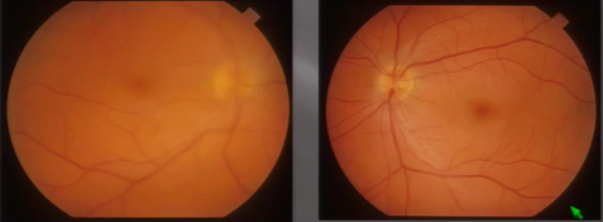
Vitrectomy for the control of uveitis activity
active
Active Pars planitis OD on medical therapy and inactive OS following therapeutic PPV

Slide 32
Vitrectomy for the control of uveitis activity
PPV may offer an alternative to or be used adjunctively with IMT by altering the natural history of inflammation in selected patients with :
1- Attenuation in disease activity and the number of inflammatory recurrences
2- A reduction in CME
3- A diminish requirement for anti- inflammatory medications and an improvement in vision.

Slide 33
Vitrectomy for the control of uveitis activity
Therapeutic PPV for non-infectious uveitis remains controversial among uveitis specialists
COST/ RISK/Benefit Ratio – PPV
COST/ RISK/Benefit Ratio - IMT

Slide 34
Vitrectomy for the control of uveitis activity
Variables
1) Different forms of non-infectious uveitis
-Systemic disease vs local forms
-Anterior, posterior, intermediate, and panuveitis forms
2) Stages and severity of the disease
3)The presence of CME , cataract , ERM and glaucoma
4) Timing of surgery and surgical expertise
5) Adjunctive use of steroids and IMT

Slide 35
Prophylactic vitrectomy
There are some reports about prophylactic vitrectomy in patients with ARN .
But definitive role of PPV in these cases is unknown.

Slide 36
Conclusion
Based on the evidence in the literature PPV appears to be nearly safe and helpful in controlling inflammation, reducing CME, improving VA and reducing the number of medications required to control uveitis in selected cases.

Slide 37
Conclusion
Therapeutic PPV is recommended in patients with non-infectious uveitis as part of a balanced, individualized and case-by-case approach to control inflammation

Slide 38
Conclusion
A multi-centered well designed, randomized and controlled clinical trial is needed to confirm these observation and conclusions.

Slide 39
THANK YOU FOR YOUR ATTENTION

