Slide 1
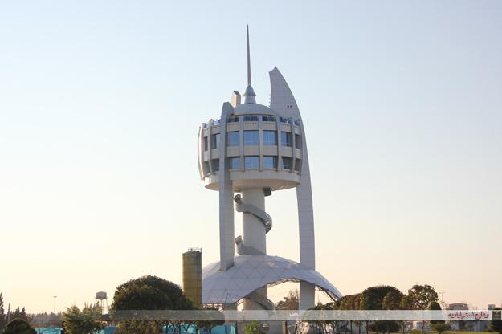
خدا
نام
به

Slide 2
A 41 years old lady , married from Gorgan was presented to retina clinic with metamorphopsia and decreased vision of right eye . No other positive history , No trauma, No drug, No surgery…

Slide 3
In PE:
V/A: OD: 20/200 OS: 20/20
Iop : normal SLE: Normal
Fundoscopy : Epiretinal membrane OD and normal findings : OS
OCT was ordered: 15.6.2014 93خرداد
Surgery was planned.

Slide 4
She went to home and returned 11 months later, Her vision was 20/30 OD

Slide 5
Another OCT was ordered. She went and again was visited with a new OCT 15.2.2016. Her visual acuity was 20/20.Surprise .

Slide 6
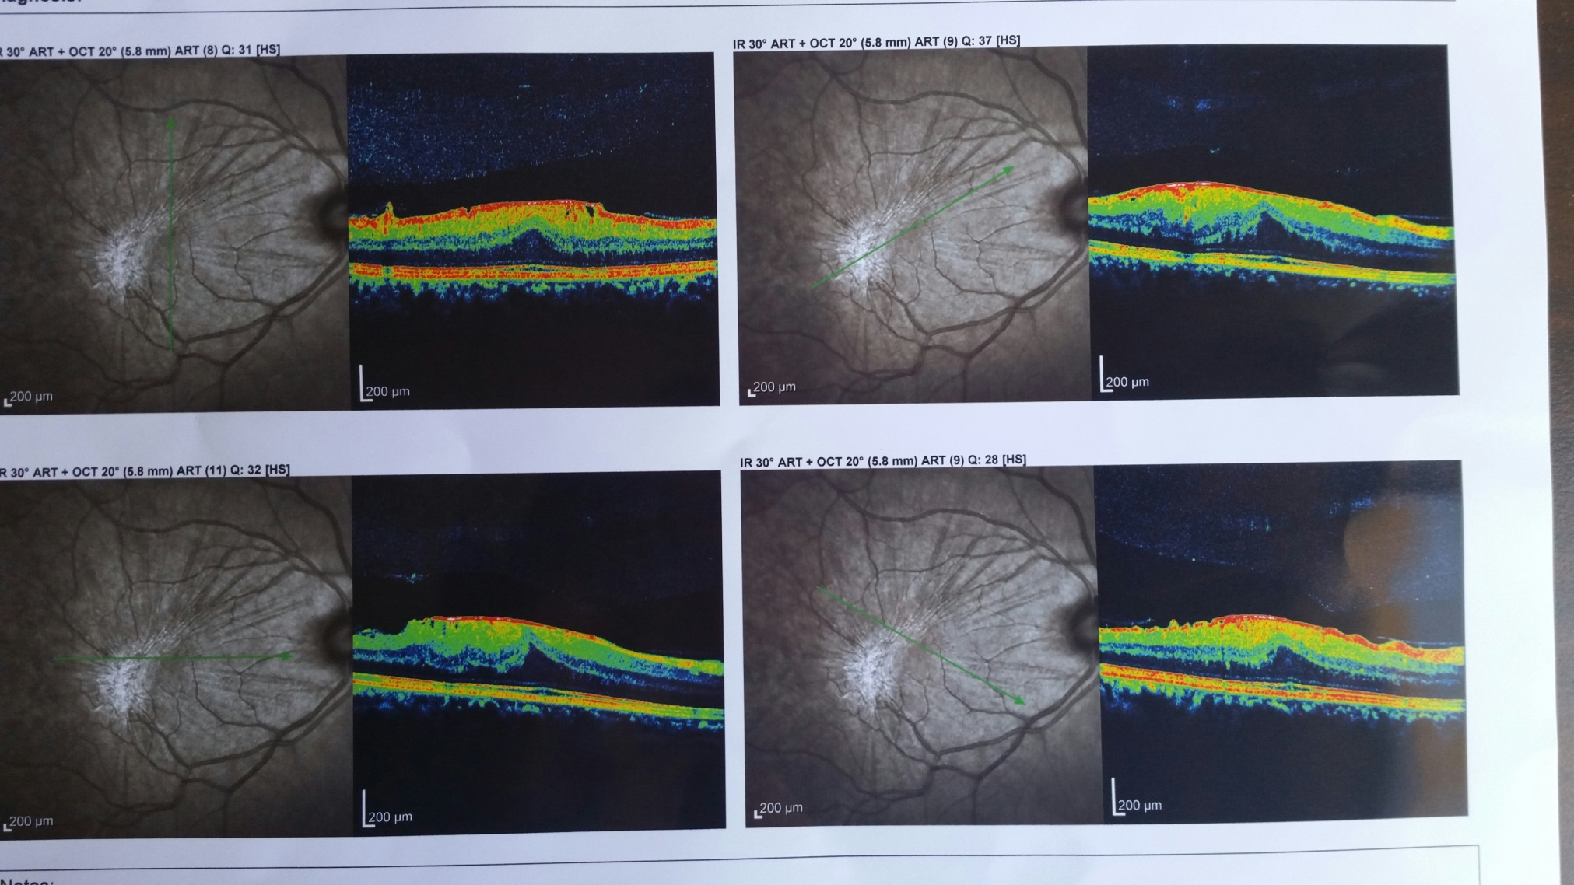

Slide 7
