Slide 1
Legal and Regulatory Issues in Pain Management
دکترارتین کمالی ثابتی
(متخصص پزشکی قانونی ومسمومیتها)

Slide 2
LAWS AND POLICIES AFFECTING PAIN MANAGEMENT
painrelated laws have not kept pace with advances in medical
and scientific understanding
This has particular implications for treating pain with opioids
clinicians generally do not receive training in legal and regulatory issues related to opioid prescribing, and are not familiar with the federal and state laws
Controlled substances laws govern the distribution of prescription medications
closed distribution system to minimize their abuse, trafficking, and diversion

Slide 3
“Controlled substances” status of any medication is not intended to diminish its medical usefulness or create the perception that practitioners should avoid its use when appropriate

Slide 4
The CSA specifies five classification schedules for controlled
substances:
- Schedule I controlled substances (e.g.,heroin, LSD, and marijuana) have no currently accepted medical use
- Drugs that have an approved medical use are placed in Schedules II through V according to potential for abuse
- Schedule II controlled substances in medical emergencies
under specific circumstances

Slide 5
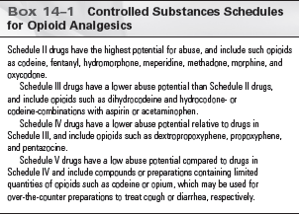

Slide 6
Treating Addiction versus Treating Pain
methadone,a Schedule II medication approved for the purpose of addiction treatment, also can be prescribed as an analgesic according to the same laws

Slide 7
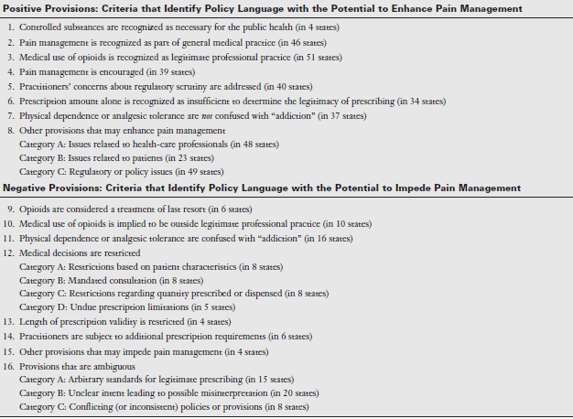

Slide 8
health-care regulatory boards (e.g., medical, osteopathic, pharmacy, and nursing) in some states have worked together to adopt joint guidelines for pain management, palliative care, and end-of-life care.
Inadequately treated pain is a multifactorial phenomenon
insufficient to guarantee patient access to appropriate pain relief and symptom control
Health-care practitioners increasingly have assumed a leadership role in collaborating that avoids undue restrictions, recognizes the professional obligation to treat pain, and promotes effective patient pain care

Slide 9
CRIMINAL LITIGATION
pain management usually involve allegations that
excessive prescribing of opioids either lead to patient’s
untimely death and therefore constituted homicide, or
that the prescriptions had no legitimate medical purpose

Slide 10
CONCLUSION
policy change actions improve laws
Health-care institutions and professionals are now
on notice that pain management must be a priority in
patient care

Slide 11
