Slide 1
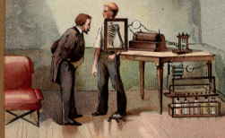
Radiation protection in flouroscopy
فرهاد نعلینی. رادیولوژیست.دانشگاه علوم پزشکی کرمانشاه

Slide 3
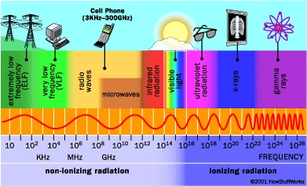
X ray is an electromagnetic radiation

Slide 4
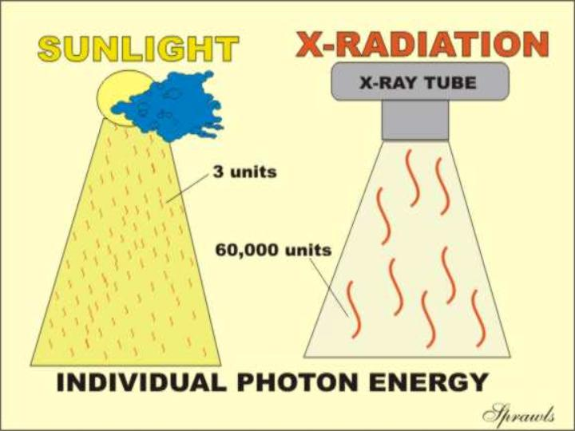

Slide 5
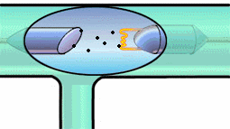
X ray production
mA & kVp are key concepts

Slide 6
dose
mAs
image
kVp

Slide 7
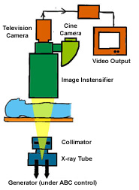
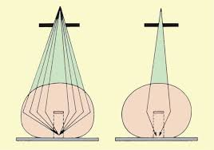
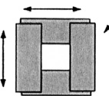
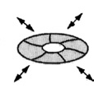
Flouroscopy system

Slide 8
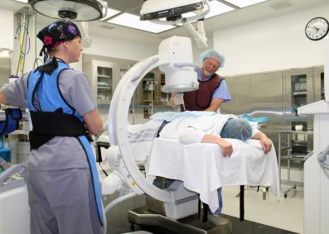
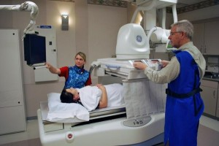

Slide 9
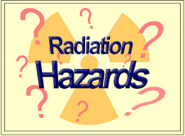

Slide 10
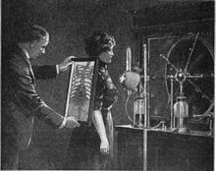
Thoracic fluoroscopy using handheld fluorescent screen, 1909. No radiation protection is used, as the dangers of x-rays were not yet recognised
Notes:
Thoracic fluoroscopy using handheld fluorescent screen, 1909. No radiation protection is used, as the dangers of x-rays were not yet recognised

Slide 11
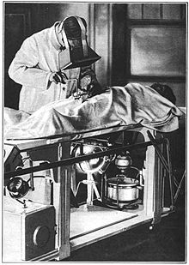
Surgical operation during World War I using a fluoroscope to find embedded bullets
Notes:
Surgical operation during World War I using a fluoroscope to find embedded bullets

Slide 12
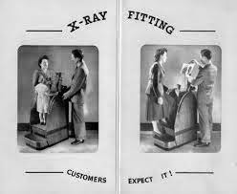
Pedscope!!!
Notes:
Now you may like me remember as children going to your friendly shoe shop and being measured by the shop assistant using a fantoosh x-ray machine. A fluorescent image of the feet was reflected to three viewing ports at the top of the x ray cabinet, where the customer, the salesperson, and a third person usually accompanying adult could gaze with wonderment at the foot sitting in the new shoe. Tres space age. The Pedoscope remained in vogue for well over 40 years, but are nowhere to be seen now. Where did they come from, and perhaps more importantly where are they now?

Slide 13
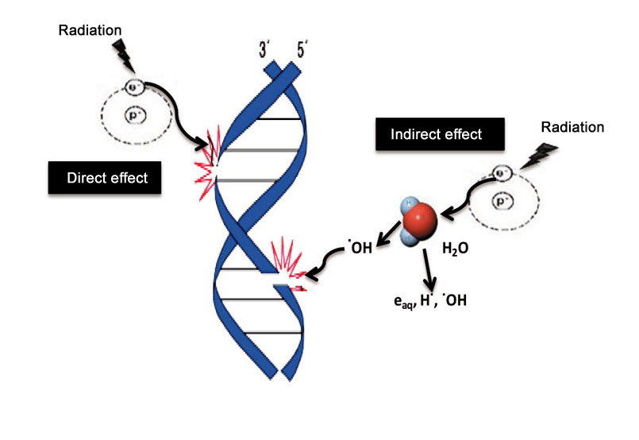
Biological effects

Slide 14
Biological effects
deterministic
stochastic
Early
late
late
Nausea diarrhea skin lesions hair loss bleeding cytopenia infertility ……….
cataract
Somatic
Hereditary
cancer
Genetic teratogenic

Slide 15
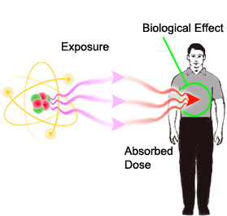
Biological effects, quantification
REM , Sivert
1Si = 100Rem
Rontgen
RAD , Gray
1Gy = 100RAD

Slide 16
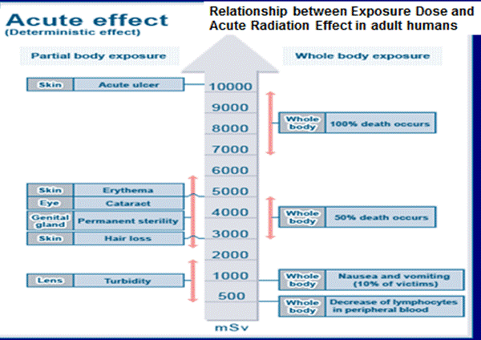
Notes:
Acute radiation effects can be observed after irradiation of the greater part of the body. A latent period supervenes after initial symptoms of malaise, loss of appetite and fatigue. The length of this period is roughly inversely proportional to the radiation dose received. The end of the latent period is followed by the onset of the illness: early lethality, des­truction of bone marrow, damage to the gastrointestinal tract associated with diarrhoea and haemorrhage, central nervous system symptoms, epilation, dermatitis, sterility. Pathological acute effects arise after exposure to doses hundreds of times greater than those likely to be received from environmental contamination, except in major accidents.

Slide 17
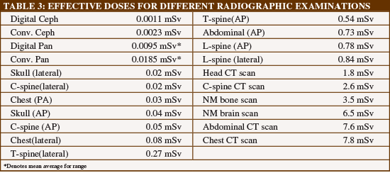

Slide 20
Radiation protection TDS
Notes:
Time
Reduce the time spend working with radioactive materials as much as possible. A good work practice is to perform the experiment without radioactive material first, to get used to the procedures, and perform the first experiment (if possible) with the smallest amount of radioactive material that will give a readable result. After becoming familiar with the procedures and safe handling of these materials, the quantities used can be increased.
Distance
The second method involves increasing the distance between the body and radioactive materials. Always store radioactive materials and radioactive waste far from other working areas and/or offices. What if the procedure requires working with radioactive materials close to the body? Whenever possible, especially for strong beta and gamma emitters, use tools. Don't touch the materials with hands unless strictly necessary. However, if hand contact cannot be avoided, manipulation of the materials with gloved hands is required.
Shielding
Most work with radioactive materials at the University will require that the user be quite close to the material. Therefore, working behind shielding is recommended. As explained earlier, different kinds of shielding must be used for different radionuclides. No shielding is required for pure alpha or pure low energy beta emitters. Plexiglass shielding is required for beta emitters, metal for gamma or X-rays, water, and wax or concrete for neutrons. Large enough layers of air, water, or concrete can protect the human body from all types of radiation.
Always check the effectiveness of the shielding before starting an experiment.

Slide 21
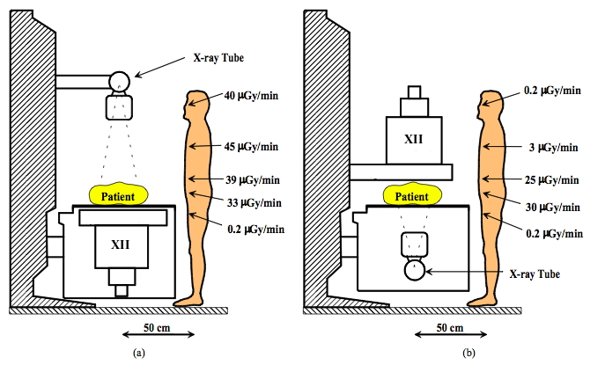
Typical occupational skin absorbed dose rates near fixed fluoroscopic equipment in the absence of protective aprons and drapes: (a) over-couch and (b) under-couch X-ray tube.
Notes:
Typical occupational skin absorbed dose rates near fixed fluoroscopic equipment in the absence of protective aprons and drapes: (a) over-couch and (b) under-couch X-ray tube.

Slide 22
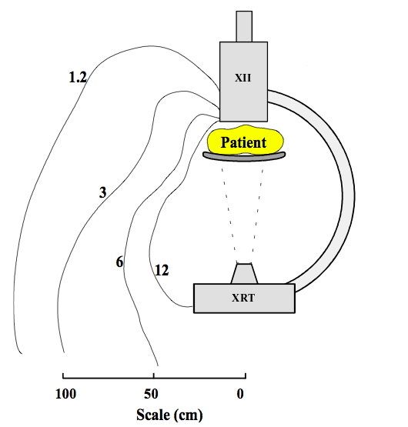
Typical isodose curves (in μGy/min) for a mobile C-arm fluoroscopy system
Notes:
Typical isodose curves (in μGy/min) for a mobile C-arm fluoroscopy system.

Slide 23
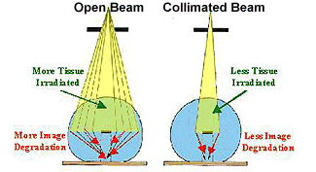
Collimation effect
Notes:
Benefits from using collimation
Limiting beam size by using the collimators provides benefits to both patient and image.
Less tissue is subject to radiation exposure, reducing patient risk and also scatter production.
Reducing scatter radiation improves image quality since scatter only contributes noise to the image.

Slide 24
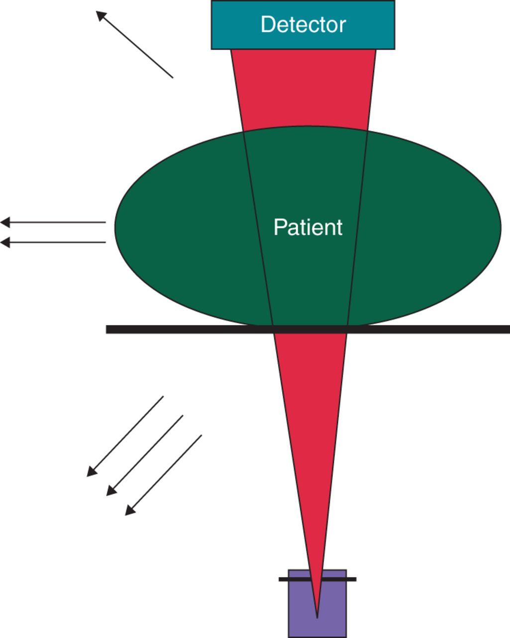
Back scattered radiation

Slide 25
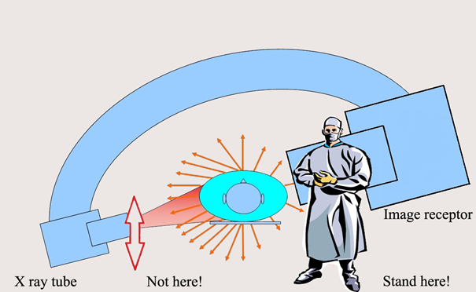
standing in relation to the X ray tube during a fluoroscopic procedure
Notes:
. Where should I stand in relation to the X ray tube during a fluoroscopic procedure?
The scattered radiation from the patient comprises the main source of radiation dose to staff. Measurements have shown that scattered radiation from a patient’s body is more intense at the entrance side of X ray beam, i.e. on the side where the X ray tube is located. Therefore it is better to stand on the side of the detector, that is the exit side, and not on the X ray tube side during a fluoroscopic procedure. Typically only around 1% to 5 % of the radiation falling on the patient body comes out on the exit side. So if you stand on the side of transmitted beam you encounter scattered radiation corresponding to only 1% to 5% of the incident beam intensity, whereas you encounter scattered radiation corresponding to 100% of the entrance beam intensity on other side.

Slide 26
shielding
Notes:
Shielding
Most work with radioactive materials at the University will require that the user be quite close to the material. Therefore, working behind shielding is recommended. As explained earlier, different kinds of shielding must be used for different radionuclides. No shielding is required for pure alpha or pure low energy beta emitters. Plexiglass shielding is required for beta emitters, metal for gamma or X-rays, water, and wax or concrete for neutrons. Large enough layers of air, water, or concrete can protect the human body from all types of radiation.
Always check the effectiveness of the shielding before starting an experiment.

Slide 27
10 Pearls: Radiation protection of patients in fluoroscopy

Slide 28
1. Maximize distance between the X ray tube and the patient to the extent possible

Slide 29
2. Minimize distance between the patient and the image receptor

Slide 30
3. Minimize fluoroscopy time Keep records of fluoroscopy time and DAP/KAP (if available) for every patient

Slide 31
4. Use pulsed fluoroscopy with the lowest frame rate possible to obtain images of acceptable quality

Slide 32
5. Avoid exposing the same area of the skin in different projections Vary the beam entrance port by rotating the tube around the patient

Slide 33
6. Larger patients or thicker body parts trigger an increase in entrance surface dose (ESD)

Slide 34
7. Oblique projections also increase ESD
Be aware that increased ESD increases the probability of skin injury

Slide 35
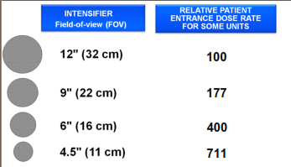
8. Avoid the use of magnification
Decreasing the field of view by a factor of two increases dose rate by a factor of four

Slide 36
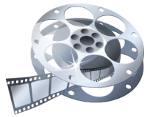
9. Minimize number of frames and cine runs to clinically acceptable level
Documentation should be performed with last image hold whenever possible and not with cine images

Slide 37
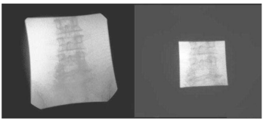
10. Use collimation Collimate the X ray beam to the area of interest

Slide 38
10 Pearls: Radiation protection of staff in fluoroscopy
Reducing patient dose always results in staff dose reduction

Slide 39
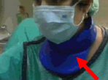
1. Use protective devices!
Advisable skirt type lead apron to distribute weight
0.25 mm lead equivalence but with overlap on front to make it 0.5 mm on the front and 0.25 mm on the back
(Provides >90% protection)
Lead glass eyewear with side protection
Thyroid protection

Slide 40
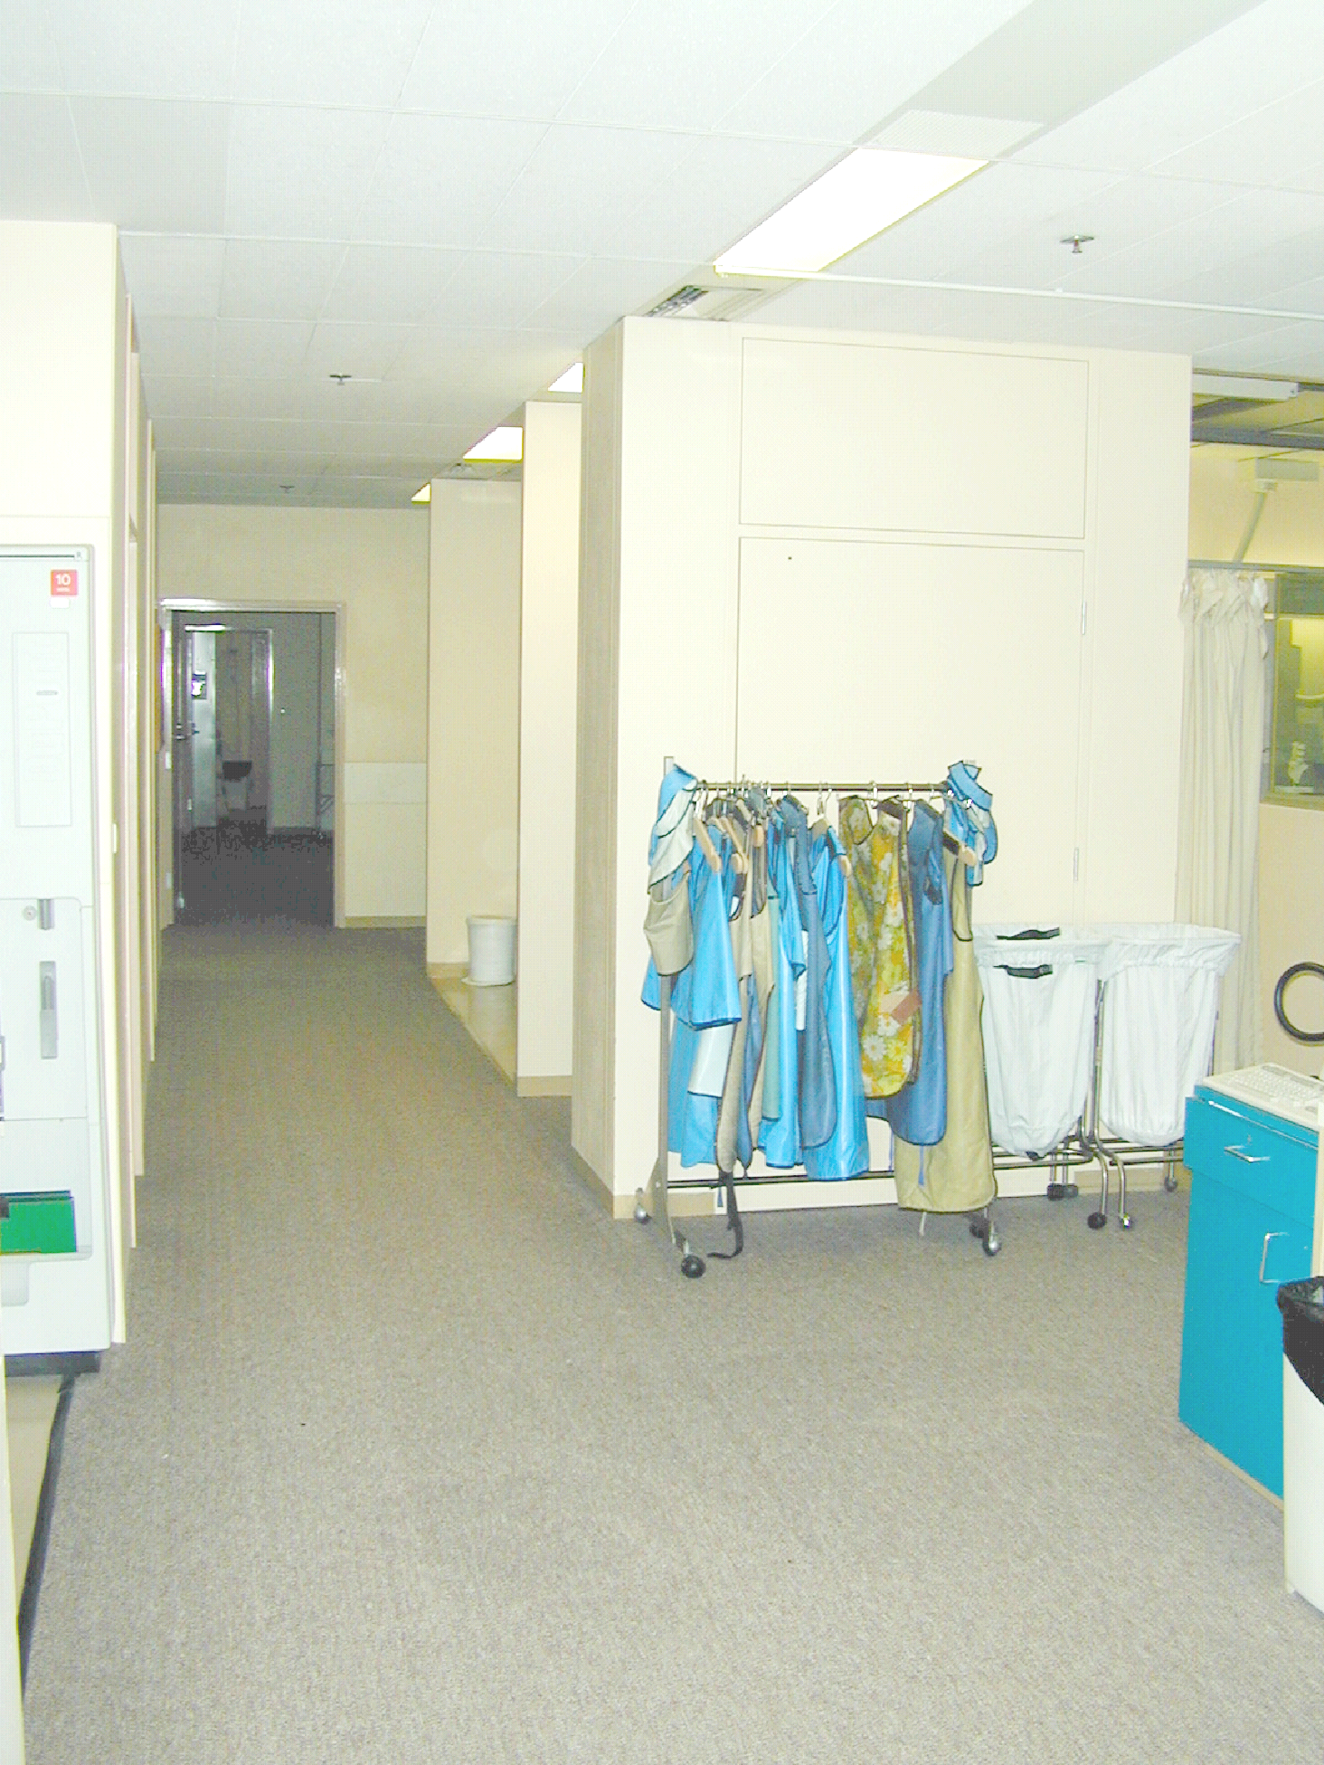

Slide 41
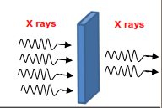
2. Make good use of time-distance-shielding (TDS) principle
Minimize time
Use shielding
Maximize distance as much as clinically possible

Slide 42
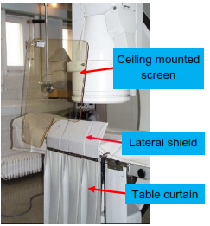
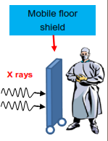
3. Use ceiling suspended screens, lateral shields and table curtains
They provide more than 90% protection from scattered radiation in fluoroscopy
Mobile floor shielding is advisable when using cine acquisition

Slide 43
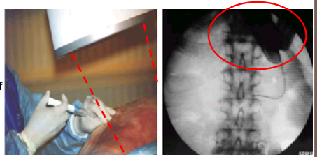
4. Keep hands outside the primary beam unless totally unavoidable
Hands inside the central area of the primary beam will increase exposure factors (kV, mA) and doses to patient and staff

Slide 44
5. Only 1-5% of radiation falling on the patient’s body exits the other side
Stand on the side of the transmitted beam (i.e. by the detector), which contains only 1-5% of the incident radiation and its respective scatter

Slide 45
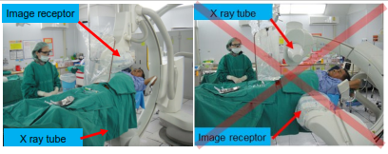
6. Keep X ray tube under the patient table and not over it
Undercouch systems provide better protection from scattered dose

Slide 46
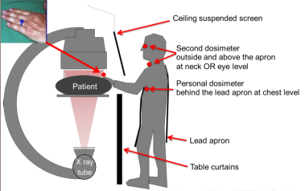
7. Use personal dosimetry- Use at least two dosimeters
One inside the apron at chest level
One outside the apron at neck or eye level
Additional finger ring dosimeter for procedures requiring hands close to primary beam

Slide 47
8. Update your knowledge about radiation protection

Slide 48
9. Address your concerns about radiation protection to radiation protection specialists (medical physicists)

Slide 49
10. REMEMBER
• Quality control testing of fluoroscopy equipment enables safe and stable performance
• Know your equipment! Using the equipment’s features appropriately will help reduce doses to patients and staff
• Use injector devices

