Slide 1
به نام خداوند بخشنده مهربان
شرایط محیطی لازم در زمان بستری نوزادان پره ترم

Slide 2
The Thermal Environment of the Intensive Care Nursery
Protecting infants against excessive heat loss:
1- improves their chances for survival
2- reduces their need to perform heat producing metabolic work
3- eliminates the problems associated with rewarming of cold infants.
During intrauterine life, fetal temperature that is about 0.5°C higher than the maternal temperature.
After birth, the newborn infant is exposed to air and surfaces facing the infant, which have a much lower temperature than that previously experienced in utero. The skin at birth is covered with amniotic fluid,causing heat loss through evaporation in an environment. As a result, the body temperature of the infant decreases.
This gives rise to thermogenic responses that increase basal heat production,and the skin circulation may decrease to lower the heat losses.

Slide 3
شرایط محیطی لازم در زمان بستری نوزادان پره ترم
Heat balance in newborn infants depends on the heat transfer between the infant and the environment.*
This transfer is related to:1- the temperature ،humidity ، flow velocity of environment air, the temperature of the surfaces facing the infant, and surfaces in contact with the infant .
After birth, the immediate interventions required to avoid body cooling are to wipe off the amniotic fluid from the skin surface to lower the loss of heat through evaporation,and to cover the infant with a warm, dry towel or blanket, or both, to lessen the exposure of the infant's skin to the environment. The extremely preterm infants usually need other measures to maintain their body temperature,usually placement in an incubator or under a radiant heater* and, if necessary, mechanical ventilation with warm and humidified gas.

Slide 4
ROUTES OF HEAT EXCHANGE
Heat exchange between the infant and its environment
occurs through the skin and through the respiratory tract.
It has previously been difficult to estimate the heat exchange
between the infant and the environment. The introduction of
new techniques to measure the evaporation rate from the
skin' and from the respiratory tract has permitted
the heat loss through evaporation to be determined. It is
also possible to calculate the heat loss through other modes
of heat exchange, such as radiation, convection, and conduction;

Slide 5
RESPIRATORY LOSS OF HEAT
Respiratory water and heat exchange take place by the combined processes of evaporation and convection. Consequently the losses are related to air temperature and humidity and directly proportional to the rate of breathing. In fact,the relatively higher respiratory water loss observed in preterm infants depends solely on their higher rate of breathing. Provision of a warm and humid environment (e.g.,humidified incubator) and/or assisted ventilation with use of adequately warmed and humidified gas will reduce respiratory loss of water and heat to a minimum and aid temperature stability.

Slide 6
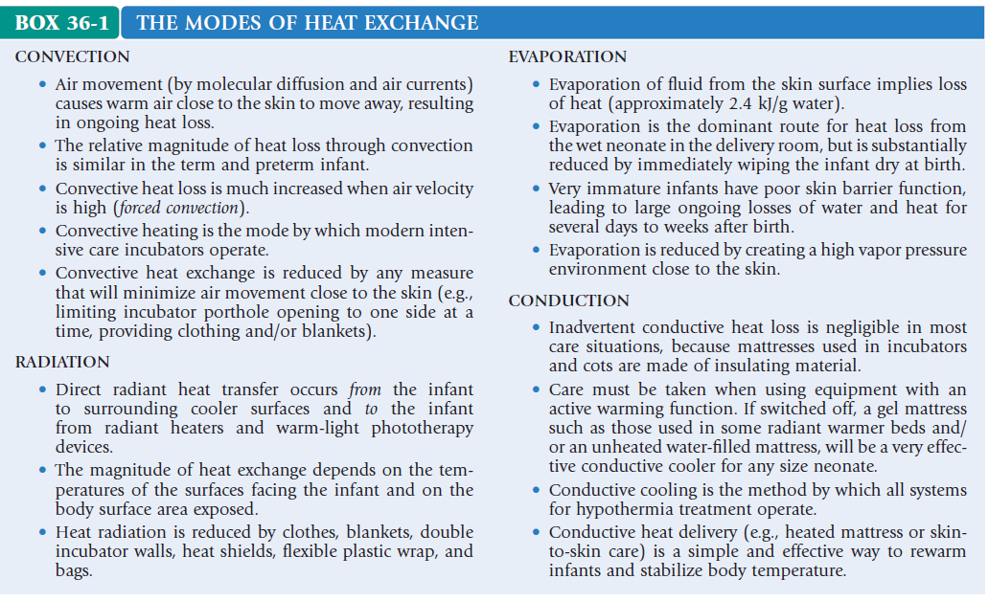

Slide 7
NEONATAL THERMOREGULATION
The exposure to cold, clamping of the umbilical cord, and the general “stress of being born” induce a thermal response. This response is part of a homeostatic system with input (detectors) and output (effectors) that is aimed at preserving body temperature.
Exposure to cold induces a sympathetic surge that acts on receptors in brown fat stores (mainly located in interscapular, paraspinal,and perirenal areas) stimulating lipolysis.
The presence of the protein thermogenin in brown fat uncouples β-oxidation, resulting in metabolic production of heat instead of adenosine triphosphate.
The metabolic rate of a newborn has been observed to increase up to threefold when maximally stimulated by cold.However, in the preterm infant fat stores are scarce and nutritional provision often suboptimal, limiting their thermogenic capacity.

Slide 8
THERMONEUTRALITY
thermoneutral zone” is defined as the range of temperature
within which the infant can maintain a normal body temperature at minimal metabolic rate with use of nonevaporative processes (vasoconstriction,vasodilation, and/or changes in posture) only. Outside this range, body temperature might still be maintained at the cost of an increased metabolism, but if the temperature deviates further, inevitable cooling (or warming) will take place.

Slide 9
NEONATAL THERMOREGULATION
Even a slight longterm exposure to cold will increase thermogenesis,consume oxygen and substrate stores, and impact negatively
on growth.

Slide 10
WHAT TEMPERATURE SHOULD BE AIMED FOR?
Normal human central body temperature is considered to be 37.0- +05― However, it is evident that seemingly well babies with central temperature kept within this range may suffer from cold stress (i.e., display increased metabolic rate owing to thermogenesis).
In the preterm infant, to minimize the risk of cold stress when caring for infants with limited thermoregulatory capacity, it has been shown
to be adequate to aim for higher core temperatures within the
range of 37.6 to 38.2° C, or the slightly wider range of 37.5 to
38.5° C. Such core temperatures in an infant without
signs of overwarming (vasodilation, signs of discomfort,
or inversion of the central-peripheral temperature difference)
may be considered normal

Slide 11
CONVECTIVE THERMAL SUPPORT—INCUBATOR CARE
In a modern double-walled, convectively heated incubator,
the warm air is directed so that the walls of the incubator
are also kept warm. With a low airflow velocity
(<0.1 m/s), the convective heat transfer will depend on
the gradient between the skin and the air temperature,
and the vapor pressure gradient close to the skin will be
maintained, avoiding an increased evaporative heat
loss. Adding the feature of double wall design also
reduces the radiant heat loss to the inner walls of the
incubator. In a single wall incubator, the “working” temperature
in the incubator will be lower than the set air temperature because of the higher radiant loss of heat. Moreover, it will be influenced by room temperature. As a general rule, the air temperature in a single wall incubator has to be increased 1° for every 7° C difference between room and incubator air temperature, as compared with the double wall incubator.

Slide 12
CONVECTIVE THERMAL SUPPORT—INCUBATOR CARE
The incubator is controlled thermostatically by air or infant temperature. Both modes are capable of providing a stable thermoneutral environment
Infant skin temperature servo control has the advantage of providing a more stable body temperature under changing care conditions, different ventilation modes,opening of port holes, and so on. However, there is a risk that the probe may become detached, which may lead to overwarming, although usually this is not severe. When using skin servo-controlled incubator temperature, the use of body temperature as a possible signal of disease(hypovolemia, sepsis) has to be replaced by monitoring incubator temperature, which might not be as intuitive.
An anterior abdominal skin temperature of 36.5° C has been widely used for servo control of incubator air temperature, but may be too low to ensure thermoneutrality.
An abdominal skin (or back to mattress) temperature setting of 37.0° C may be preferable.

Slide 13
CONVECTIVE THERMAL SUPPORT—INCUBATOR CARE
Air temperature servo control usually provides a more
stable environment, but makes it necessary to frequently
determine infant temperature, thus adding further to the
load of procedures disturbing the infants. For both
modes, Although reserving high ambient humidification (70%-90%) for the first postnatal week of the extremely preterm (<28 weeks) infant, a medium level of 40% to 50% can be recommended for general incubator care

Slide 14
RADIANT THERMAL SUPPORT— RADIANT WARMERS
Radiant warmers provide excellent accessibility and visibility for the care of the newborn infant and have, therefore,become widely used in neonatal intensive care The high power output of the device explains the effectiveness and speed with which a hypothermic infant can be warmed. On the other hand, harmful overheating can rapidly occur unless careful monitoring (preferably continuous)of infant temperature is instituted. Because ambient humidity is low and air velocity at times relatively, heat loss through evaporation and convection may be extensive but can be compensated for by radiant heat gain.
An anterior abdominal temperature of 37.0°C is generally recommended for servo control of radiant heat output at least as a starting point.

Slide 15
RADIANT THERMAL SUPPORT— RADIANT WARMERS
A transparent heat shield positioned over the infant
may influence the heat exchange (occurring through convection,
evaporation, and radiation) and result in reduced
losses of heat. However, such a shield interpositioned
between the infant and radiant heat source will also
disrupt the servo-control mechanism and reduce direct
radiant heat delivery to the infant, which may intervene
with thermal control.

Slide 16
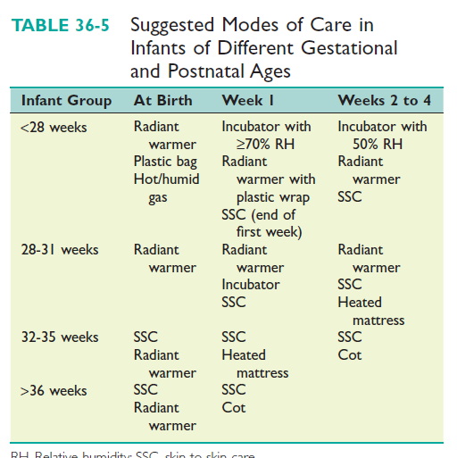

Slide 17
The Sensory Environment of the Intensive Care Nursery
Sensory development begins early in fetal life in an environment
that is quite different from that of the neonatal intensive care unit (NICU). In an uncomplicated pregnancy,the fetus spends the full gestational period in a warm, dark, contained womb that is the source of extensive kinesthetic, auditory, and gustatory stimuli. The NICU unavoidably and dramatically alters this normal progression of sensory development Not only are familiar stimuli replaced by unfamiliar ones, but they also are apprehended by the infant in a much different fashion—auditory stimuli arrive through an air medium rather than the liquid and solid medium of the amniotic fluid and uterus, tactile stimuli are frequently uncomfortable or painful, visual stimuli may have little relationship with a circadian rhythm,.

Slide 18
Overview
In the last 3 months of gestation, the fetal brain increases
in mass by 400%, and to an even greater extent in complexity
and organization.This is comparable to the400% growth that occurs from term delivery to adulthood,yet we have generally assumed that nearly all learning occurs after birth.
In reality, a substantial amount of learning occurs during the third trimester, whether a Baby is in or ex utero.

Slide 19
Touch and Movement
Touch is the first sense to develop in the fetus, with reflexive movement to a stimulus seen as early as 8 weeks. Movements tend to be gentle, often prolonged(as when the mother is walking), and occur with a definite circadian rhythm. In the NICU, however, an infant may spend an extended period of time lying on a flat mattress, interrupted at irregular and unpredictable intervals to be moved suddenly, unnaturally, and sometimes painfully. The NICU infant is constantly “touched” by monitoring devices, indwelling devices, and surfaces that have a much different consistency and impact on the skin than would be experienced in utero. Skin injury is very common in the most premature infants, which may have an additional effect on the sensory experience in the NICU.

Slide 20
Taste and Smell
The senses of taste and smell become functional by 24 to 28 weeks’ postconceptional age and soon after reach a level of competence comparable to that of the term infant. Maternal dietary flavors are transmitted to the amniotic fluid and recognized as both flavors and odors by the term newborn, especially in breast milk.In the NICU, infants are exposed to a multitude of odors and tastes, mostly unfamiliar and many of them noxious. Sometimes, these odors or tastes are associated with other noxious stimuli, and this interaction may affect the infant’s response.

Slide 21
Auditory
The fetus responds to sound by the end of the second trimester, and
extensive development of the auditory system continues in the third
trimester of fetal life. The in utero environment transmits sounds to the
fetus through a liquid medium (the amniotic fluid) and, to some
extent,through a solid medium as the infant approaches term and
remains in more extended contact with the uterus.
This environment attenuates sound, especially high frequency auditory
impulses. The sounds experienced by the fetus are primarily those of
the mother—both of voice and bodily functions, and it is clear that by
term birth, an infant is able to distinguish its mother’s voice from those
of other women, but not that of its father.
In the NICU, a cacophony of sounds arrives at the infant’s ear at all
hours, transmitted through an air medium that does not attenuate any
frequencies.

Slide 22
The Physical Environment
Noise
The NICU is filled with technologically advanced machines, health care professionals, and caregivers, all of which directly or in directly generate noise pollution. “Studies have demonstrated that there is a direct link between noise and health. Problems that are related to noise and health include: stress related illness, high blood pressure,
speech interference, hearing loss, and sleep deprivation” . Sudden and loud noise leads to physiological and behavioral disturbances including sleep disturbance,, startles, crying, hypoxemia, tachycardia, and inceased intracranial pressure . Increased intracranial pressure can further contribute to intra-ventricular hemorrhage .

Slide 23
Talking should be at a considerately low level and laughing should be discouraged. Equipment should not be placed on incubators and opening and closing of portholes in the incubator should be done in a gentle manner. Monitoring equipment should be minimal and manufacturers should be encouraged to reduce the noise levels in
their products. During the night a noise policy or “quiet period” should be applied. Audible alarms should be replaced by visual alarms, and all units should be transported gently and with care.

Slide 24
Light
Sources of light in the NICU have increased over the years. Little is known about the effects of light exposure on small infants, but damage to the structure and function of the retina
has been documented in animal studies.
Light may be reduced by covering isolettes with a blanket. Eyes should always be covered when using phototherapy lights. During quiet time” at night, lights need to be dimmed along with noise reduction rules

Slide 25
Handling
In extremely small premature infants, their skin is very fragile requiring gentle care. Studies have indicated that for premature infants less than30 weeks gestational age, touch may be more stressful rather than soothing. However, for older premature infants, touching may be helpful. Infants respond differently to different kinds of touch. How often a premature infant is touched should be dependent on how he or she responds. It is recommended that application of bland, sterile oil be applied to small preterm infants to help soothe them. Positioning and handling strategies include enhancing flexion in the arms and trunk and preventing flailing and extensions. By taking these factors into consideration, infant stress may be reduced significantly. Nesting using blankets or commercial positioning devices provides boundaries and reduces infant stress. Kangaroo Mother Care (KMC) is also recommended as a positioning and handling technique for medically fragile infants .

Slide 26
The physical and psychological neonatal Intensive care unit (NICU) environment may be the single most important factor in neonatal development. Frequent procedures, handling, and exposure to light and noise may cause physiological stress on infants that increase their length of stay in the NICU and ultimately decrease cognitive development.

Slide 27
با تشکر

