Slide 1
Non ST elevation Acute coronary syndrome
Dr. A- Rai
Associated professor of Interventional cardiology
Kermanshah University of Medical science

Slide 2
Several features help to differentiate ACS from chronic stable angina, including (1) sudden onset of symptoms at rest (or with minimal exertion) that last at least 10 minutes unless treated promptly; (2) severe pain, pressure, or discomfort in the chest; and (3) an accelerating pattern of angina that develops more frequently, with greater severity, or that awakens the patient from sleep. The 12-lead electrocardiogram (ECG) and markers of myocardial necrosis are essential tools in distinguishingbetween the three types of ACS.
Patients with typical symptoms (>20 minutes continuously) ST-segment elevation in at least two contiguous electrocardiographic leads, but with elevation of myocardial biomarkers >99% percentile of normal, are classified as having NSTEMI. Patients without typical symptoms and serial negative markers of myocardial necrosis areclassified as having UA, a diagnosis that carries a better prognosis.

Slide 3
Epidemiology
Despite the decline in cardiovascular disease (CVD) mortality over the past three decades,2,3 cardiovascular and circulatory diseases remain the leading causes of death in the world, responsible for more than 54 million deaths in 2013.4 In 2016 in the United States, it is estimated that more than 1.1 million patients will experience an ACS event, of whom 72% will have a myocardial infarction (MI).
The fraction of ACS attributed to NSTEMI continues to increase, while that for STEMI is declining, for several reasons:
(1) wider use of preventive measures such as aspirin, statins, and smoking cessation;
(2)aging of the population, with greater prevalence of diabetes and chronic kidney disease (CKD) and lowerrates of smoking; and
(3) broader use of troponin assays with higher sensitivity for myocardial necrosis, which shifts the diagnosis from UA to NSTEMI.

Slide 4
Pathophysiology
The pathogenesis of NSTE-ACS involves four processes operating singly or in various combinations:
(1)disruption of an unstable atheromatous plaque, which may be driven at least in part by inflammation1
(2) coronary arterial vasoconstriction;
(3) gradual intraluminal narrowing of an epicardialcoronary artery caused by progressive atherosclerosis or restenosis after stenting; and (4) oxygen supplydemand
mismatch Our understanding of the complex interactions between thesepathways continues to evolve. For example, recent studies have identified increased levels of proproteinconvertase subtilisin/kexin type 9 (PCSK9) as a risk factor for more severe atherosclerosis, a marker forvulnerable plaques, and a contributor to plaque destabilization resulting in ACS.

Slide 5
Clinical Assessment History
NSTE-ACS resulting from atherosclerosis is relatively uncommon in men younger than 40 and women younger than 50 in the absence of genetic disorders such as familial hypercholesterolemia, but the incidence rises steadily thereafter. Patients with ACS frequently have traditional risk factors for coronary heart disease (CHD)
However, while coronary risk factors reliably assess risk inpopulations, they are less helpful in the assessment of individual patients.

Slide 6
Clinical Assessment History
The initial symptom of NSTE-ACS is typically described as retrosternal pressure, heaviness, or frankpain and although it resembles stable exertional angina, it is usually more intense and lasts longer (>10 minutes). Radiation to the ulnar aspect of the upper left arm, eitheshoulder, the neck, or the jaw is common, but symptoms may localize anywhere between the ear and epigastrium.11 Symptoms such as diaphoresis, nausea, abdominal pain, dyspnea, and syncope may accompany the discomfort.

Slide 7
Features that support the diagnosis include exacerbation of symptoms by physical exertion; precipitation by severe anemia, infection, inflammation, fever, or metabolic or endocrinologic disorders. Atypical manifestations, such as dyspnea without chest discomfort, pain limited to the epigastrium, or indigestion, represent “anginal equivalents.” These atypical findings are more prevalent in women, older adults, and patients with diabetes, CKD, or dementia and can lead to underrecognition, undertreatment,and worse outcomes

Slide 8
Physical Examination
Findings on physical examination may be normal, although patients with large territories of myocardial ischemia may have audible third and/or fourth heart sounds or pulmonary rales. Rarely, hypotension, pale cool skin, sinus tachycardia, or frank cardiogenic shock can occur; these findings are much more common with STEMI than with NSTE-ACS. Potential precipitating causes of ACS, such as fever, resistant hypertension, tachycardia, profound bradycardia, thyroid disease, and gastrointestinal (GI) bleeding, can sometimes be identified. Findings such as pulse deficits, tachypnea, and tachycardia in the presence of clear lung fields and pulsus paradoxus with jugular venous distention may lead to alternative lifethreatening diagnoses, such as aortic dissection, pulmonary embolism, or cardiac tamponade.

Slide 9
Electrocardiography
The most common abnormalities on the 12-lead ECG are ST-segment depression and T wave inversion, which are more likely to be present while the patient is symptomatic. Comparison with a recent ECG is important because dynamic ST-segment depressions as little as 0.05 mV are a sensitive (but not specific)marker for NSTE-ACS. Greater degrees of ST-segment depression predict poorer outcomes.
Transient ST-segment elevation lasting less than 20 minutes occurs in up to 10% of patients and suggests either UA or coronary vasospasm. Deep (>0.2 mV) T wave inversions are compatible with, but not necessarily diagnostic of, NSTE-ACS, whereas isolated T wave inversions of lesser magnitude are not particularly helpful given their low specificity.
More than half of patients with definite NSTE-ACS may have normal or nondiagnostic ECGs. Because ischemia may occur in a territory that is not well represented on thestandard 12-lead ECG (see later), or because the patient may have episodic ischemia that is missed on theinitial ECG, tracings should be repeated every 20 to 30 minutes until the symptoms resolve, or thediagnosis of MI is established or excluded.

Slide 10
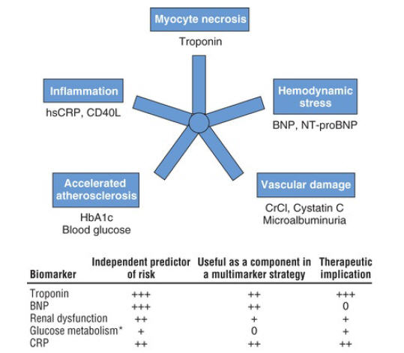

Slide 11
Laboratory Testing: Biomarkers
Fourth-generation cTn assays currently used in the United States are less sensitive than hsTn assays available in some European countries. Thus, two negative cTn assays at least 6 hours apart are needed toexclude MI with these less sensitive assays.
However, with newer hs Tn assays (approved in the UnitedStates in 2017), it is possible with a single measurement at presentation of less than 5 ng/L to classifyal most two thirds of patients presenting to the ED with suspected ACS as “very low risk” for MI or cardiac death in the next 30 days (negative predictive value [NPV], 99.6%).18 Absolute changes in hsTngreater than 9.2 ng/L are even more predictive of acute MI than a single measure or relative changes between two measurements

Slide 12
Noninvasive Testing
The safety of early stress testing in patients with NSTE-ACS has been debated, but symptom-limited or pharmacologic stress testing appear to be safe after at least 24 hours of stabilization without symptoms of active ischemia or other signs of hemodynamic or electrical instability.
The merits of various modalities of stress testing have been compared Exercise stress myocardial perfusion imaging with nuclear isotopes and stres echocardiography with dobutamine have greater sensitivity than electrocardiographic exercise stress testing without imaging

Slide 13
CT Angiography
Contrast-enhanced coronary CTA (CCTA) in patients with or suspected of having NSTE-ACS can help:
(1) recognize or exclude the presence of epicardial CHD,
(2) identify which vessel(s) have coronary atherosclerosis,
(3) assist in risk stratification and prognosis
trials have shown that CCTA compared to standard evaluation expedites the triage of patients presenting with chest discomfort in the ED, thereby shortening length of stay

Slide 14
Invasive Imaging
Approximately 85% of patients with a clinical diagnosis of NSTE-ACS have significant coronary obstruction (i.e., >50% stenosis of luminal diameter, in at least one major coronary artery). Most have obstructive disease, including multiple epicardial arteries—approximately 10% with left main coronary artery disease, 35% with three-vessel disease, and 20% with two-vessel disease—whereas only approximately 20% have single-vessel disease. The remaining 15% have no significant coronaryobstruction, a finding that is more common in women and minorities.

Slide 15
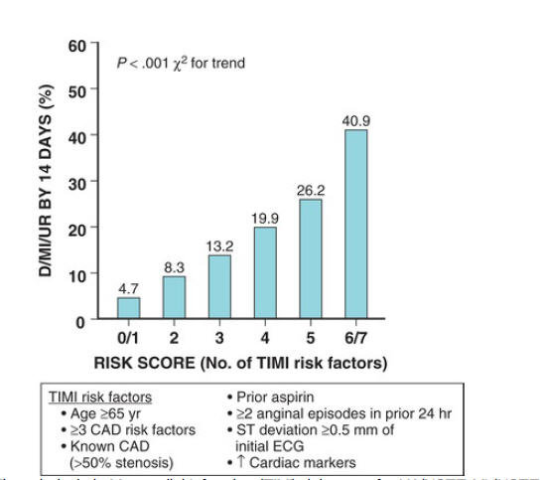
Risk Assessment

Slide 16
Anti-Ischemic Therapy
Nitrates are vasodilators that increase myocardial blood flow (coronary vasodilation of atherosclerotic and normal vessels), reduce myocardial oxygen requirements by lowering cardiac preload (systemic venodilation), reduce cardiac afterload (systemic arterial dilation) thereby diminishing ventricular wall stress, and may have a mild antiplatelet effect. Reflex increases in heart rate (HR) and contractility that increase myocardial oxygen demand can be mitigated by concomitant use of a beta blocker.

Slide 17
Beta-Adrenergic Receptor–Blocking Agents
Beta blockers competitively inhibit the myocardial effects of neuronally released and circulating
catecholamines and reduce myocardial oxygen consumption by lowering HR, BP, and myocardial
contractility. The evidence supporting beta blockers derives largely from older studies of patients with
acute MI (generally STEMI) or new left bundle branch block (LBBB), before the current era of
reperfusion therapy. In clinical trials of patients with acute MI, beta blockers reduce reinfarction,
ventricular arrhythmias, and death. The findings from these trials, some of which included patients
without ST elevation, have been extrapolated to patients with UA and NSTEMI.

Slide 18
Calcium Channel Blockers
Calcium channel blockers (CCBs) have vasodilatory effects and reduce arterial pressure. Some CCBs, such as verapamil and diltiazem, also slow HR, reduce myocardial contractility, and thereby reduce myocardial oxygen requirements. CCBs have been effective in reducing ischemia in patients with NSTEACS and persistent ischemia despite treatment with full-dose nitrates and beta blockers, as well as in patients with contraindications to beta blockers and in those with hypertension

Slide 19
Aspirin (Acetylsalicylic Acid, ASA)
In addition to reducing adverse clinical events early in treatment, ASA also reduces the frequency of ischemic events in secondary prevention. It is a cornerstone of antiplatelet therapy in patients with all forms of ACS, as well as those with chronic CHD.11

Slide 20
P2Y12 Inhibitors
Clopidogrel
Prasugrel
Ticagrelor

Slide 21
Glycoprotein IIb/IIIa Inhibitors
The glycoprotein (GP) IIb/IIIa inhibitors block the final common pathway of platelet aggregation— fibrinogen-mediated cross-linkage of platelets—caused by a variety of stimuli (e.g., thrombin, ADP, collagen, serotonin) potent oral and IV P2Y12 inhibitors. Three agents in this class are available: abciximab, a monoclonal antibody approved only in patients undergoing PCI, and eptifibatide and tirofiban, both of which are reversible smal -molecule inhibitors approved for use in patients with ACS and in those undergoing PCI

Slide 22
Cangrelor
Cangrelor is an IV direct-acting P2Y12 inhibitor that blocks ADP-induced platelet activation and aggregation.
The parent compound exhibits an almost immediate onset of action and short half-life of 3 to 6 minutes

Slide 23
Heparin
A meta-analysis of 1353 patients in six trials showed a 33% reduction in death or MI with UFH plus ASA versus ASA alone.90 Daily monitoring of the anticoagulant response via the activated partial thromboplastin time (APTT) is recommended, with titrations made according to a standardized nomogram to achieve an APTT of 50 to 70 seconds or 1.5 to 2.5 times control

Slide 24
Low-Molecular-Weight Heparin
(1) its greater anti–factor Xa activity (relative to factor IIa) inhibits thrombin generation more Effectively.
(2) LMWH induces greater release of tissue factor pathway inhibitor than UFH, and it is not neutralized by platelet factor 4;
(3) LMWH less frequently causes HIT;
(4) the high and consistent bioavailability of LMWH allows subcutaneous (SC) administration;
(5) monitoring of the anticoagulation level is not necessary; and
(6) LMWH binds less avidly to plasma proteins than UFH and therefore has amore consistent anticoagulant effect.

Slide 25
Direct Thrombin Inhibitors
Bivalirudin
Fondaparinux

Slide 26
Invasive Versus Conservative Management
(1) an early invasive strategy involving routine early (within 48 hours of initial evaluation) cardiac catheterization, followed by PCI, CABG, or continuing medical therapy, depending on the coronary anatomy, and (2) an ischemia-guided (or selective invasive) approach, with initial medical management and catheterization being reserved for patients with hemodynamic instability or recurrent ischemia, either at rest or on a noninvasive stress test, followed by revascularization if the anatomy is suitable.
An early invasive strategy is not recommended in patients with extensive comorbidities in whom the risks of revascularization outweigh the potential benefits, or in patients with acute chest pain with lowclinical likelihood of ACS and a negative troponin assay.

Slide 27
Older Adults
Since older patients are more likely to have more severe and extensive CAD, they are more likely to have coronary anatomy amenable to revascularization than younger patients with NSTE-ACS. However, since elderly patients are at higher risk for procedural complications and bleeding, patients and physicians often exercise more caution regarding invasive procedures, resulting in lower rates of revascularization. A meta-analysis142 of three randomized trials demonstrated a 29% reduction (HR, 0.71; 95% CI 0.55 to 0.91) in death or MI at 5 years in patients age 75 or older with an early invasive strategy.
More recently, a randomized trial of 457 patients 80 or older (median 85) demonstrated a 47% reduction (HR, 0.53; 95% CI 0.41 to 0.69) in the composite of MI, need for urgent revascularization, stroke, and death over a median follow-up of 1.5 years with an early invasive strategy versus a conservative strategy (optimum medical treatment alone)

Slide 28
Women
Nevertheless, women with NSTE-ACS should receive the same pharmacologic therapy as men in both the acute care and the secondary prevention phase, and women with NSTE-ACS with high-risk features should undergo an early invasive strategy.11 In contrast, low-risk women with NSTE-ACS should not routinely undergo an early invasive strategy because of the lack of benefit and potential for harm. In a pooled analysis of 3550 patients with NSTE-ACS from eight trials, women are more likely than men to have non obstructive CAD on coronary angiography.40 Although rates of MACE are lower in patients with non obstructive disease compared to those with obstructive CAD, they are not negligible (16% at 5 years in women participating in the WISE registry146), and therefore secondary preventive measures should not be withheld in either women or men with nonobstructive CHD.

Slide 29
Chronic Kidney Disease
In patients with multivessel CHD, acceptable surgical risk, and life expectancy longer than 1 year, CABG is preferred over PCI, whereas in patients with high surgical risk or shorter life expectancy, PCI is recommended.2

Slide 30
Thanks

