Slide 1
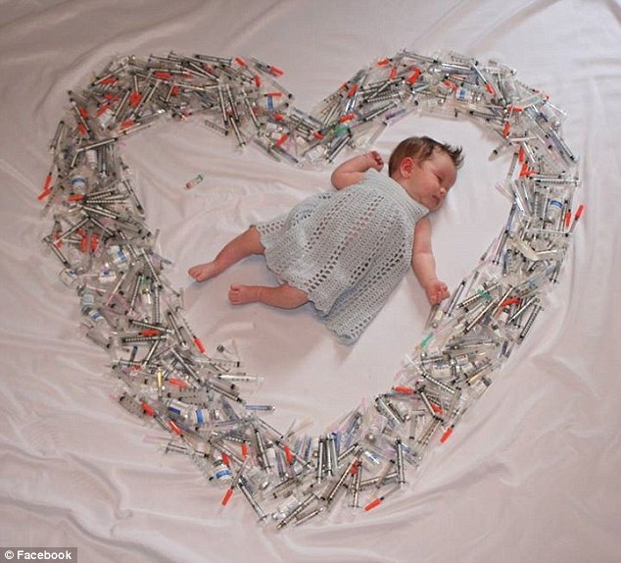
In The Name Of God

Slide 2
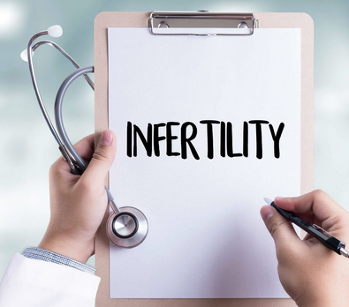
Dr. Negin Rezavand
Obstetrices & Gynecology Department
KUMS

Slide 3
A
B
Fecundability
C
Fecundity
D
Subfertility
Infertility

Slide 4
Prevalence
10-15%
Maximum of fertility in 20-24y cause of decrease fertility with increase age
Aneuploidy

Slide 5
When we have to beginning investigation
if Age>35 beginning after 6m
Beginning as soon as possible
A: Irregular mens
B: Endometriosis
C:PID
D:Spermogram

Slide 6
Patient History
Age
Mens History
Duration of Infertility
Previous Medical disease
Coitus rithm
PID
Family History
Previous Pregnancy Outcome
Drug
Pelvic Surgery
Ovucite 12-24 h
Sperm 3-5 days

Slide 7
Lifestyle
Weight
BMI 20-25
Alchol
Coffeine
Smoking
Illicit Drugs
Stress

Slide 8
Drug
NSAID
Immunosuppresive
Thyroid Hormon
Chemotherapy
Anti Depression
Asthma
Tranquilizer

Slide 9
Occupation
Hard and long time work
Radioactive
Manitor
Pb, Hg, Cademium
Chemotherapy Drug
AB
NO
Banzen, Cholorofom
Percholoroethylen
Toluen
Ethylen Oxid
Alchol

Slide 10
Laboratory test
Spermogram
CBCdiff, BG, Rh, FBS, Lipid profile, Cr, Vit.D
HbA1C, OGTT,
HIV, HCV, HbSAg, VDRL,PPD
PRL, TSH, FT4, 0/1<TSH<2/5 (q6m)
FSH, AMH
E2, Progestrone
Testestrone, DHEA-SO4
Anti Rubella Ab
Papsmear

Slide 11
Breast
Sonography & Mamography
For 40-50 Patient

Slide 12
Some Person High risk for Treatment
Cancer
Renal Failure
Liver Filure

Slide 13
Cause of Infertility
Male Factor 35%
Ovulatory Factor 15%
Plevic & Tubal factor 35%
Unexplained factor 10%

Slide 14
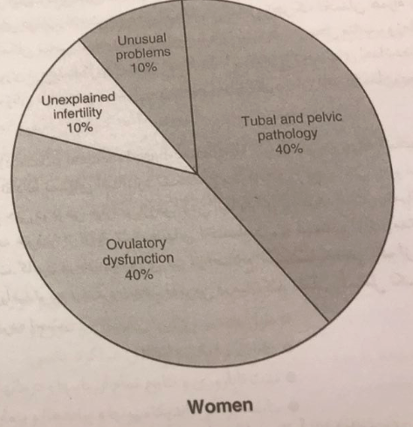
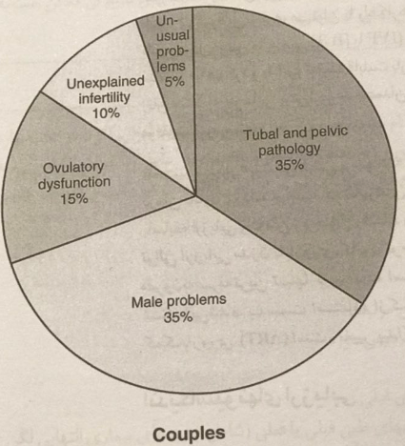
Causes of Infertility

Slide 15
Age & Ovarian reserve
FSH
E2
Inhibin B
AMH
AFC with TVS
Ovarian Volum

Slide 16
Decrease Ovarian Reserve
Medication DHEA
IVF
Egg Donation
Embryo Donation

Slide 17
Ovulatory dysfunction
Hypogonadism Hypogonadotropic eugonadotropic , euestrogenic
Hypergonadotropic Anovulatory
Hyperprolactinemia Anovulatory

Slide 18
Ovulation factor
BBT
CX
LH(30-35 MIu/ml)(4-10 pm)
Sonography TVS(1-3 mm/24h)

Slide 19
Tubal Factor
Infection
TB
Endometriosis
Polyp
PID
Septic Abortion
Tubal spasm

Slide 20
Tubal Study
A HSG(7-12)
Analgesic - AB
Side effect - Cx Rapture, Uterine perforation, V/B, Alergia, Pain, entered dye in vessel
PID(0/3-3/1%)
B Laparoscopy
C Falloposcopy
D Sonohystrography
E 3D TVS with Doppler

Slide 21
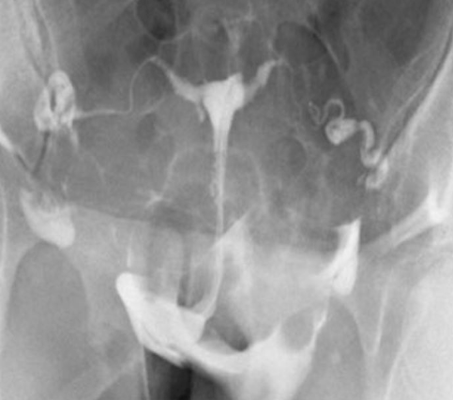
HSG reveals bilateral fallopian tube patency

Slide 22
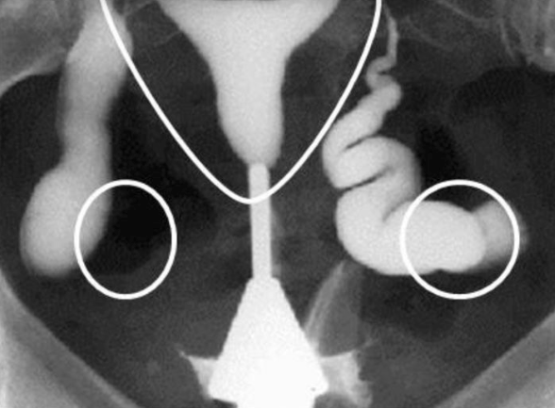

Slide 23
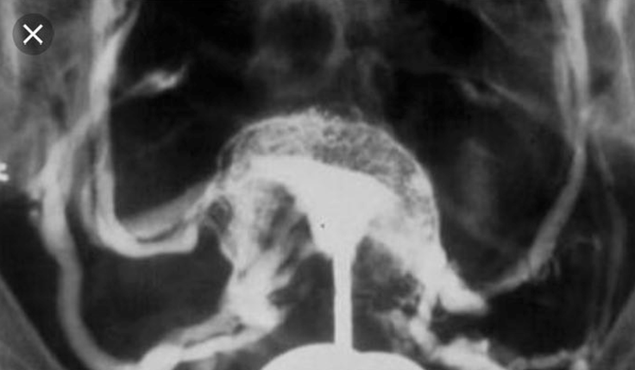
Hysterosalpingography(1)

Slide 24
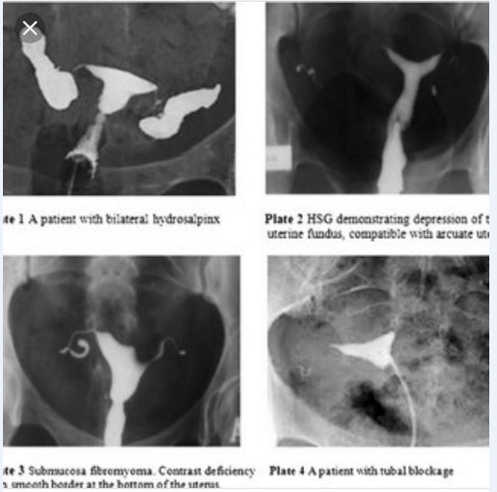

Slide 25
Uterus Study
Polyp, Myoma, Hyperplasia, Malformation, Asherman
Adhision
A Hystroscopy
B HSG
C TVS, 3D
D SIS Polyp
E MRI Myoma

Slide 26
Myoma
&
Infertility

Slide 27
Pelvic Factor
Adhesion
Endometriosis
Laprascopy

Slide 28
Unexplained Infertility

Slide 29
Absolut Infertility

