Slide 1
Shoulder MRI Anatomy Normal anatomy, Variants and Checklist

Slide 3
The glenohumeral joint has the following supporting structures:
Superiorly
coracoacromial arch and coracoacromial ligament
long head of the biceps tendon
tendon of the supraspinatus muscle
Anteriorly
anterior labrum
glenohumeral ligaments - SGHL, MGHL, IGHL (anterior band)
subscapularis tendon
Posteriorly
posterior labrum
posterior band of the IGHL
infraspinatus and teres minor tendon

Slide 4
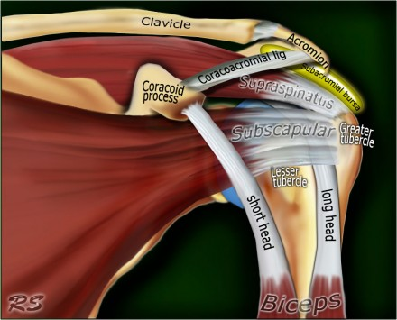

Slide 5
Anterior graphic of the shoulder.
The tendon of the subscapularis muscle attaches both to the lesser tubercle aswell as to the greater tubercle giving support to the long head of the biceps in the bicipital groove.
Dislocation of the long head of the biceps will inevitably result in rupture of part of the subscapularis tendon.
The rotator cuff is made of the tendons of subscapularis, supraspinatus, infraspinatus and teres minor muscle.

Slide 6
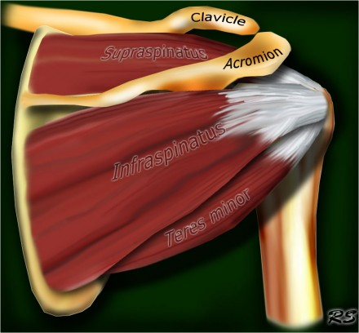

Slide 7
Posterior graphic of the shoulder.
The supraspinatus, infraspinatus and teres minor muscles and tendons are shown.
They all attach to the greater tuberosity.
The rotator cuff muscles and tendons act to stabilize the shoulderjoint during movements.
Without the rotator cuff, the humeral head would ride up partially out of the glenoid fossa, lessening the efficiency of the deltoid muscle.
Large tears of the rotator cuff may allow the humeral head to migrate upwards resulting in a high riding humeral head.

Slide 8
Normal anatomy : Axial anatomy and checklist

Slide 9
Look for an os acromiale.
Notice that the supraspinatus tendon is parallel to the axis of the muscle. This is not always the case.
Notice that the biceps tendon is attached at the 12 o'clock position. The insertion has a variable range.
Notice superior labrum and attachment of the superior glenohumeral ligament.
At this level look for SLAP-lesions and variants like sublabral foramen.
At this level also look for Hill-Sachs lesion on the posterolateral margin of the humeral head.
The fibers of the subscapularis tendon hold the biceps tendon within its groove. Study the cartilage.

Slide 10
At this level study the middle GHL and the anterior labrum. Look for variants like the Buford complex. Study the cartiage.
The concavity at the posterolateral margin of the humeral head should not be mistaken for a Hill Sachs, because this is the normal contour at this level. Hill Sachs lesions are only seen at the level of the coracoid.
Anteriorly we are now at the 3-6 o'clock position. This is where the Bankart lesion and variants are seen.
Notice the fibers of the inferior GHL. At this level also look for Bankart lesions.

Slide 11
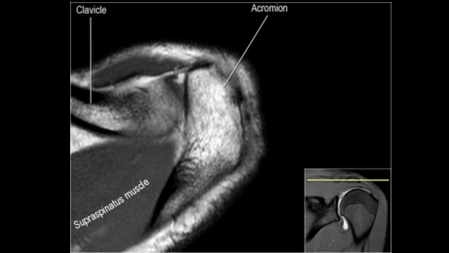

Slide 12
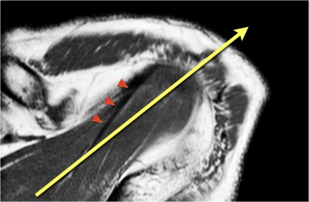

Slide 13
Axis of supraspinous tendon
The supraspinatus tendon is the most important structure of the rotator cuff and subject to tendinopathy and tears.
Tears of the supraspinatus tendon are best seen on coronal oblique and ABER-series.
In many cases the axis of the supraspinatus tendon (arrowheads) is rotated more anteriorly compared to the axis of the muscle (yellow arrow).
When you plan the coronal oblique series, it is best to focus on the axis of the supraspinatus tendon.

Slide 14
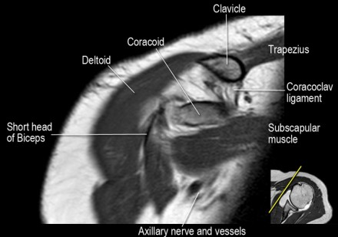

Slide 15
Coronal anatomy and checklist

Slide 16
Notice coracoclavicular ligament and short head of the biceps.
Notice coracoacromial ligament.
Notice suprascapular nerve and vessels.
Look for supraspinatus-impingement by AC-joint spurs or a thickened coracoacromial ligament
Study the superior biceps-labrum complex and look for sublabral recess or SLAP-tear.
Look for excessive fluid in the subacromial bursa and for tears of the supraspinatus tendon.

Slide 17
Look for rim-rent tears of the supraspinatus tendon at the insertion of the anterior fibers.
Study the attachment of the IGHL at the humerus. Study the inferior labral-ligamentary complex. Look for HAGL-lesion (humeral avulsion of the glenohumeral ligament).
Look for tears of the infraspinatus tendon.
Notice small Hill-Sachs lesion.

Slide 18
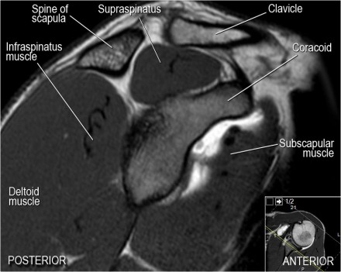

Slide 19
Sagittal anatomy and checklist

Slide 20
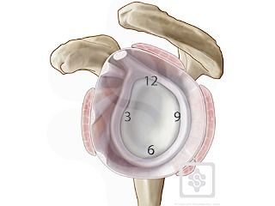
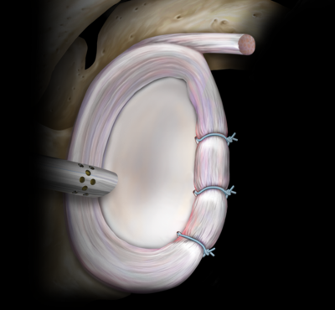

Slide 21
Notice rotator cuff muscles and look for atrophy
Notice MGHL, which has an oblique course through the joint and study the relation to the subscapularis tendon.
Sometimes at this level labral tears at the 3-6 o'clock position can be visualized.
Study the biceps anchor.
Notice shape of the acromion
Look for impingement by the AC-joint. Notice the rotator cuff interval with coracohumeral ligament.
Look for supraspinatus tears.

Slide 22
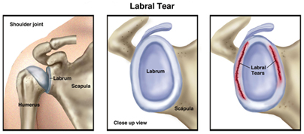

Slide 23
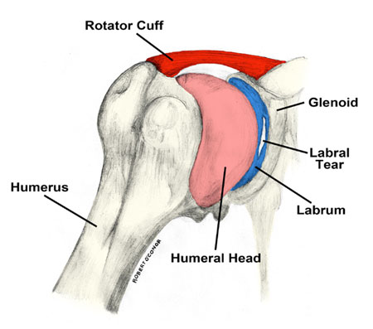
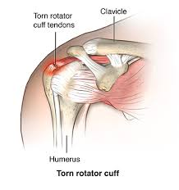

Slide 24
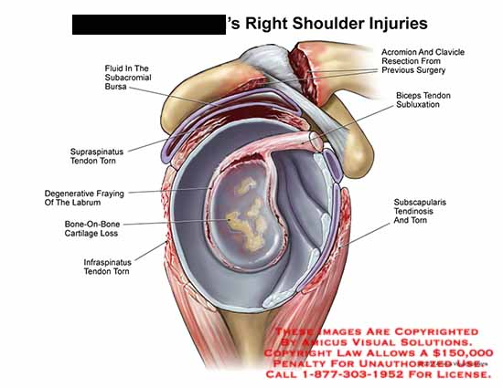

Slide 25
Acromial types

Slide 26
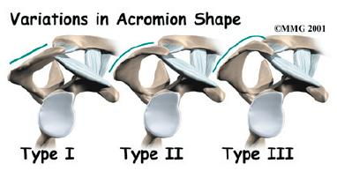
Bones
Humerus.
Scapula (acromin):
Type I : flat
Type II: curved
Type III: hooked
Clavicle

Slide 27
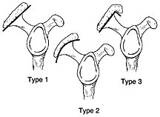

Slide 28
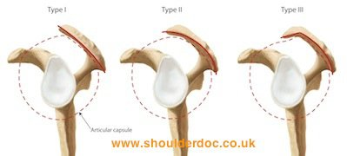

Slide 29
Classification: Acromion morphology based on sagittal oblique MRI:
1- flat inferiorly (12%6)
2- curved (56%)
parallel to the humeral head with concave undersurface
considered most common type

Slide 30
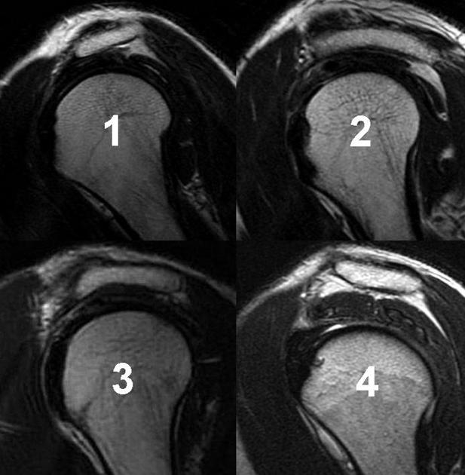

Slide 31
3- hooked (29%)
most anterior portion of the acromion has a hooked shape
associated with increased incidence of shoulder impingement
4- convex (upturned) (3%)
most recent classification of acromion process shape
the undersurface of the acromion is convex near the distal end
no convincing correlation between a type 4 acromion and impingement syndrome exists

Slide 32
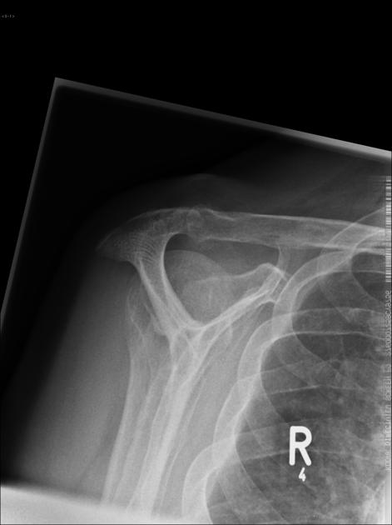
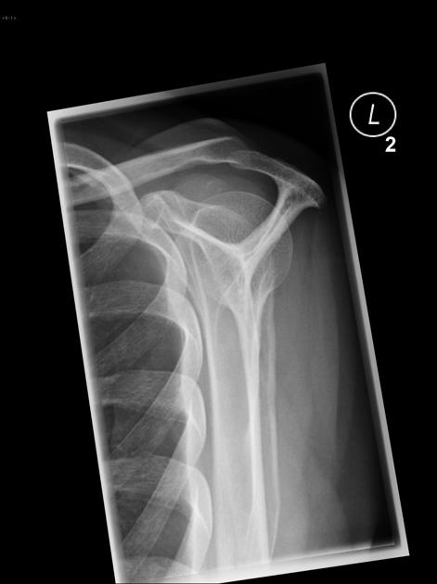
Type 1
Type 2

Slide 33
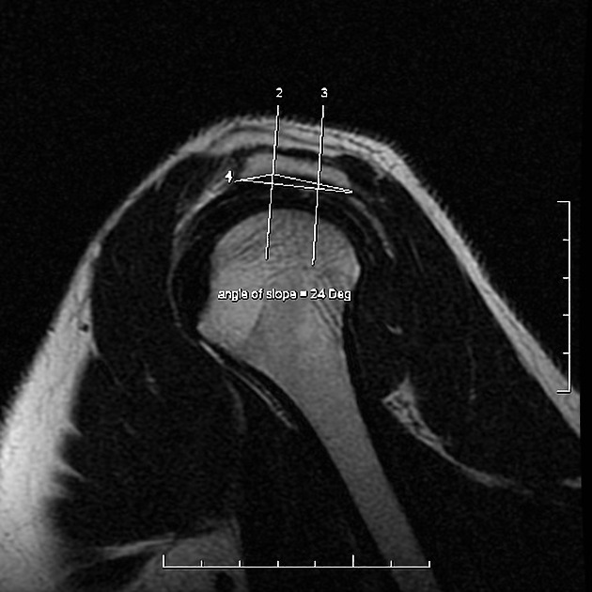
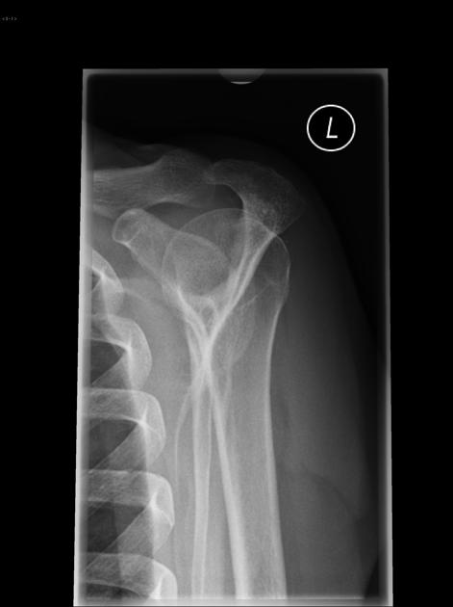
Type 3
Type 3

Slide 34
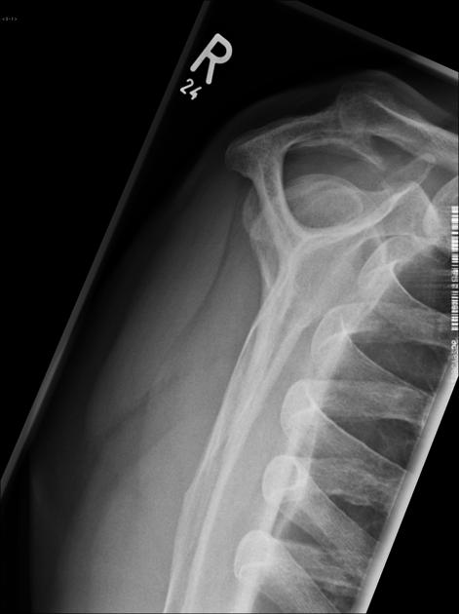

Slide 36
ABER view
Labral tears
The abduction external rotation (ABER) view is excellent for assessing the anteroinferior labrum at the 3-6 o'clock position, where most labral tears are located.
In the ABER position the inferior glenohumeral ligament is stretched resulting in tension on the anteroinferior labrum, allowing intra-articular contrast to get between the labral tear and the glenoid.

Slide 37
Rotator cuff tears
The ABER view is also very useful for both partial- and full-thickness tears of the rotator cuff.
The abduction and external rotation of the arm releases tension on the cuff relative to the normal coronal view obtained with the arm in adduction.
As a result, subtle articular-sided partial thickness tears will not lie apposed to the adjacent intact fibers of the remaining rotator cuff nor be effaced against the humeral head, and intra-articular contrast can enhance visualization of the tear

Slide 38
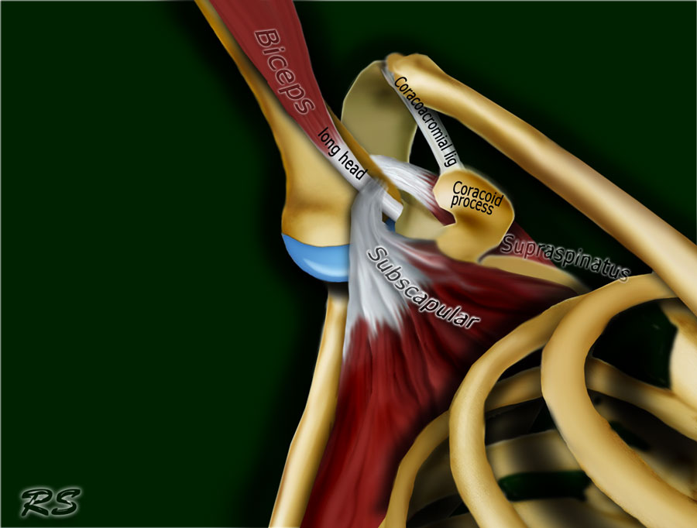

Slide 39
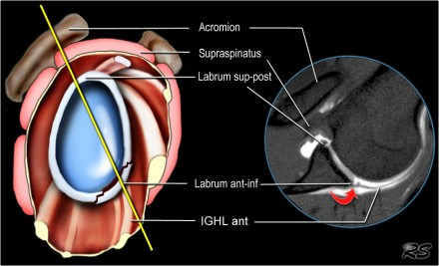

Slide 40
Images in the ABER position are obtained in an axial way 45 degrees off the coronal plane (figure).
In that position the 3-6 o'clock region is imaged perpendicular.
Notice red arrow indicating a small Perthes-lesion, which was not seen on the standard axial views.

Slide 41
ABER - anatomy
Notice the biceps anchor. The undersurface of the supraspinatus tendon should be smooth.
Look for supraspinatus irregularities.
Study the labrum in the 3-6 o'clock position. Due to the tension by the anterior band of the inferior GHL labral teras will be easier to detect.
Notice smooth undersurface of infraspinatus tendon and normal anterior labrum.
Notice smooth undersurface of infraspinatus tendon and normal anterior labrum.

Slide 42
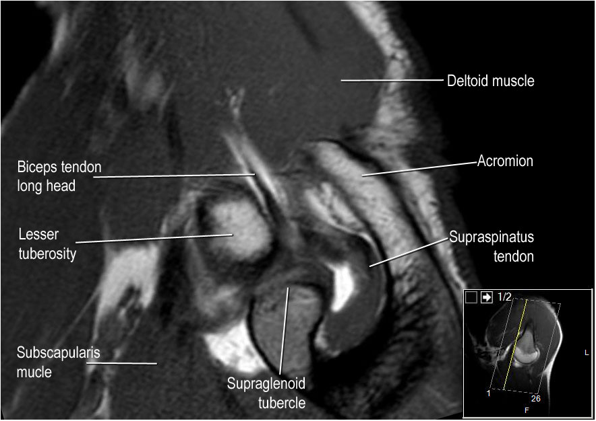

Slide 43
Labral variants
There are many labral variants.
These normal variants are all located in the 11-3 o'clock position.

Slide 44
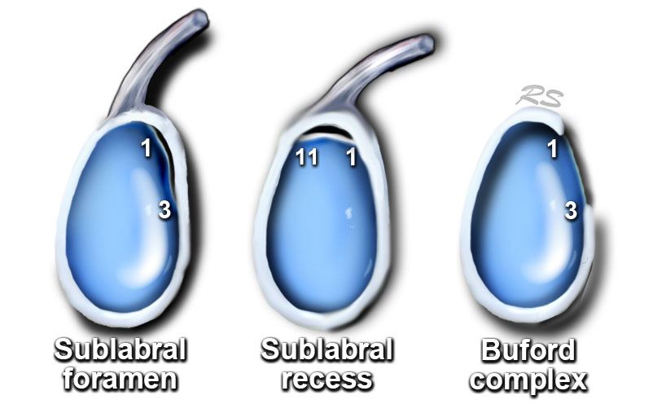

Slide 45
It is important to recognise these variants, because they can mimick a SLAP tear.
These normal variants will usually not mimick a Bankart-lesion, since it is located at the 3-6 o'clock position, where these normal variants do not occur.
However labral tears may originate at the 3-6 o'clock position and subsequently extend superiorly.

Slide 46
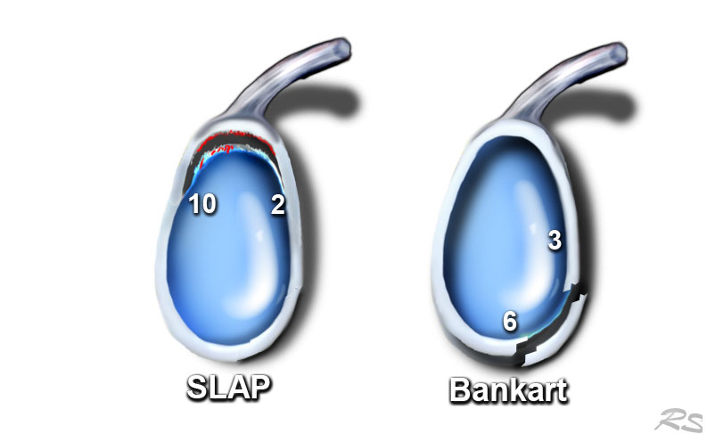

Slide 47
Sublabral recess
There are 3 types of attachment of the superior labrum at the 12 o'clock position where the biceps tendon inserts.
In type I there is no recess between the glenoid cartilage and the labrum.
In type II there is a small recess.
In type III there is a large sublabral recess.
This sublabral recess can be difficult to distinguish from a SLAP-tear or a sublabral foramen.

Slide 48
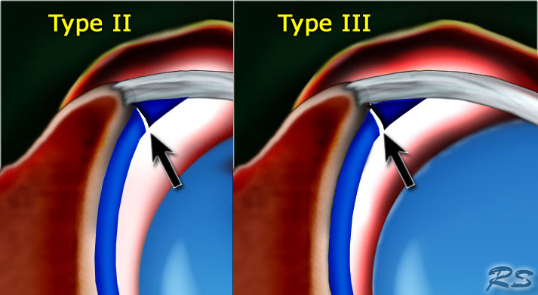

Slide 49
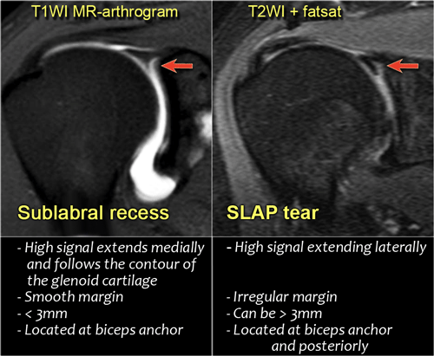

Slide 50
These images illustrate the differences between an sublabral recess and a SLAP-tear.
A recess more than 3-5 mm is always abnormal and should be regarded as a SLAP-tear.

Slide 51
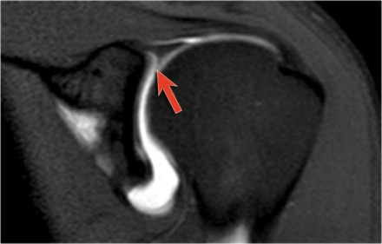
The image shows the typical findings of a sublabral recess.

Slide 52
Sublabral Foramen
A sublabral foramen or sublabral hole is an unattached anterosuperior labrum at the 1-3 o'clock position.
It is seen in 11% of individuals.
On a MR-arthtrogram a sublabral foramen should not be confused with a sublabral recess or SLAP-tear, which are also located in this region.
A sublabral recess however is located at the site of the attachment of the biceps tendon at 12 o'clock and does not extend to the 1-3 o?lock position.
A SLAP tear may extend to the 1-3 o'?lock position, but the attachment of the biceps tendon to the superior labrum should always be involved.

Slide 53
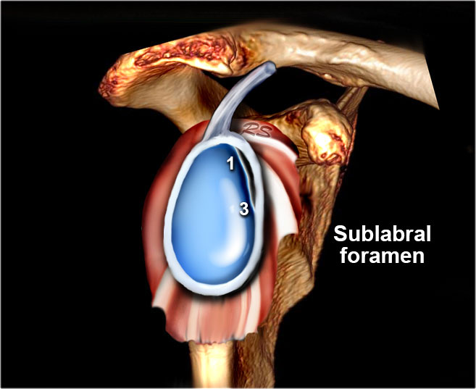

Slide 54
Buford complex
A Buford complex is a congenital labral variant.
The anterosuperior labrum is absent in the 1-3 o'clock position and the middle glenohumeral ligament is usually thickened.
It is present in approximately 1.5% of individuals.

Slide 57
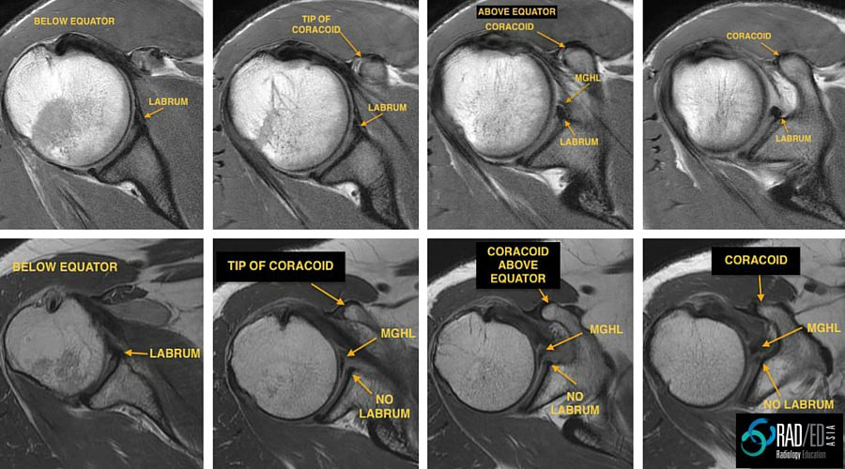

Slide 58
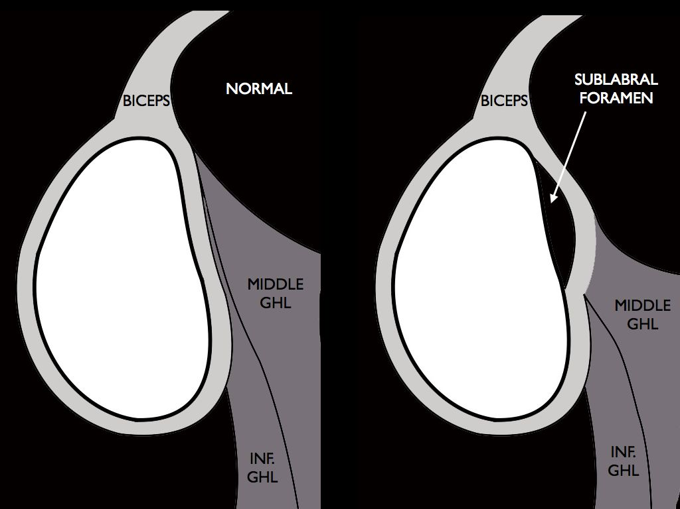
In 10%, a foramen appears
under the insertion.
This anatomical variant
is called sublabral foramen,
and we must distinguish
it from SLAP and Bankart lesions.

Slide 59
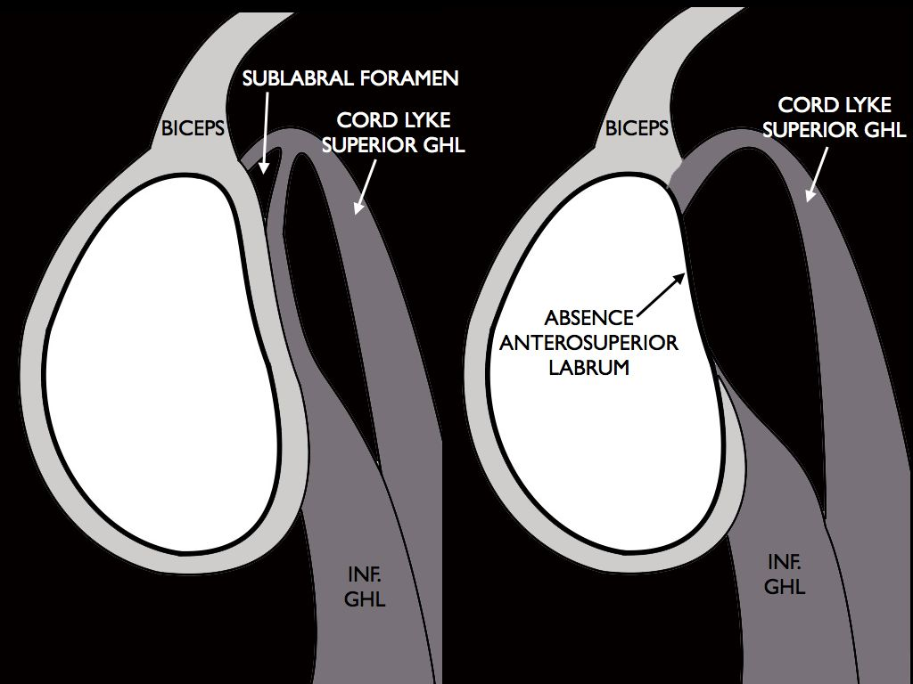
The last anatomical variant is
Buford’s complex, which is
characterized by an absence of
anterio-superior labrum and a
middle string-shaped
glenohumeral ligament that
originates directly from the
superior labrum.

Slide 60
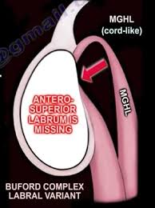

Slide 61
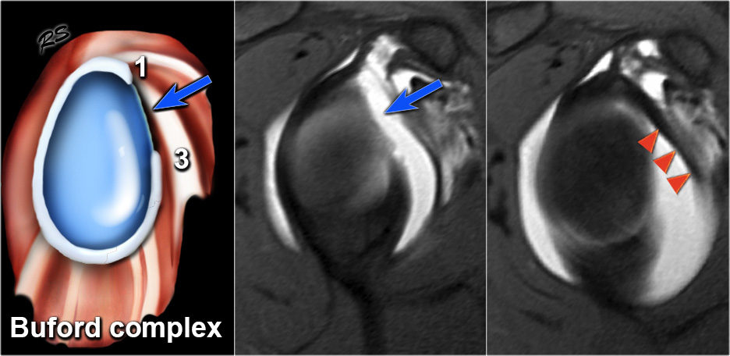

Slide 62
On these axial images a Buford complex can be identified.
The anterior labrum is absent in the 1-3 o'clock position and there is a thickened middle GHL.
The thickened middle GHL should not be confused with a displaced labrum.
It should always be possible to trace the middle GHL upwards to the glenoid rim and downwards to the humerus.

Slide 63
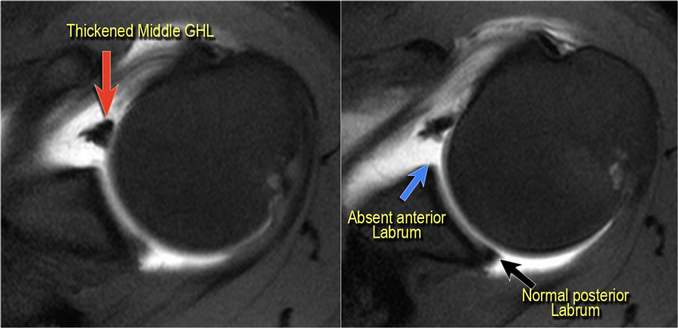

Slide 64
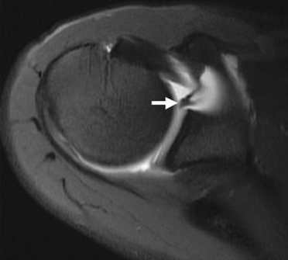
MRI in which Buford’s complex is shown.

Slide 65
Os Acromiale
Failure of one of the acromial ossification centers to fuse will result in an os acromiale.
It is present in 5% of the population.
Usually it is an incidental finding and regarded as a normal variant.
The os acromiale may cause impingement because if it is unstable, it may be pulled inferiorly during abduction by the deltoid, which attaches here.

Slide 66
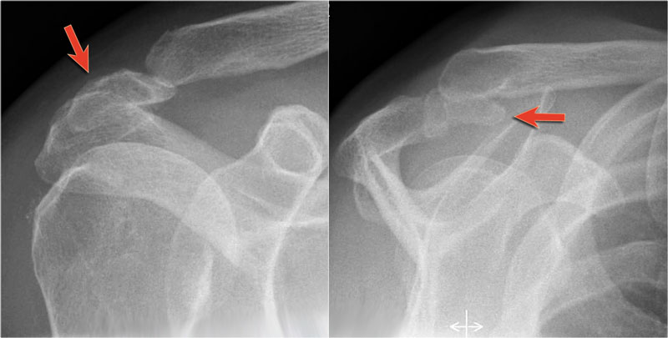

Slide 67
On MR an os acromiale is best seen on superior axial images.
An os acromiale must be mentioned in the report, because in patients who are considered for subacromial decompression, the removal of the acromion distal to the synchondrosis may further destabilize the synchondrosis and allow for even greater mobility of the os acromiale after surgery and worsening of the impingement (4).
The axial MR-images show an os acromiale with degenerative changes, i.e. subchondral cysts and osteophytes (arrow).

Slide 68
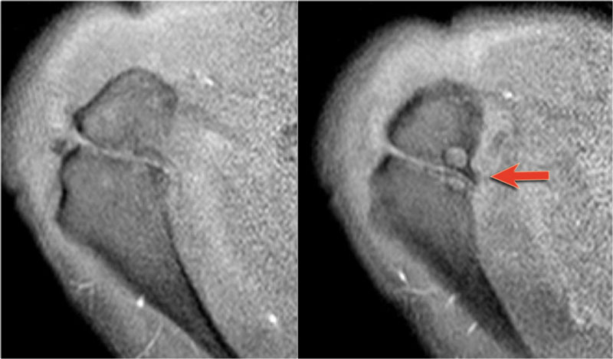

Slide 69
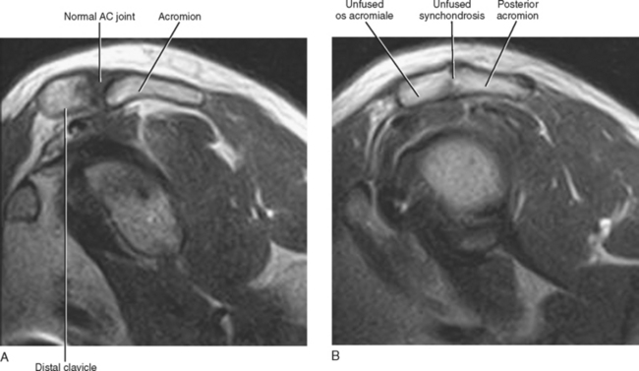

Slide 70
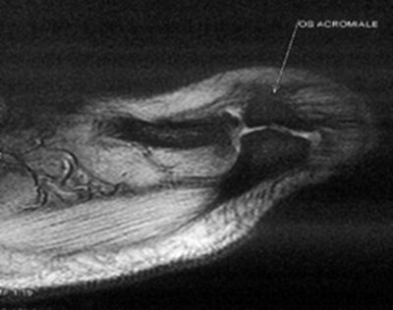
Axial Gradient Echo Image (MEDIC) : revealed an unfused lateral most ossification center of acromion, best appreciated on upper most axial sections suggestive of os acromiale.

Slide 71
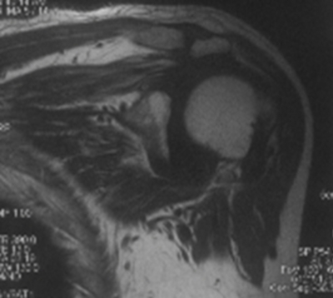
There is retraction of musculotendinous junction of supraspinatus medial to the acromioclavicular joint and fatty infiltration of muscle fibres of supraspinatus- indirect signs of complete rotator cuff tear

Slide 72
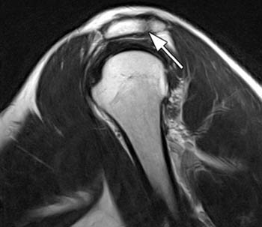
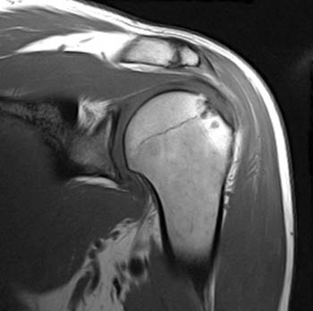
Failure of fusion of an anterior acromial ossification center is demonstrated on both images. The persistent apophysis is visible within the lateral acromion (arrows) on (2a) the T1 weighted coronal view and within the posterior acromion (arrow) on (2b) the T2-weighted sagittal image.

Slide 73
Video of Buford complex
VIDEO

Slide 74
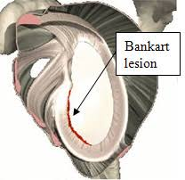
Bankart lesion

Slide 75
Glenohumeral ligaments
VIDEO

Slide 76
Lesion of the SLAP tear
video

Slide 77
SLAP tear: symptoms and treatment
video

Slide 78
Shoulder MRI
Images in three planes

Slide 79
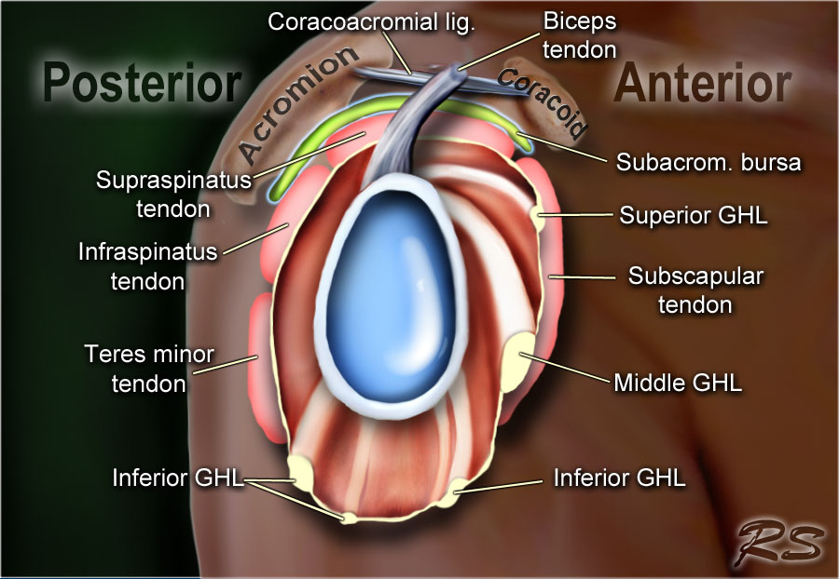

Slide 80
The glenohumeral joint has the following supporting structures:
Superiorly
coracoacromial arch and coracoacromial ligament
long head of the biceps tendon
tendon of the supraspinatus muscle
Anteriorly
anterior labrum
glenohumeral ligaments - SGHL, MGHL, IGHL (anterior band)
subscapularis tendon
Posteriorly
posterior labrum
posterior band of the IGHL
infraspinatus and teres minor tendon

Slide 82
Anterior graphic of the shoulder
The tendon of the subscapularis muscle attaches both to the lesser tubercle as well as to the greater tubercle giving support to the long head of the biceps in the bicipital groove. Dislocation of the long head of the biceps will inevitably result in rupture of part of the subscapularis tendon. The rotator cuff is made of the tendons of subscapularis, supraspinatus, infraspinatus and teres minor muscle.

Slide 84
Posterior graphic of the shoulder
The supraspinatus, infraspinatus and teres minor muscles and tendons are shown. They all attach to the greater tuberosity. The rotator cuff muscles and tendons act to stabilize the shoulder joint during movements. Without the rotator cuff, the humeral head would ride up partially out of the glenoid fossa, lessening the efficiency of the deltoid muscle. Large tears of the rotator cuff may allow the humeral head to migrate upwards resulting in a high riding humeral head.

Slide 85
Shoulder MRI Axial view
Normal anatomy

Slide 86
Axial anatomy and checklist
Look for an os acromiale.
Notice that the supraspinatus tendon is parallel to the axis of the muscle. This is not always the case.
Notice that the biceps tendon is attached at the 12 o'clock position. The insertion has a variable range.
Notice superior labrum and attachment of the superior glenohumeral ligament.
At this level look for SLAP-lesions and variants like sublabral foramen.
At this level also look for Hill-Sachs lesion on the posterolateral margin of the humeral head.

Slide 87
The fibers of the subscapularis tendon hold the biceps tendon within its groove.
Study the cartilage.
At this level study the middle GHL and the anterior labrum. Look for variants like the Buford complex. Study the cartiage.
The concavity at the posterolateral margin of the humeral head should not be mistaken for a Hill Sachs, because this is the normal contour at this level. Hill Sachs lesions are only seen at the level of the coracoid. Anteriorly we are now at the 3-6 o'clock position. This is where the Bankart lesion and variants are seen.
Notice the fibers of the inferior GHL. At this level also look for Bankart lesions.

Slide 88
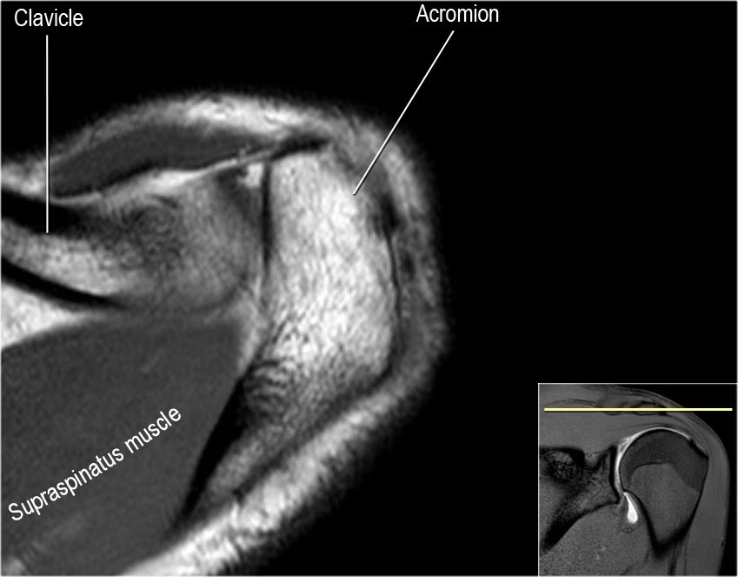

Slide 89
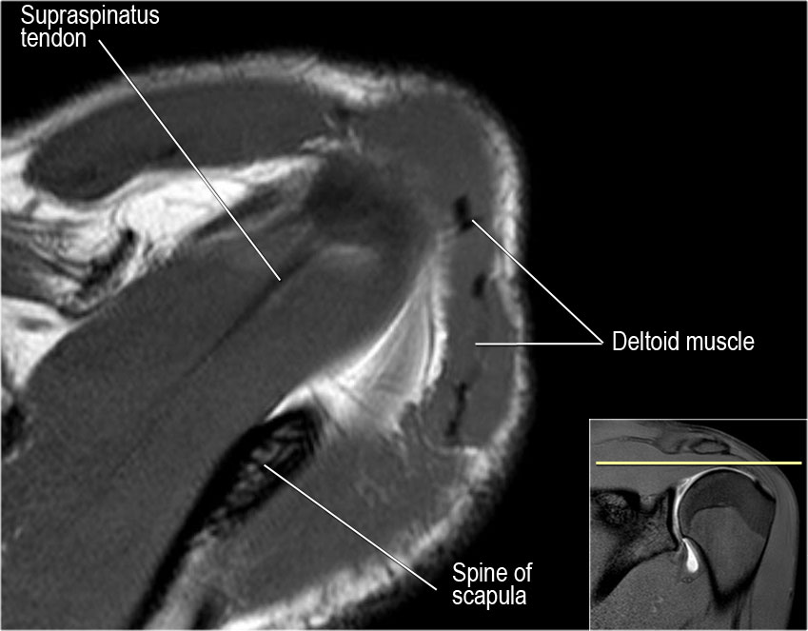

Slide 90
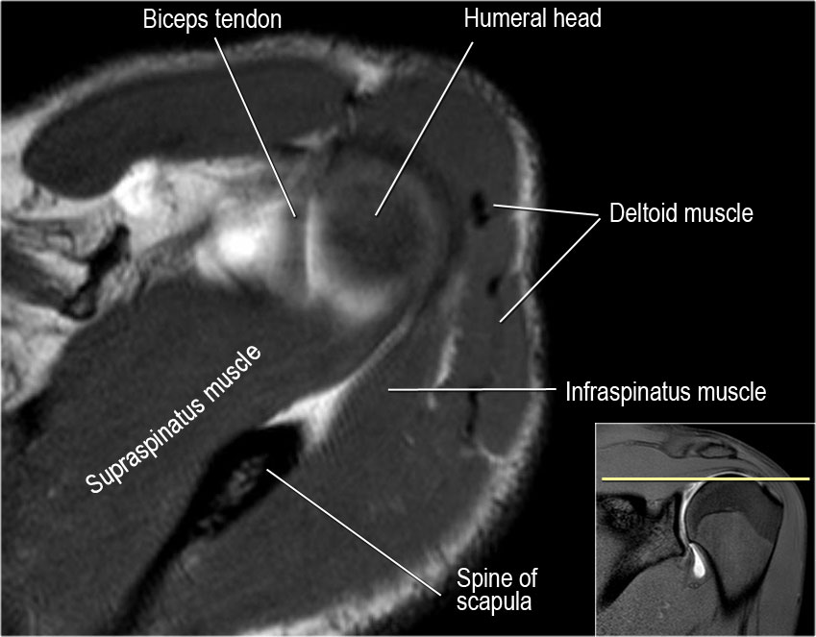

Slide 91
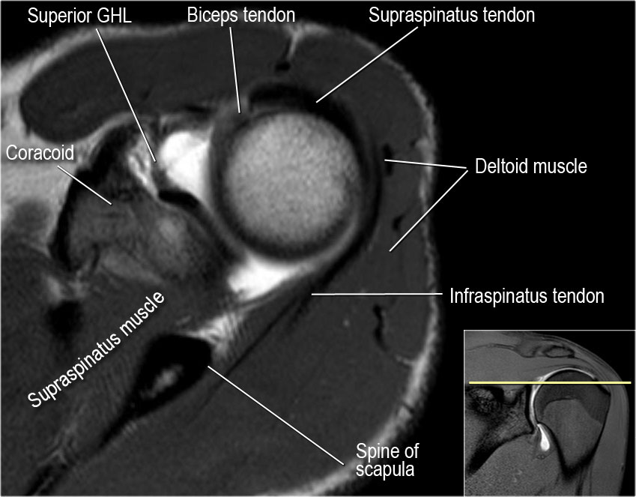

Slide 96
In many cases the axis of the supraspinatus tendon (arrowheads) is rotated more anteriorly compared to the axis of the muscle (yellow arrow).

Slide 97
Coronal anatomy
Normal anatomy

Slide 116
Sagittal anatomy
Normal anatomy

Slide 117
In sagittal view:
Notice rotator cuff muscles and look for atrophy
Notice MGHL, which has an oblique course through the joint and study the relation to the subscapularis tendon.
Sometimes at this level labral tears at the 3-6 o'clock position can be visualized.
Study the biceps anchor.
Notice shape of the acromion
Look for impingement by the AC-joint. Notice the rotator cuff interval with coracohumeral ligament.
Look for supraspinatus tears.

Slide 125
Rotator Cuff Tear

Slide 133
SLAP Tears

Slide 134
SLAP Tears
A SLAP tear is an injury to the labrum of the shoulder, which is the ring of cartilage that surrounds the socket of the shoulder joint.
The head of your upper arm bone fits into a rounded socket in your shoulder blade. This socket is called the glenoid. Surrounding the outside edge of the glenoid is a rim of strong, fibrous tissue called the labrum. The labrum helps to deepen the socket and stabilize the shoulder joint. It also serves as an attachment point for many of the ligaments of the shoulder, as well as one of the tendons from the biceps muscle in the arm.

Slide 136
The term SLAP stands for Superior Labrum Anterior and Posterior. In a SLAP injury, the top (superior) part of the labrum is injured. This top area is also where the biceps tendon attaches to the labrum. A SLAP tear occurs both in front (anterior) and back (posterior) of this attachment point. The biceps tendon can be involved in the injury, as well.

Slide 138
(Left) An MRI image of a healthy shoulder. (Right) This MRI image shows a tear in the labrum.

Slide 146
hill sach lesion

