Slide 1
Magnetic Resonance Imaging of Muscles
Magnetic resonance (MR) imaging is a valuable tool in the study of skeletal muscle anatomy, exercise physiology, and traumatized tissue

Slide 2
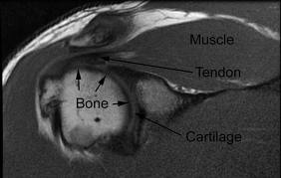

Slide 3
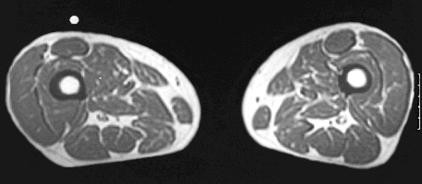
T1-weighted axial image of bilateral thighs obtained to evaluate muscle anatomy (TR/TE, 600/20 msec).

Slide 4
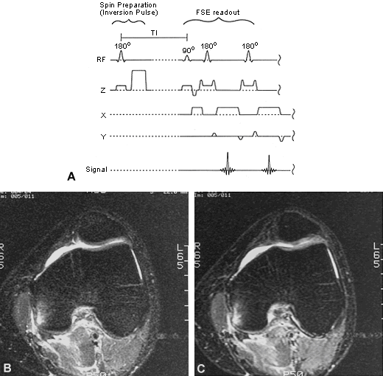
Axial plane standard STIR image of the knee at the level of the femoral condyle showing bone contusion and soft tissue edema secondary to an impact injury. Same section location as seen in image B, obtained using an IR-FSE pulse sequence.

Slide 5
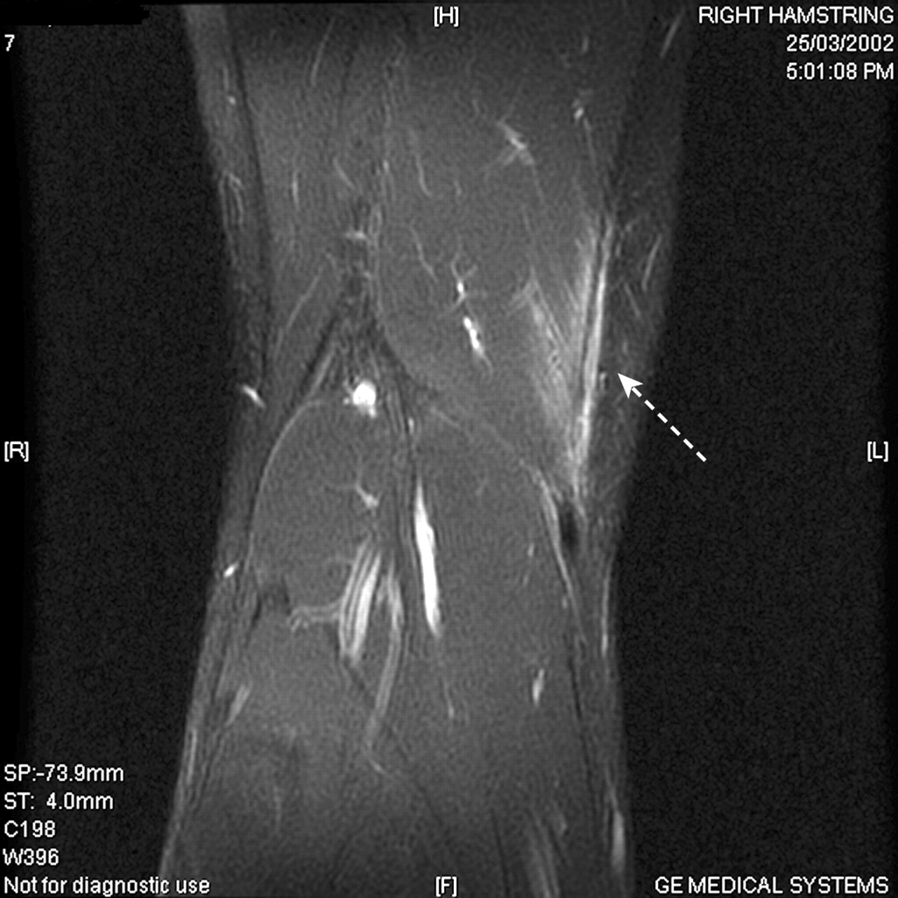

Slide 6
exercise-induced changes in MR imaging
Low-intensity, submaximal exercise causes an increase in muscle water content that is primarily due to changes in the extracellular compartment. Maximal-intensity exercise also causes an increase in muscle water, which is relatively greater in intracellular than extracellular water content.These water content changes are caused by the production of lactate and other substrates associated with a shift of water out of the vascular compartment and into the interstitial and intracellular spaces. As a result of these alterations in muscle water content, there is a short-term (ie, 10 minutes or less, depending on pulse sequence and other factors) increase in signal intensity that is seen during or immediately after exercise.

Slide 7
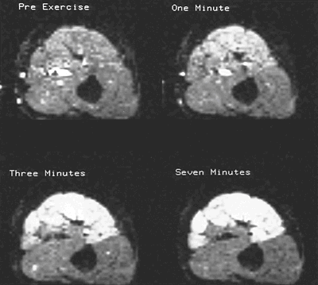
MR imaging of skeletal muscle during exercise
Images shown are before exercise, at 1 minute, at 3 minutes, and at 7 minutes. Note recruitment pattern of muscles related to duration of activity.

Slide 8
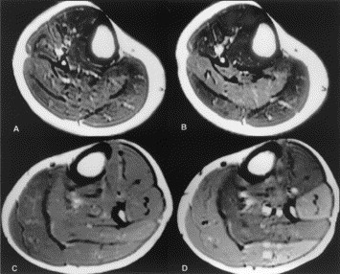

Slide 9
MRI of the lower leg (mid-calf) obtained before and immediately after exercise. A: Before plantar flexion with the knee flexed at 90°, B: After plantar flexion with the knee flexed at 90°, C: Before plantar flexion with the knee fully extended (0° flexion), D: After plantar flexion with the knee fully extended (0° flexion). At full knee extension the peroneus was recruited to stabilize the ankle.

Slide 10
Muscle Injuries And Pain

Slide 11
A simple grading system of MTU strains muscle-tendon unit (MTU)
A simple grading system of MTU strains has been advanced in which injuries are characterized as mild, moderate, or severe. According to this scheme, if weakness is absent, the strain is mild, or first degree, and is believed to represent injury in the absence of myofascial disruption. In order to be categorized as a mild strain, pathologic findings must be restricted to mild inflammatory cell infiltration, edema, and swelling. In moderate, or second degree, strains, weakness is associated with a variable degree of separation of muscle from tendon or fascia. In severe, or third degree strains, myofascial separation is complete and there is an associated lack of muscle function.

Slide 12
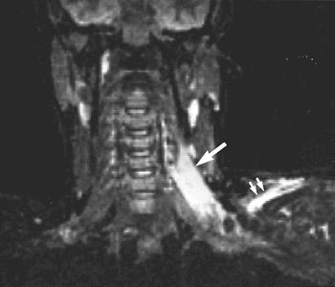
Cervical strain. Coronal image of the neck and shoulders of a woman following a motorcycle accident. Diffusely abnormal signal intensity is obvious in the left scalenus anterior muscle (arrow) as well as the left supraspinatus(double arrows).

Slide 13
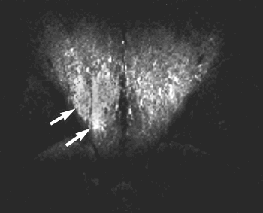
Lumbar strain. A construction worker had severe paraspinous muscle spasm while lifting at work. Coronal STIR image shows abnormal signal intensity in the latissimus dorsi muscles, which is worse on the right side

Slide 14
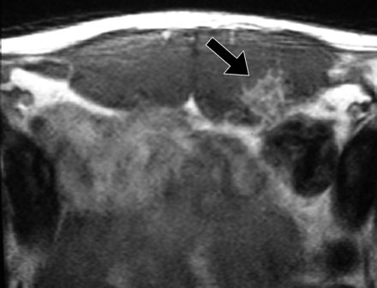
Lt. rectus abdominis hypertrophy and focal edema or hemorrhage

Slide 15
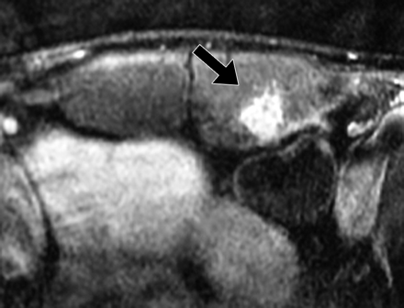

Slide 16
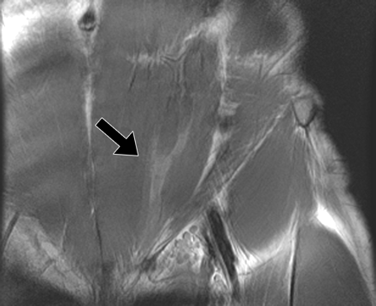
left lower rectus abdominis tear

Slide 17
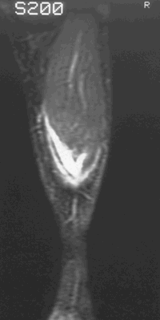
Coronal STIR image shows grade 1 strain of the gastrocnemius

Slide 18
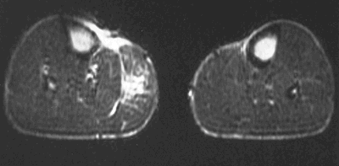
Axial image of grade 2 strain of the gastrocnemius. There is focal disruption of the muscle architecture as well as increased signal intensity associated with edema and interstitial hemorrhage (TR/TE, 2000/80 msec).

Slide 19
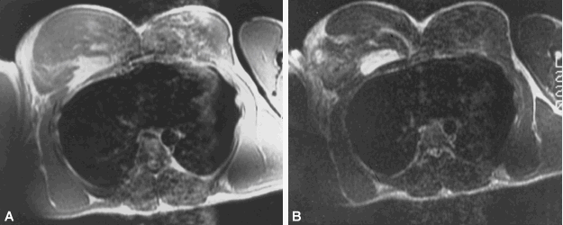
Grade 3 strain of the pectoralis. Rupture and retraction of the right pectoralis in a weight lifter that occurred during maximum weight bench pressing. Note the marked distortion of the anatomy as well as the localized edema. A focal hematoma shows high signal intensity on (A) T1-weighted and (B) T2-weighted images

Slide 20
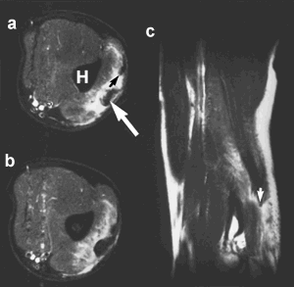
Triceps rupture. (A, B) Contiguous axial STIR and (C) coronal T2-weighted images obtained at the level of the distal triceps show extensive areas of high signal intensity intervening between the retracted tendon (white arrow) and the humerus (H). Discontinuity is evident (C) between the remaining intact tendon (black arrow) and the retracted portion (arrow). The longitudinal image shows retraction of the MTU portion superiorly

Slide 21
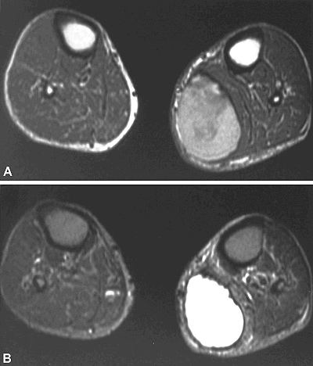
Hematoma complicating calf strain. (A) Focal hematoma can be diagnosed when T1 shortening, due to methemoglobin, causes high signal intensity on this axial T1-weighted image (TR/TE, 600/20 msec). (B) Hemosiderin causes T2 shortening, seen as decreased signal intensity in the rim of the hematoma on this axial T2-weighted image.

Slide 22
Delayed Onset Muscle Soreness
Muscle pain that occurs several hours to days after the activity is referred to as DOMS (as opposed to a muscle strain, which usually has corresponding pain that occurs during or immediately following a muscle contraction).The painful symptoms associated with DOMS typically increase in intensity during the first 24 hours after exertion, peak from 24 to 72 hours after the activity, and then subside. The degree of soreness is related to both the intensity of the muscular contraction and the duration of exercise, with intensity appearing to be the most important factor.

Slide 23
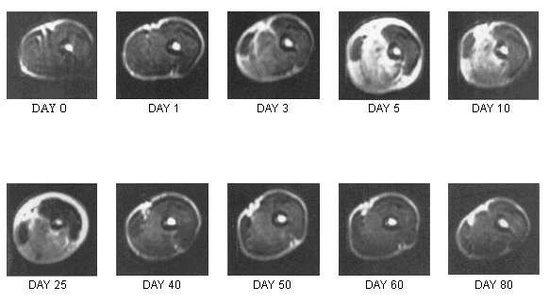

Slide 24
T2-weighted axial images obtained from the middle upper arm of the subject before (day 0) and serially after performance of eccentric muscle actions. The slight peripheral shading of the image obtained on day 0 was caused by contact of the subject’ s arm with the bore of the magnet during MR imaging. Anatomy is best depicted on the day 1 image, which shows a subtle increase in signal intensity in the biceps and brachialis muscles. The day 3 image shows a more diffuse pattern and a greater increase in signal intensity in the brachialis and almost the entire biceps muscle. The lateral aspect of the biceps, however, appears to have been unaffected throughout the time of the MR evaluation. The peak increased signal intensity is seen on day 5, along with the greatest distortion in the anatomy.

Slide 25
Delayed onset muscle soreness (DOMS). T2-weighted axial images obtained from the middle upper arms of five different subjects on day 5 after performing biceps curl exercise involving eccentric actions. Note the variability in the pattern of increased signal intensity affecting the biceps and brachialis muscles.

Slide 26
Muscle Contusion
A contusion of muscle is any compressive or concussive form of direct trauma to the tissue and is typically caused by a blunt object.
** Mild contusion: Active or passive range of motion is limited by less than one third of normal. Patients have an average of 6 days of disability.
** Moderate contusion: Active motion is limited to one third to two thirds of the normal range of motion, usually due to the presence of muscle spasms. Patients have an average of 56 days of disability.
** Severe contusion: Active motion is limited by greater than two thirds of the normal range of motion. Patients have longer than 60 days of disability.

Slide 27
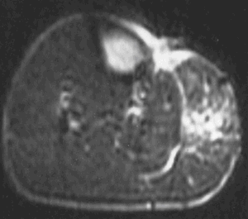
Contusion. MR images of the gastrocnemius in a soccer player who sustained a contusion injury. The MR appearance on this axial image in contusion is similar to that seen in grade 1 or grade 2 muscle strains

Slide 28
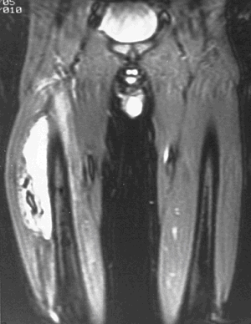
Sequelae of exertional muscle injury, myositis ossificans. This coronal STIR image shows extensive increased signal intensity in the right quadriceps. A focal area of bone is evident in the soft tissue of the vastus lateralis.

Slide 29
Muscle Exercise
Muscle recruitment patterns can be determined for specific movements by comparing MR images obtained before exercise with those obtained either during or immediately after the activity is performed.

Slide 30
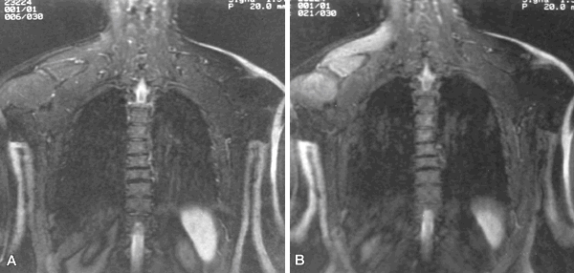
MR imaging showing exercise-induced changes in signal intensity. Coronal plane IR-FSE images obtained immediately before (A) and after (B) the subject performed unilateral, side-lateral dumb bell raise exercise. Note the high signal intensity changes seen in the muscles of the rotator cuff. This information is often useful for evaluation of rehabilitation programs designed for training specific muscle groups

