Slide 1
به نام خدا

Slide 2
cancer related malnutrition

Slide 3
Patients with cancer are at particularly high risk for malnutrition
because both the disease and its treatments threaten their nutritional status.
It is estimated that the deaths of 10- 20% of patients with
cancer can be attributed to malnutrition rather than to the malignancy itself
Thus, nutrition is an important aspect of multimodal cancer care

Slide 4
prevalence of malnutrition in patients with cancer
patients with cancer are more likely to be malnourished than patients treated in many other specialties. The prevalence of malnutrition in patients with cancer has been reported to range from about 20% to more than 70% in worldwide studies, with differences related to patient age, cancer type, and cancer stage. Patients with gastrointestinal tract, head and neck, and liver and lung cancers are at high risk for malnutrition. Malnutrition is more highly prevalent in older adults than in younger ones

Slide 5
Malnourished patients with cancer may be cared for in hospitals, in nursing homes, or at home, and care must be adjusted to the setting. One report described the general prevalence of malnutrition as 30% in hospitals,11% in nursing homes, and 23% in home care for adults <60 years old and as 39%, 20%, and 23% respectively for those 60 years

Slide 6
Recent studies in European hospitals found that only 30%-60% of patients with cancer who were at risk of malnutrition actually received nutritional support (i.e., oral supplements and/or parenteral nutrition and/or enteral nutrition)

Slide 7
cancer and nutrition: the terminology
Critically important work has been done to build universally accepted definitions for malnutrition, cachexia, and sarcopenia.

Slide 8
Disease-related malnutrition
has been defined as a condition that results from the activation of systemic inflammation by an
underlying disease such as cancer.
The inflammatory response causes anorexia and tissue breakdown that can, in turn, result in
significant loss of body weight, alterations in body composition, and declining physical function

Slide 9
Cachexia
is a multifactorial wasting syndrome characterized by involuntary weight loss with ongoing loss of skeletal muscle mass with or without loss of fat mass;
such wasting cannot be reversed by conventional nutrition care and may lead to functional impairment

Slide 10
Sarcopenia
is low lean body mass (mostly muscle); fatigue is common, strength may be lessened, and physical function limited.
As functionality is lost, patients with cancer may no longer be able to live independently, and they often report lower quality of life

Slide 11
Sarcopenic obesity
is low lean body mass in obese individuals.
In such patients, clinicians frequently overlook muscle loss due to the presence of excess fat and extracellular water. In fact, the presence of sarcopenic obesity is an important predictor of adverse outcome, which can be further worsened by surgical interventions

Slide 13
High health and financial costs of malnutrition in patients with cancer
Numerous studies have highlighted the consequences of malnutrition in patients with cancer, including adverse impact on health and survival and added healthcare costs.
In terms of poor health outcomes, malnutrition was associated with loss of weight and muscle, reduced immune competence and more infections , psychosocial stress, lower quality of life, treatment toxicity, and greater risk of mortality.

Slide 14
Mechanisms underlying cancer-related impairment of nutritional status
Cancer-related malnutrition is a multimodal process because many factors collude to impair food intake, increase energy and protein needs, decrease anabolic stimuli such as physical activity, and alter metabolism in different organs or tissues.
The multimodal drivers of malnutrition form a rationale for use of multiple therapeutic strategies to prevent, delay, or treat malnutrition in people with cancer.

Slide 15
Immune response, systemic inflammation, and symptoms
Patients with cancer report clusters of symptoms that can be related to poor nutrient intake, weight loss, and declining physical function, as well as fatigue, pain, and depression .
In fact, there is a consistent association between symptoms, the presence of inflammatory markers, and upregulated immune responses.
Poor cancer outcomes are predicted by markers of the systemic inflammatory

Slide 16
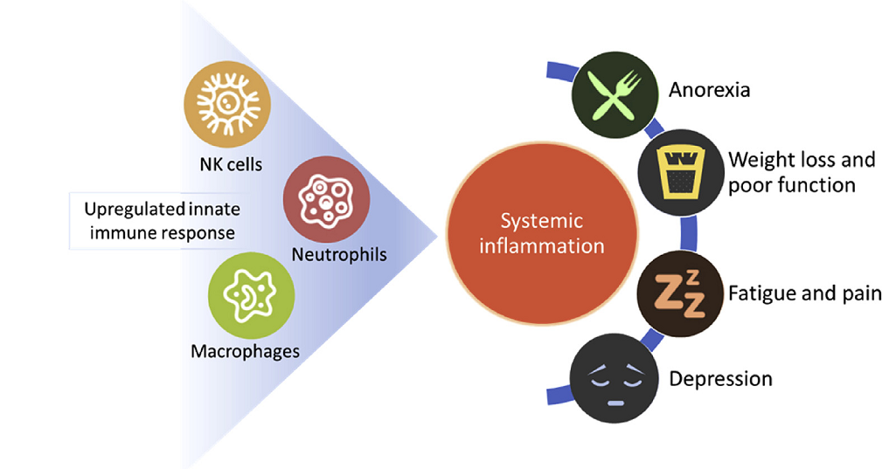

Slide 17
Spillover of tumor-derived cytokines worsens systemic inflammation
Further systemic inflammation can be provoked by spillover of proinflammatory cytokines produced by the tumor. In turn, these proinflammatory cytokines disrupt metabolism of carbohydrates, fats, and proteins throughout the body.
Cytokines can affect the neuroendocrine control of appetite, leading to anorexia

Slide 18
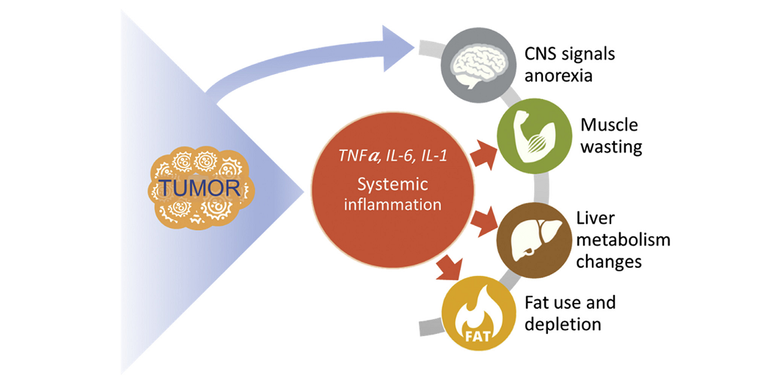

Slide 19
Hypoxic stress in the tumor microenvironment
tumor hypoxia occurs when tumor cells have been deprived of oxygen. A tumor growing rapidly may outpace its blood supply, resulting in regions of the tumor where the partial pressure of oxygen is significantly lower than in healthy tissues. When such hypoxia develops, complex (mal-)adaptive mechanisms are initiated; tumor metabolism is altered to rely more on glycolysis and less on oxidative phosphorylation, and protection against harmful reactive oxygen species is reduced
Oxidative pathways are also altered in skeletal muscle during muscle wasting and this seems to be a consequence of mitochondrial abnormalities that include altered morphology and function, decreased ATP synthesis and uncoupling.

Slide 20
These changes are associated with enhanced tumor growth, malignant progression, and even resistance to anticancer therapy
Nutritional interventions, by modulating the local generation of reactive oxygen species might potentially interfere with these processes.
Given the pathophysiological effects of tumor hypoxia, researchers are seeking new techniques to assess tumor hypoxia (e.g., oxygen electrodes, endogenous markers of hypoxia, magnetic resonance imaging-based measurements) with hopes that such information can potentially be used to improve the course of treatment

Slide 21
Indirect effects of cancer or its treatments
Beyond anorexia, poor food intake will often result from side effects of cancer treatments (drug- or radiation-therapy, surgery).
Such conditions include pain, fatigue, dry mouth or mouth ulcers, difficulty chewing, thick saliva, dysphagia, abdominal pain, nausea, intractable vomiting due to intestinal blockage, constipation, and diarrhea due to infections or malabsorption

Slide 22
Nutritional counseling and nutritional support
Nutritional counseling is the first and most commonly utilized intervention for the management of malnourished patients with cancer.
A dietitian-nutritionist can provide individualized advice to achieve energy and nutrient balance based on the patient's estimated REE, lifestyle, disease state, current intake, and food preferences.
Counseling needs to address the presence and severity of symptoms such as anorexia, nausea, dysphagia, abdominal bloating or cramping, diarrhea, and constipation.

Slide 23
Anti-catabolic and anti-inflammatory ingredients
In patients with cancer, systemic inflammation inhibits nutrient utilization and promotes catabolism, thus leading to muscle breakdown.
Calorie and protein fortification of regular foods, even with standard ONS, does not reduce systemic inflammation. Updated nutritional strategies now suggest considering nutrition with:
anti-catabolic and inflammation-suppressing ingredients.
Studies have indicated that ONS with addition of essential amino acids (EAA) or high-dose leucine may improve muscle protein synthesis even within the context of inflammation, although results have not been fully consistent
More research is needed in this area to confirm roles of nutrition with EAA and leucine in the management of patients with cancer

Slide 24
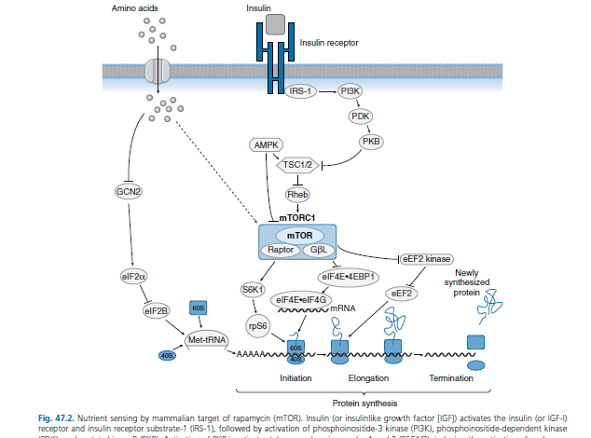

Slide 25
anti inflammation-suppressing ingredients
Foods that cause inflammation
Anti-inflammatory foods
refined carbohydrates, such as white bread and pastries
French fries and other fried foods
soda and other sugar-sweetened beverages
red meat (burgers, steaks) and processed meat (hot dogs, sausage)
margarine
tomatoes
olive oil
green leafy vegetables, such as spinach, kale, and collards
nuts like almonds and walnuts
fatty fish like salmon, mackerel, tuna, and sardines
fruits such as strawberries, blueberries, cherries, and oranges

Slide 26
Fish oil, a source of long chain omega-3 fatty acids, is currently suggested to improve appetite, oral intake, lean body mass, and body weight in patients with advanced cancer and at risk of malnutrition. The mechanism of fish oil to downregulate the systemic inflammation related to cancer cachexia is still under investigation.
While studies are still needed to confirm improvement in clinical outcomes, fish oil remains promising as an important part of overall nutrition management

Slide 27
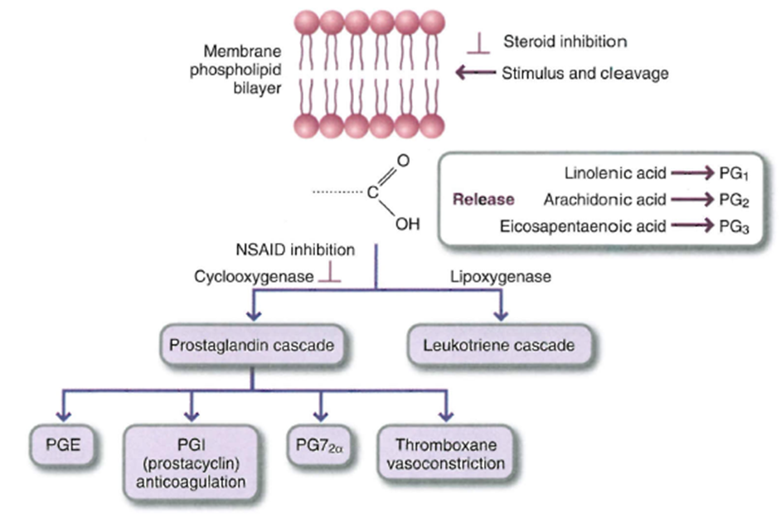

Slide 28
Arginine and nucleotides are being studied as immune supporting ingredients in enteral feeding formulas in surgical and radiation patients. When immunomodulatory enteral formulas were given to patients undergoing cancer surgery, there were positive trends toward enhancing the immune response and reducing post-operative infections
Arg is a physiological substrate for the synthesis of nitric oxide (NO), which is a key mediator of immune responses. Additionally, emerging evidence shows that Arg exerts a regulatory role in signal transduction pathways involving mammalian (or mechanistic) targets of rapamycin
and …

Slide 29
Realizing the importance of exercise training and physical rehabilitation
Physical activities are included in the new ESPEN guidelines on nutrition and cancer. Endurance and resistance exercises of varying intensities are increasingly recognized as
essential anabolic stimuli
for maintaining body resources in patients undergoing anticancer treatment, as well as for recovery in survivors of cancer.

Slide 30
Multimodal therapy: putting it all together
nutritional therapy by itself could be clinically ineffective if other current needs are not addressed.
Nutritional therapy should be part of a more comprehensive supportive care, including psychological counseling, optimal pain control, among others.

Slide 31
For patients with cancer who are nearing end of life, dedicated palliative care is appropriate
In end-of-life care, nutrition is tailored to the patient's symptomatic needs and is primarily intended to support comfort and quality of life.
While many earlier goals for care are no longer valid (e.g., maintaining energy intake, physical activity), patient feelings of hunger and thirst must still be met

Slide 32
Medical nutrition care strategies have been updated, including recommendations for energy and protein requirements and the use of immune modulators and specialized nutrients to lessen adverse inflammatory and catabolic effects

Slide 33
با تشکر

